Slide 1
Intro to Quantum Theory
AH Quanta & Waves

Slide 2
Quotes
“I think it’s safe to say that no-one understands quantum mechanics” (Richard Feynman 1965)
“God, doesn’t play dice with the Universe” (Einstein 1927)
“If quantum Mechanics hasn’t shocked you, you haven’t understood it yet” (Niels Bohr 1952)
“It doesn’t matter how beautiful your mathematical theory is, if it doesn’t fit the experimental evidence, it’s wrong!” (Feynman 1965)
“Not only is the Universe stranger than we think, it is stranger than we can think” (Werner Heisenberg 1972)

Slide 3
Classical Physics
At the turn of the 20th Century experiments were being carried out that began to question the validity of “Classical Physics”
Up until this point light energy was considered to be a wave. This had been demonstrated experimentally by Thomas Young in 1798 with his famous double slit experiment.
It was also thought that matter was composed of particles and if you could measure the position and velocity of particles with an unlimited level of precision, then future behaviour of those particles could be predicted precisely. In other words the universe was deterministic.
But there was a large cloud on the horizon………..

Slide 4
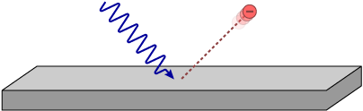
The Challenge to Classical Physics
A number of experiments and observations began to question to validity of classical physics.
1. The Photoelectric effect (1900):
You met this at Higher, light was behaving like a particle.
Only light above a certain threshold frequency would have enough “momentum” to knock electrons out of the surface of a metal.
This implied that light travelled in “packets” or “quanta” of energy.
The energy and momentum of each “packet” is directly proportional to its frequency

Slide 5
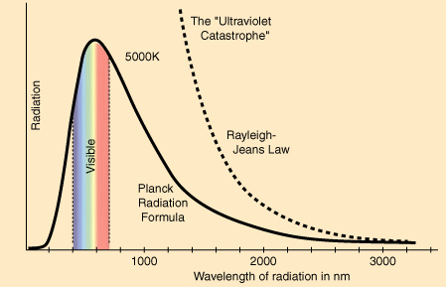
2. The Ultraviolet Catastrophe (c.1900)
Classical physics theory predicted that hot objects would radiate an ever increasing amount of energy as their temperature increased and they began to emit shorter wavelengths of light.
The theory and equations predicted that the radiation of UV light would require an infinite amount of energy.
Observation of stars and analysis of blackbody radiation showed that this was obviously not the case.
It took Plank and Einstein using the idea of “quanta” of energy to explain the observed shape of the curve of the spectrum of light radiated by hot objects

Slide 6
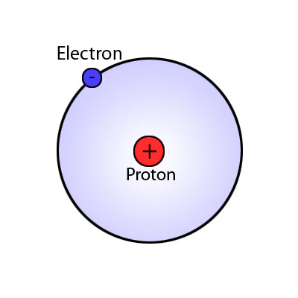
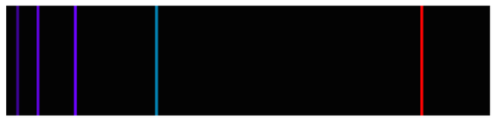
3. Hydrogen atom line spectrum
Why is it that a Hydrogen atom that comprises of 1 proton and 1 electron is only capable of producing a line emission spectrum with only 5 discrete wavelengths of light in its visible spectrum?
Niels Bohr (1913) considered that the electron could only exist in specific energy levels – more about this later.

Slide 7
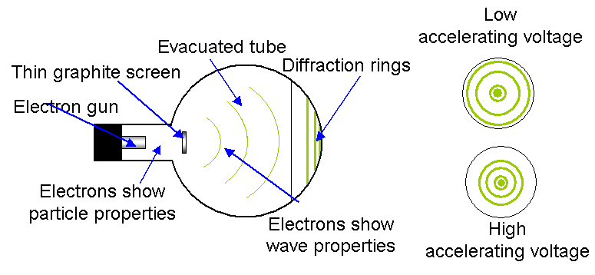
4. Electron diffraction (1927)
Electrons fired at a thin crystal structure of graphite (carbon) produced an interference pattern of bright and dark rings on a fluorescent screen
Particles were behaving like waves- more about this later.

Slide 8
Modern Physics
All of these experiments pointed to the fact that the laws of Classical Physics were broken and needed a complete re-write. This brought in the revolution in the early 1900’s of Quantum mechanics
Particles can have wave-like properties
Waves can have particle-like properties
The universe on the smallest scale is “quantised” – matter and energy exist in tiny “packets” - photons of energy and fundamental particles of matter.
Matter and energy have a wave- particle duality.

Slide 9
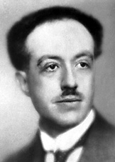
De Broglie (1924)
Prince Louis Victor de Broglie (pronounced de-broy) put together the ideas of Planck and Einstein and formulated a relationship between wavelength and momentum of both waves and particles.
This equation relates mass and energy.
This shows the relationship between wavelength and momentum for a particle or a photon.
This was shown to be correct in 1927 when electron diffraction was observed
This equation relates energy and frequency of a single photon of light.
momentum

Slide 10
examples
Using the deBroglie relationship determine:
1. The wavelength of a 0.2kg baseball travelling at 120 ms⁻¹
2. The momentum of a photon of red light (700nm)
3. The momentum of a photon of UV light. (200nm)
The deBroglie relationship provided mathematical agreement with the experimental observations in electron diffraction and the photoelectric effect. Wave-like nature of everyday objects are insignificant!

Slide 11
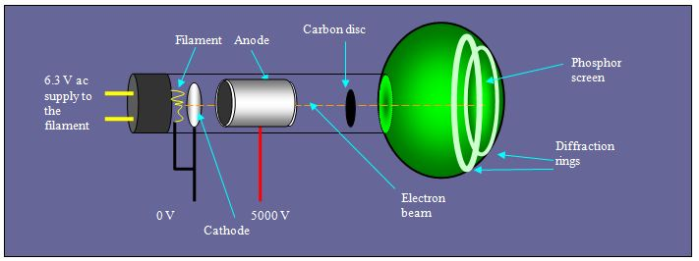
electron diffraction
Electrons are accelerated by an electric field (high voltage)
The fact that they can be accelerated by an electric force shows that they are particles (F=ma)
Electron then pass through a carbon grid and produce an interference pattern on a phosph0r screen.
This shows that electrons are behaving like waves!

Slide 12
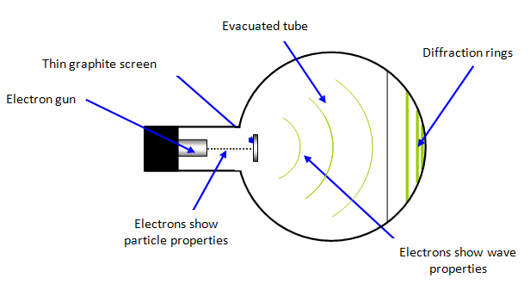
Example
An electron is accelerated through 25kV in a particle accelerator
a) Calculate:
(i) the work done by the electric field on the electron (ii) the final velocity of the electron
(iii) the momentum of the electron
(iv) the wavelength of the electron
b)
(i) In which stage of the process are the electrons behaving like particles.
(ii) In which stage are the electrons behaving like waves.

Slide 13
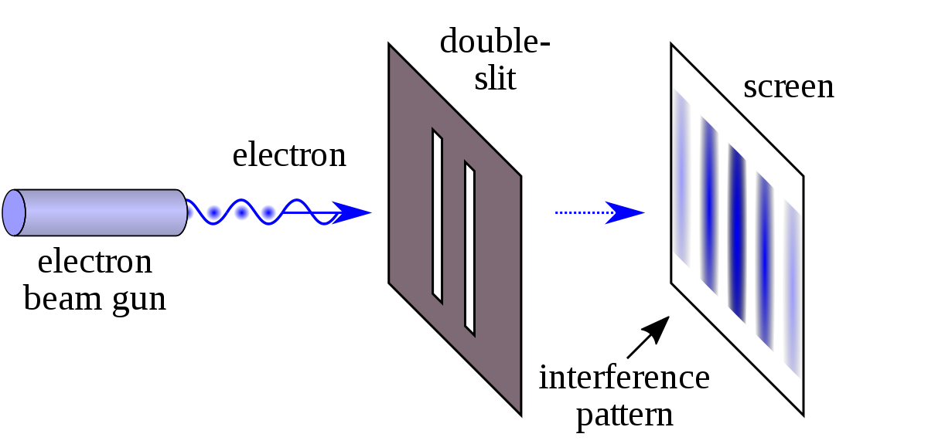
The double slit experiment with particles
If electrons are fired at a double slit then an interference pattern is observed! Electrons are behaving like waves.
But if the beam of electrons is slowed down so that only one electron at a time is fired at the double slit, an interference pattern is still built up over a period of time.
The deBroglie interpretation is that the electron goes through both slits simultaneously as its wavelength is bigger than the slit separation.
Dr Quantum
Nova

Slide 14
The Schrödinger interpretation
Edwin Schrödinger (1935) formulated another idea that matter exists as a probability function.
When a particle is observed, the probability function collapses and the particle takes on definite position .
Einstein didn’t believe this interpretation of quantum mechanics. He said “I believe that the moon is still there even when I am not looking at it”
Schrodinger is most famous for his “Schrödingers Cat” analogy for probability functions.

Slide 15

Schrödingers Cat – interest only
A cat is in a box along with a radioactive source with a half life of an hour and a glass bottle of poison
If the source emits half of its radiation (which is a totally random process), a hammer smashes the jar of poison and the cat dies.
So after a time of 1 hour………..as long as you don’t open the box the cat has a probability function of being both dead and alive at the same time.. (50-50 chance)
The act of opening the box and observing the cat collapses the probability wave function and the cat is observed to be either dead or alive.
It is the act of observing that makes matter take on a definite state of existence.

Slide 16
The Heisenberg Uncertainty Principle (1927)
Werner Heisenberg (1927) tried to quantify wave particle duality of matter and energy.
Whether we observe the wave nature or the particle nature of matter or energy depends on how we carry out our observations and measurements.
Werner Heisenberg (1927) suggested that the the more precisely you try to measure the position of a particle, the less precisely you can determine its momentum (and hence wavelength) and vice versa.
This idea was mathematically formulated into the Heisenberg uncertainty principle. World Science U

Slide 17
The Heisenberg Uncertainty Principle
“The precise position and momentum of a particle cannot be known simultaneously”
(In other words, the more precisely you measure the position of a particle, the less precisely you can determine its momentum and vice versa.)
The uncertainty principle puts to an end the idea that the universe is deterministic. We cannot predict the future behaviour of matter and energy due to the limitations of the precision of simultaneous measurements of position and momentum
(don’t use the word accurate when talking about the uncertainty principle!)

Slide 18
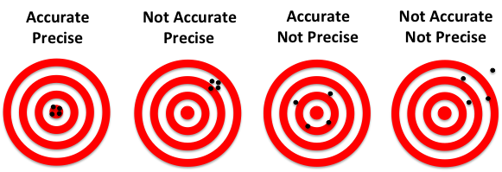
A note on precision and accuracy
Accuracy is a measure of how close you are to a required actual value.
Precision is a measure of the level of significant figures you have in your measurements or how close a set of measurements are to each other,
Measurements can be very precise but not accurate and vice versa.

Slide 19
The Heisenberg uncertainty principle equation
The uncertainty principle can be stated in a relationship that Heisenberg developed that states the limits to measuring the precision in position and momentum of a particle simultaneously.
Δx = absolute uncertainty in the position of an object (m)
Δp = uncertainty in the momentum of the object (kgms⁻¹)
h = plancks constant 6.63 x10⁻³⁴Js

Slide 20
Past Paper Question 2016
(i) Uncertainty in momentum
a) (ii) Position and momentum cannot be determined precisely simultaneously

Slide 22

Energy and “lifetime”
Energy x time = Js
(F x d) x t = Nms
ma x d x t = kgms⁻²ms = kgm²s⁻¹
The units of Planck’s constant are Js.
The units of are kgm²s⁻¹ which are equivalent to Js.
Heisenberg reasoned that any pair of quantities that units equivalent to Js would also obey the uncertainty principle.
$$ΔxΔp$$
ΔE = absolute uncertainty in the Energy of an object (J)
Δt = lifetime of the particle (s)
h = Plancks constant 6.63 x10⁻³⁴Js
This relationship provided the mathematical support to other phenomena that could not be explained by classical physics. These phenomena are often called examples of “Quantum tunnelling”

Slide 23
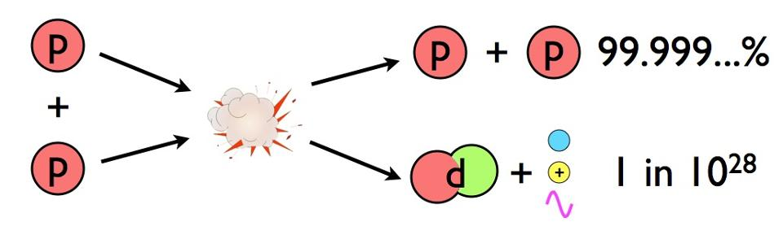
Nuclear fusion
According to classical theory, temperatures and pressures in the sun are not high enough to allow nuclear fusion to take place.
According to quantum theory, if the proton-proton pair exist for a very small lifetime (Δt) then the uncertainty in their energy (ΔE) can be large enough to result in enough energy to produce fusion into deuterium.

Slide 24
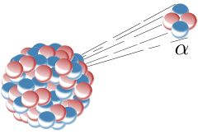
Alpha decay
According to classical physics there should not be enough energy available to cause an alpha emission from a radioactive nucleus
Quantum mechanics shows that an alpha particle can borrow enough energy to tunnel out of the unstable nucleus in a very short lifetime.

Slide 25
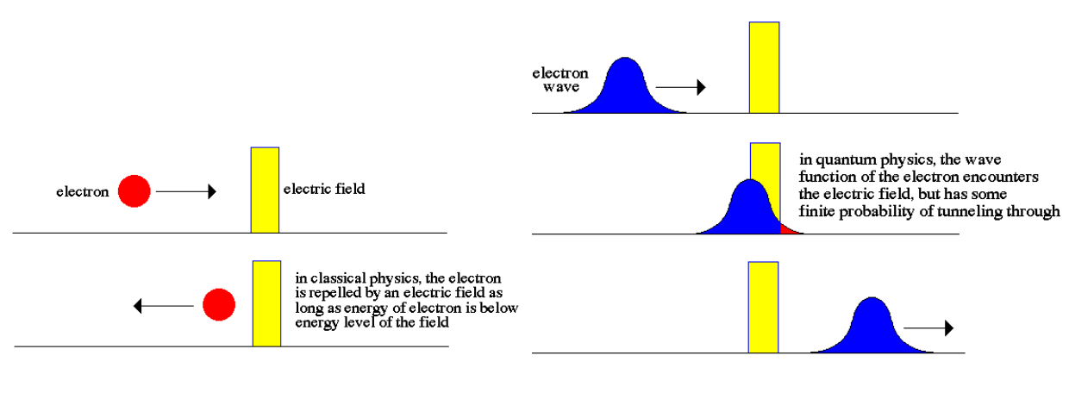
Quantum tunnelling – another look
Running through walls is impossible, right? Or is it? watch
If we consider the wave nature of a particle then when it encounters a barrier for a very short time there is a very small, but real, probability that it could appear on the other side of the barrier.

Slide 26
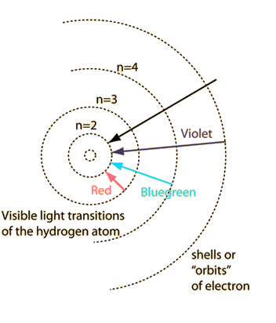
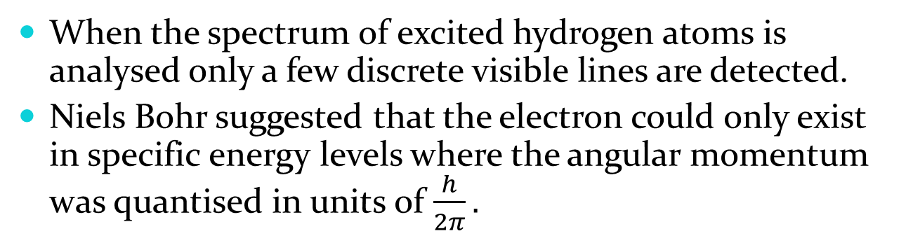
Bohr model of the hydrogen atom
When the spectrum of excited hydrogen atoms is analysed only a few discrete visible lines are detected.
Niels Bohr suggested that the electron could only exist in specific energy levels where the angular momentum was quantised in units of $\frac{h}{2π}.$
Electrons are not permitted to exist between these quantised states.
Electrons gain or lose energy when moving between states.
Energy is absorbed or released in the form of a photon of energy.
This theory exactly matched the observed spectrum of hydrogen

Slide 27
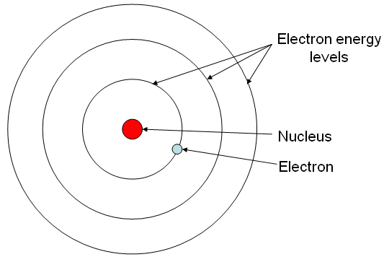
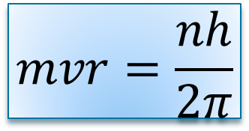
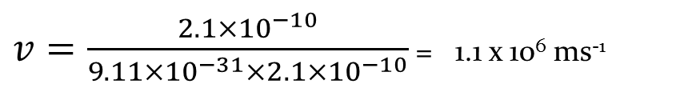
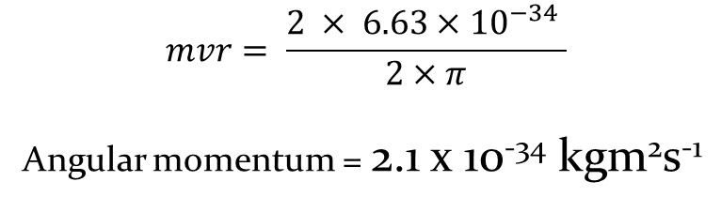
Example:
Calculate the angular momentum of an electron in the 2nd energy level of the hydrogen atom
Calculate the speed of the electron if the radius of the 2nd energy level is 2.1 x10⁻¹⁰m
$$mvr=\frac{nh}{2π}$$
$$mvr= \frac{2 × 6.63×{10}^{−34} }{2×π}$$
Angular momentum = 2.1 x 10⁻³⁴ kgm²s⁻¹
$v=\frac{2.1×{10}^{−10}}{9.11×{10}^{−31}×2.1×{10}^{−10}}$ = 1.1 x 10⁶ ms⁻¹

Slide 28
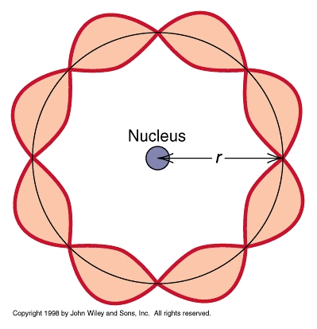
Bohr and de Broglie
If we combine the ideas of Bohr and de Broglie then an alternative explanation can be given for the discrete energy levels in the hydrogen atom.
From Bohr
From de Broglie
The allowed electron orbits are equal to a whole number of de Broglie wavelengths

Slide 29
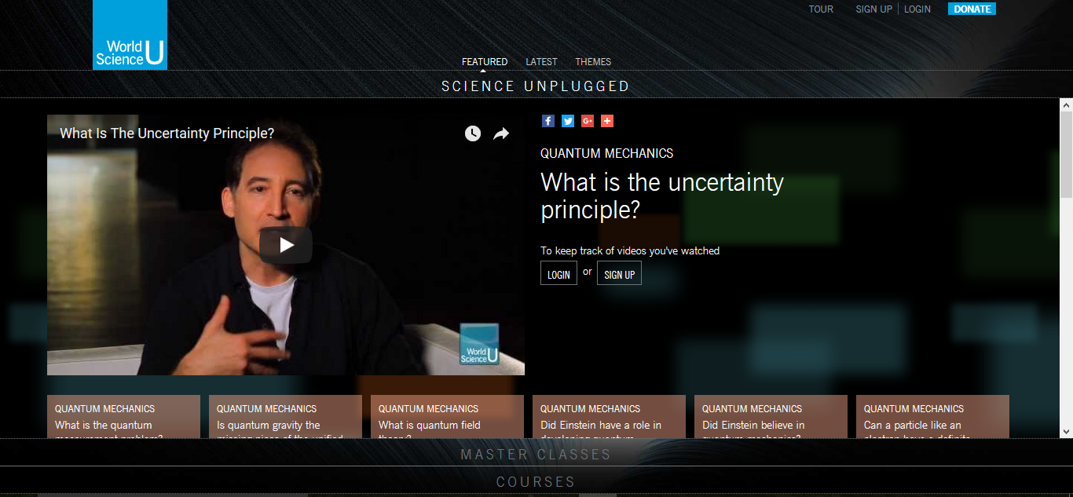
Any questions?
For more questions and answers visit: Worldscienceu

