Slide 1
Particles from Space
AH Physics Q&W

Slide 2
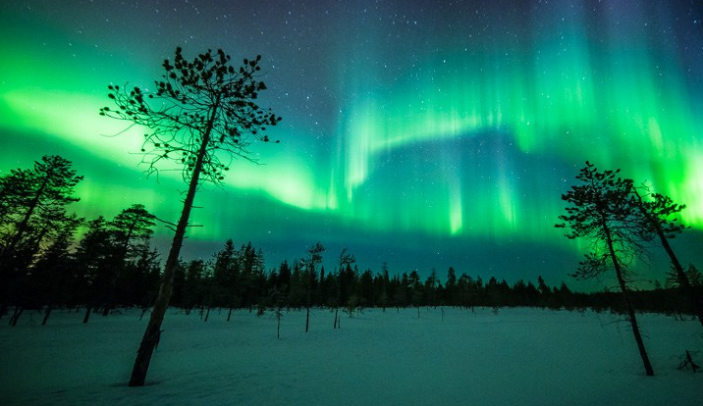
Cosmic Radiation
Particles and waves from space are continually being received on Earth and can be detected using a range of telescopes and particle detectors.
The stream of charged particles ejected from the Sun is called the Solar Wind.
It can produce spectacular light shows in the polar regions called Aurora.
Charged particles can be investigated using electric and magnetic fields.
You were introduced to electric and magnetic fields in Higher Physics.
So let’s do a bit of revision first…………..

Slide 3
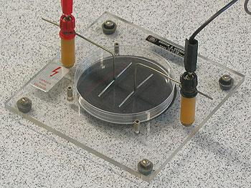
What is a field?
In physics a field is a region where a particle experiences a force.
An electric field is a region in which an electric charge experiences a force (more about that in Unit 3)
A magnetic field is a region in which a moving electric charge experiences a force
(also remember: a gravitational field is a region in which a mass experiences a force)
Watch as the electrons in the atoms of the seeds are affected by a large electric field - watch

Slide 4
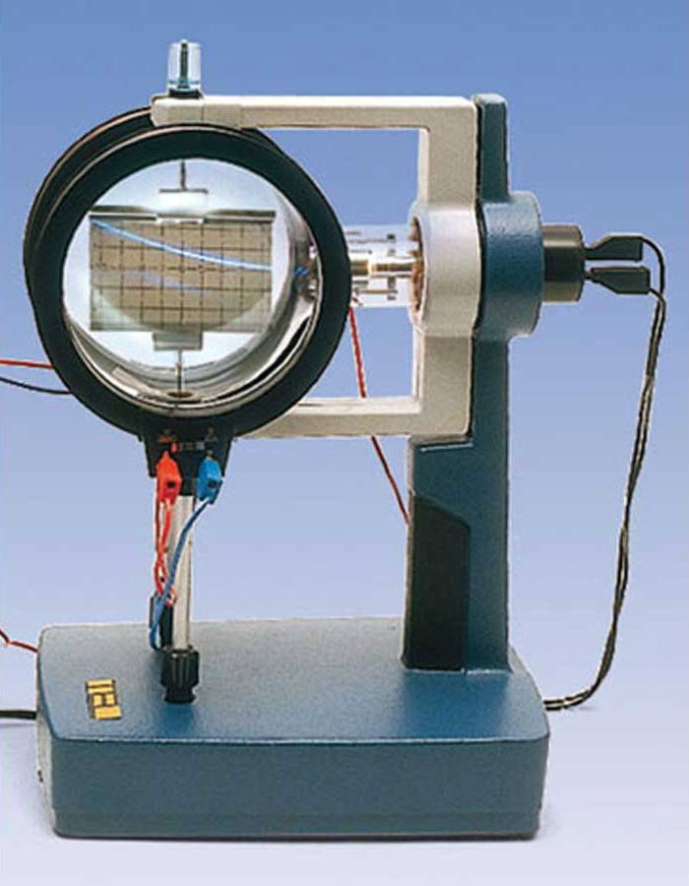
Studying fields – The cathode ray tube
We can study fields in the classroom using this apparatus:
Electrons are fired from a negative “cathode” towards a positive “anode” in an “electron gun”
This beam of electrons can then be steered in a circular path with a magnetic field produced using electromagnets.

Slide 5
Magnetic fields
A magnetic field is a region in which a moving charge experiences a force. Since electrons are moving charges they will experience a force when they enter a magnetic field.
If a charged particle enters a magnetic field perpendicular to the field, it will experience a force at right angles to its motion and it will be steered into a circular path.

Slide 6
Magnetic field direction?
To represent magnetic fields going into or coming out of the page the following system is used:
Magnetic field going into the page:
A grid of crosses showing the field region
Magnetic field coming out of the page:
A grid of dots showing the field region

Slide 7
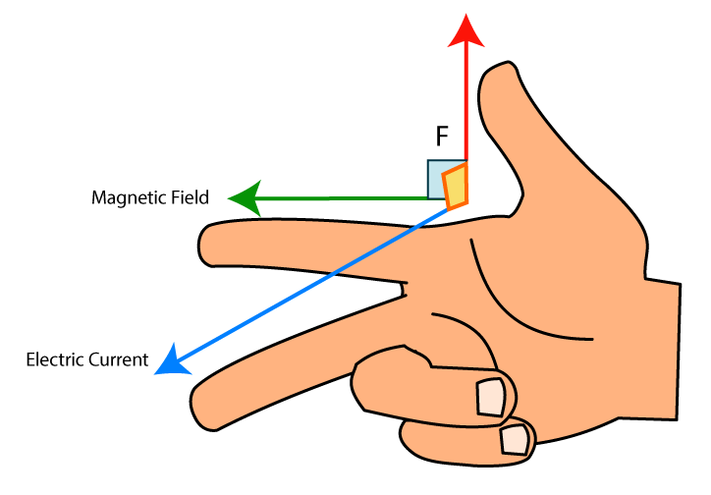
The right hand rule – (for negative charge)
The direction of the magnetic force on a negatively charged particle can be determined if you know the direction of the magnetic field (north to south) and the direction of the motion of a negative charge
First finger = magnetic Field
seCond finger = direction of moving Charge
Thumb = direction of the force (Thrust) on the charge

Slide 8
Example:
Use the right hand rule to check which of these 2 diagrams is/are correct
Both are correct!!

Slide 9
Magnetic Induction (B)
The magnitude of a magnetic field is called the magnetic induction. It is given the symbol B and is measured in tesla (T). (Named after Nikola Tesla 1856-1943)
The tesla is defined as the size of magnetic field needed to produce a force of 1N on a conductor of length 1m carrying a current of 1A – more about this in the 3rd unit!
You may have seen this demo in 3rd year of the force on a current carrying conductor.
The bigger the current the bigger the force and hence the greater the acceleration of the axle.
Remember – A current is a flow of moving charge!

Slide 10
Magnetic force
The size of the magnetic force on a charge that is moving in a magnetic field is given by the relationship
F = magnetic force in newtons (N)
B = magnetic induction in tesla (T)
q = electric charge on the moving particle in coulombs (C)
v = velocity in metres per second (ms⁻¹)
Since the magnetic force acts at right angles to the motion of the charge, the resulting motion of the charged particle is circular motion. We can use our knowledge of central force to determine the radius of the circular path.

Slide 11
Circular path in a magnetic field.
The magnetic force provides the central force to keep the charged particle moving in a circle.
The radius of the circular path depends on mass, velocity, magnetic induction and the charge on the particle
Examine carefully the effect on the radius of changing one or more of the quantities in this relationship.
The measurement of this circular path has many applications in Physics and Chemistry in the study of charged particles.

Slide 12
Circular path of a charge in a magnetic field
An electron is accelerated by an electron gun into a 0.5mT uniform magnetic field with a velocity of 4.2 x10⁷ ms⁻¹
a) Calculate the radius of its circular path in the field.
b) State what happens to the radius of the circular path if…….
the velocity of the electron is increased
The electron is replaced with a proton moving at 4.2 x10⁷ ms⁻¹
The electron is replaced with an alpha particle moving at 4.2 x10⁷ ms⁻¹
a) 0.48m b) increases c) increases d) increases

Slide 13
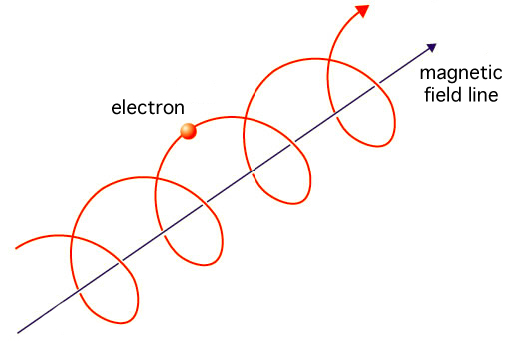
Helical Motion in a Magnetic field
If a charged particle enters a magnetic at an angle other than perpendicular to the field then its velocity can be split into 2 components
A component perpendicular to the field
A component parallel to the field
The perpendicular component will result in circular motion (right hand rule)
The parallel component will result in a linear (translational) motion
The combination of these motion results in a helical motion (spiral)
The distance between the “loops” is called the pitch of the helix.

Slide 14
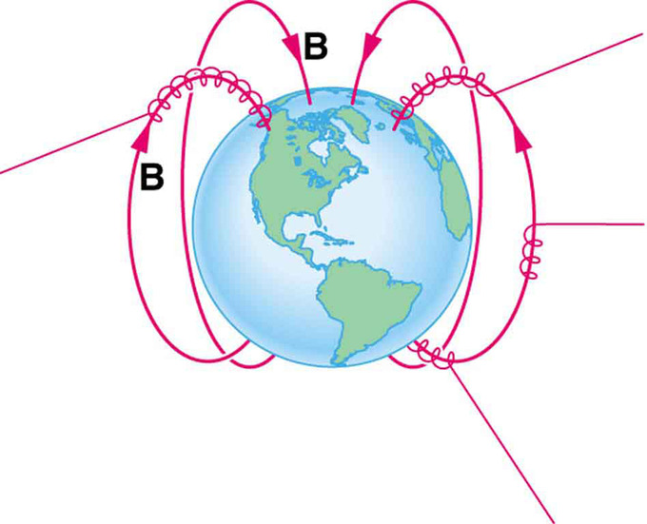
Earths Magnetic field
When charged particles from the solar wind enter the Earths magnetic field they are deflected towards the poles in a helical path.
When they enter the Earth’s atmosphere near the poles they excite atoms in the atmosphere which they glow causing Aurora.
watch

Slide 15
Earths Magnetic field
The Geographic North Pole (in the Arctic) is actually the Earth’s magnetic South pole!
The Earth’s core acts like a bar magnet, south at the top , north at the botton.
Magnetic field reversals have happened at various time in the past!

Slide 16
Example 2015 Q9(a)

Slide 17
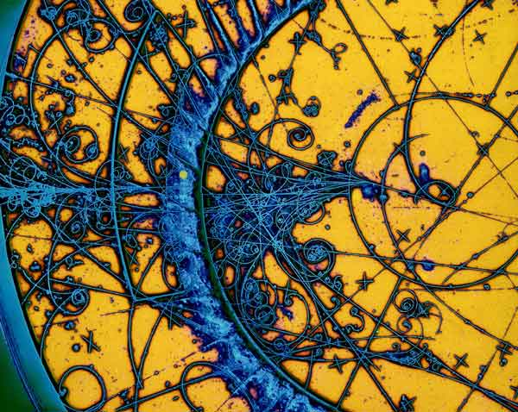
Bubble chamber (1952)
The bubble chamber was one of the first devices to observe and measure the characteristics of cosmic rays and subatomic particles.
A magnetic field is produced across a chamber containing a fluid and charged particles passing through it leave tracks of bubbles. The radius of these tracks can be measured and the mass and charge of the particles can be deduced.
These are currently being used to look for WIMPs, the possible source of dark matter, at CERN.

Slide 18
Mass Spectrometer
In Chemistry, the relative atomic mass of elements and compounds can be determined by passing ions that are all travelling at the same speed through a magnetic field that steers them in a circular path.
Lighter masses (isotopes) are deflected most.

Slide 19
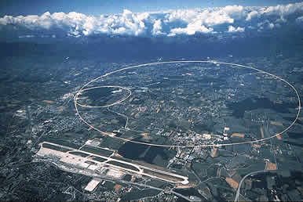
CERN
In the Large Hadron Collider at CERN, protons are accelerated to high velocities around a tunnel of circumference 26km.
The beams of protons are initially steered by electromagnets with a magnetic induction of 7.6 x10⁻⁵ T.
Determine the speed of the protons in the machine.

Slide 20
