Slide 1
Simple Harmonic Motion 2
AH Physics Q&W

Slide 2
In the following slides I talk about SHM in the vertical direction using the symbol “y” for the vertical displacement.
This could equally be described using SHM in the horizontal direction using the symbol “x” for the horizontal displacement

Slide 3
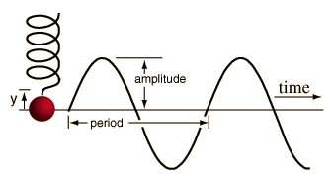
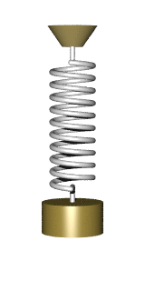
Definition
Simple Harmonic Motion (SHM) is defined as the oscillating motion of an object such that the acceleration of the object is directly proportional to the displacement and in the opposite direction.
The energy in the system is continually changing from:
mechanical potential→ kinetic → potential.
Professor Dave
Crash Physics

Slide 4
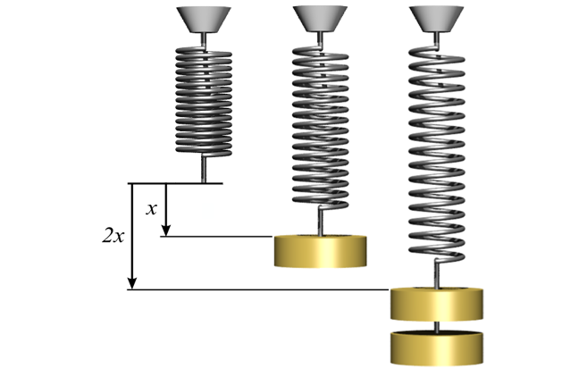
Hooke’s Law (Robert Hooke 1676)
If a mass is hung on a spring then the extension of the spring increases as the weight of the mass (or Force) increases.
The extension of the spring varies directly with the force on the spring
F= weight (N)
y = vertical displacement (m)
k is called the spring constant in Nm⁻¹
This relationship holds for all springs as long as they are not stretched beyond there elastic limit and can return to their original shape when the weight is removed. (Different springs have different spring constants.)

Slide 5
SHM on a spring
If a mass on a spring is pulled down and then released it will perform SHM. The restoring force varies directly with the displacement (as per Hooke’s Law) and always acts towards the central position.
In SHM the displacement and restoring force are changing over time.
The restoring force and hence the acceleration are always directed towards the central position.
We can derive a general equation for SHM by looking back at circular motion………

Slide 6
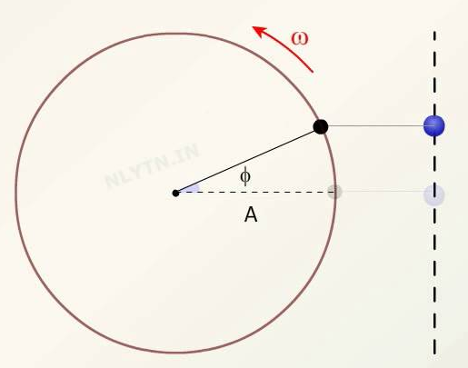
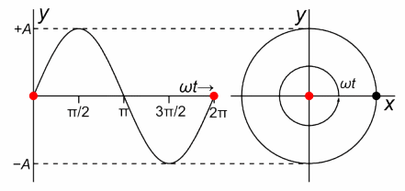
Derivation of the relationship for SHM
Consider a mass moving in a circle with a constant angular velocity ω and radius A.
After a certain time t, the mass will have moved through an angular displacement θ
The vertical displacement of the mass is given by:
Alternatively, if the motion starts from
the “12 o’clock” position:

Slide 8
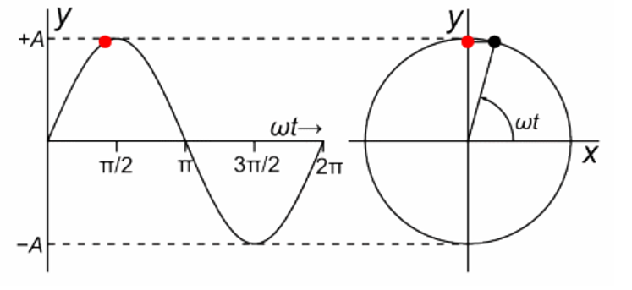

Slide 9
Derivation of SHM – a bit of calculus
Displacement of a particle undergoing SHM
Differentiate to get velocity
Differentiate again to get acceleration:
This is the general equation for SHM.
Acceleration varies directly with displacement (and is in the opposite direction)
y=A sin ωt and y=A cos ωt are both solutions to this relationship.

Slide 10
A note about ω
In circular motion ω is the symbol for angular velocity.
In one complete revolution of a circle θ =2π radians and the time taken for 1 revolution is the period T.
Therefore:
ω = angular velocity in radians per second rad s⁻¹
T = period of the circular motion in seconds
In SHM it is more usual to talk about the frequency of the oscillations and ω is called the angular frequency. (in radians per second)
And since:

Slide 11
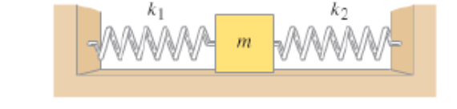
example
A 12g mass is connected between 2 horizontal springs and is undergoing SHM. The mass completes 15 oscillations in 10 seconds. The amplitude of the motion is 8cm.
a) Calculate the angular frequency (ω) of the mass.
b) Calculate the acceleration of the mass when it’s displacement is:
(i) 8cm
(ii) 4cm
(iii) 0cm
c) (i)Determine the maximum restoring force on the mass
(ii) At what point in its motion will the mass experience the maximum restoring force.

Slide 12
Velocity in SHM
It’s possible to derive a relationship for the velocity of a particle undergoing SHM.
From Trigonometry:

Slide 13
Velocity in SHM
From this equation for velocity
we can note the following:
At the extremities:
At the midpoint:

Slide 14
example
A mass is undergoing SHM with amplitude 25.0 cm and angular frequency 4.20 rad s⁻¹
a) Determine the speed of the mass:
(i) At the extremities of its motion
(ii) At the midpoint (equilibrium position)
(iii) Halfway between the midpoint and its maximum amplitude
b) Determine the acceleration at the same positions
a) (i) v = 0 (ii) v = ωA = 4.20 x 0.25 = 1.05ms⁻¹ (iii)
b) (i) a = -w²y = -4.41ms⁻² (ii) a=0 (iii) a = - 2.21ms⁻²

Slide 15
Energy in SHM
We can use our linear equation for kinetic energy and use conservation of energy to derive relationships for kinetic and potential energy in SHM.
Potential energy at any point is given by:
Potential energy at the midpoint is zero, therefore total energy = Kinetic energy at the midpoint when y=0 therefore:

Slide 16
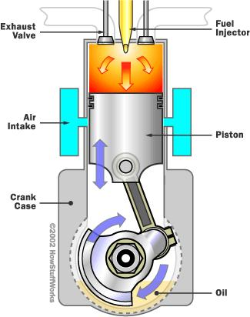
example
The piston in a car engine has a mass of 2.0kg and can be considered to move with simple harmonic motion. The amplitude of its motion is 6.0cm. When the car is “idling” the piston has an angular frequency of 125 rad s⁻¹
a) Calculate the maximum kinetic energy of the piston
b) Calculate the maximum acceleration of the piston
a)
b)
a = -(125²) x 0.06
a = - 940 ms⁻²
= 0.5 x 2.0 x125² x 0.06²
= 56 J

Slide 17
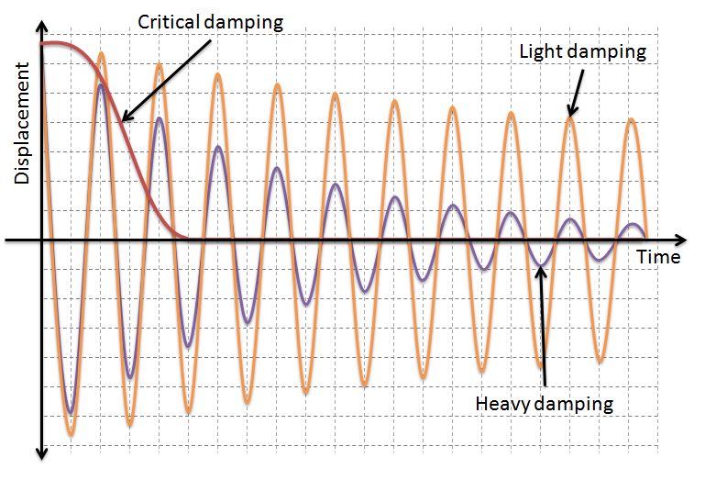
Damped SHM
In practical applications energy is lost in oscillating systems due to friction.
This means that the amplitude decreases over a period of time.
This decrease in amplitude is called damping.
If the damping causes the amplitude to decrease to zero before it crosses the midpoint it is called critical damping.

Slide 18
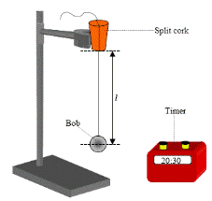
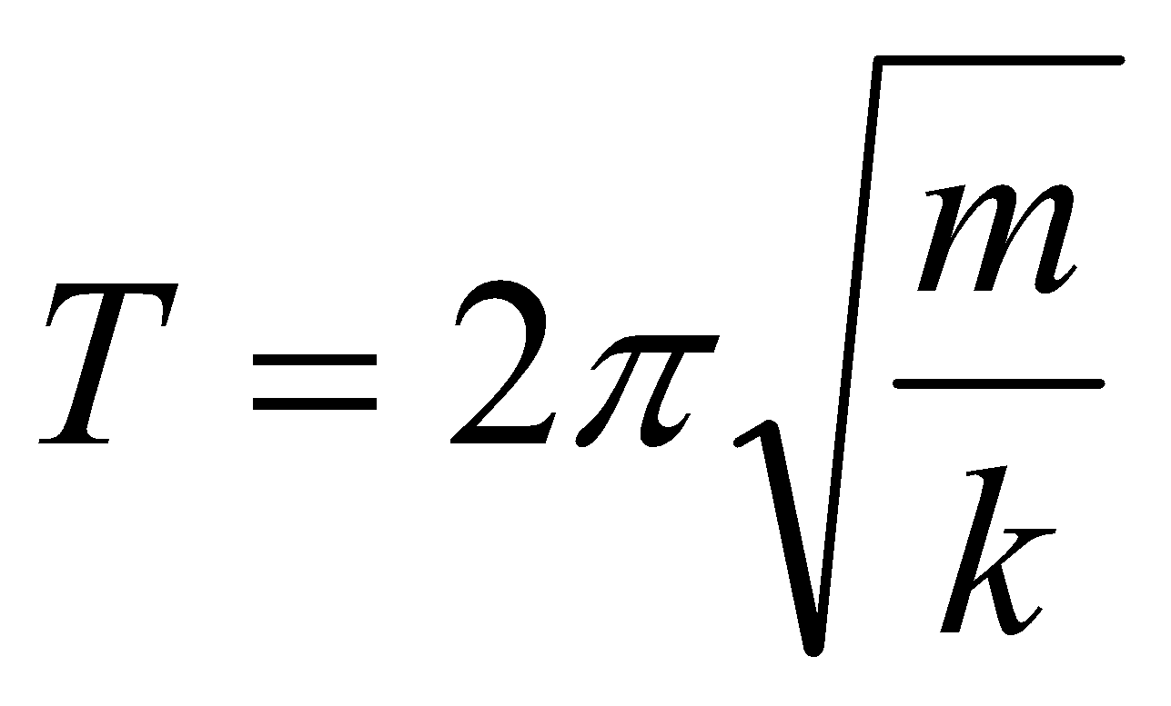
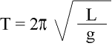
2 special cases of SHM
Mass on a spring
pendulum
If these are asked about these in an exam, equations will be given
(not on equation sheet)

Slide 19
Past Paper question - 2017

Slide 21
Past Paper question - 2016

