Slide 1
Central Force
AH Physics

Slide 2
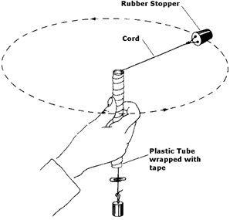
Experiment: Relationship between F and ω
Hang a 100g mass on a string that runs through a glass tube.
Place a marker on the string below the tube so that there is a 0.6 m length of string above the tube.
Swing the rubber stopper in a circle until the forces are balanced and the hanging mass is held in a stationary position with the marker at the bottom of the tube.
In this state the central force is being provided by the weight of the hanging mass.
Measure the number of revolutions in 30s whilst the hanging mass is held in a stationary position.
(i) Calculate the weight of the hanging mass. This is equal to the central force, F_{w} = F_{c}
(ii) Determine the angular velocity of the rubber stopper, ω, in radians per second.
Repeat 5 times with the 100g hanging mass and hence find the mean and random uncertainty in the mean for ω.
Repeat with masses, 200g, 300g, 400g, 500g. Plot a graph of F against ω²
From the gradient of the graph, determine the mass of the rubber stopper.

Slide 3
Sample Results (with string of radius 0.6m)
mass (kg) | Central force (N) | ω (rad s⁻¹⁾ | ω² ( rad² s⁻²)

Slide 4
Sample Results (with string of radius 0.6m)
mass (kg) | Central force (N) | ω (rad s⁻¹⁾ | ω² ( rad² s⁻²)
0.1 | 1.0 | 5.5 | 30.2
0.2 | 2.0 | 7.8 | 60.8
0.3 | 2.9 | 9.4 | 88.4
0.4 | 3.9 | 10.9 | 119
0.5 | 4.9 | 12.2 | 149

Slide 5
Graph

Slide 6
Analysis
Graph is a straight line, therefore F α ω² Gradient of the line = 30
Therefore gradient = $\frac{∆y}{∆x}$ =
Therefore:
(Radius of circle = 0.6 m )
Check it on an electronic balance.
(should be about 55 g)
The LINEST function on Excel will give you the uncertainty in the gradient and hence the uncertainty in the mass can be determined.

Slide 7
Central Force equations and examples
Central force or centripetal force is the unbalanced force that keeps an object moving in a circle.
Applications of centripetal force is one area when you are guaranteed a question in the final exam.

Slide 8
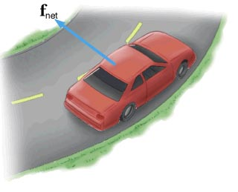
Horizontal circle
A Renault Clio with 4 passengers has a total mass of 1250 kg. It is driven round the Murray roundabout in East Kilbride at 8.94ms⁻¹ (20mph)
The Murray roundabout has a radius of 12 m in the outside lane.
Calculate the centripetal force required to keep the car moving in a circle around the roundabout.
A passenger in the passenger seat has a mass of 60kg. Calculate the force required to keep them moving in the same circular path.
Explain why you feel thrown out to the side when a car goes round a roundabout.
The maximum friction provided by the tyres is 18500 N . Calculate the maximum speed the car could go round the roundabout without skidding.
a) 8330 N b) 400 N c) (Newtons 1st Law) d) 13.3 ms⁻¹ (30mph)

Slide 9
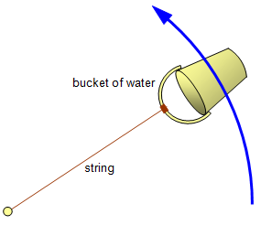
Motion in a vertical circle
Consider a mass being swung in a vertical circle, i.e. a bucket of water attached to a rope…..
Weight always acts down
Central force always acts towards the centre of the circle.
At the top tension is reduced as weight provides some of the central force.
At the bottom weight is added to the central force. This increases the tension.
To keep the bucket moving in a vertical circle, the central force must be greater than or equal to the weight.
Therefore there is a minimum velocity to keep it moving in a vertical circle.
If the velocity is less than this minimum, weight will be greater than the central force and the mass no longer moves in a circle.

Slide 10
Humpback bridge
A car of mass 800kg crosses a humpback bridge of constant radius 15m. The weight of the car provides the centripetal force to keep it in contact with the bridge.
Calculate the weight of the car
Calculate the maximum speed of the car that allows it to stay in contact with the road
A car of mass 1250 kg now crosses the bridge. State the maximum speed that this car can cross the bridge and still stay in contact with the road.
Show that the maximum speed of a vehicle to remain in contact with the road is given by the relationship
W =mg = 800 x 9.8 = 7840 N
d)
b)
c) 12 ms⁻¹

Slide 11
2017 paper – vertical circle

Slide 13
Vertical circle 2013 Q1

Slide 14
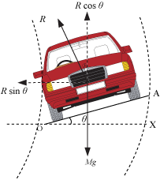
Banking
A banked track produces a component of the reaction force of the car on the road to provide the central force to assist the car to move in a circular path with a greater speed than a flat track.
Central force provided = R sin θ
Where R is the reaction force and
θ is the angle of the banking of the track

Slide 15
Maximum Banking speed
If we consider the horizontal and vertical components of the reaction force of the car on a banked track then we can derive an equation for the maximum speed of a vehicle (assuming no friction)
Horizontal component:
Vertical component:
Combining these 2 components:
Note : mass doesn’t matter!!

Slide 16
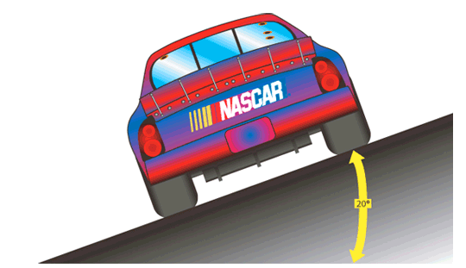
Banking example
A circular frictionless racetrack has a radius of 50m.
Determine the maximum speed a vehicle travel at without drifting off the track when the bank angle is:
a) 5˚ b) 10˚ c) 45˚
a) 6.55ms⁻¹ b) 9.3ms⁻¹ c) 22ms⁻¹

Slide 17
Conical pendulum 2010 Q2
Components of force can also be used to solve problems in situations involving a conical pendulum
Eg: Past paper 2010 Q2:

Slide 18
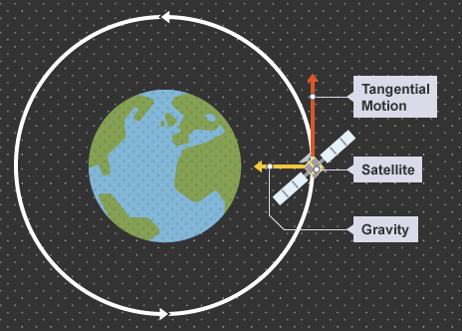
Satellite motion
We shall mention this special case of circular motion when we study gravity in more detail.

Slide 19
Satellite motion – we will come back to this!
In satellite motion the central force is provided by Gravity
From Higher, Newton’s Universal Law of Gravitation states:
Therefore:
From this we can work out the necessary height of an orbit to place geostationary satellite (orbital period = 24 hours)
Radius of orbit
Tangential speed

Slide 20
Period of satellite orbit – (nice derivation)
This is often called “Kepler’s 3rd Law”

Slide 21
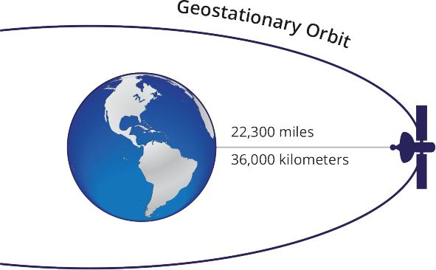
Height of Geostationary Orbit
Gravitational constant: 6.67 x 10⁻¹¹ N m² kg⁻²
Mass of Earth: 6.0 x 10²⁴ kg
Geostationary Period: 24 hours
But……..Radius of the Earth is 6.4 x 10⁶ m
So: Height above Earth’s surface = 4.23 x 10⁷ – 6.4 x 10⁶
= 3.6 x 10⁶ m (36,000 km)

