Slide 1
Newton’s Law of Gravitation
AH Physics

Slide 2
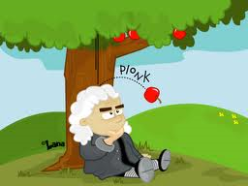
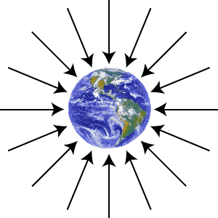
What is Gravity? – Higher revision
Gravity is an invisible force of attraction between objects that have mass.
Gravity is a very weak force and therefore is only noticeable when the mass of an object is very big
A Gravitational field is an invisible force field around a mass.
Einstein revised our ideas of gravity in his General Theory of Relativity

Slide 3
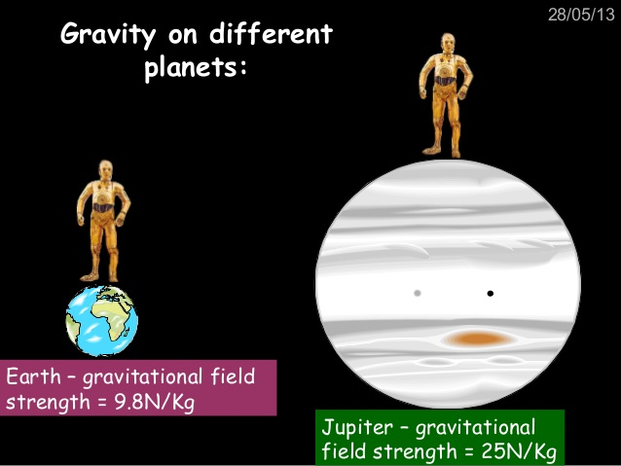
Gravity on Earth
The Earths gravitational field strength (g) is 9.8 Nkg⁻¹ at sea level.
This means that the Earth “attracts” each kilogram of mass with a force of 9.8N.
Gravitational field strength (g) is different on other planets.

Slide 4
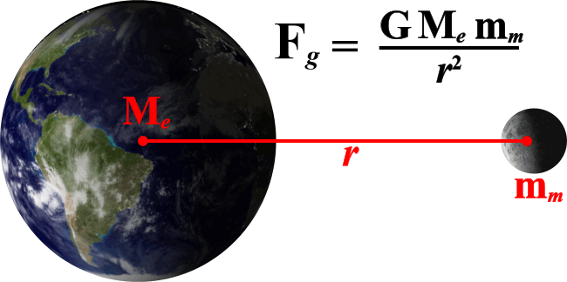
Newton’s Law of Gravitation
Issac Newton (1643 -1727) thought that there must be a single equation that links the masses of two objects , the distance between them and the force of Gravity between them.
He considered that this force must increase as the masses (M and m) increase and as the distance (r) between them decreases.

Slide 5
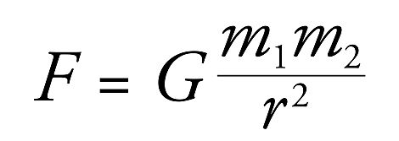
Newtons Law of Gravitation (Higher Revision)
The constant in this equation is called the Universal Gravitational constant and is 6.67 x10⁻¹¹ Nm⁻²kg⁻² (Newton died before this number was found!!)
Veritasium - Gravity & Newtons 3rd Law.
F = Gravitational force of attraction (N)
G = Newtons Gravitational constant
m₁ = mass of object 1 (kg)
m₂ = mass of object 2 (kg)
r = distance between the centre of the
2 masses (m)

Slide 6
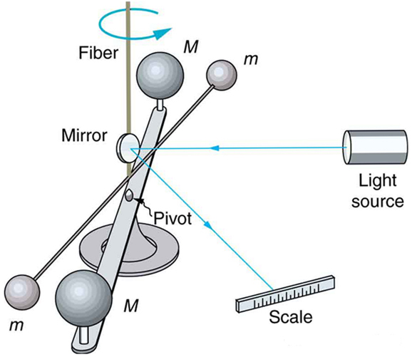
Cavendish Boys experiment
The Cavendish experiment, performed in 1797–1798 by British scientist Henry Cavendish, was the first experiment to measure the force of gravity between masses in the laboratory^{[1]} and the first to yield accurate values for the gravitational constant.
He got a value of 6.7 x 10⁻¹¹ Nm²kg⁻²

Slide 7
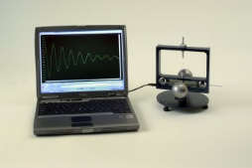
Cavendish experiment
This has been improved and refined over the years… in fact you can now get….. A usb version

Slide 8
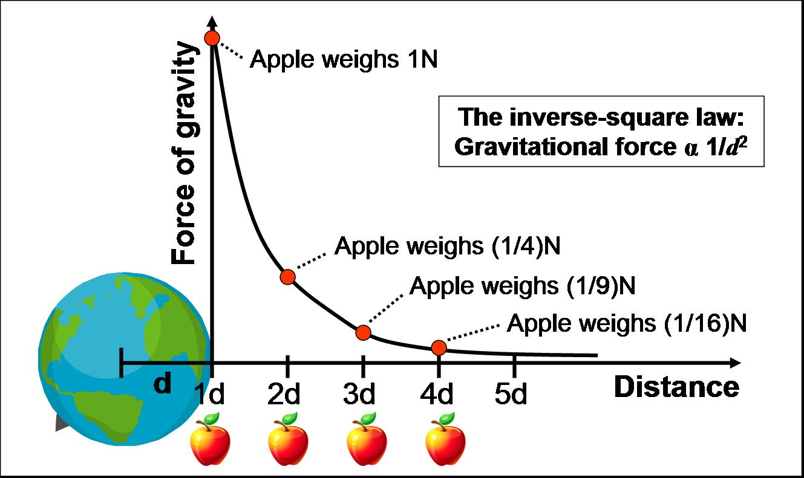
Gravity & Distance
The further away you go from the Earth, the less the force of Gravity becomes.
The force of Gravity decreases with the square of the distance from the centre of the Earth.
(This is called the inverse square law.)
If the distance is doubled, the force is only ¼ of what it originally was.
If the distance is 3 times greater the force is 1/9

Slide 9
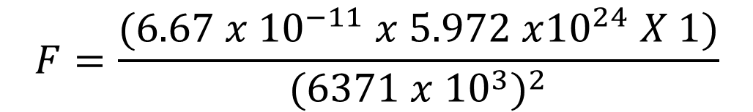
Calculating “g” on Earth.
The size of the force due to gravity on a mass of 1kg at the Earths surface can be calculated using Newton’s Universal Law of Gravitation..
G = 6.67 x10⁻¹¹ Nm⁻²kg⁻²
Mass of the Earth = 5.972 x10²⁴ kg
Radius of the Earth = 6371 km
This is the Earths Gravitational field strength at the surface: 9.8 Nkg⁻¹
$$F=\frac{(6.67 x {10}^{−11} x 5.972 x{10}^{24} X 1)}{{(6371 x {10}^{3})}^{2}}$$
F = 9.8 N acting on 1 kg
Build a planet video – 18 mins in..

Slide 10
Examples
1. 2 oil tankers each of mass 2.6 x10⁸ kg are docked 40m from each other.
Calculate the gravitational force of attraction between them.
2 What is the gravitational force of attraction between 2 60kg students sitting 0.8 m apart
3 What is the force of attraction between the Earth and the moon
mass of the Earth : 6 x 10²⁴ kg
mass of the moon : 7.3 x 10²² kg
mean Earth / moon radius : 3.84 x 10⁸ m.

Slide 11
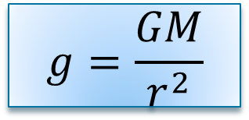
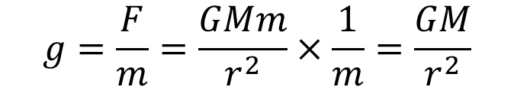
‘g’ on other planets
If the mass and radius of a planet are known, the gravitational field strength on the planet can be determined
Since gravitational field strength is “the force per unit mass”………
$$g=\frac{F}{m}=\frac{GMm}{r^{2}}×\frac{1}{m}=\frac{GM}{r^{2}}$$
G =Newtons Universal constant of gravitation 6.67 x 10⁻¹¹ Nm²kg⁻²
M = mass of planet (kg)
r = radius of planet (m)
$$g=\frac{GM}{r^{2}}$$
This also means that ‘g’ also depends on the height or distance from the centre of a planet.
The further away you are the smaller the value of ‘g’.
Note: If a question gives you the height above a planet, remember to add on the radius of the planet to get the total ‘r’.

Slide 12
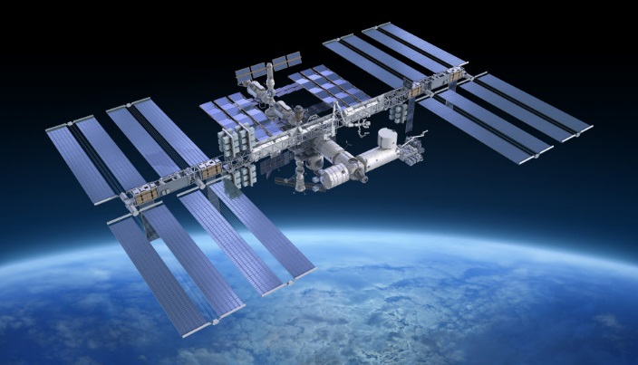
examples
a) Calculate ‘g’ on the surface of the moon
b) Calculate ‘g’ at the top of mount Everest
(height above Earth = 8,850m)
c) Calculate ‘g’ at the orbit of the International
Space Station (ISS)
(height of orbit above Earth surface = 400km)
d) Where will the value for Earth ‘g’ be zero?
a) 1.7 Nkg⁻¹ b) 9.7 Nkg⁻¹ c) 8.7Nkg⁻¹ d) At infinity

Slide 13
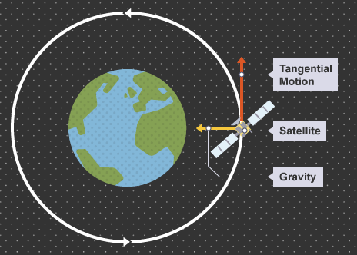
Period of Satellite motion
The time if takes for a satellite to orbit the Earth only depends on:
The height above the Earths surface
The force due to gravity
By choosing heights carefully satellites can be placed into a geostationary orbit above the equator.
This means they take 24 hours to orbit the Earth and appear to stay in the same spot in the sky.

Slide 14
Satellite motion – back to central force!
In satellite motion the central force is provided by Gravity
From Higher, Newton’s Universal Law of Gravitation states:
Therefore:
From this and v=d/t we can derive a relationship between the period of a satellites motion and it’s distance from the centre of the Earth
Radius of orbit
(Tangential speed)²

Slide 15
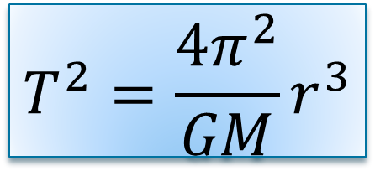
Period of satellite orbit – (nice derivation)
This is the tangential speed of any object moving in a circular path
$$T^{2}=\frac{4π^{2}}{GM}r^{3}$$
Period
radius
This is often called “Kepler’s 3rd Law” – Period² varies directly with radius³
Task: Determine the height of a geostationary satellite orbit above the Earth’s surface. (period = 24 hours)

Slide 16
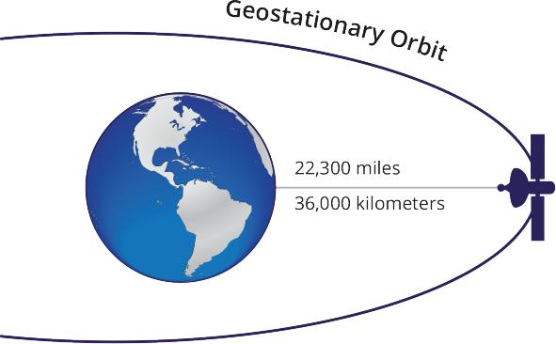
Height of Geostationary Orbit
Gravitational constant: 6.67 x 10⁻¹¹ N m² kg⁻²
Mass of Earth: 6.0 x 10²⁴ kg
Geostationary Period: 24 hours
But……..Radius of the Earth is 6.4 x 10⁶ m
So: Height above Earth’s surface = 4.23 x 10⁷ – 6.4 x 10⁶
= 3.6 x 10⁶ m (36,000 km)

Slide 17
Kinetic Energy
We can also derive an equation for the kinetic energy of any mass in a circular orbit around a planet or star
This is not in the course but could be asked as Problem Solving

Slide 18
Gravitational Potential
When a mass is in a gravitational field near to a planet, work must be done to move it out of the field, or away from the planet. Similarly gravity will do the work to pull a mass into a gravitational field.
This is similar to National 5 when we said that work must be done to lift a mass vertically to gain gravitational potential energy.
The problem we now have is that ‘g’ is not constant when you move away from a planet, so we can’t use E_{p} =mgh (It’s only an approximation)
Gravitational Potential is defined as:
“ The work done by an external force in moving a unit mass from infinity to a point in a gravitational field.”

Slide 19
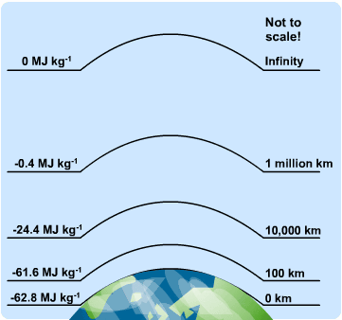
Gravitational potential.
The closer you are to the Earth, the more work has to be done to get you out of the Earths gravitational field.
It’s a bit like being in a “well”. The deeper you are in the well, the more work you have to do to get out.
Now the tricky part is………..the zero of potential is at infinity. This means that all values of gravitational potential are negative. You have to do work to get out of the field to a point where the potential is zero.
(You have already met this before in Higher Physics where we studied electron energy levels in the hydrogen atom. The energy levels are all negative because the top level is zero!)

Slide 20
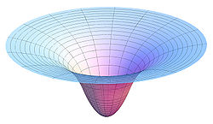
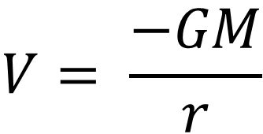
Gravitational Potential
$$V= \frac{−GM}{r}$$
Gravitational potential V measured in joules per kilogram J kg⁻¹
From this equation you can see that it is only when you get to an infinite distance (r) from the centre of a planet that the gravitational potential falls to zero.
A more mathematical (calculus) approach says……….. “As distance tends to infinity , gravitational potential tends to zero.”

Slide 21
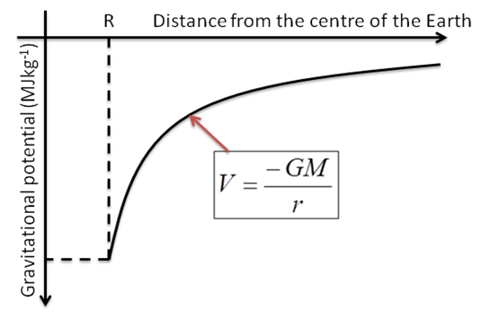

example
Determine the gravitational potential at:
a) the surface of the Earth
b) the surface of the moon
$$V= \frac{−GM}{r}$$
6.3 x10⁷ J kg⁻¹ b) 2.9 x10⁶ J kg⁻¹
(gravitational potential on the moon surface is about 20 times smaller than on Earth’s surface )
G = 6.67 x 10⁻¹¹ N m² kg⁻²

Slide 22
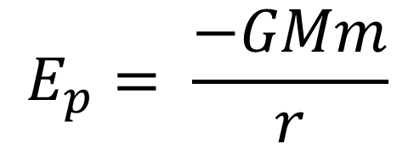
Gravitational Potential Energy
Since gravitational potential is the work done per unit mass….
The potential energy of a mass at a point in a gravitational field is given by
$$E_{p}= \frac{−GMm}{r}$$
or Ep = Vm
Gravitational potential energy in joules J
Note:
Gravitational potential energy is always negative. This is because zero is at infinity and external forces have to do work to get a mass from inside a gravitational field up to zero.
As you move away from Earth the change in gravitational potential energy ∆E_{p} is positive!
In other words the potential energy gained is positive.

Slide 23
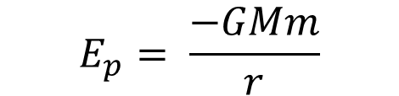
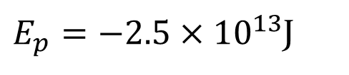
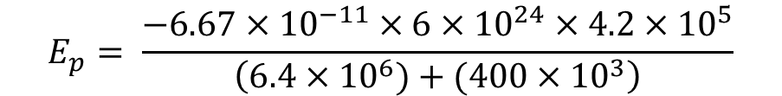
example
The International Space Station (ISS) has a mass 4.2 x 10⁵ kg of and is in orbit at a height of 400km above the surface of the Earth.
Determine the gravitational potential energy of the ISS.
$$E_{p}= \frac{−GMm}{r}$$
$$E_{p}= \frac{−6.67×{10}^{−11}×6×{10}^{24}×4.2×{10}^{5}}{\left(6.4×{10}^{6})+(400×{10}^{3}\right)}$$
$E_{p}=−2.5×{10}^{13}$J

Slide 24

Escape velocity.
Objects that are thrown up in the air always come back down again.
Could an object ever be thrown vertically from the Earth’s surface and escape the pull of Earth’s gravity?
In other words could a mass be given enough velocity so that it could theoretically reach a point where the gravitational potential is zero?
If so, what would this velocity be ?
Think about conservation of energy…………..
∆E_{k} → ∆E_{p}

Slide 25
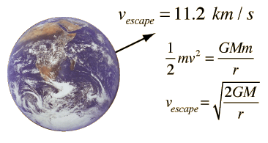
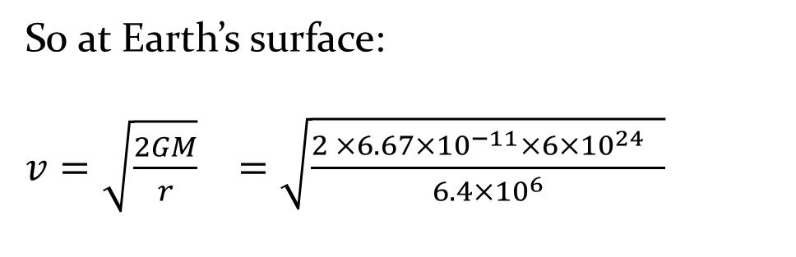
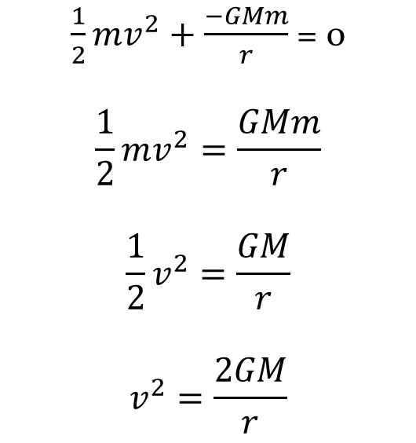
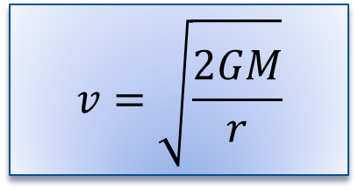
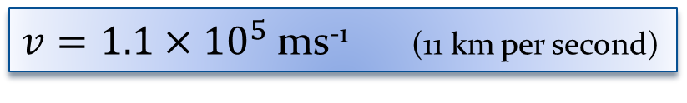
Earth escape velocity
$\frac{1}{2}mv^{2}+\frac{−GMm}{r}$ = 0
$$\frac{1}{2}mv^{2}=\frac{GMm}{r}$$
$$\frac{1}{2}v^{2}=\frac{GM}{r}$$
$$v^{2}=\frac{2GM}{r}$$
At infinity, total energy = 0
S0 at Earth’s surface:
$v=\sqrt{\frac{2GM}{r}}$ $=\sqrt{\frac{\begin{aligned}2 ×6.67×{10}^{−11}×6×{10}^{24} \\ \end{aligned} }{6.4×{10}^{6}}}$
$v=1.1×{10}^{5}$ms⁻¹ (11 km per second)
Note: this is for an unpowered mass, ie a tennis ball, not a space rocket or powered vehicle.
$$v=\sqrt{\frac{2GM}{r}}$$
A space rocket could escape at velocities below this as escape velocity decreases as distance from Earth decreases.

Slide 26
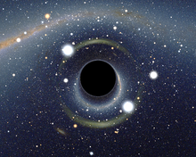

Black Holes
A black hole is a massive star that has collapsed into a tiny volume of dense matter that has a gravitational pull that is so great that not even light can escape from it.
Another way of saying this is that the mass of the object is so great and the radius is so small that the escape velocity from the object is greater than the speed of light.
$$v=\sqrt{\frac{2GM}{r}}$$
The edge of a black hole is called the “Event Horizon”
What would the radius of the Earth have to decrease to for it to become a black hole?
Answer: 9 mm

Slide 27
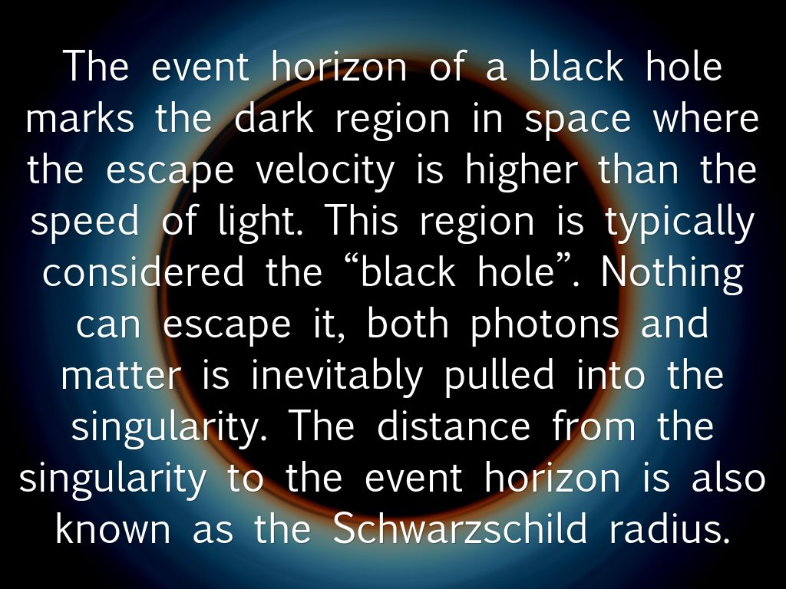
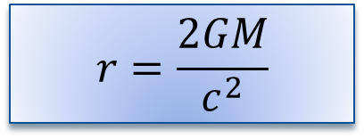

Schwarzchild radius
The Schwarzchild radius is defined as:
“the radius of a sphere such that, if all the mass of an object were to be compressed within that sphere, the escape velocity from the surface of the sphere would equal the speed of light”
The Schwarzchild radius of any mass can be found by rearranging the escape velocity equation and substituting in the speed of light for the escape velocity (c )
$$v=\sqrt{\frac{2GM}{r}}$$
$$r=\frac{2GM}{c^{2}}$$
Calculate the Schwartzchild radius of the sun
Explain why our sun could never become a black hole.
3km
Not enough mass

Slide 28
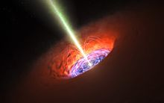
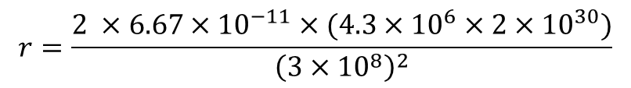
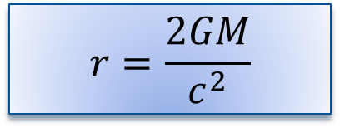
Schwartzchild radius example
Scientists predict that there is a supermassive black hole at the centre of our galaxy.
Observations predict that it has a mass 4.3 million times that of our sun. (4.3 x 10⁶ solar masses)
Calculate the Schwartzchild radius of the black hole.
$$r=\frac{2GM}{c^{2}}$$
$$r=\frac{2 ×6.67×{10}^{−11}×(4.3×{10}^{6}×2×{10}^{30})}{{\left({3×10}^{8}\right)}^{2}}$$
$$r=1.3×{10}^{10}m (13 million km)$$
Note: this is the event horizon of the black hole, not the radius of the collapsed star itself! Its radius is unknown but smaller then the r_{s}

Slide 29
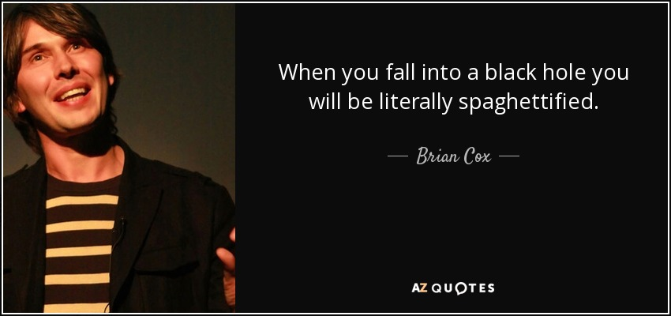
Einstein’s prediction
Albert Einstein first predicted black holes in 1916 with his general theory of relativity. The term "black hole" was coined in 1967 by American astronomer John Wheeler, and the first one was discovered in 1971. There are three types: stellar black holes, supermassive black holes and intermediate black holes
www.space.com/15421-black-holes
Brian Cox on Black Holes
vsauce
Life and death of a black hole
(so I guess we’d better have a quick look at Einstein’s theory of General Relativity)

