Slide 1
Band theory

Slide 2
Materials can be divided into three broad categories according to their electrical properties.
(a) Conductors. These have many free electrons which are available to move when an electric field is applied across the material and constitute a current. Examples – all metals are conductors.
(b) Insulators. These have very few free electrons which cannot move easily and therefore offer a high resistance. Examples – plastic, wood, rubber, glass etc.
(c) Semiconductors.
Materials which are insulators when pure, but will conduct when an impurity is added/or in response to light, heat, voltage etc.
Examples – elements like silicon (Si), germanium (Ge)

Slide 3
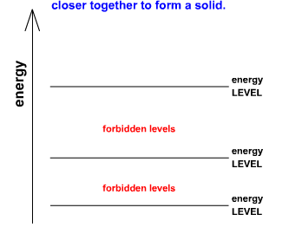
Electrons in an ATOM can only occupy discreet energy levels.
However when atoms come together to form SOLIDS, electrons in the different atoms interact.
The atoms also have thermal vibrations. As this process takes place between large numbers of atoms, each energy level divides into a band of closely spaced levels.

Slide 4
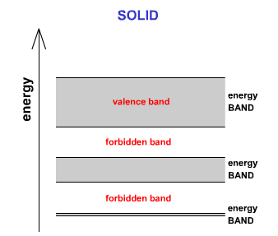
Band Theory

Slide 5
Band Theory
Notice that when the atoms are pushed together the greatest effect is on the outer electrons or VALENCE BAND, i.e the highest energy levels.
Inner electrons (lower energy levels) are effected much less.

Slide 6
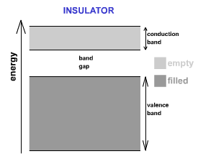
Band Theory
The nature of the energy bands determines whether a substance is an electrical conductor or insulator.
In an INSULATOR at absolute zero (0K) the valence band is completely filled.
The next highest band is called the CONDUCTION BAND and is completely empty at absolute zero.

Slide 7
There is a very large gap for insulators between the top of the valence band and the bottom of the conduction band.
Since the valence band is full, in order to be mobile an electron requires to gain enough energy to reach the conduction band.
Even at ambient temperatures there is not enough energy available to elevate sufficient electrons into the conduction band to allow conduction to take place.
It can happen in extreme situations e.g. Van de Graff or lightening. This is called insulation breakdown.

Slide 8
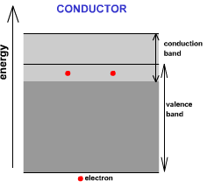
Band Theory
In all CONDUCTORS the highest occupied band is only partly filled, leaving plenty of energy levels to allow these electrons to be mobile.
In many conductors the conduction band and the valance bands actually overlap providing many more energy states which only require small amounts of energy to be reached.

Slide 9
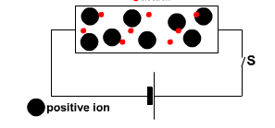
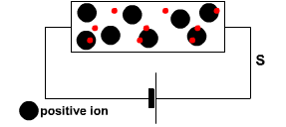
Consequently these electrons are highly mobile and can move freely when an external e.m.f is applied.

Slide 10
The electrical properties of semi conductors lie somewhere in-between conductors and insulators.
Like insulators, in a semi conductor at absolute zero the valance band is completely filled and the conduction band is completely empty. However semiconductors have a very narrow gap between the valance band and the conduction band

Slide 11
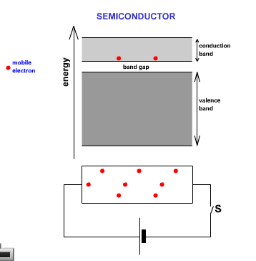
This means that for temperatures above absolute zero some electrons can gain enough energy from thermal motion to jump into the conduction band.
Once in the conduction band they are free to move under an applied e.m.f as there are plenty of nearby empty states available for them to move to.

Slide 12
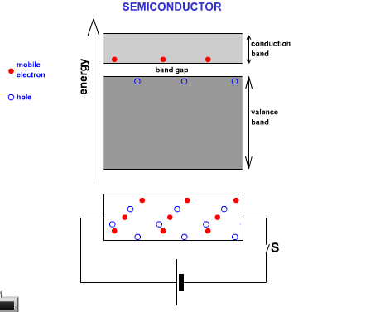
Semiconductors have a very regular crystalline structure. At absolute zero, all the valance electrons are tied up in this structure.
When a valence electron gains enough energy to move into the conduction band it leaves behind a hole in the structure.

Slide 13
Within the valance band an electron may move to fill this hole, but in doing so it leaves behind another hole where it came from.
In this way a hole can move through the structure and behaves like a positive charge carrier since it moves in the opposite direction to the electrons.

Slide 14
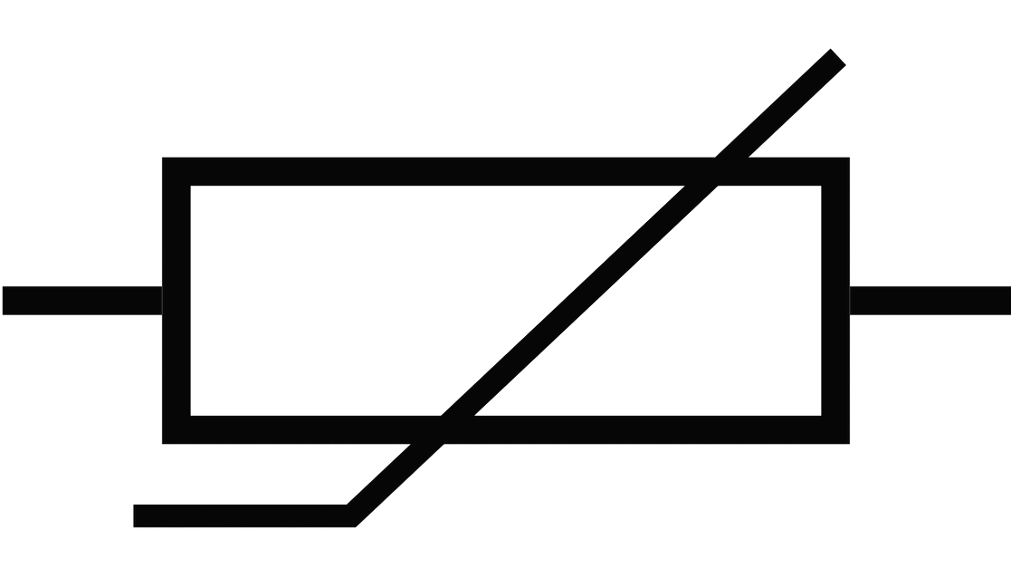
Semiconductors are very sensitive to temperature changes. If the temperature is increased then more electrons can move into the conduction band with a resulting increase in conductivity. For a semiconductor at room temperature an increase of 10ºC could result in a doubling of the number of electrons in the conduction band.
What effect would this have on the resistance of the semiconductor?
Can you think of any electrical devices that change their resistance with temperature?

Slide 15
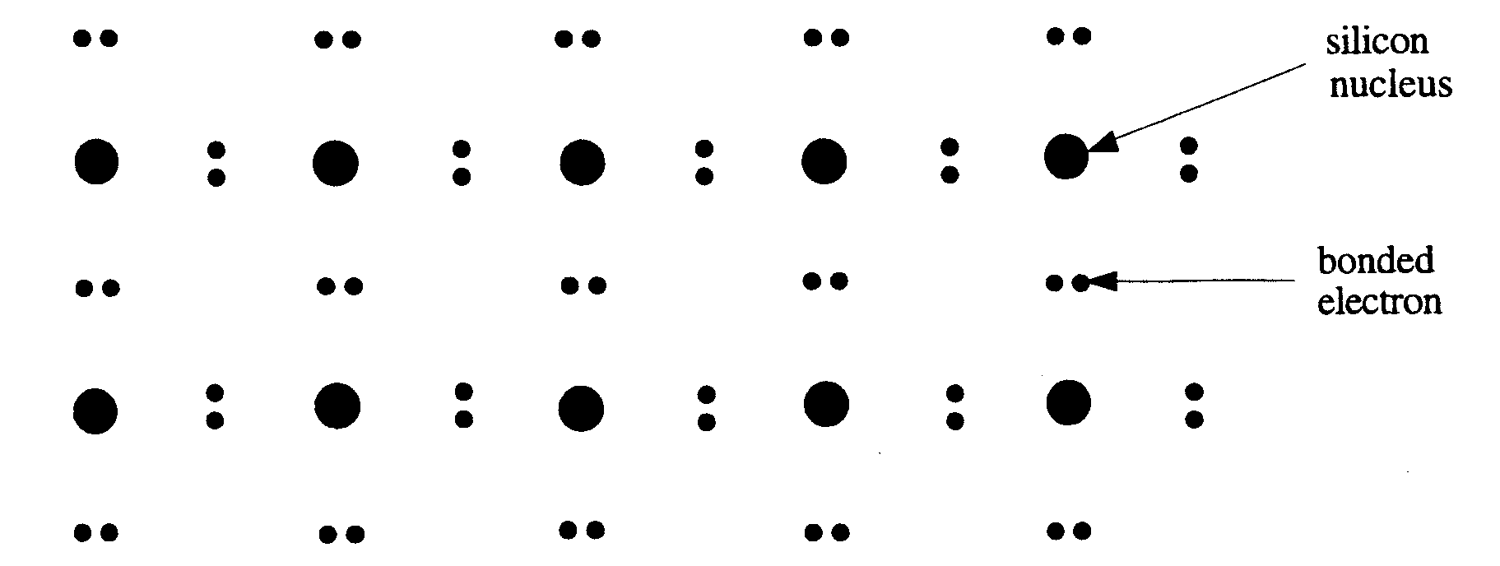
1. Intrinsic Semiconductors
Often called pure semiconductors, these have very few free electrons under normal conditions and so behave like insulators.
The most commonly used semiconductors are silicon and germanium.
Both these materials have a valency of four, that is they have four outer electrons available for bonding. In a pure crystal, each atom is bonded covalently to another four atoms. All of its outer electrons are bonded and therefore there are very few free electrons available to conduct so making the resistance very large

Slide 16
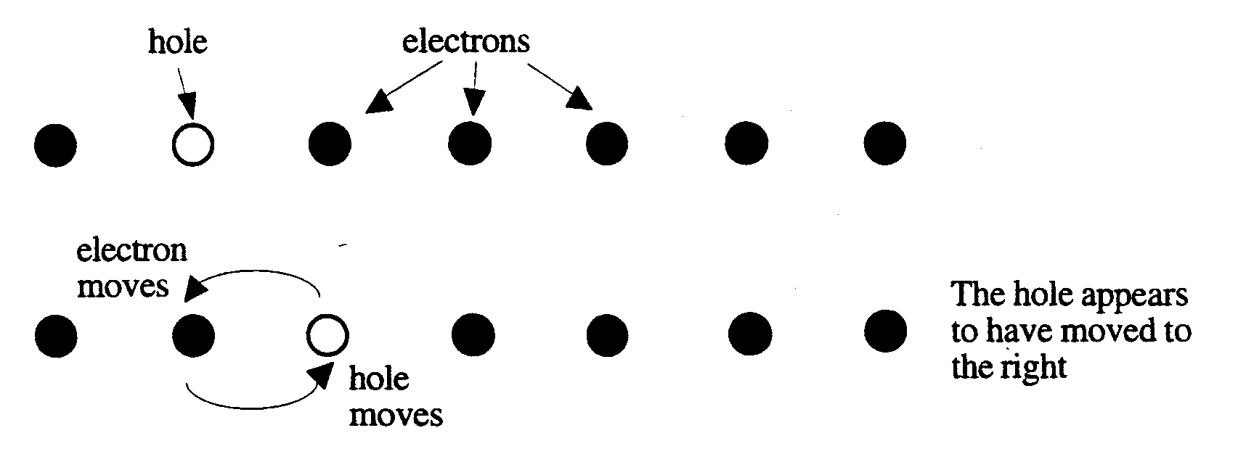
Although all the outer electrons are bonded and unable to move, if the crystal is heated or illuminated with light, some of the electrons acquire sufficient energy to break their bonds and become available for conduction.
When the electron escapes from an atom it leaves behind a “hole” which is positively charged. This hole may be filled by an electron from a neighbouring atom, which will in turn leave a hole there. Although it is technically the electron which moves, the effect is the same as if it was the hole that moves through the crystal lattice.
In an undoped semiconductor, the number of holes is equal to the number of electrons.
Current consists of drifting electrons in one direction and drifting holes in the other.

Slide 17
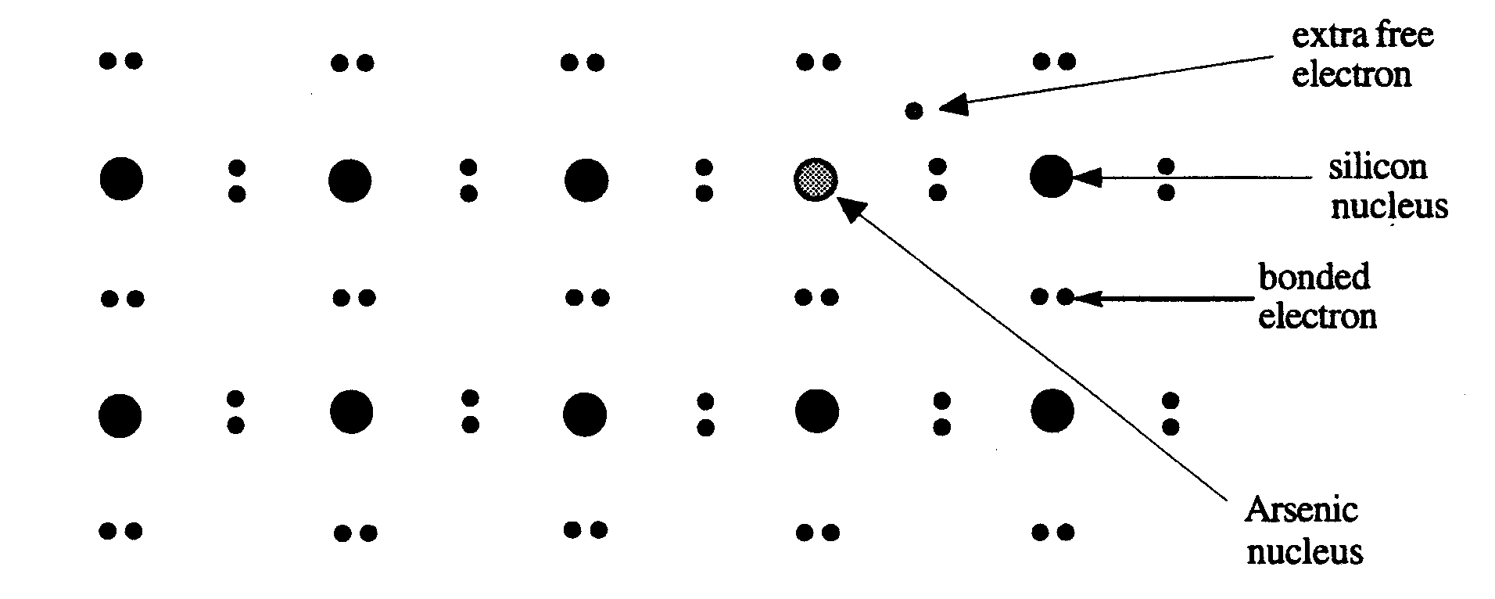
2. Extrinsic Semiconductors
These are formed by adding controlled amounts of impurity atoms to a pure semiconductor.
The addition of impurities is called doping.
(a) n-type semiconductor
If an impurity such as arsenic which has five outer electrons is added to the crystal lattice, then four of its electrons will be used in bonding with the silicon. The fifth will be free to move about – doping has increased the ability of the crystal to conduct.
Since the free electrons are negative charge carriers, this is an n-type semiconductor.
The addition of impurity atoms to a pure semiconductor (a process called doping) decreases its resistance.

Slide 18
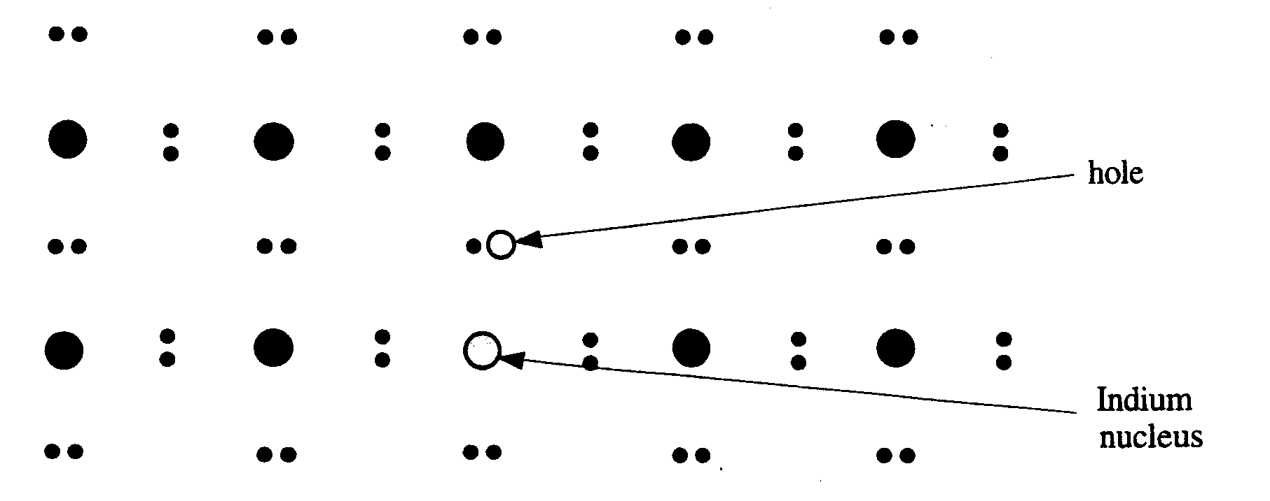
(b) p-type semiconductor
The semiconductor may also be doped with an element like Indium (In), which has only three outer electrons. This produces a hole in the lattice, where an electron is “missing”.
An electron from the next atom can move into the hole leaving behind another hole and a net positive charge on the atom. In effect a positive hole appears to move through the semiconductor carrying a positive charge. This is called a p-type semiconductor as most conduction takes place by the movement of positively charged holes.

Slide 19
N.B.
1. Doping reduces the resistance of the semiconductor.
The more doping that takes place, the more charge carriers there are. Each impurity atom gives one charge carrier.
2. Although p-type and n-type semiconductors have different charge carriers, they are still both neutral overall. (Just as a metal can conduct but is normally neutral).
3. Each type of semiconductor will have additional free charge carriers due to thermal ionisation.
This gives:
p-type – majority charge carriers holes, minority electrons.
n-type – majority charge carriers electrons, minority holes.

Slide 20
3.2.10 The p-n Junction Diode

Slide 21
3.2.10 The p-n Junction Diode
A diode is a device that allows the current to flow in one direction only.
When a semiconductor is grown so that one half is p-type and the other half is n-type, the product is called a p-n junction diode.
p-type
n-type
Circuit symbol:
p-type
n-type

Slide 22
Some of the free electrons from the n-type material diffuse across the junction and fill some of the holes in the p-type.
This can also be thought of as holes moving in the opposite direction to be filled by electrons. Because the n-type has lost electrons, it becomes positively charged near the junction.
The p-type, having gained electrons, will become negatively charged.
There will be a small voltage, a potential barrier (about 0⋅7 V), across the junction due to this charge separation. This voltage will tend to oppose any further movement of charge.
The region around the junction has lost virtually all its free charge carriers. This region is called the depletion layer.
Only about one millionth of a metre wide, the depletion layer acts as an insulator.

Slide 23
Potential barrier (0.7V)
Holes as charge carriers
Electrons as charge carriers
Depletion layer, no free charge carriers

Slide 24
Biasing the Diode
Applying a voltage to a semiconductor is called biasing. A diode may be biased in two ways.
The Forward-biased Diode (n-type connected to negative).
The diode conducts when forward-biased.
Cell connected positive end to p-type, negative end to n-type.
n
p

Slide 25
In a forward biased diode, electrons from the n-type will be given enough energy from the battery to overcome the depletion layer p.d. (the potential barrier).
So when forward biased, electrons continually flow from n-type to p-type to positive terminal of supply and holes flow from p-type to n-type.
holes as charge carriers
electrons as charge carriers
p-type
n-type
holes
electrons
The diode conducts because the depletion layer has been removed.

Slide 26
2. The Reverse-biased Diode
The diode does not conduct when reverse-biased.
Cell connected positive end to n-type, negative end to p-type.
p
n

Slide 27
In the reverse-biased diode, electrons are attracted to the positive terminal while holes are attracted to the negative terminal and so the charge carriers move away from the junction.
The depletion layer becomes wider and the diode does not conduct.
depletion layer
- -
++
p-type
n-type
holes
electrons

Slide 28
I-V Characteristics of a p-n Junction Diode
I
Leakage current
0
0.5V
V
60V
Breakdown voltage
When reverse biased there is a small leakage current due to the flow of the minority charge carriers.

Slide 29
3.2.11 Applications of the p-n Junction Diode

Slide 30
1. The Light Emitting Diode

Slide 31
We have seen that in a forward biased p-n junction diode, holes and electrons pass through the junction in opposite directions.
Sometimes holes and electrons will meet and recombine. When this happens, energy is emitted in the form of a photon.
For each recombination of electron and holes, one photon of radiation is emitted. In most semiconductors this takes the form of heat, resulting in a temperature rise.
In some semiconductors however, the energy is emitted as light. If the junction is close to the surface of the material, this light may be able to escape. This makes what we call a Light Emitting Diode (LED).
In the junction region of a forward biased p-n junction diode, positive and negative charge carriers may recombine to give quanta of radiation

Slide 32
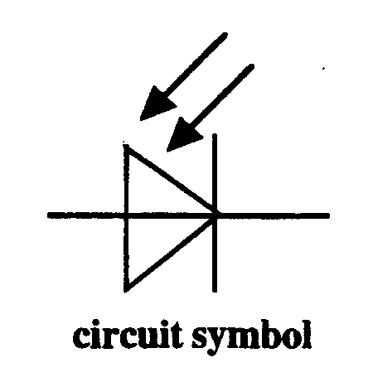
2. The Photodiode
A photodiode is a LED in reverse.
A photodiode is a solid-state device in which positive and negative charges are produced by the action of light on a p-n junction.
When light falls on the junction, electron-hole pairs are produced. Each photon gives up its energy and produces one electron-hole pair. The electron-hole pair move in opposite directions and a small voltage is produced across the diode.

Slide 33
photon
electron
hole
p-type
n-type
If irradiance increases, the number of photons increases, so more electron-hole pairs are produced and consequently more voltage.
This photodiode can be used in two modes.

Slide 34
(A) Photovoltaic Mode
In this mode the diode has no bias voltage applied. Photons that are incident on the junction have their energy absorbed, freeing electrons and creating electron-hole pairs. A voltage is generated by the separation of the electron and hole.
More intense light (more photons) will lead to more electron-hole pairs being produced and therefore a higher voltage. In fact, the voltage is proportional to the light irradiance.
When light shines on the photodiode, the motor spins round. The greater the light irradiance, the faster the motor spins.
In the photovoltaic mode , a photodiode may be used to supply power to a load.

Slide 35
(B) Photoconductive Mode
In this mode the photodiode is connected in reverse bias and would normally not conduct. If it is kept in the dark it acts just like an ordinary reverse biased p-n junction. However, light shining on the junction will create electron-hole pairs.
This will provide a number of free charge carriers in the depletion layer, decreasing the resistance and enabling a current to flow. A greater irradiance of light will lead to more free charge carriers and therefore less resistance. The photodiode acts as a Light Dependant Resistor (LDR).
In the photoconductive mode, the photodiode may be used as a light sensor.

Slide 36
Incident light on junction
p-type
n-type
Depletion layer

Slide 37
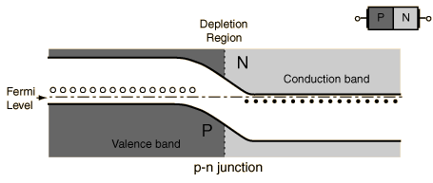

Slide 38
N.B.
The switching action of a reverse biased diode is extremely fast. (The electron-hole pairs created in a photodiode recombine very rapidly, therefore a photodiode reacts very quickly to changes in light irradiance, which makes it very useful for detecting rapid light level changes e.g. speed measurement, fibre optic communication).
2. The reverse leakage current of the photodiode is directly proportional to the irradiance of light falling on it.
3. As long as the reverse biasing voltage is less than the breakdown voltage of the photodiode, the reverse leakage current is almost independent of the reverse biasing voltage.

Slide 39
Summary of Semiconductor Devices
p-n junction diode forward bias – conducts
reverse bias – does not conduct
LED forward bias – conducts and emits light
reverse bias – does not conduct, so does not emit light
Photodiode no bias – photovoltaic mode - acts like a solar cell
reverse bias – photoconductive mode - acts like an LDR

