Slide 1
National 5 Practice Prelim
Solutions

Slide 2
Section 1 – Multiple Choice

Slide 3
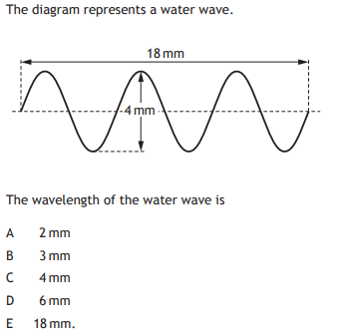
Question 1

Slide 4
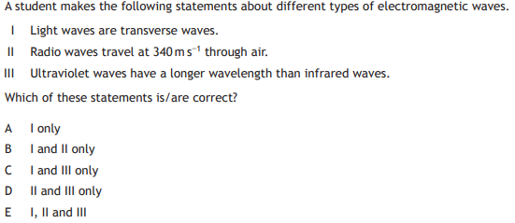
Question 2

Slide 5
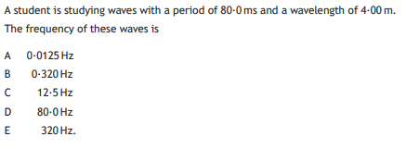
Question 3

Slide 6
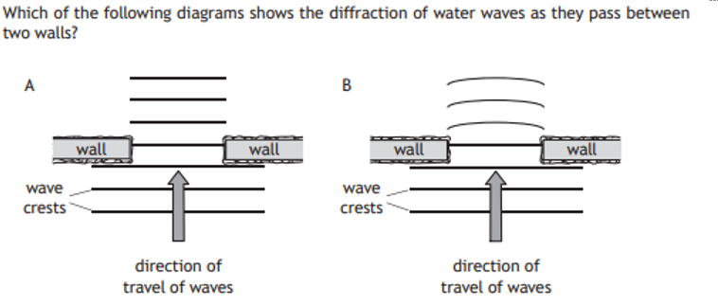
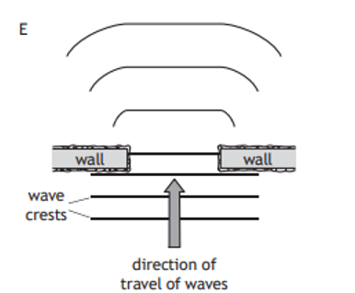
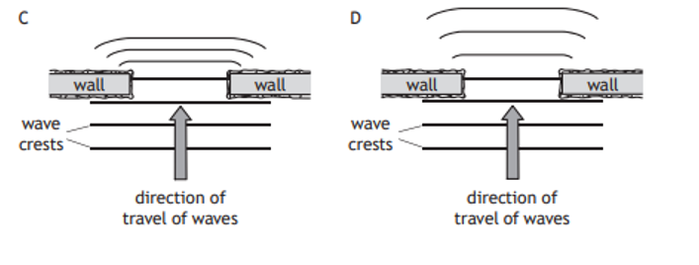
Question 4

Slide 7
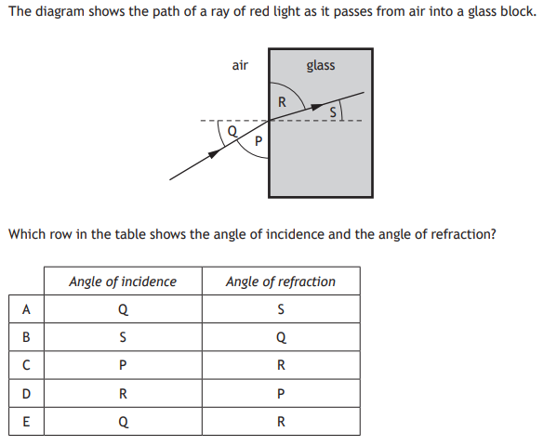
Question 5

Slide 8
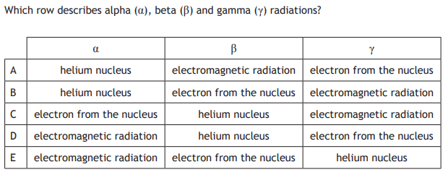
Question 6

Slide 9
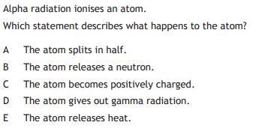
Question 7

Slide 10
Question 8

Slide 11
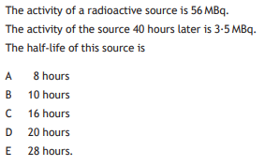
Question 9

Slide 12
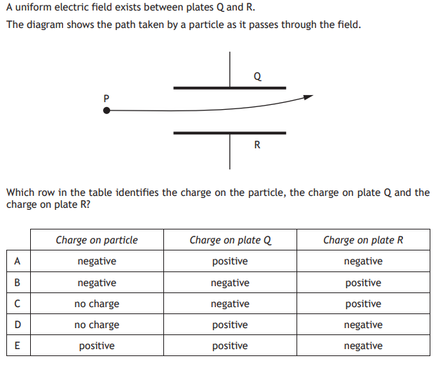
Question 10

Slide 13
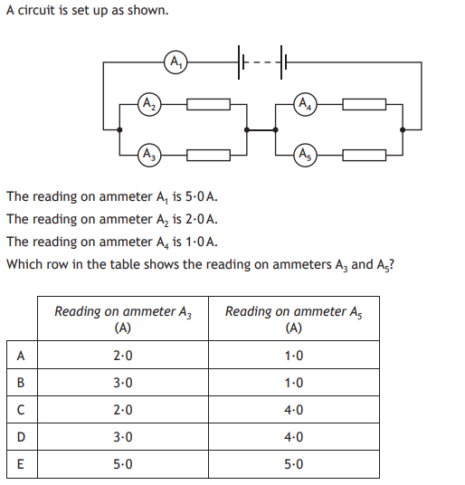
Question 11

Slide 14
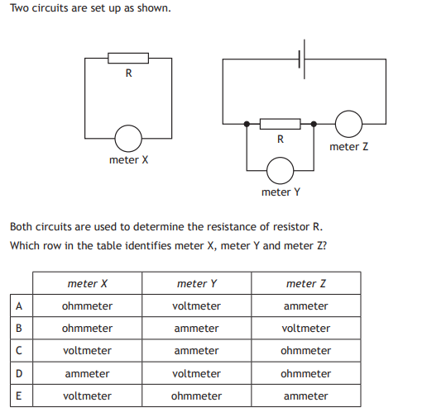
Question 12

Slide 15
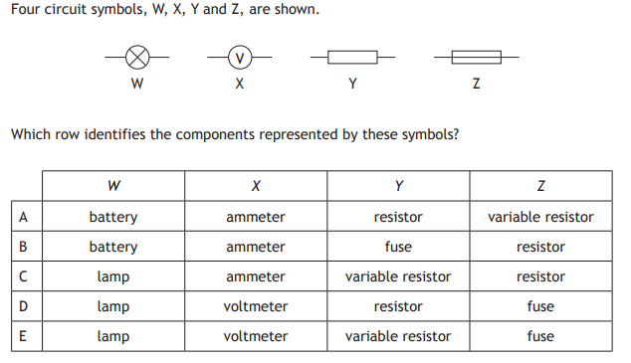
Question 13

Slide 16
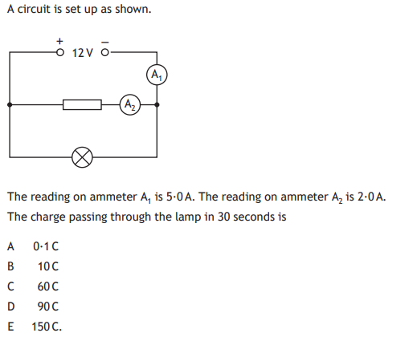
Question 14

Slide 17
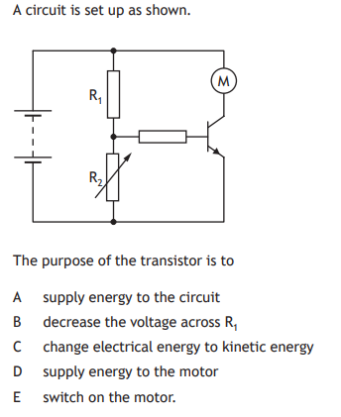
Question 15

Slide 18
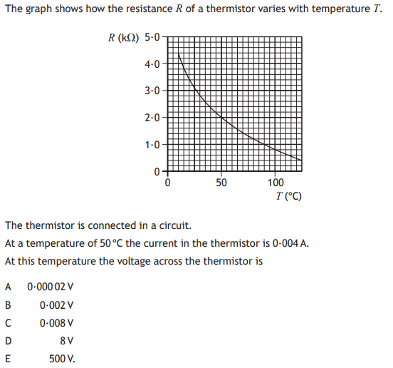
Question 16

Slide 19
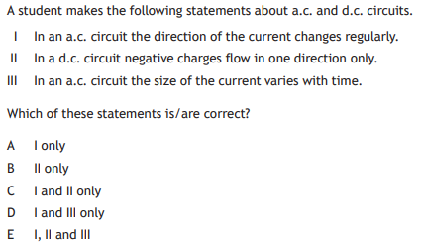
Question 17

Slide 20
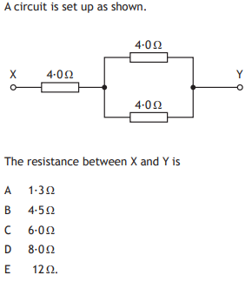
Question 18

Slide 21
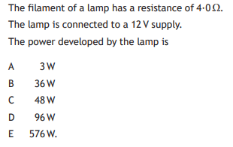
Question 19

Slide 22
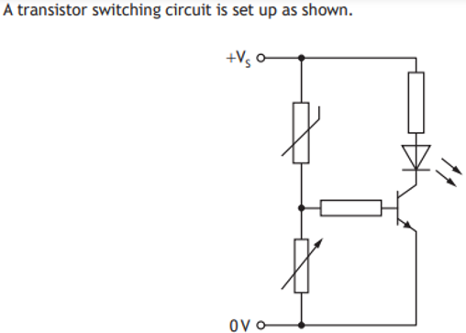
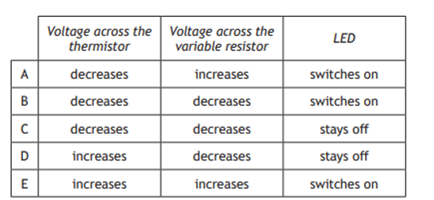
Question 20

Slide 23
Section 2

Slide 24
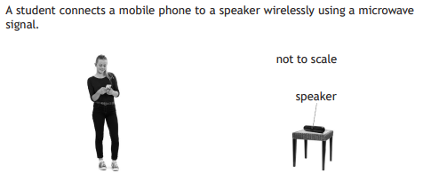
Question 1 (a)

Slide 25
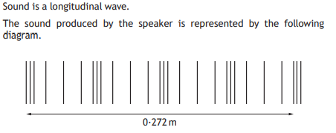
Question 1 (b)(i)

Slide 26
Question 1 (b)(ii)

Slide 27
Question 1 (b)(iii)

Slide 28
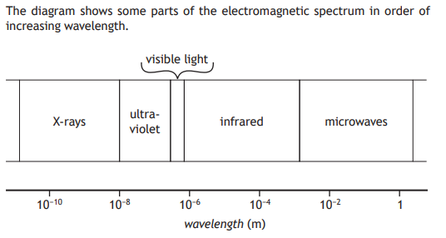
Question 2 (a)

Slide 29
Question 2 (b)

Slide 30
Question 2 (c)(i)

Slide 31
Question 2 (c)(ii)

Slide 32
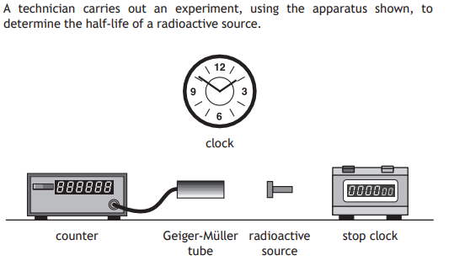
Question 3(a)

Slide 33
Question 3(a)

Slide 34
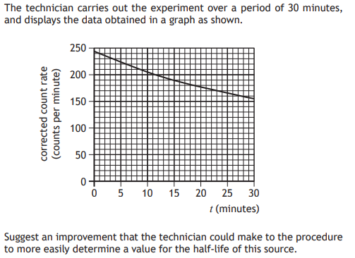
Question 3(b)

Slide 35
Question 3 (c)(i)

Slide 36
Question 3 (c)(ii)

Slide 37
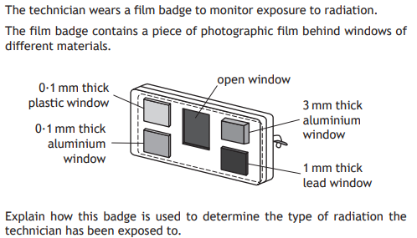
Question 3 (d)

Slide 38
Question 3 (e)
As an additional protective measure, technicians are asked to wear protective clothing. Describe and explain the type of clothing they might use.

Slide 39
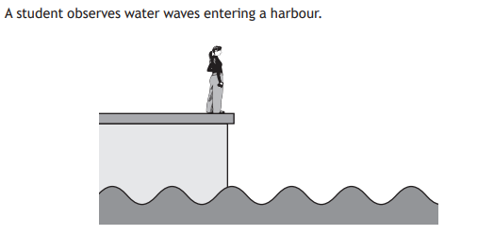
Question 4

Slide 40
Question 4 (a)(i)

Slide 41
Question 4 (a)(ii)

Slide 42
Question 4 (b)

Slide 43
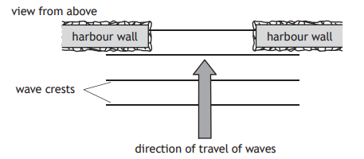
Question 4 (c)
Copy and complete the diagram to show the pattern of the wave crests inside the harbour

Slide 44
Question 4 (c)

Slide 45
Question 4 (d)

Slide 46
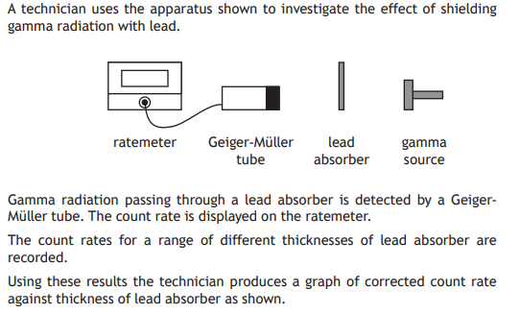
Question 5

Slide 47
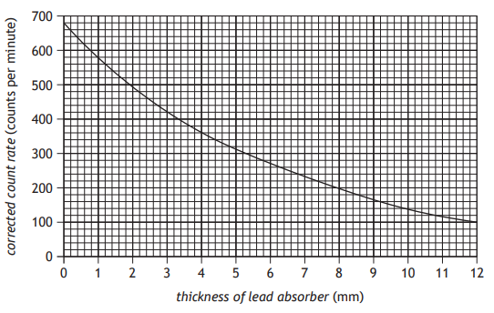
Question 5(a)

Slide 48
Question 5(b)(i)

Slide 49
Question 5(b)(ii)

Slide 50
Question 5(b)(iii)

Slide 51
Question 5(c)

Slide 52
Question 6

Slide 53
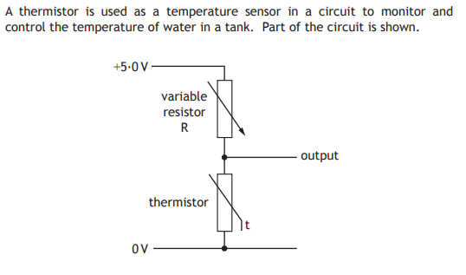
Question 7(a)(i)

Slide 54
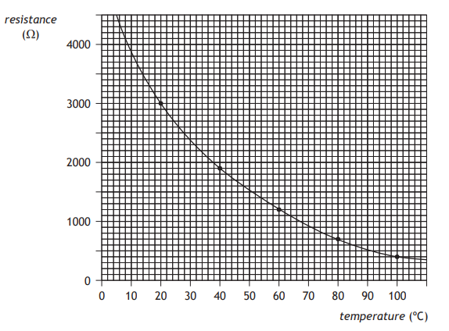
Question 7(a)(ii)

Slide 55
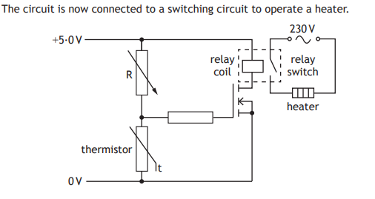
Question 7(b)(i)

Slide 56
Question 7(b)(ii)

Slide 57
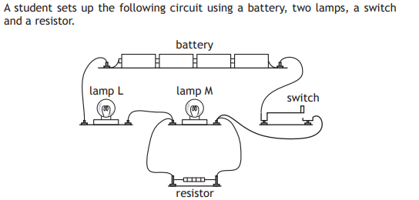
Question 8(a)

Slide 58
Question 8(b)

Slide 59
Question 8(c)

Slide 60
Question 9(a)

Slide 61
Question 9(b)

Slide 62
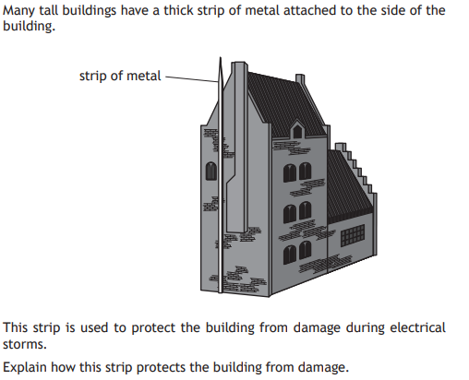
Question 9(c)

Slide 63
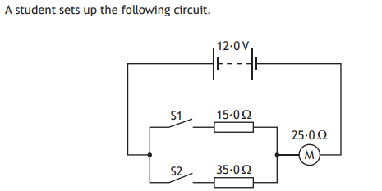
Question 10(a)(i)

Slide 64
Question 10(a)(ii)

Slide 65
Question 10(b)(i)

Slide 66
Question 10(b)(ii)

Slide 67
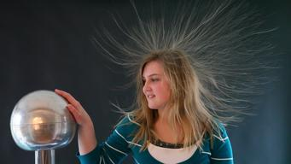
Question 11
Two students are investigating the nature of electricity by experimenting with a Van De Graff Generator. Student A places their hand on the generator and Student B switches it on. Student B observes Student A’s hair ‘standing on end’. After observing the effects of the experiment student B moves to switch off the generator but gets too close and both students receive a shock.
At the point at which the shock occurred, Student A’s hair lowered.
Use your knowledge of Physics to comment on observations made during the experiment.

Slide 68
Question 11
Two students are investigating the nature of electricity by experimenting with a Van De Graff Generator. Student A places their hand on the generator and Student B switches it on. Student B observes Student A’s hair ‘standing on end’. After observing the effects of the experiment student B moves to switch off the generator but gets too close and both students receive a shock.
At the point at which the shock occurred, Student A’s hair lowered.
Use your knowledge of Physics to comment on observations made during the experiment.

