Slide 1
Open-ended Questions with sample solutions
There are no definitive solutions for open-ended questions – these are just some of the approaches which could be taken to answer the individual questions. You should approach an open-ended question by looking at identifying the underlying ‘theme’ of the questions and then building an answer by using your knowledge of the Physics behind that theme. Practice will develop your ability to answer these types of questions. There are two 3 mark open-ended questions in Paper 2. 3 marks are awarded for an answer showing good (not great) understanding of the physics.

Slide 2
Open Ended Questions (Electricity)

Slide 3
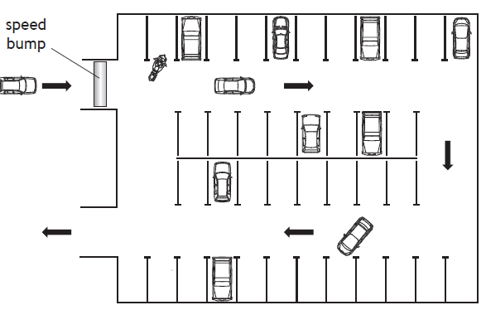
2019 CfE Higher Section 2 Q13(d)
The use of analogies from everyday life can help improve the understanding of physics concepts.
Vehicles using a car park may be taken as an analogy for the charging of a capacitor.
Use your knowledge of physics to comment on this analogy.

Slide 4
Example solution
Consider the cars in the analogy to be representative of the charges (electrons) building up on the surface of a capacitor and the car park to be representative of the capacitor itself. Cars would be able to fill the car park more easily when the car park is relatively empty, but as it begins to fill, it would be hard to find a space and so space would fill more slowly. This is similar to the charging characteristic of a capacitor which shows a decreasing rate of the flow of charge with time (current). The point at which the car park (capacitor) is full, no more cars (charges) will be able to enter and so there is no flow of cars (no current).
The speed bump in the analogy could be used to represent the energy which needs to be supplied to the cars (charges) in order to get to the car park. The bigger the speed bump, the greater the amount of energy required.
The arrows show that cars enter in one direction and exit in the opposite direction. This is similar to the charge/discharge characteristic of a capacitor where current flow changes direction.

Slide 5
2016 CfE Higher Section 2 Q11

Slide 6
Example solution
The statement is actually quite accurate, if very simplified. Electrical energy is divided between the resistor and the LED. The potential available to the LED is then used to allow electrons to cross the potential barrier in the depletion layer thus allowing for the re-combination of electron-holes pairs releasing energy a photons of light “light waves”.

Slide 7
2014 Revised Higher Q31

Slide 8
Example solution
Using Q=CV and Q=It we can calculate that the charge which can be stored by the capacitor is 75mAh – this is significantly less than the rechargeable battery.
Depending on the load (resistance) attached to a capacitor, it may charge very slowly which would limit their applications.
Capacitors tend to discharge very quickly and have a high initial current which may not be suitable for all applications.
Batteries can easily be added in series to provide a greater potential and so the greater maximum potential of the capacitor is inconsequential

Slide 9
Practice questions from Question Bank

Slide 10
Example solution
When the engine is started, current flows in the lighting circuit meaning that there will be voltage ‘lost’ due to the internal resistance of the battery.
Assuming the battery has a maximum EMF of 12V the ‘lost volts’ will mean that less than 12V will be available to the load (the lights). The effective voltage available to the lights is known as the terminal potential difference.
In order for the lamps to operate normally, they will need to be connected to a battery with a higher EMF and/or lower internal resistance.
It is possible that the lighting circuit is connected to a ‘starter motor’ which acts as an additional load in the circuit which would split the voltage from the supply meaning that much less than 12V is provided to the lights. After the motor has started, this load will be removed and the lights will become brighter, however will still receive less than 12V due to the lost volts.

Slide 12
Example solution
Current does flow from negative terminal to the positive terminal, however the charge are not ‘consumed’ by the resistors, rather the electrical energy carried by the charges (provided by the supply EMF) is provided to the resistors where it is converted to heat.
The amount of energy which is ‘dropped’ across each resistor it directly proportional to the value of the resistors (ohm’s law). The sum of the voltages across the resistors is equal to the supply voltage assuming that there is negligible internal resistance.

Slide 13
Open Ended Questions (Our Dynamic Universe)

Slide 14
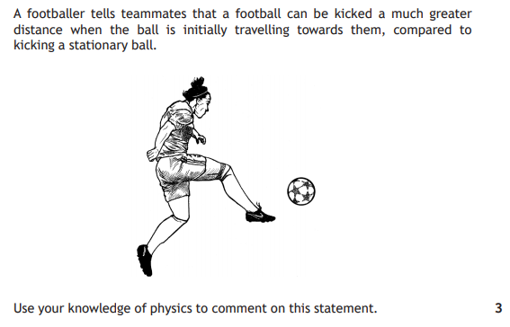
2019 CfE Higher Paper 2 Q3

Slide 15
Example solution
Assuming the same force is applied for the same length of time for each of the scenarios then the change in momentum (=Ft) will be the same.
A ball travelling towards the footballer will have an initial momentum due to its mass and velocity (p=mv), however the direction of the momentum will be in the opposite direction to the force applied by the footballer. This means that the momentum of the ball leaving after the collision will be less than it would be if the ball is stationary.
However, if the ball coming towards the footballer means that the time of contact with the ball will be increased, then (assuming the same force applied) the change of momentum will not have increased as the impulse will be larger. A significantly larger change in momentum could mean that the final momentum (and thus final velocity) of the ball will be greater after the collision.

Slide 16
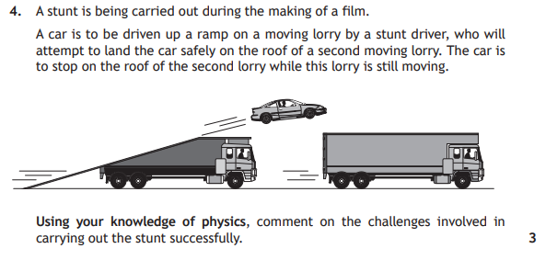
2018 CfE Higher Section 2 Q4

Slide 17
Example solution
The car will have to be moving at a significant initial horizonal velocity in order to achieve the range between the car and lorry. If the vertical velocity is not large enough then the car will fall below the level of the lorry by the time it reaches it horizontally.
If the vertical and horizontal components of the car are too high then it will over-shoot the lorry.
Due the Newton’s 1st law (assuming negligible air resistance) the car will continue to move at a horizontal velocity when it lands on the lorry. The lorry will need to be travelling at a high enough velocity (and the car will have to brake) in order not go over the front of the lorry.
The car will have its greatest kinetic energy at the point of launch and landing. This kinetic energy will be transferred to work done on landing which will apply significant force to the top of the lorry. It will need to be re-enforced in order to withstand the impact. Another way to think of this is that there will be a significant change in momentum in the car on collision with the lorry leading to a high impulse with a high force of impact.

Slide 18
2015 CfE Higher Section 2 Q5

Slide 19
Example solution
He ‘nothing’ in the passage refers to the singularity at the beginning of the universe. Whilst the singularity was extremely dense and massive, it did not contain matter such as the elements and so could be considered ‘nothing’.
The word ‘explosion’ is used to describe the rapid expansion of the universe at the beginning of the big bang though this was not an explosion in the conventional sense as at that time there was no mass to ‘explode’.

Slide 20
2015 Revised Higher Q24

Slide 21
Example solution
Though the car is travelling at speed for long period of time, the cars velocity is much less (below 10% c) and so the Lorentz factor is negligible. Assuming the car is travelling at an average speed of 100km/h (27.7ms⁻¹) then the Lorentz factor (you could show the calculation here) reduces to 1 and therefore there is no perceptible time dilation.

Slide 22
2014 Revised Higher Q24

Slide 23
Example solution
The universe is expanding and its rate of expansion is increasing due the existence of dark energy.
It is estimated that at the beginning of the universe during the rapid expansion immediately after the big bang theory that the rate was indeed faster than the speed of light and so it can be assumed that objects which are on the edge of the universe should be expanding at a rate faster than the speed of light.
Special relativity states that nothing can travel faster than the speed of light, however this is limited to the observable universe. As we do not know the true nature of dark energy and dark matter, it is possible that they do not observe the same restrictions under special relativity.
12 million miles a minute is slightly faster than the speed of light

Slide 24
2013 Revised Higher Q23

Slide 25
Example solution
If we estimate the mass of each pupil to be approximately 60kg and a distance of 1m apart then we can use the equation: F = G x$\frac{M1xM2}{r2}$ then the force between the pupils will be 2.4 x 20⁻⁷N.

Slide 26
2013 Revised Higher Q25(b)

Slide 27
Example solution
Looking through a telescope allows to look at objects which a very far away.
Assuming a telescope is used to see an object 1 light year away, it would take a year for the light from that object to reach us and so we are actually seeing that object a year into the past. Objects which are further away would be seen further ‘back in time’ and so the analogy is correct.

Slide 28
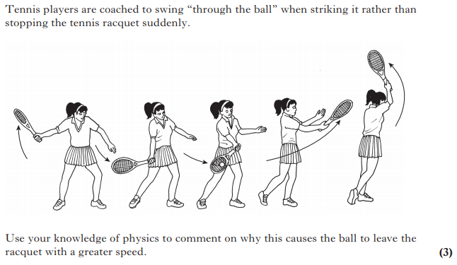
2012 Revised Higher Q24

Slide 29
Example solution
Swinging ‘through the ball’ would increase the time of contact with the ball and so increase the impulse (Ft) and so the change of momentum of the ball. This would mean that the ball would leave the racket at a greater velocity.

Slide 30
Practice questions from Question Bank

Slide 31
Example solution
We can assume that as the footballer was running at the point he jumped, he would be following a projectile path (with a horizontal and vertical velocity), at the point at which he reached his maximum height, his vertical velocity would be zero and so he would not be getting any higher or lower, however he would continue to be travelling at a constant horizontal velocity and so wouldn’t be motionless and so couldn’t be ‘hanging there’.
If however the footballer had been stationary before he jumped, then he would not have a horizontal velocity and there would be a moment at which his velocity of zero.

Slide 32
Practice questions from Question Bank

Slide 33
Example solution
Assume that at the point of braking all kinetic energy is converted to heat energy.
Assuming the mass of the cyclist an the bicycle is 80kg and he is travelling at 10ms⁻¹ then his kinetic energy would be:
E_{k} = ½mv²
= ½ x 80 x 10 x 10
= 4000J
And so 4000J of heat energy is produced

Slide 34
Practice questions from Question Bank

Slide 35
Example solution
Newton’s third law states that every action force has an equal and opposite reaction force.
The rocket exerts a force downwards on the exhaust gases and so they exert an equal force upwards on the rocket. It is that force which provides the thrust for the rocket.

Slide 36
Practice questions from Question Bank

Slide 37
Example solution
Assume the car is travelling at an average speed of 15ms⁻¹.
Assume that the car and driver has a mass of 1500kg.
Assume that the flywheel is 60% efficient (40% of the energy is converted to heat and sound)
Kinetic energy before braking:
E_{k} = ½mv² = 0.5 x 1500 x 15 x 15 = 168750J
60% of 168750 = 101250 = 100kJ

Slide 38
Practice questions from Question Bank

Slide 39
Example solution
Time how long it takes the rock to fall to the ground. This gives you t, we know acceleration due to gravity (a) is 9.8ms⁻². We assume u (initially velocity) to be 0.
s (displacement), the height of the cliff can be found using the equation s = ut + ½at²
Likely sources of error would be wind resistance affecting the acceleration of the rock (slowing it down) which would give a higher value of t and thus a higher calculated value of the height of the cliff.

Slide 40
Practice questions from Question Bank

Slide 41
Example solution
The head made of steel would not deform as much as the head made of rubber.
This would mean a shorter time of contact with the peg.
Assuming that the change in momentum of both hammers was the same (as they have the same mass and velocity) then the force of impact of the steel hammer would be greater as Ft=∆mv.

Slide 42
Practice questions from Question Bank

Slide 43
Example solution
Assuming you could travel at the speed of light then wouldn’t be at all places as it would still take time to travel to far away objects. For example, it would take 8min to get to the Sun. Light from objects which are far away is observed a long time after they were produced.
The furthest away objects emit radiation produced at the beginning of the universe, however the universe is expanding at an accelerating rate and so even at light speed it would be impossible to reach these objects.
Evan at light speed it is still only possible to go forward in time and not backwards and so an object could not be ‘at all times’.

Slide 44
Open Ended Questions (Particles and Waves)

Slide 45
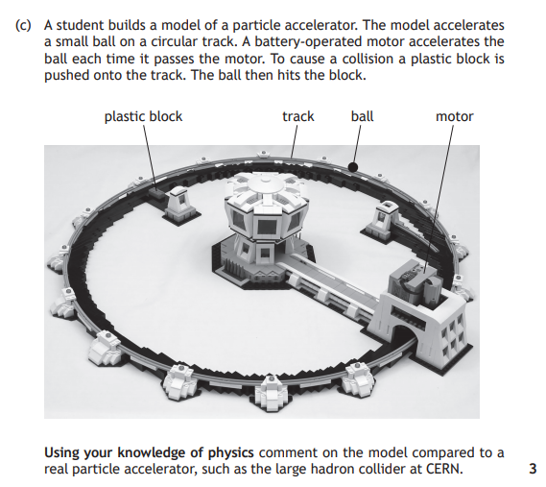
2018 CfE Higher Section 2 Q6(c)

Slide 46
Example solution

Slide 47
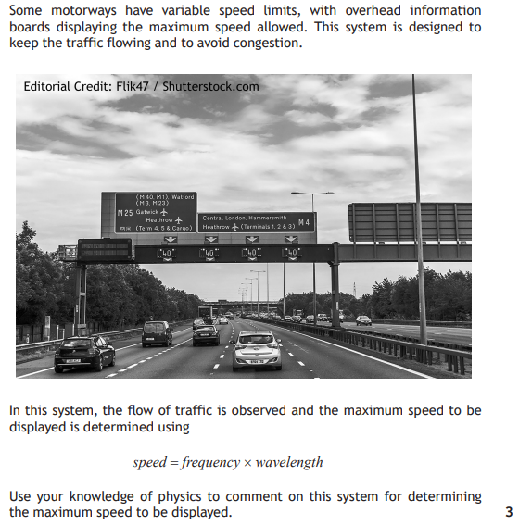
2017 CfE Higher
Section 2 Q4

Slide 48
Example solution

Slide 49
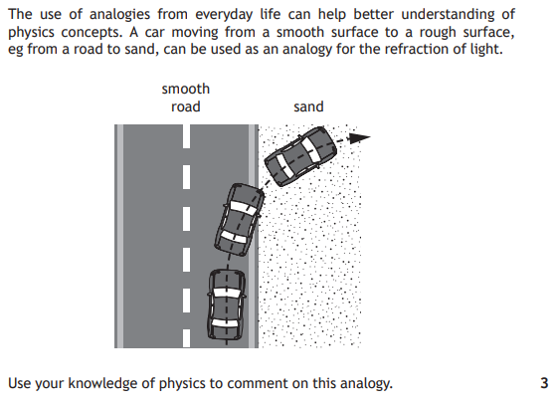
2017 CfE Higher Section 2 Q11

Slide 50
Example solution

Slide 51
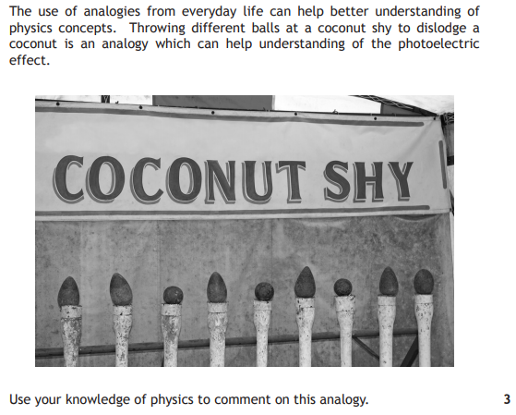
2015 CfE Higher Section 2 Q7

Slide 52
Example solution

Slide 53
2012 Revised Higher Q28

Slide 54
Example solution

Slide 55
Open Ended Questions (Mixed topics)

Slide 56
Example solution

Slide 57
2016 CfE Higher Section 2 Q6

