Slide 1
National 4/5 Waves
Refraction

Slide 2
Refraction
Definition of Refraction
Characteristics of Refraction
Lenses (uses of refraction)

Slide 3
Refraction
Refraction is the change in speed of light when passing from one medium (material) to another e.g. from air to glass
When light enters a more dense medium it will slow down. For example, the speed of light in air is approximately 3 x 10⁸ ms⁻¹, however the speed of light in glass is approximately 2 x 10⁸ ms⁻¹.

Slide 4
Refraction – Rectangular Block
When light enters the glass block (from air) at 90° to the surface, it passes straight through in a straight line.
air
glass
air
3 x 10⁸ ms⁻¹
2 x 10⁸ ms⁻¹
3 x 10⁸ ms⁻¹
We can’t see it, but REFRACTION has taken place and the light travels slower in the glass than in the air.
NOTE: The frequency of the light does not change

Slide 5
Refraction – Rectangular Block
If the light travels at an angle to the normal (drawn at 90° to the surface) then we see the light changing direction at the boundary between the air and glass.
air
glass
air
The light changes direction again when exiting the block from the glass to the air
normal
Refracted ray
Incident ray

Slide 6
Refraction – Rectangular Block
The angle between the incident ray and the normal is called the angle of incidence (i)
air
glass
air
-
r
-
normal
i
-
-
r
From glass to air
i < r
i
The angle between the refracted ray and the normal is called the angle of refraction (r)
From air to glass
i > r

Slide 7
Refraction – The Triangular Prism
We can use our knowledge about the change in direction of light between different mediums to predict the path of light through other shapes e.g. the triangular prism
NOTE: This is MONOCHROMATIC light - light of only one colour
normal
normal
air
glass
air
From air to glass the light bends towards the normal
From glass to air the light bends away from the normal

Slide 8
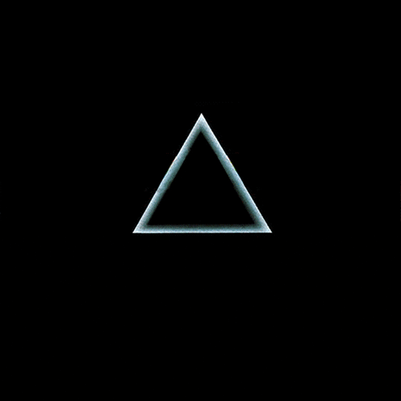
Refraction – White Light Through a Prism
WHITE LIGHT is made up of a series of other colours – Red, Orange, Yellow, Green, Blue, Indigo and Violet
or ROY G BIV

Slide 9
Explanation
NOTE: This is how Rainbows are formed – white light refracting through water droplets in the air. BUT the rainbow song is wrong – here is a different one:
The colour of light is determined by it’s frequency which does not change when it is refracted.
Each frequency (or wavelength) of light refracts by different amounts – Violet light refracts the most and Red light the least.
When white light refracts through a prism, it is split into it’s component colours creating what is known as a continuous spectrum.

Slide 10
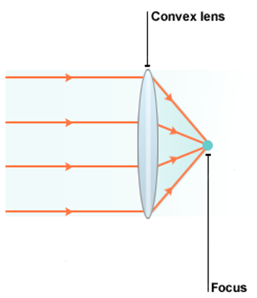
Convex and Concave Lenses
When light enters a convex lens it is brought to a focus point.
This is why this lens is sometimes referred to as a converging lens

Slide 11
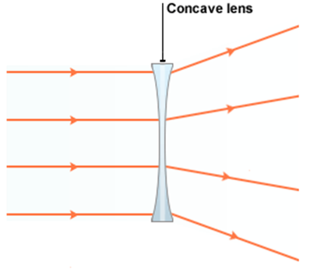
Convex and Concave Lenses
When light enters a concave lens it is spread out .
This is why this lens is sometimes referred to as a diverging lens

Slide 12
Uses of Convex and Concave Lenses
Convex and Concave lenses are often used to correct sight defects (these are what are in the glasses people wear).

Slide 13
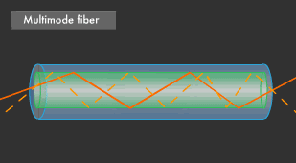
Total Internal Reflection (TIR)
Total Internal Reflection (TIR) occurs when light is completely reflected after entering a lens.
TIR can only happen if the angle of incidence is greater than the critical angle.
NOTE: The principle of TIR is used in the transmission of light through optical fibres
An advantage of optical fibres is that many signals can be sent simultaneously through a single fibre, thus increasing bandwidth.

Slide 14
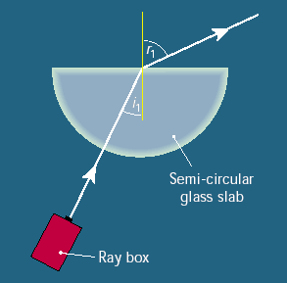
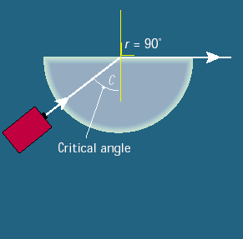
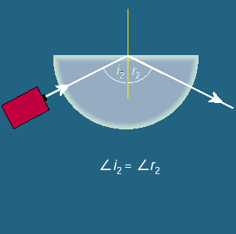
Total Internal Reflection (TIR)
Diagram 1 – light is refracted.
Diagram 2 – Light is refracted at 90⁰, the angle of incidence in this case is called the critical angle, Θ_{c}
Diagram 3 – Any angle bigger than the critical angle will show Total Internal Reflection

Slide 15
Summary
Refraction is the change in speed of light when passing from medium to another
Lenses of different shapes are used to refract light
Prisms can be used to split light into the spectrum
Convex and Concave lenses can be used to correct sight defects
Total Internal Reflection is used to transmit light wave in optical fibres

