Slide 1
S3/S4 Physics
Light

Slide 2
Reflection
A plane mirror can be used to show the Law of Reflection.
All waves, including light waves, will obey this law which states that..
… the angle of incidence (i) is equal to the angle of reflection (r)
(the angles are always measured from the normal line in the diagram)
ALL LIGHT DIAGRAMS MUST USE ARROWS TO SHOW THE DIRECTION IN WHICH THE LIGHT IS TRAVELLING DUE TO THE REVERSIBILITY OF LIGHT.

Slide 3
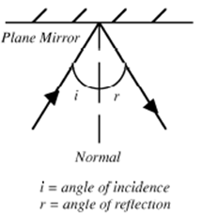
Reflection

Slide 4
Refraction
When a wave enters a new material it will change speed.
This will cause a change in direction.
This is known as refraction.
This can be show by passing light waves through a rectangular glass block.

Slide 5
Refraction of Light

Slide 6
Refraction of Light
The light waves slow down when they travel from the air to the rectangular glass block because glass is more dense than air.
The slowing down of the waves makes them bend towards the normal when they travel from the air to the glass.
The light waves speed up when they travel from the rectangular glass block to the air because air is less dense than glass.
The speeding up of the waves makes them bend away from the normal when they travel from the glass to the air.

Slide 7
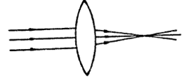
Refraction and Lenses
When parallel light rays enter a convex (converging) lens the refraction that takes place brings the rays of light to a focus or focal point.

Slide 8
Refraction and Lenses
A convex lens can be used to help someone with long-sight. The diagram below shows that light would not be focussed on the retina (back of the eye) when you do not correct long-sightedness.

Slide 9
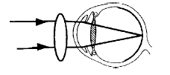
Refraction and Lenses
By using a convex lens it is possible to correct long-sightedness.
The diagram below shows that the convex lens makes the light focus on the retina.

Slide 10
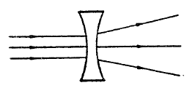
Refraction and Lenses
When parallel light rays enter a concave (diverging) lens the refraction that takes place spreads the rays of light out.

Slide 11
Refraction and Lenses
A concave lens can be used to help someone with short-sight. The diagram below shows that light would not be focussed on the retina (back of the eye) when you do not correct short-sightedness.

Slide 12
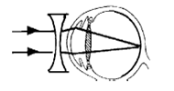
Refraction and Lenses
By using a concave lens it is possible to correct short-sightedness.
The diagram below shows that the concave lens makes the light focus on the retina.

