Slide 1
S3/S4 Physics
Sound

Slide 2
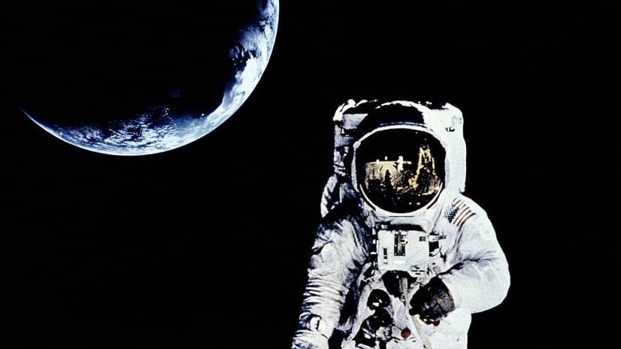
Vibrations and Waves
To produce a sound the particles in an object must vibrate.
This means sound can travel through solids, liquids and gases.
Sound cannot travel through a vacuum as it contains no particles.

Slide 3
Vibrations and Waves
Sound is a wave which carries energy.
Sound waves travel at a speed of 340ms⁻¹ in air.
The number of waves in a second is called the frequency.
Frequency is measured in a unit called Hertz (Hz).
Frequency (f) can be calculated using the equation f = N
t
Where,
N – is the number of waves and t – is the time in seconds

Slide 4
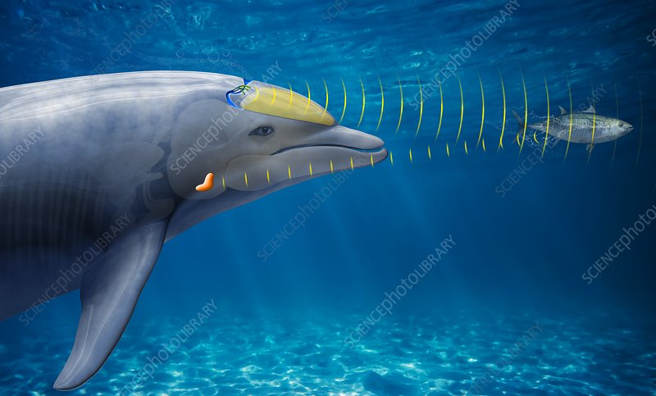
Vibrations and Waves
Most humans can hear sounds in the range 20Hz to 20,000Hz.
High frequency sounds, beyond the range of human hearing are called ultrasounds.
Ultrasounds have a variety of uses including scanning unborn babies and sonar.

Slide 5
Sound Waves
Sound waves are described as being longitudinal.
This means the particles in the wave move along in the same direction as the wave carries energy. In this diagram, all the movements are along the horizontal (left to right) direction.

Slide 6
CRO Traces
A CRO is a device that can display a “picture of sounds”.
The “picture” can give you information about the frequency, wavelength and amplitude of the sound.
Wavelength is the distance from on point on a wave to the same point on the next wave.
Amplitude is measured from the middle of the wave to the top OR from the middle of the wave to the bottom.

Slide 7
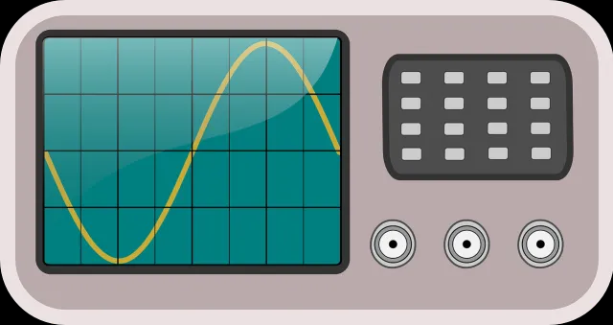

Slide 8
Noise
Sounds that you do not like or do not want to hear are called noise.
If you are forced to hear these noises, it is called noise pollution.
Some examples of noise pollution are…
Aircraft
HGVs
Pneumatic drills

Slide 9
Noise
Loud noises are the most common type of noise pollution.
Loudness of a sound (or noise) is measured by a sound level meter.
The unit used to measure the loudness of all sounds is the decibel (dB).

Slide 10
Noise
Situation | Loudness
Whisper | 30dB
Quiet classroom | 60 to 70dB
Concert | 120dB
Threshold of Pain | 140dB

Slide 11
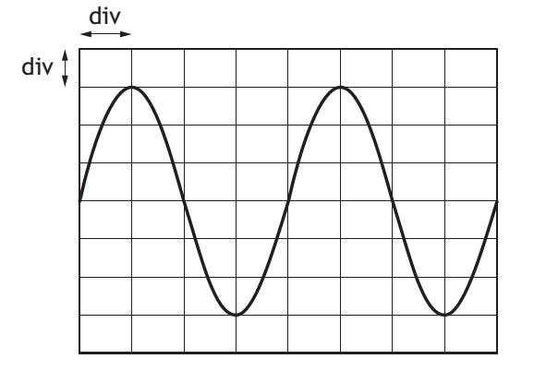
Wave Picture A
Example One
For Wave Picture A, calculate:
a) The amplitude, if each vertical (up and down) division represents 1cm.
b) The frequency, if the two waves travel across the screen in 4seconds.
c) The wavelength, if each horizontal (left to right) division represents 0.5cm.

Slide 12
Wave Terms
Example One – Answers
a) 3cm (you can count three divisions from middle to top 3 x 1 = 3)
b) 0.5Hz (frequency = number of waves / time = 2 / 4 =0.5)
c) 2cm (each wave has 4 divisions; 4 x 0.5 = 2)

Slide 13
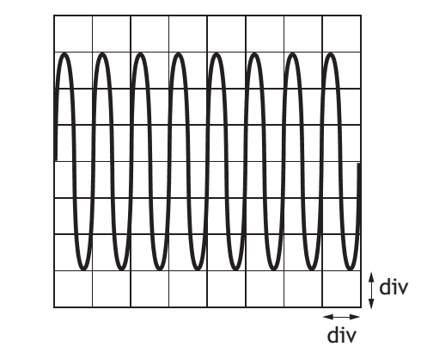
Wave Picture B
Example Two
For Wave Picture B, calculate:
a) The amplitude, if each vertical (up and down) division represents 0.5cm.
b) State the number of waves.
c) The frequency, if the waves travel across the screen in 4seconds.

Slide 14
Wave Terms
Example Two – Answers
a) 1.5cm (you can count 3 divisions from middle to top 3 x 0.5 = 1.5)
b) 8 waves
c) 2Hz (frequency = number of waves / time = 8 / 4 = 2)

Slide 15
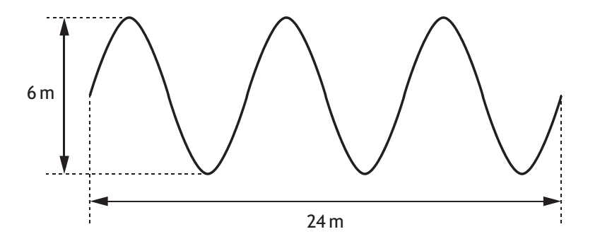
Wave Picture C
Example Three
For Wave Picture C,
calculate:
a) The amplitude.
b) State the number of waves.
c) The wavelength.

Slide 16
Wave Terms
Example Three – Answers
a) 3m (if the height from top to bottom is 6m the height from middle to top is 6 / 2 = 3)
b) 3 waves
c) 8m (the length of 3 waves is 24m,the length of one wave is 24/3 = 8)

Slide 17
Review Questions
1. Sounds are produced when particles vibrate. Why does sound not travel through space?
(1)
2. Which Physics term is defined as “the number of waves which pass a point in one second”?
(1)
3. What are ultrasounds?
(2)
4. What is the speed of sound in air?
(2)

Slide 18
Review Questions
5. Use the CRO traces on the following slide to answer these questions.
a) Which trace displays the quietest sound?
b) Which two traces display sounds with the same amplitude?
c) Which trace displays the sound with the highest frequency?
(4)

Slide 19
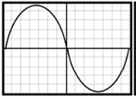
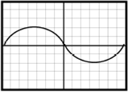
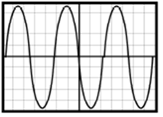
Review Questions
Trace A
Trace B
Trace C

Slide 20
Review Answers
1. Space can be treated as a vacuum (containing no particles) so sound will be unable to travel. (1mark)
2. Frequency (1mark)
3. Ultrasounds are sounds beyond the range of human hearing (1mark)
This means that they are produced at a frequency above 20000Hz (1mark)
4. 340 (1mark) ms⁻¹ (1mark)
5. a) B b) A and C c) C (Every correct answer gets 1mark)

