Slide 1
S3/S4 Physics
Charge Calculations

Slide 2
Charge Calculations
In S1 Science you learned the definition of current as,
“the flow of electrons”
In Physics, the definition of current must be quoted as,
“the electric charge transferred per unit time”

Slide 3
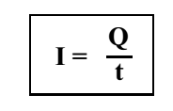
Charge Calculations
The Physics definition of current leads to the following equation.

Slide 4
Charge Calculations
In this equation,
I is the current measured in Amperes(A)
Q is the charge measured in Coulombs(C)
t is the time measured in seconds(s)

Slide 5
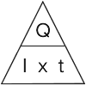

Slide 6
Charge Calculations
Example One
There is a current of 5A in a hairdryer when it is switched on. Calculate the charge which flows through the hairdryer when it is switched on for 4 minutes.
Before doing calculation remember time must be in seconds (4 x 60)
Q = I x t
Q = 5 x 240
Q = 1200C

Slide 7
Charge Calculations
Example Two
A lamp passes 120 C of charge in 60 seconds. Calculate the current in the lamp.
Q = I x t
120 = I x 60
I = 120 / 60
I = 2 A

Slide 8
Charge Calculations
Example Three
Calculate how long it takes for a current of 4 A to transfer 2400 C of charge through a resistor.
Q = I x t
2400 = 4 x t
t =2400 / 4
t = 600 s

Slide 9
Charge Calculations
Current (A) | Charge (C) | Time
 | 5000 | 500s
 | 3600 | 1 hour
25 | 7500
3 | 2.7 x 10⁶
5 |  | 300
13 |  | 0.5hours

Slide 10
Charge Calculations
Current (A) | Charge (C) | Time
10 | 5000 | 500 s
1 | 3600 | 1 hour
25 | 7500 | 300 s
3 | 2.7 x 10⁶ | 9.0 x 10⁵ s
5 | 1500 | 300 s
13 | 23400 | 0.5hours

Slide 11
Review Questions
1. The current in a wire is 0.2 A. Calculate the charge transferred through the wire in 50 seconds.
(3)
2. When 600 C of charge are transferred through a wire, the current in the wire is 1.5 A. Calculate the time taken for the charge to be transferred.
(3)
3. In 5 minutes, 150 C of charge pass through a resistor. Calculate the current in the resistor.
(3)

Slide 12
Review Questions
4. A wind generator is used to charge a 12V battery. The charging current depends on the wind speed.
The graph on the next slide shows the charging current at different wind speeds.

Slide 13
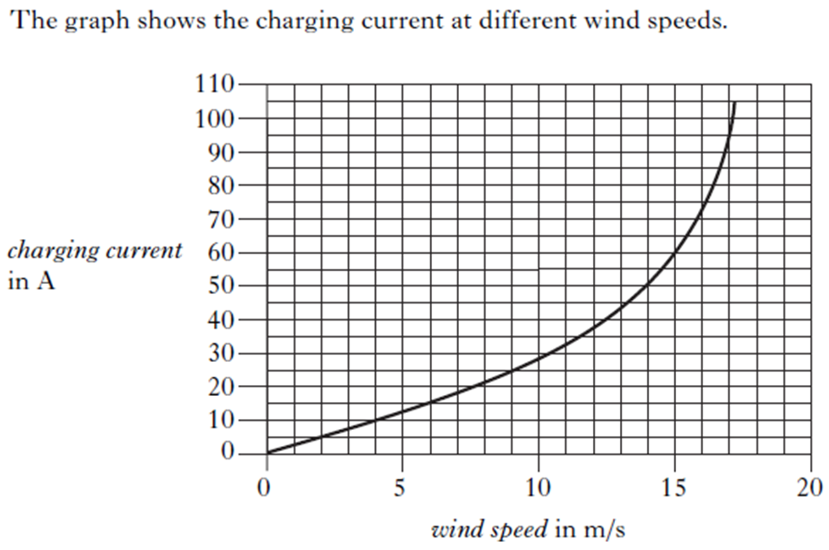
Review Questions

Slide 14
Review Questions
4. (continued)
During one charge of the battery the wind speed is constant at 15 m/s.
During this time a charge of 4500 C is transferred to the battery.
Calculate the time taken to transfer this charge to the battery.
(4)

Slide 15
Review Answers
1.
Q = I x t (1 mark)
Q = 0.2 x 50 (1 mark)
Q = 10 C (1 mark)
2.
Q = I x t (1 mark)
600 = 1.5 x t (1 mark)
t = 400 s (1 mark)

Slide 16
Review Answers
3.
Q = I x t (1 mark)
150 = I x (5 x 60) (1 mark)
I = 0.5 A (1 mark)
4.
Select 60 A from graph (1 mark)
Q = I x t (1 mark)
4500 = 60 x t (1 mark)
t = 75 s (1 mark)

