Slide 1
S3/S4 Physics
Cosmology

Slide 2
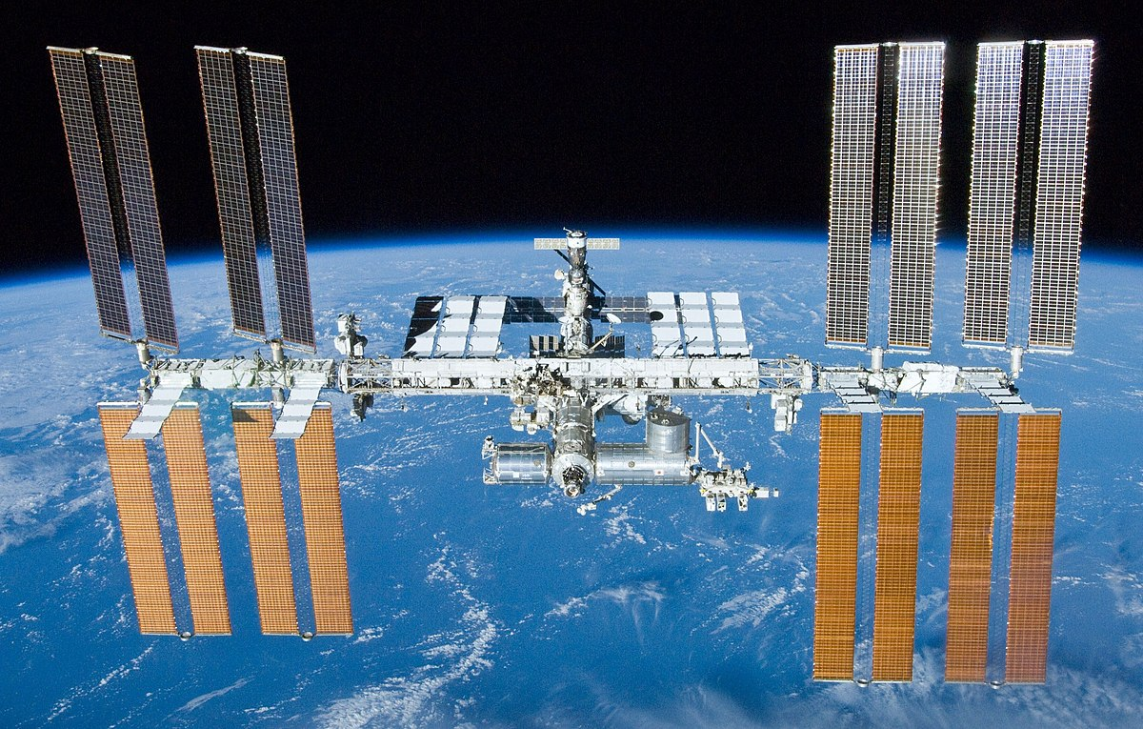
Cosmology
Many technological advances have allowed space exploration to take place. These helped develop the Hubble Space Telescope (HST) and the International Space Station (ISS).

Slide 3
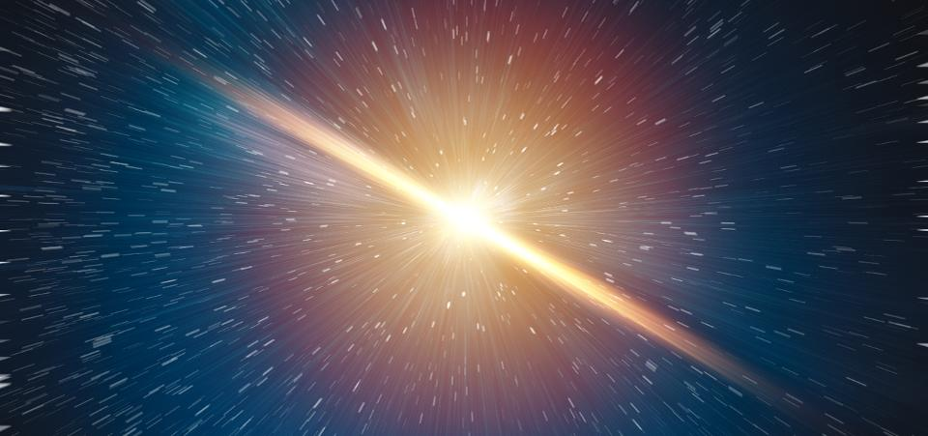
Cosmology
Data from space exploration has allowed the age of the universe to be estimated as 13.8 billion years and has provided supporting evidence for the Big Bang theory.

Slide 4
Cosmology
Q. What is the Big Bang Theory?
A.

Slide 5
Cosmology
Q. What is the Big Bang Theory?
A. The Big Bang theory states that the universe started from a singularity (single point) and is continually expanding.
Q. What is the diameter of the universe at the moment?
A. 880 000 000 000 000 000 000 000 000 m
Metres are not a good measure of distances in space. A much better unit for measuring the large distances in space is the light year.
Q. What is a light year?

Slide 6
Cosmology
One light year (ly) is the distance travelled by light in one year.
As light travels at 3 x 10⁸ ms⁻¹ (300 000 000 ms⁻¹), using the equation
distance = speed x time
We can work out the distance light would travel:
In one minute
distance = 3 x 10⁸ x 60
distance = 18 000 000 000 m

Slide 7
Cosmology
In one hour
18 000 000 000 x 60 = 1 080 000 000 000 metres
In one day
1 080 000 000 000 x 24 = 25 920 000 000 000 metres
In one year light travels,
25 920 000 000 000 x 365 = 9 460 800 000 000 000 metres
This is usually presented as:
One light year = 9.46 x 10¹⁵ m

Slide 8
Cosmology
The light year calculation can also be written as:
Distance = speed x time
One light year = 3 x 10⁸ x (60 x 60 x 24 x 365)
One light year = 9.46 x 10¹⁵ m
For light year calculations you will need to remember this number as it is not usually given in your Data Sheet.

Slide 9
Cosmology
Example One The star Proxima Centauri is 4.3 ly from Earth. Calculate the distance to Proxima Centauri in metres.
Solution
Distance = 4.3 x (9.46 x 10¹⁵) = 4.1 x 10¹⁶ m
Example Two The star Deneb is 1.32 x 10¹⁹ m from Earth. Calculate the distance to Deneb in light years.
Solution
Distance = 1.32 x 10¹⁹ / 9.46 x 10¹⁵ = 1400 ly

Slide 10
Cosmology
Many technological advances have allowed space exploration to take place.
But we have been studying the visible light from space since ancient times using the naked eye.
The study of light from space has been helped with the advances in the field of Physics known as spectroscopy.

Slide 11
Cosmology
When spectroscopy is used to study the light from a solid object a continuous spectrum can be seen.

Slide 12
Cosmology
When spectroscopy is used to study the light from a gaseous object (like a star) a line spectrum can be seen.

Slide 13
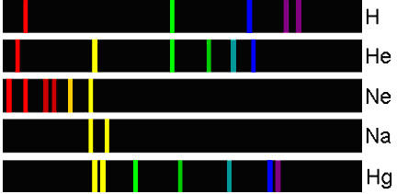
Cosmology
All gaseous elements produce their own, unique line spectrum.
This means that the gases present in a star can be identified by carrying out an analysis of the star’s line spectrum.

Slide 14
Cosmology
Example
The line spectrum form a distant star is shown below.
By studying the line spectra shown on the next slide, identify the elements present in the distant star.

Slide 15
Cosmology
Star
Cadmium
Calcium
Krypton
Mercury

Slide 16
Cosmology
Answer: Cadmium and Mercury

Slide 17
Cosmology
The members of the EM spectrum have helped us to understand space, although not all the members can penetrate our atmosphere.

Slide 18
Cosmology
By analysing properties of stars, e.g. temperature, and the radiations that they emit, there is evidence that shows the presence of all the members of the EM spectrum throughout the universe.
Some examples are shown in the next slides.

Slide 19
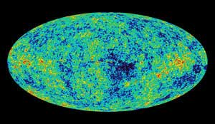
Cosmology
Cosmic Microwave Background Radiation (CMBR).
This discovery (1965) helped to support the Big Bang Theory.

Slide 20
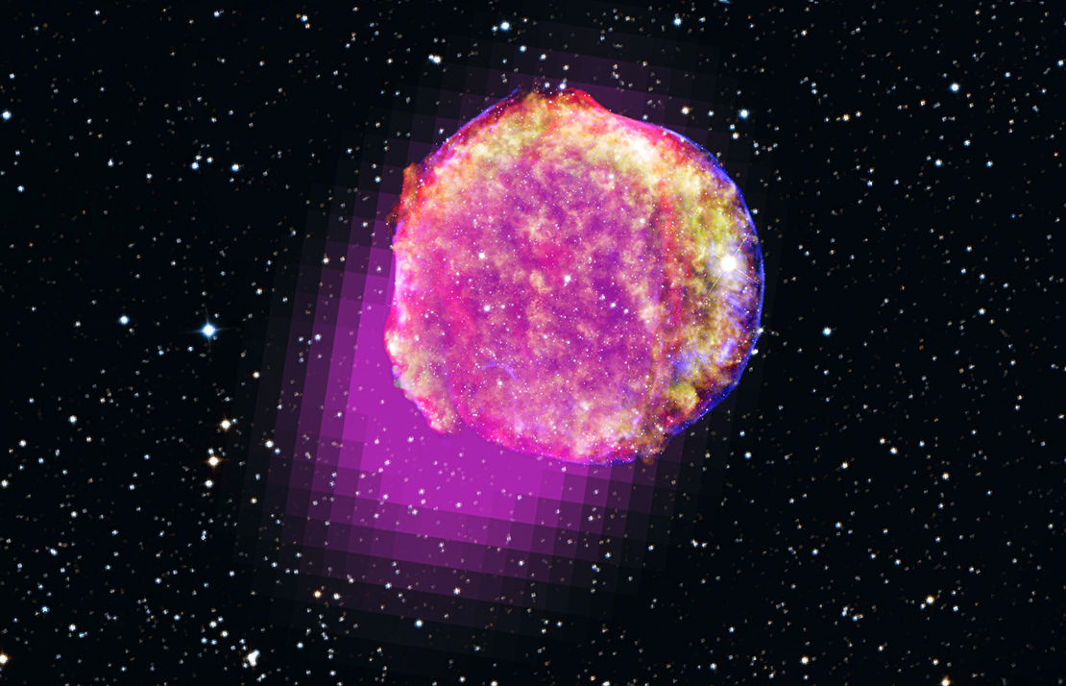
Cosmology
This supernova image shows the presence of:
Gamma – magenta
X-rays – yellow, green and blue
Infrared - red

Slide 21
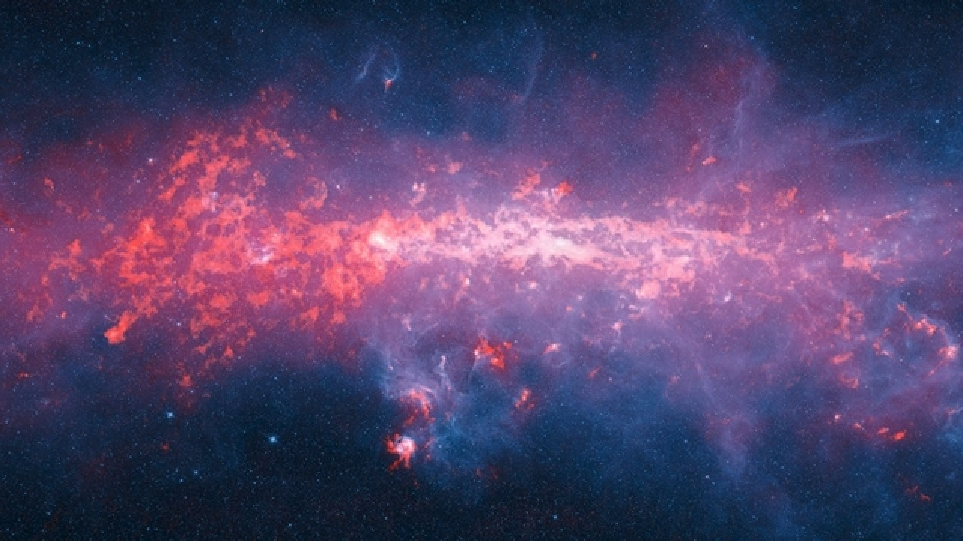
Cosmology
Fast Radio Bursts – Radio signals from space that last for about a millisecond. A repeated signal was discovered in 2012 coming from a dwarf galaxy. Evidence of an extra-terrestrial civilisation?

Slide 22
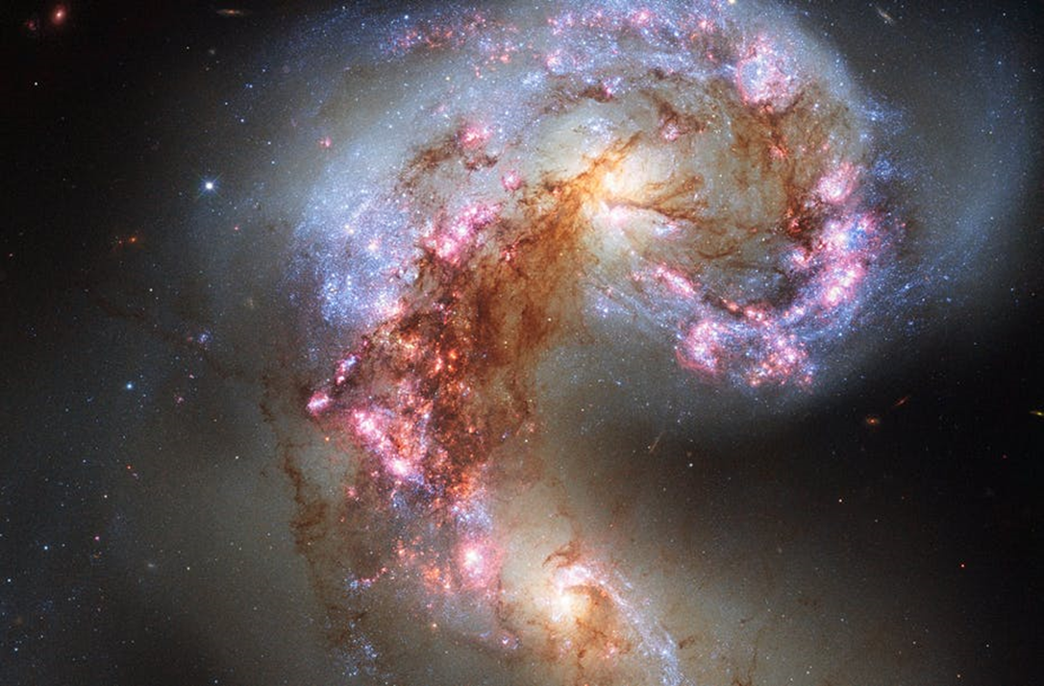
Cosmology
Part of the Hubble mission is collect ultraviolet images. The one below shows two galaxies that are locked together.

Slide 23
Cosmology – Review Questions
Q.1. State the approx. age of the universe to the nearest billion years.
Q.2. The Big Bang Theory states that the universe is continually expanding. True or False.
Q.3. The star Antares is 3.78 x 10¹⁸ m from Earth. Calculate the distance to Antares in light years.
Q.4. Name two members of the EM spectrum that can easily penetrate the Earth’s atmosphere.

Slide 24
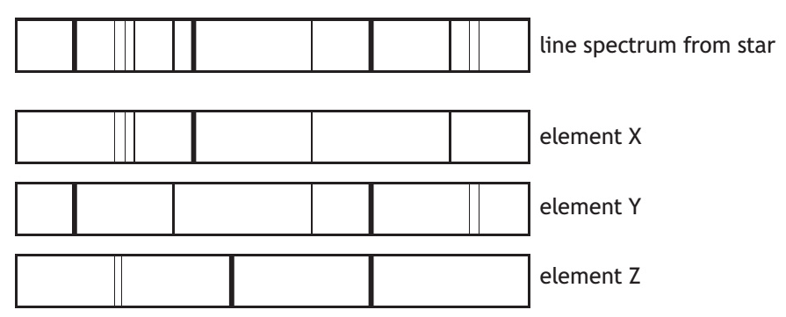
Cosmology – Review Questions
Q.5. By studying the line spectra shown below, identify the elements present in the star.

Slide 25
Cosmology – Review Answers
Q.1. 14 billion years
Q.2. True
Q.3. 400 ly
Q.4. Radio, micro, visible light
Q.5. X and Y

