Slide 1
S3/S4 Physics
Acceleration

Slide 2
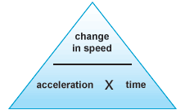
Acceleration
Acceleration is a quantity that describes how quickly the speed (velocity) of an object changes.
It is defined as the change in speed (velocity) per unit time.

Slide 3
Acceleration
As an equation the triangle becomes…
where,
a is acceleration measured in ms⁻²
Δv is change in speed (velocity) measured in ms⁻¹
t is time for change measured in s

Slide 4
Acceleration – Calculations Part One
Example One
The speed of a car changes by 10 ms⁻¹ in 5 seconds. Calculate the acceleration of the car.
Solution
a = Δv / t
a = 10 / 5
a = 2 ms⁻²

Slide 5
Acceleration – Calculations Part One
Example Two
A plane accelerates from rest to 36 ms⁻¹ in 20 seconds. Calculate the acceleration of the plane.
Solution
a = Δv / t
a = (36 – 0) / 20
a = 1.8 ms⁻²

Slide 6
Acceleration – Calculations Part One
Example Three
A train travelling at 8 ms⁻¹ accelerates to 20 ms⁻¹ in 2 minutes. Calculate the acceleration of the train.
Solution (Remember that “t” is measured in seconds)
a = Δv / t
a = (20 – 8) / (2 x 60)
a = 0.1 ms⁻²

Slide 7
Acceleration – Calculations Part One
Example Four
A car accelerates at 3 ms⁻² for 4 seconds. Calculate the change in speed of the car.
Solution
a = Δv / t
3 = Δv / 4
Δv = 3 x 4
Δv = 12 ms⁻¹

Slide 8
Acceleration – Calculations Part One
Example Five
A racing car, starting at rest, accelerates at 5 ms⁻², and reaches a speed of 35 ms⁻¹. Calculate the time taken to reach this speed.
Solution
a = Δv / t
5 = 35 / t
t = 35 / 5
t = 7 s

Slide 9
Acceleration – Calculations Part One
Copy and complete the following table:
Acceleration (ms⁻²) | Change in Speed (ms⁻¹) | Time for Change (s)
 | 10 | 2.5
 | 40 | 5
2 |  | 8
0.5 |  | 20
3 | 18
2.5 | 37.5

Slide 10
Acceleration – Calculations Part One
Copy and complete the following table:
Acceleration (ms⁻²) | Change in Speed (ms⁻¹) | Time for Change (s)
4 | 10 | 2.5
8 | 40 | 5
2 | 16 | 8
0.5 | 10 | 20
3 | 18 | 6
2.5 | 37.5 | 15

Slide 11
Acceleration
To carry out an acceleration experiment in the lab. you need to be able to measure the following three quantities…
the initial speed (velocity)
the final speed (velocity)
the time taken for the speed (velocity) to change
An experimental set up for measuring acceleration is shown on the next slide.

Slide 12
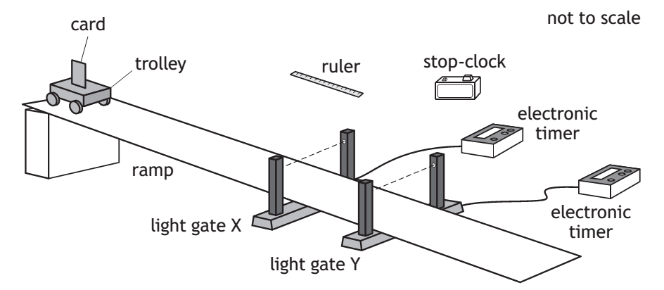
Acceleration

Slide 13
Acceleration
Initial Speed
Use ruler to find length of card; use light gate X and its timer; carry out an instantaneous speed calculation.
Final Speed
Use ruler to find length of card; use light gate Y and its timer; carry out an instantaneous speed calculation.
Time Taken to Change Speed
Start stop-clock when trolley reaches X, stop stop-clock when trolley reaches Y.

Slide 14
Acceleration
A possible set of data from the experiment is shown below:
Length of card = 0.048 m
Time for card to pass through light gate X = 0.012 s
Time for card to pass through light gate Y = 0.01 s
Time for trolley to travel between light gate X and light gate Y = 0.4 s
Show that for this data the acceleration of the trolley is 2 ms⁻²

Slide 15
Acceleration
Solution
Initial speed = length of card / time on timer X = 0.048 / 0.012 = 4 ms⁻¹
Final speed = length of card / time on timer Y = 0.048 / 0.01 = 4.8 ms⁻¹
Change in speed = (4.8 – 4) = 0.8 ms⁻¹
a = Δv / t
a = 0.8 / 0.4
a = 2 ms⁻²

Slide 16
Acceleration
The acceleration equation can also be written as follows:
where,
a is acceleration measured in ms⁻²
v is final speed (velocity) measured in ms⁻¹
u is initial speed (velocity) measured in ms⁻¹
t is time for change measured in s

Slide 17
Acceleration – Calculations Part Two
Example One
When overtaking a bus, a car increases its speed from 9 ms⁻¹ to 21 ms⁻¹ in a time of 4 s. Calculate the acceleration of the car.
Solution
a = (v - u) / t
a = (21 – 9) / 4
a = (12) / 4
a = 3 ms⁻²

Slide 18
Acceleration – Calculations Part Two
Example Two
A student, starting from rest, reaches a speed of 5.1 ms⁻¹ when they are chasing another student in the corridor. Calculate the acceleration of the student if the chase lasts for 3 seconds.
Solution
a = (v - u) / t
a = (5.1 – 0) / 3
a = (5.1) / 3
a = 1.7 ms⁻²

Slide 19
Acceleration – Calculations Part Two
Example Three
A cyclist, travelling at 7.7 ms⁻¹, applies the brakes and comes to rest in a time of 3.5 s. Calculate the acceleration of the cyclist.
Solution
a = (v - u) / t
a = (0 – 7.7) / 3.5
a = (-7.7) / 3.5
a = -2.2 ms⁻²

Slide 20
Acceleration – Calculations Part Two
Example Four
A jet aircraft accelerates, from rest, at 7.5 ms⁻² for 8 s. Calculate the final speed of the aircraft.
Solution
a = (v - u) / t
7.5 = (v – 0) / 8
7.5 = v / 8
v = 7.5 x 8
v = 60 ms⁻¹

Slide 21
Acceleration – Calculations Part Two
Example Five
A rocket accelerates at 9 ms⁻² and changes its speed from 376 ms⁻¹ to 592 ms⁻¹. Calculate the time taken for this change in speed.
Solution
a = (v - u) / t
9 = (592 – 376) / t
9 = 216 / t
t = 216 / 9
t = 24 s

Slide 22
Acceleration – Calculations Part Two
Copy and complete the following table:
Acceleration (ms⁻²) | Final Speed (ms⁻¹) | Initial Speed (ms⁻¹) | Time for Change (s)
 | 13 | 3 | 10
 | 2 | 34 | 8
4 |  | 2 | 2
6 | 20 | 2
-5 | 0 |  | 3

Slide 23
Acceleration – Calculations Part Two
Copy and complete the following table:
Acceleration (ms⁻²) | Final Speed (ms⁻¹) | Initial Speed (ms⁻¹) | Time for Change (s)
1 | 13 | 3 | 10
-4 | 2 | 34 | 8
4 | 10 | 2 | 2
6 | 20 | 2 | 3
-5 | 0 | 15 | 3

Slide 24
Acceleration - Graphs
Acceleration can be calculated from any speed (velocity) – time graph.

Slide 25
Acceleration - Graphs
Graph A
a = (v – u) / t
a = (4 – 4) / 15
a = 0 ms⁻²
All horizontal lines on speed (velocity) – time graphs give a = 0 ms⁻².
The gradient of a horizontal line is always zero.

Slide 26
Acceleration - Graphs
Graph B
a = (v – u) / t
a = (6 – 0) / 15
a = 0.4 ms⁻²
All upward sloping lines on speed (velocity) – time graphs give a positive value from an acceleration calculation.
The gradient of an upward sloping line is always a positive value.
Show that the gradient of the line in Graph B is 0.4.

Slide 27
Acceleration - Graphs
Graph C
a = (v – u) / t
a = (0 – 4) / 15
a = -0.27 ms⁻²
All downward sloping lines on speed (velocity) – time graphs give a negative value from an acceleration calculation.
The gradient of an downward sloping line is always a negative value.
Show that the gradient of the line in Graph C is -0.27.

Slide 28
Acceleration - Graphs
It can be shown for all speed (velocity) – time graphs that…

Slide 29
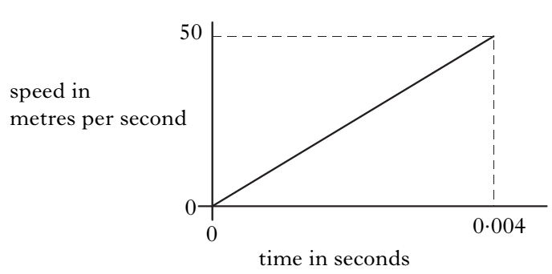
Acceleration – Review Questions
Q.1. A graph showing how the speed of a tennis ball changes while in contact with a racquet during a serve is shown below.
Calculate the acceleration of the ball during the serve.

Slide 30
Acceleration – Review Questions
Q.2. The speed of a go-kart is recorded from the start of a race for the first 4 seconds. The go-kart is travelling at 12 ms⁻¹ after 4 seconds. Calculate the acceleration of the go-kart.
Q.3. A jet achieves its minimum take-off speed by accelerating, from rest, at 35 ms⁻² for 2 seconds. Calculate the minimum take-off speed of the jet.
Q.4. An athlete changes their speed from 3 ms⁻¹ to 14 ms⁻¹, by accelerating at 5 ms⁻². Calculate the time taken to make this change in their speed.

Slide 31
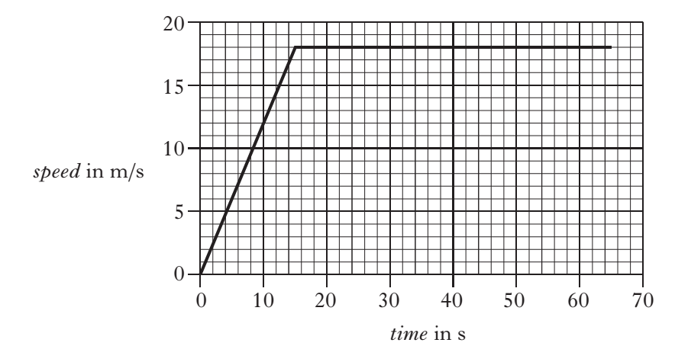
Acceleration – Review Questions
Q.5. A graph of a cyclist’s motion during a race is shown below.
State the time when they start travelling at constant speed.
Calculate the acceleration of the cyclist.

Slide 32
Acceleration - Review Answers
Q.1. 12500 ms⁻²
Q.2. 3 ms⁻²
Q.3. 70 ms⁻¹
Q.4. 2.2 s
Q.5. a) 15 s b) 1.2 ms⁻²

