Slide 1
S3/S4 Physics
Circuit Rules

Slide 2
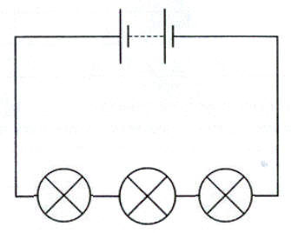
Circuit Rules – Series Circuits
There is only one path for the current in a series circuit.
From practical work (or research) series circuits can be shown to have the following rules:

Slide 3
Circuit Rules – Series Circuits
The current is the same at all points OR
And
The sum of the potential differences (voltages) across the components is equal to the potential difference (voltage) of the supply OR

Slide 4
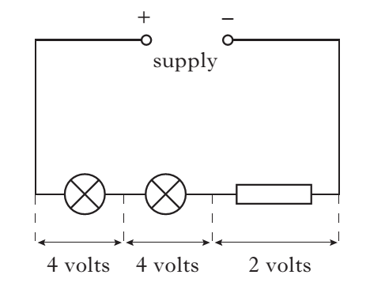
Circuit Rules – Series Circuits
Example
State the value of the supply voltage in the following circuit.
Solution Use V_{s} = V₁ + V₂ + V₃; V_{s} = 4 + 4 + 2; V_{s} = 10 V

Slide 5
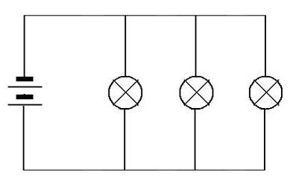
Circuit Rules – Parallel Circuits
There is more than one path (branch) for the current in a parallel circuit.
From practical work (or research) a parallel circuit can be shown to have the following rules:

Slide 6
Circuit Rules – Parallel Circuits
The sum of the branch currents is equal to the supply current OR
And
The potential difference (voltage) across components is the same for all components OR

Slide 7
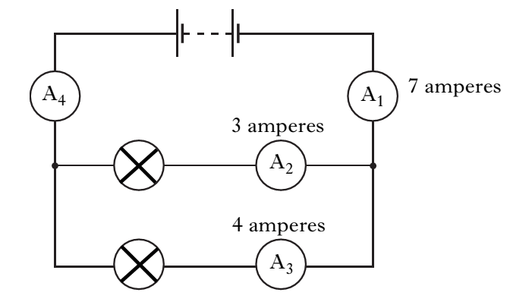
Circuit Rules – Parallel Circuits
Example
State the reading on ammeter A₄ in the following circuit.
Solution 7 A

Slide 8
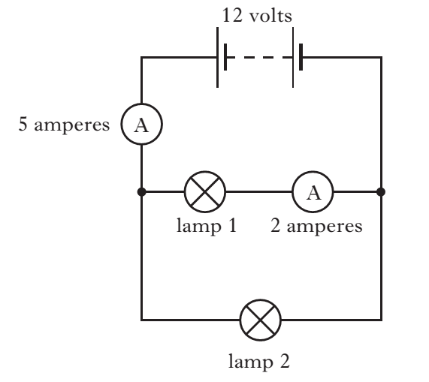
Circuit Rules – Review Questions
Q.1. A student sets up the circuit below to demonstrate the way lamps are connected inside a caravan.
State the voltage across lamp 1 and the current in lamp 2

Slide 9
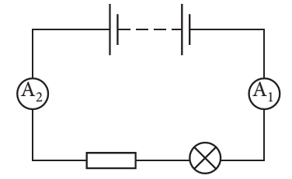
Circuit Rules – Review Questions
Q.2. A circuit is set up as shown.
The reading on ammeter A₁ is 0.5 A. State the reading on ammeter A₂.

Slide 10
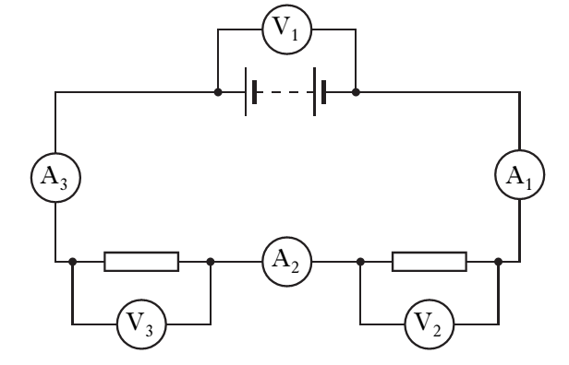
Circuit Rules – Review Questions
Q.3. A circuit is set up as shown.
All three voltmeters have the same reading. True or False.

Slide 11
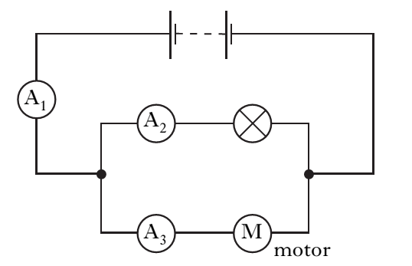
Circuit Rules – Review Questions
Q.4. A circuit is set up as shown.
All three ammeters have the same reading. True or False.

Slide 12
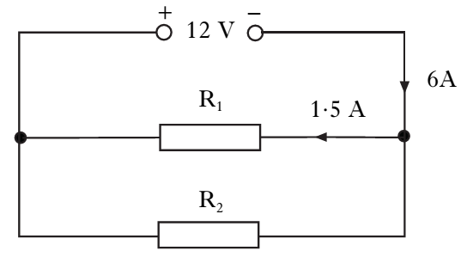
Circuit Rules – Review Questions
Q.5. A circuit is set up as shown.
State the potential difference across R₁ and the current in R₂.

Slide 13
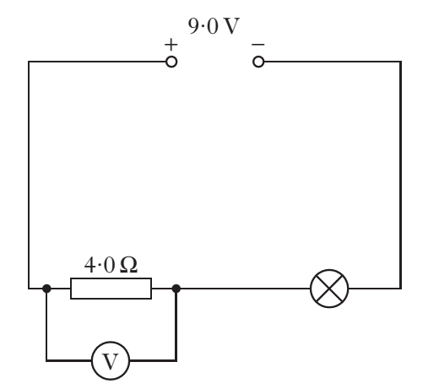
Circuit Rules – Review Questions
Q.6. A circuit is set up as shown.
The current in the lamp is 1.5 A and the voltmeter reading is 6 V. State the current in the resistor and the voltage across the lamp.

Slide 14
Circuit Rules – Review Questions
Q.7. A student suspects ammeter A₁ may be inaccurate. Ammeter A₂ is known to be accurate. Which of the following circuits should be used to compare the reading on A₁ with A₂?

Slide 15
Circuit Rules - Answers
Q.1. 12 V; 3 A
Q.2. 0.5 A
Q.3. False. All the ammeters have the same reading.
Q.4. False. A₁ = A₂ + A₃
Q.5. 12 V; 4.5 A
Q.6. 1.5 A; 3 V
Q.7. B. In a series circuit the current is the same at all points.

