Slide 1
S3 S4 Physics
Electric Fields

Slide 2
Electric Fields
Potential Difference (Voltage)
Definition
“ a measure of the energy given to the charge carriers in a circuit”

Slide 3
Electric Fields

Slide 4
Electric Fields

Slide 5
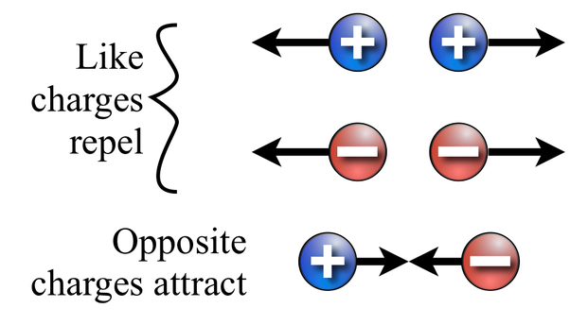

Slide 6
Electric Fields
All charged particles experience a force when in an electric field.
This force will make the charged particles move in a predictable way.
Even a single point of charge (positive or negative) will have an electric field surrounding it.

Slide 8
Electric Fields
When drawing field lines, follow these rules:
the field lines must be evenly spaced around the point charge
the lines must be drawn with a ruler
the arrows on the lines show the direction in which a positive charge would move in the field
Examples of more complex fields are shown on the next few slides.

Slide 12
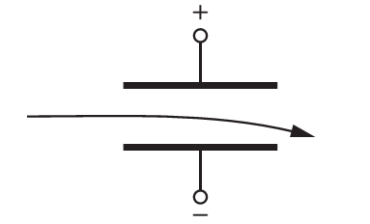
Electric Fields
+vely charged particle

Slide 13
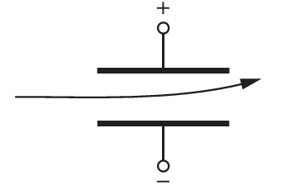
Electric Fields
-vely charged particle

Slide 14
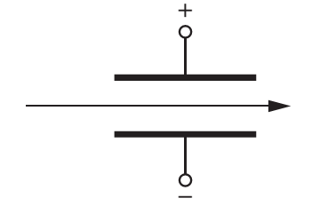
Electric Fields
no charge on particle

Slide 15
Can you complete this diagram?

