Slide 1
S3/S4 Physics
Electrical Charge Carriers

Slide 2
Electrical Charge Carriers
Charge carriers are often split into three groups…
Positive (+)
Negative (-)
Neutral or no charge (0)
All three groups are represented in an atom…but which particle belongs to which group?

Slide 3
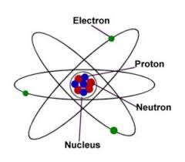

Slide 4
Electrical Charge Carriers
In the nucleus there are protons and neutrons.
Protons are positively charged (+)
Neutrons are neutral or have no charge (0)
Orbiting the nucleus are electrons.
Electrons are negatively charged (-)

Slide 5
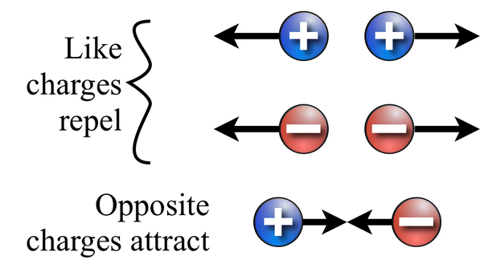

Slide 6
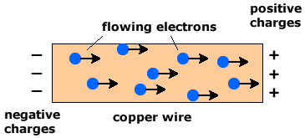
Electrical Charge Carriers
The movement of electrical charge carriers is a very important concept.
If electrons were not able to freely move within a conductor it would mean that no current could flow.
No flow of current, no electrical devices would work!
Try to imagine a world with no electricity…

Slide 8
Electrical Charge Carriers
In S1 Science you learned the definition of current as,
“the flow of electrons”
In Physics, the definition of current must be quoted as,
“the electric charge transferred per unit time”

Slide 9
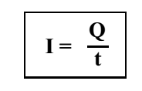
Charge Calculations
The Physics definition of current leads to the following equation.

Slide 10
Charge Calculations
In this equation,
I is the current measured in Amperes(A)
Q is the charge measured in Coulombs(C)
t is the time measured in seconds(s)

Slide 11
