Slide 1
S3/S4 Physics
Electrical Power

Slide 2
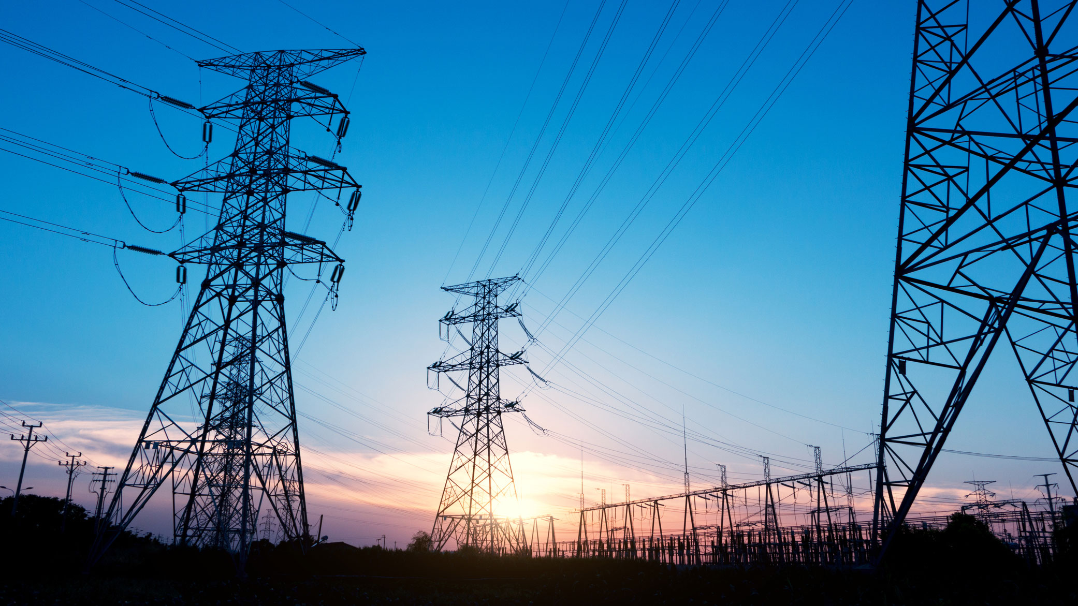

Slide 5
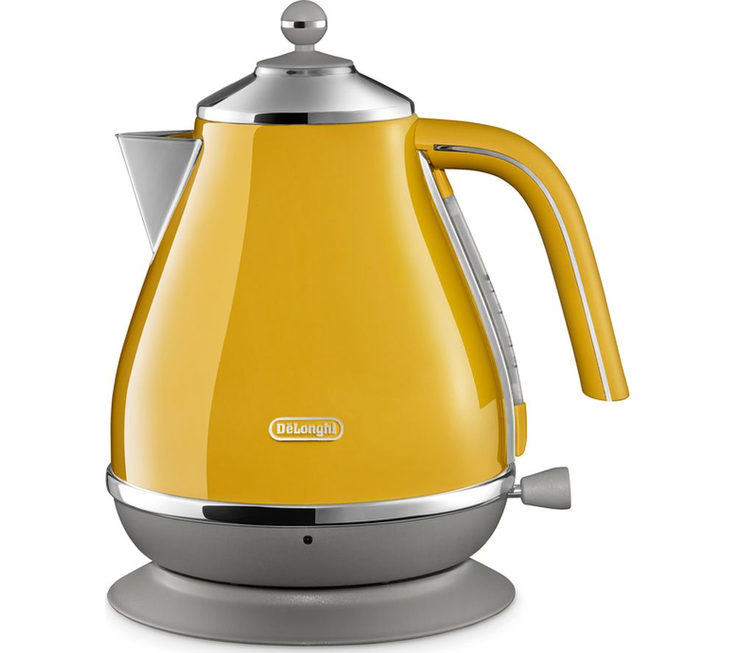
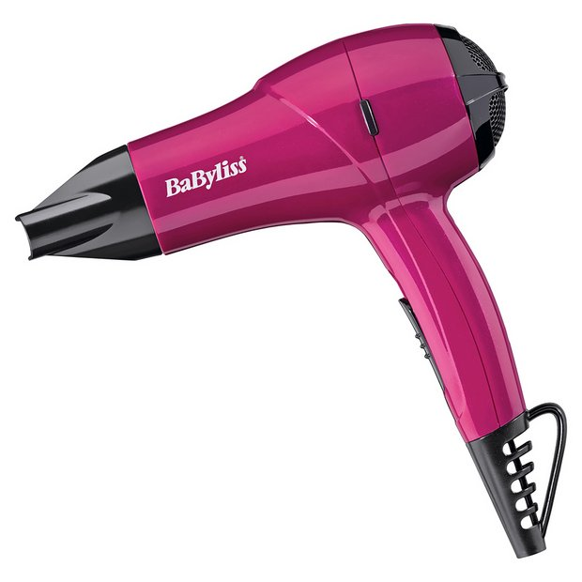
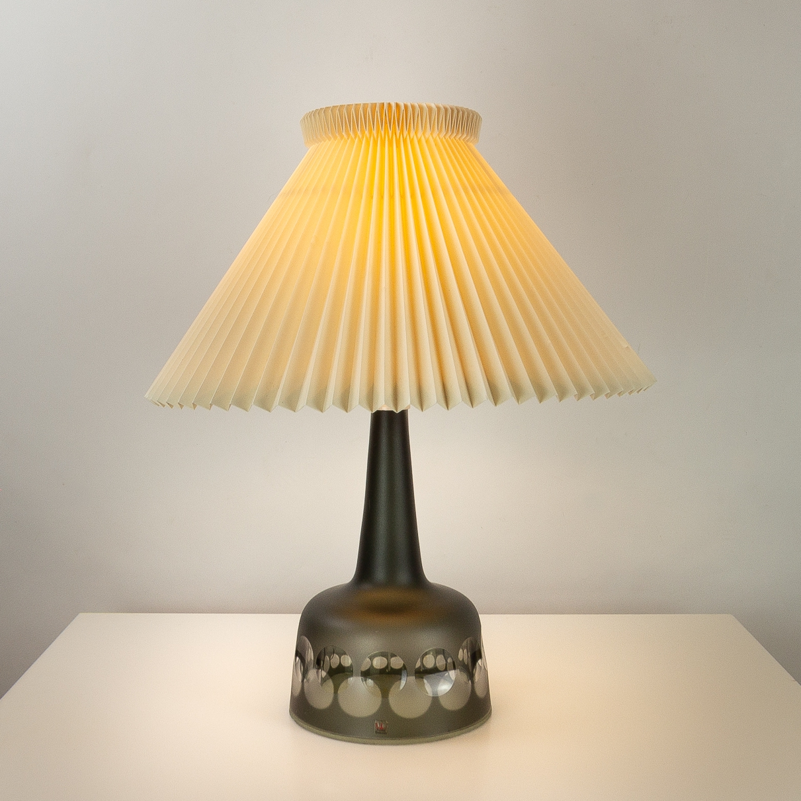
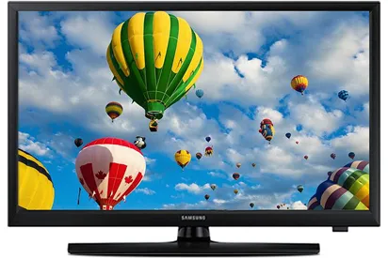
Electrical Power
Appliances in our homes change electrical energy into other types of energy.

Slide 6
Electrical Power
To compare the amount of electrical energy used by appliances, manufactures supply a value called a power rating.
They give this information because electrical power is defined as:
“a measure of the energy transferred electrically to an appliance every second”
This means the higher the power rating the greater the electrical energy used by the appliance.

Slide 7
Electrical Power
By using the catalogues provided ( or by carrying out personal research) copy and complete the following table.
The power rating of an appliance is given in Watts or kilowatts.
Remember “k” for “kilo” means “x10³” or multiply by 1000.

Slide 8
Electrical Power
Page Number | Appliance | Energy change | Power Rating Range
222 | Hairdryer | Electrical to Heat | 1200W to 2200W
474 | Saw
597 | Music System
613 | Radio
820 | Microwave
836 | Kettle
1178 | Bulbs
1243 | Shower

Slide 9
Electrical Power
Page Number | Appliance | Energy change | Power Rating
222 | Hairdryer | Electrical to Heat | 1200W to 2200W
474 | Saw | Electrical to Kinetic | 350W to 1000W
597 | Music System | Electrical to Sound | 4W to 20W
613 | Radio | Electrical to Sound | 1W to 16W
820 | Microwave | Electrical to Heat | 800W
836 | Kettle | Electrical to Heat | 2.2kW to 3kW
1178 | Bulbs | Electrical to Light | 7W to 60W
1243 | Shower | Electrical to Heat | 8.5kW to 10.5kW

Slide 10
Electrical Power
What do the appliances with the highest power ratings have in common?
Construct a bar graph for the appliances.
What problem do you have with the scale?

Slide 11
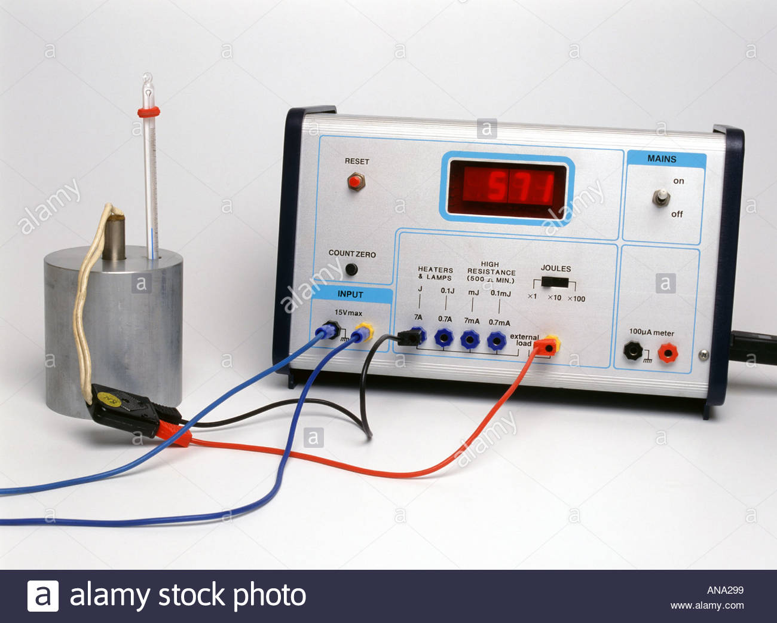
Electrical Power
The power rating of lamps and heaters can be checked in the lab using a joulemeter.

Slide 12
Electrical Power
To calculate the power rating of an appliance the following equation can be used:
Where,
P is Power measured in Watts (W) or Joules per second (Js⁻¹)
E is energy measured in Joules (J)
t is time measured in seconds (s)

Slide 13
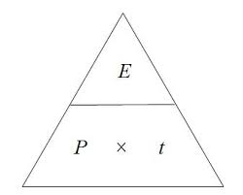
Electrical Power
The power rating equation can written as a triangle:

Slide 14
Electrical Power
Example One
A hairdryer uses 144 kJ of energy in a time of 90 seconds. Calculate the power rating of the hairdryer.
Solution
(Remember “k” or “kilo” means “x10³” or multiply by 1000)
P = E / t
P = 144000 / 90
P = 1600 W

Slide 15
Electrical Power
Example Two
A 36 W car headlamp is switched on for 30 minutes during a journey. Calculate the energy used by the headlamp.
Solution
(Remember time must be in seconds)
E = P x t
E = 36 x (30 x 60)
E = 6480 J

Slide 16
Electrical Power
Example Three
A 2.4 kW kettle uses 432 kJ of energy to boil water. Calculate the time that the kettle was switched on for.
Solution
(Remember “k” or “kilo” means “x10³” or multiply by 1000)
t = E / P
t = 432000 / 2400
t = 180 s

Slide 17
Electrical Power
Copy and complete the following table:
Power | Energy | Time
 | 60 J | 600 s
 | 1.5 kJ | 300 s
60 W |  | 5 minutes
9.6 kW |  | 400 s
1200 W | 72000 J
2000 W | 334 kJ

Slide 18
Electrical Power
Copy and complete the following table:
Power | Energy | Time
0.1 W | 60 J | 600 s
5 W | 1.5 kJ | 300 s
60 W | 18000 J | 5 minutes
9.6 kW | 3840000 J | 400 s
1200 W | 72000 J | 60 s
2000 W | 334 kJ | 167 s

Slide 19
Electrical Power - Review Questions
Q.1. Which of the following appliances will use more energy if they are all switched on for five minutes. Explain your answer.
Laptop Vacuum Cleaner Toaster
Q.2. Which of the following is a unit for electrical power?
A Js B Ws⁻¹ C Js⁻¹ D JW E JW⁻¹
Q.3. A pair of hair straighteners uses 288 kJ of energy in a time of 120 seconds. Calculate the power rating of the hair straighteners.

Slide 20
Electrical Power – Review Questions
Q.4. A 12 W energy efficient lamp is switched on for I hour 30 minutes. Calculate the energy used by the lamp.
Q.5. An 0.8 kW lawnmower uses 864 kJ of energy. Calculate the time that the lawnmower was used for.

Slide 21
Electrical Power - Answers
Q.1. Toaster. It changes electrical energy into heat energy.
Q.2. C. (Power is energy transferred per second)
Q.3. 2400 W
Q.4. 64800 J
Q.5. 1080 s

Slide 22
Electrical Power - Efficiency
Electrical systems are not 100% efficient.
The electrical energy that is put into a system does not always get changed into useful output energy.

Slide 23
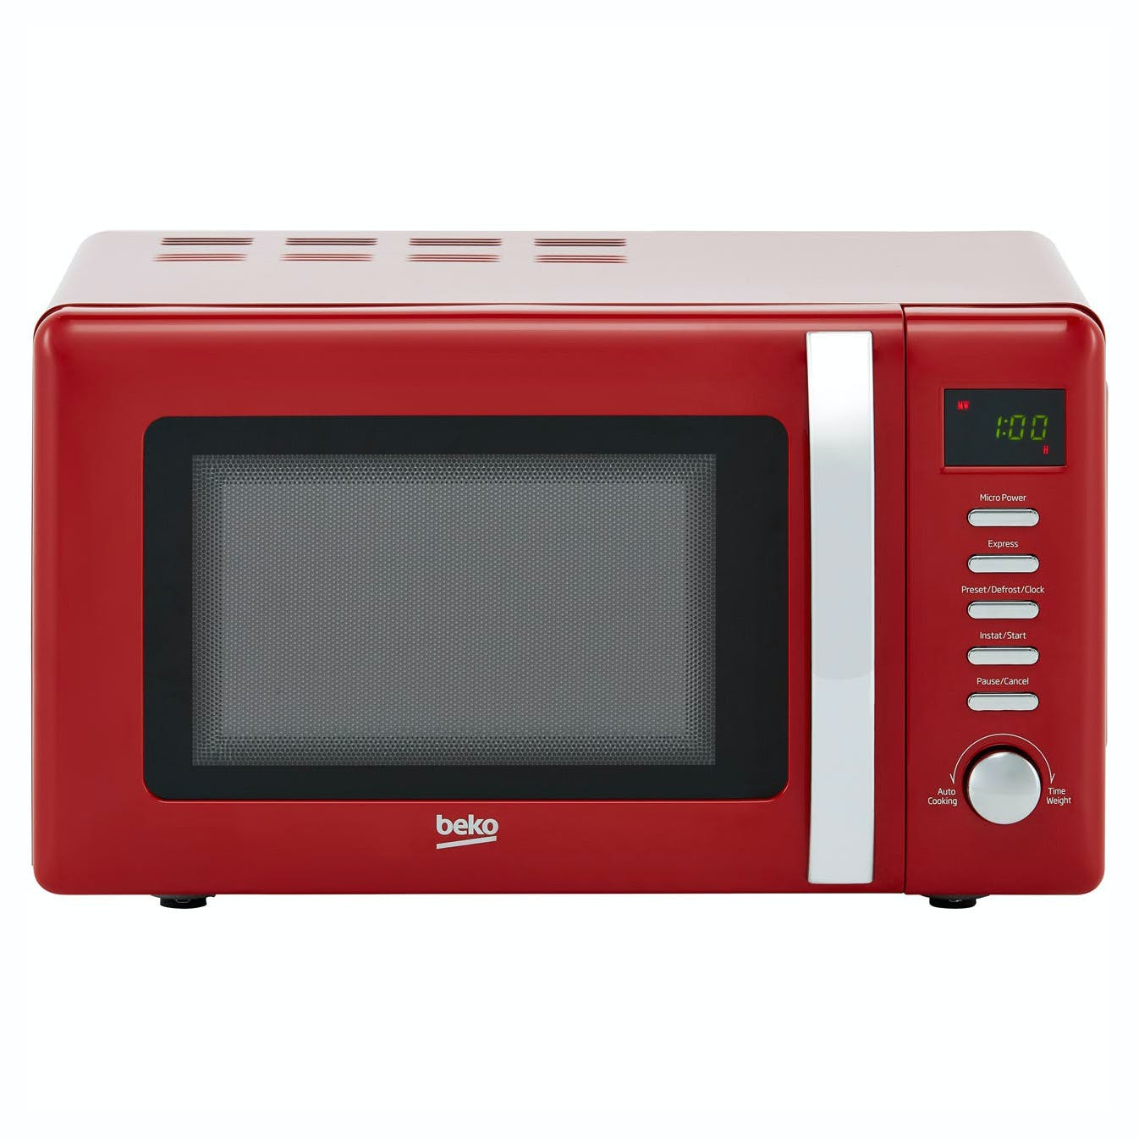
Electrical Power - Efficiency
A microwave oven is not 100% efficient because…

Slide 24
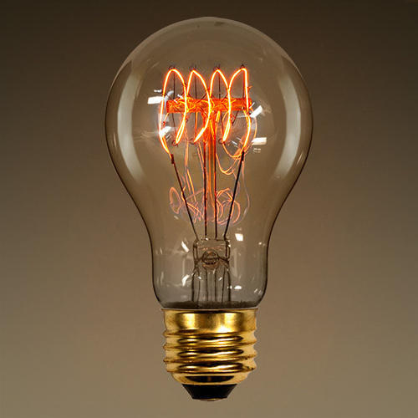
Electrical Power - Efficiency
A filament lamp is not 100% efficient because…

Slide 25
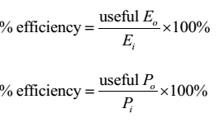
Electrical Power - Efficiency
Efficiency is usually quoted as a percentage and can be calculated using the following equations:

Slide 26
Electrical Power - Efficiency
Example One
When the input energy to a microwave oven is 660J the useful output energy is 231J. Calculate the efficiency of the oven.
Solution
% efficiency = (Useful E_{o} / E_{in}) x 100
% efficiency = (231 / 660) x 100
% efficiency = (0.35) x 100
% efficiency = 35 %

Slide 27
Electrical Power - Efficiency
Example Two
A lamp has an input power of 36W. The useful power output 27W. Calculate the efficiency of the lamp.
Solution
% efficiency = (Useful P_{o} / P_{in}) x 100
% efficiency = (27 / 36) x 100
% efficiency = (0.75) x 100
% efficiency = 75 %

Slide 28
Electrical Power - Efficiency
Example Three
A machine that is 80% efficient has a power input 25,000W. Calculate the useful power output of the machine.
Solution
% efficiency = (Useful P_{o} / P_{in}) x 100
80 = (Useful P_{o} / 25000) x 100
80 / 100 = (Useful P_{o} / 25000)
0.8 = (Useful P_{o} / 25000)
Useful P_{o} = 0.8 x 25000 = 20000 W

Slide 29
Electrical Power - Efficiency
Example Four
A motor which is 60% efficient gives out 600J of useful energy. Calculate the value of the energy taken in by the motor.
Solution
% efficiency = (Useful E_{o} / E_{in}) x 100
60 = (600 / E_{in}) x 100
60 / 100 = (600 / E_{in})
0.6 = (600 / E_{in})
E_{in} = 600 / 0.6 = 1000 J

