Slide 1
S3/S4 Physics
Electromagnetism

Slide 3
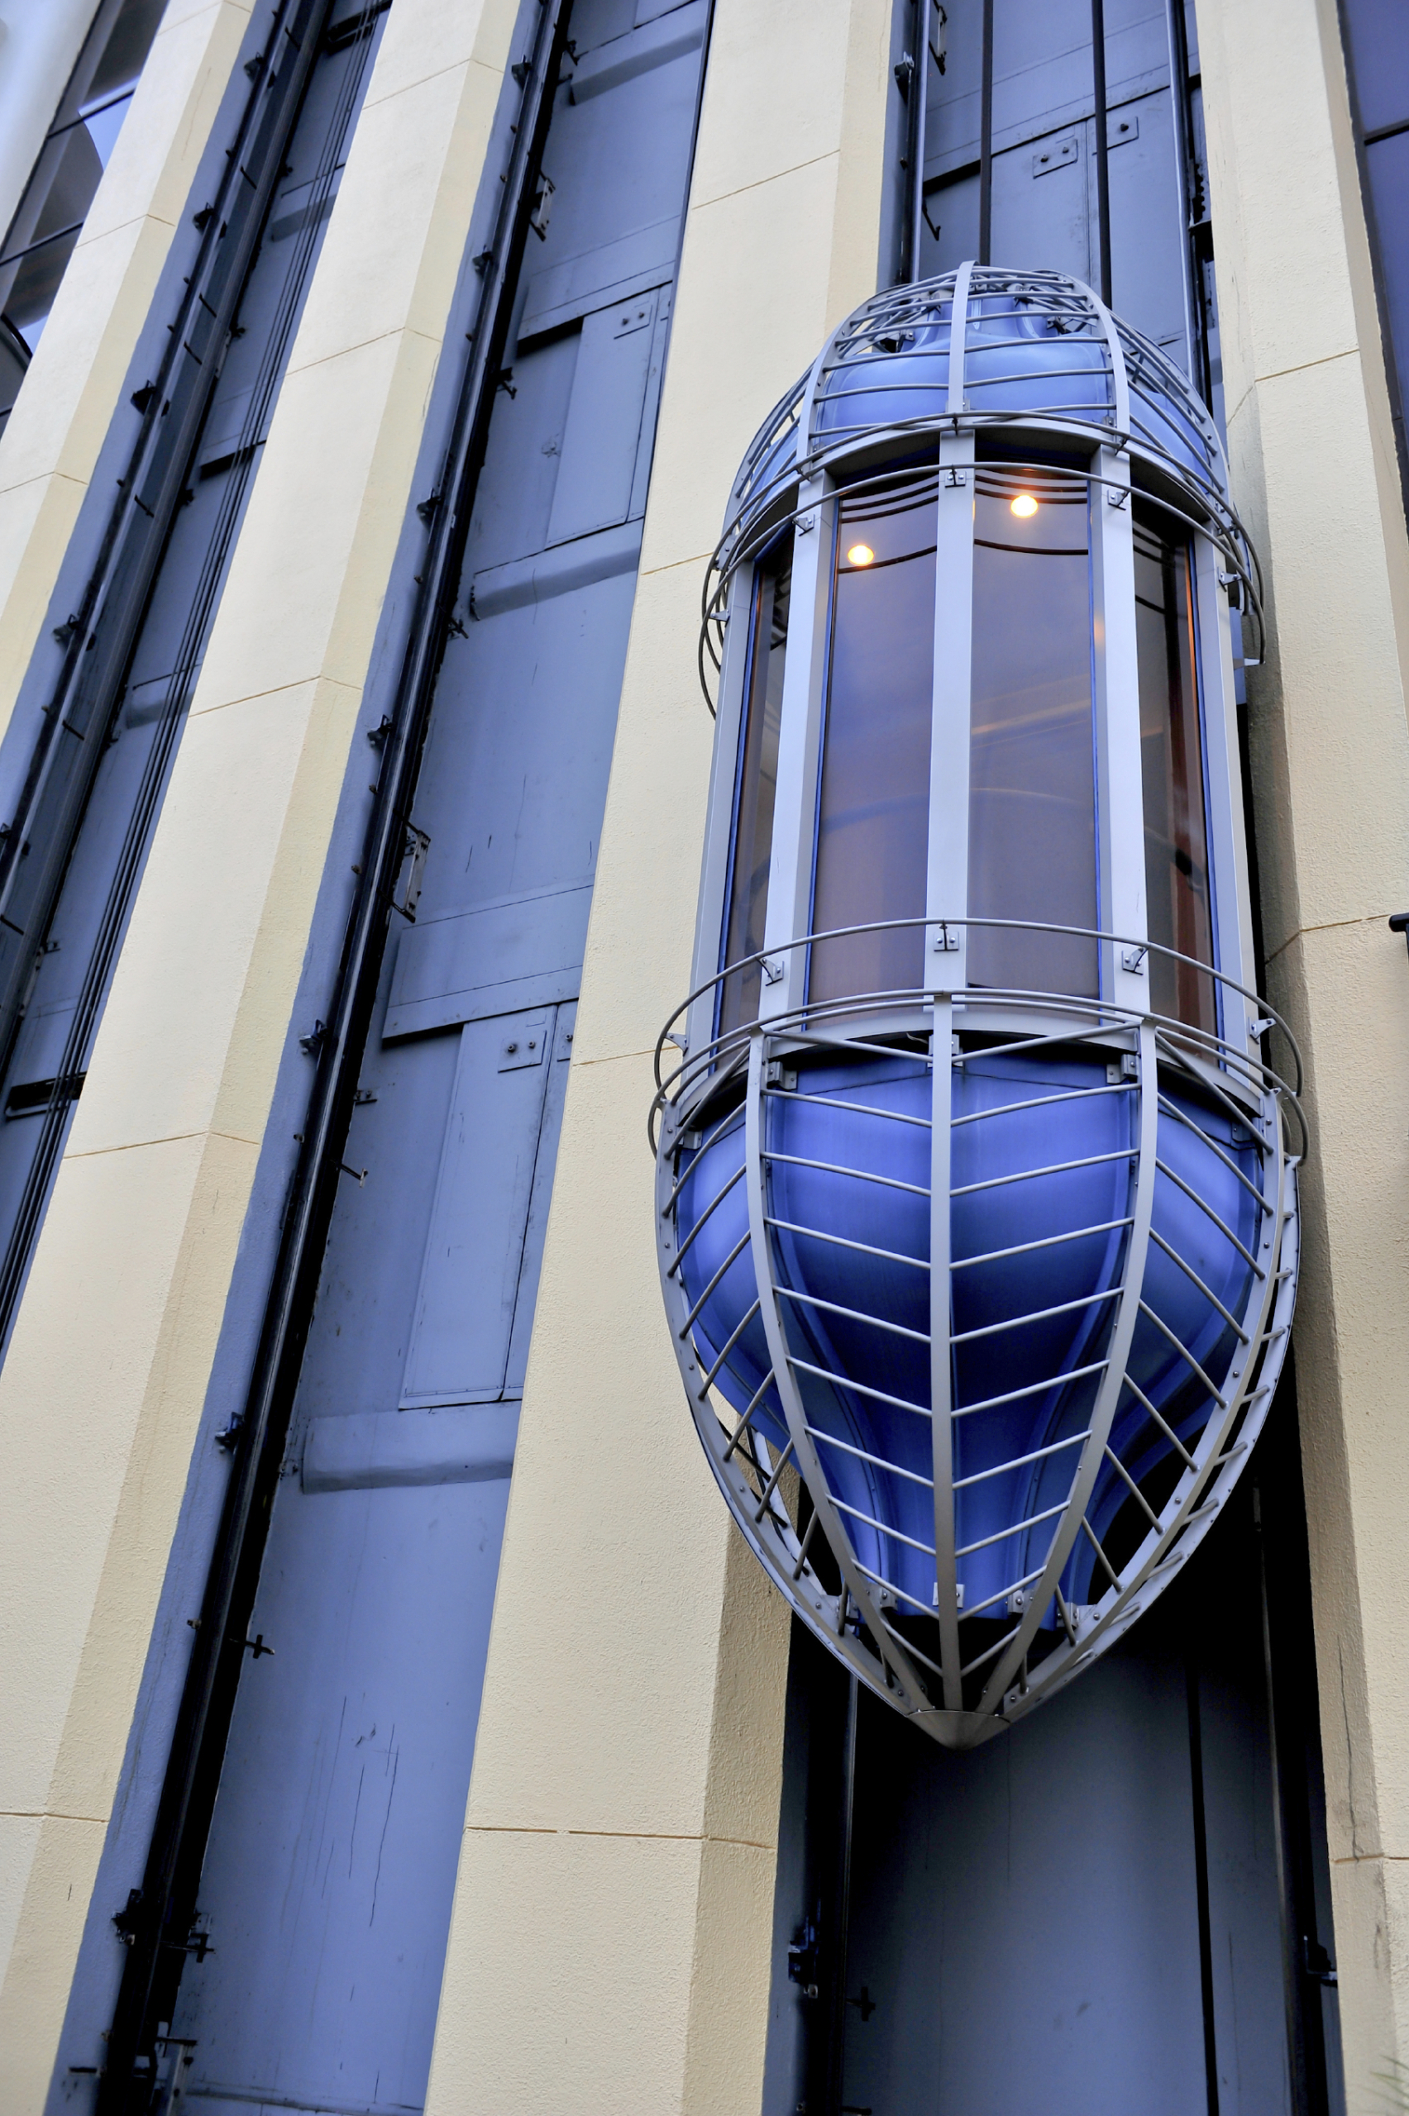
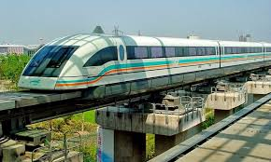

Slide 4
Electromagnetism
A permanent magnet (e.g. a fridge magnet) has a permanent magnetic field around it.

Slide 5
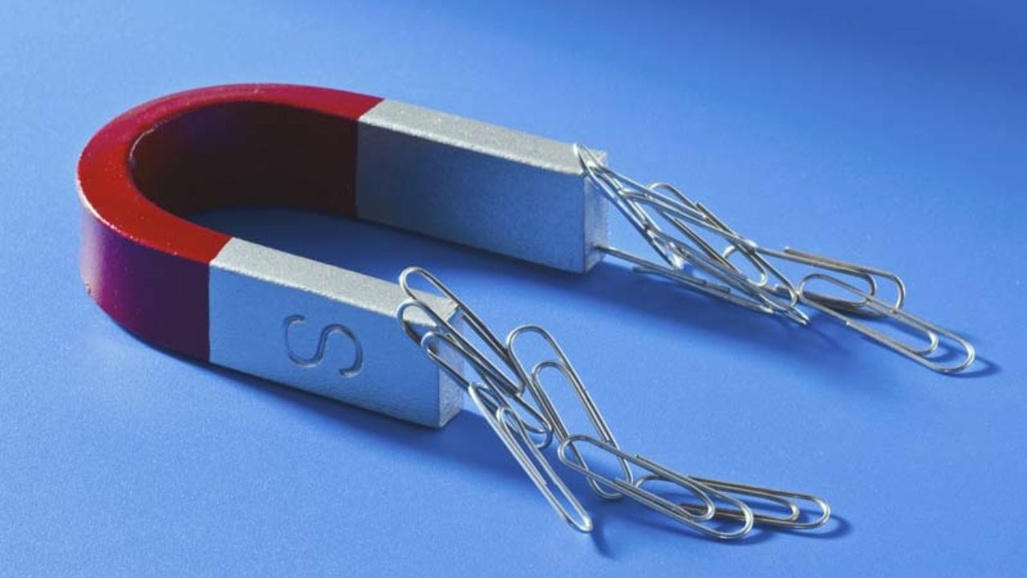
Electromagnetism
Magnetic fields are invisible but it is possible to see the effect they have on other objects. Iron based objects are always attracted to permanent magnets.

Slide 6
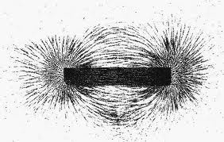
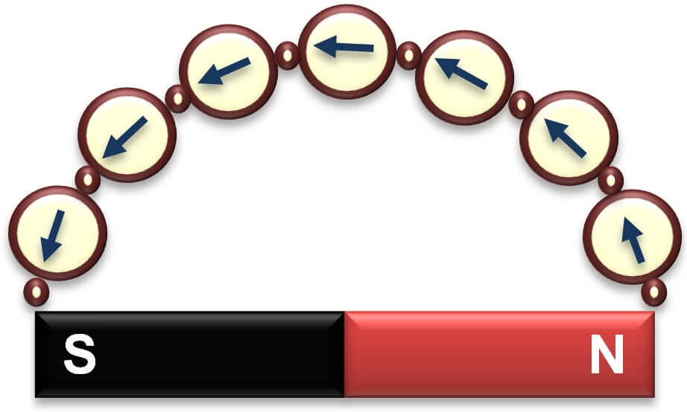
Electromagnetism
Iron filings and compasses are very useful for showing the effects of magnetic fields.

Slide 7
Electromagnetism
All permanent magnets have a fixed North-pole (N) and a fixed South-pole (S).

Slide 8
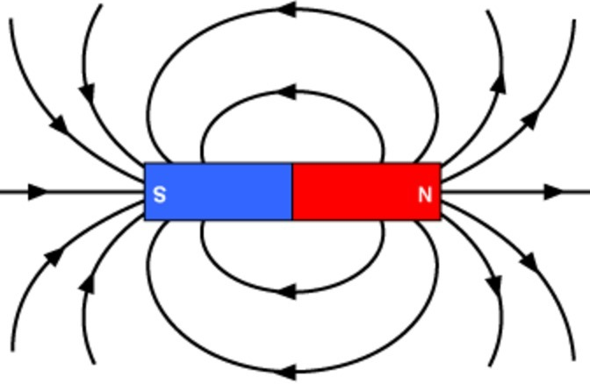
Electromagnetism
Magnetic fields can be drawn using magnetic field lines.
Field lines always point to the South pole and are closer together when the magnetic field is stronger.

Slide 9
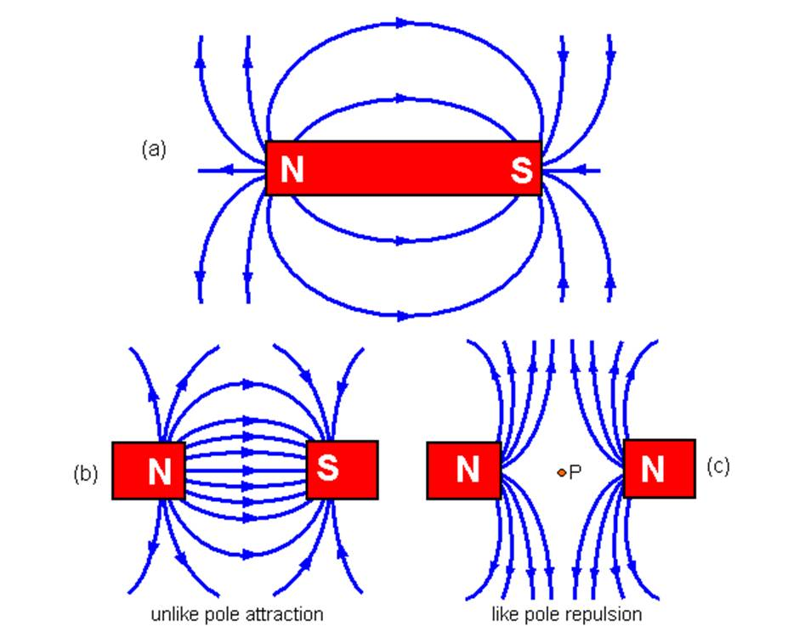
Electromagnetism
Magnetic fields also exist between magnetic poles.

Slide 10
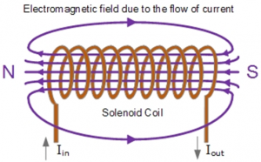
Electromagnetism
A magnetic field can also be created by passing a current through a wire. This will be a weak magnetic field.
To make the magnetic field stronger, the wire can be made into a coil. This is called a solenoid.

Slide 11
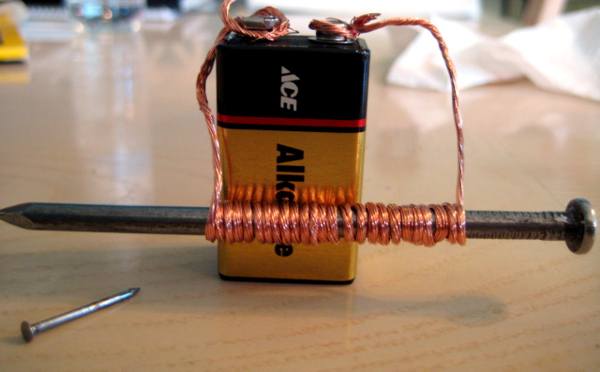
Electromagnetism
To make the magnetic field a lot stronger an iron nail or a C-core can be placed inside the coil. This is the basic arrangement of an electromagnet.

Slide 12
Electromagnetism- Practical Task
Aim
To find out if decreasing the number of coils on an electromagnet changes the strength of the electromagnet.
Apparatus
Lab Pack
Connecting Wires
Crocodile Clips
C-core
Coil of Wire
Paperclips

Slide 13
Electromagnetism – Practical Task
Experimental Set-up (Insert a suitable diagram)
Method (Describe the steps in the experiment)
Results
Number of coils | Strength Try 1 (paperclips) | Strength Try 2 (paperclips) | Strength Try 3 (paperclips) | Strength Average (paperclips)

Slide 14
Electromagnetism – Practical Task
Conclusion
(Write a statement to show what happens to strength when the number of coils decreases)
Evaluation
(Write a statement to describe an improvement in experimental safety)
AND
(Write a statement to describe an improvement in experimental procedures)

Slide 15
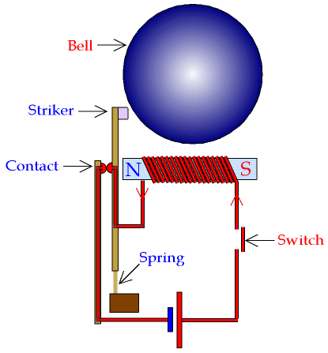
The electric bell
An electric bell contains an electromagnet.

Slide 16
The electric bell
When the switch is pressed the circuit is complete.

Slide 17
The electric bell
As current flows through the circuit the electromagnet attracts the striker.

Slide 18
The electric bell
As the striker moves towards the bell the contact is broken.

Slide 19
The electric bell
This causes the current to stop flowing, the electromagnet is now switched off.
The spring pulls the striker back and the contact is reconnected.

Slide 20
The electric bell
The whole process starts again and will continue as long as the switch is closed.

Slide 21
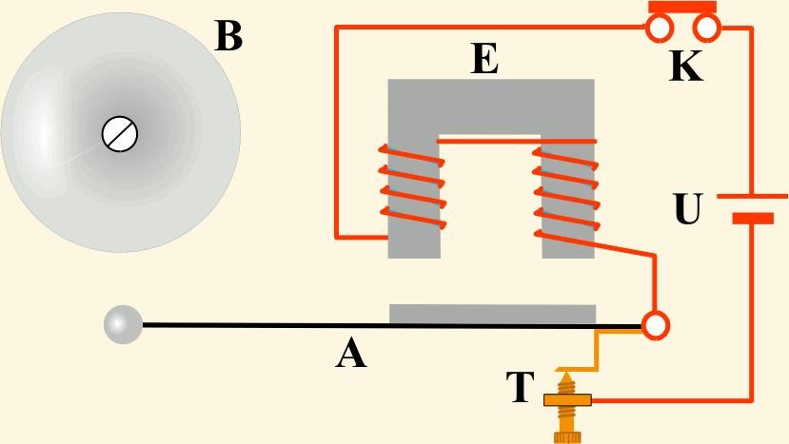
The electric bell

Slide 22
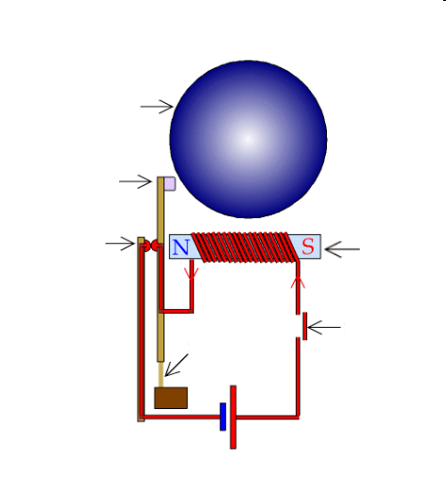
Review question
Name the parts of the bell.
1
2
3
5
4
6

Slide 23
Review Answers
1. Bell
2. Striker
3. Contact
4. Switch
5. Electromagnet
6. Spring

Slide 24
The magnetic relay
The magnetic relay is an electronically operated switch
M

Slide 25
The magnetic relay
When switch S is closed there is a small current in the electromagnet.
M
Switch S

Slide 26
The magnetic relay
The magnetic field produced pulls the pivoted armature towards the magnet.
Pivot
M
Armature
Switch S

Slide 27
The magnetic relay
This causes the armature to push the contacts together.
Contacts
Pivot
M
Armature
Switch S

Slide 28
The magnetic relay
When the contacts touch this completes the 2nd circuit, switching the motor on.
Contacts
Pivot
M
Armature
Switch S

Slide 29
The magnetic relay
When switch S is opened, the electromagnet loses its magnetism.
Contacts
Pivot
M
Armature
Switch S

Slide 30
The magnetic relay
This releases the armature allowing the contacts to open and the motor to stop.
Contacts
Pivot
M
Armature
Switch S

Slide 31
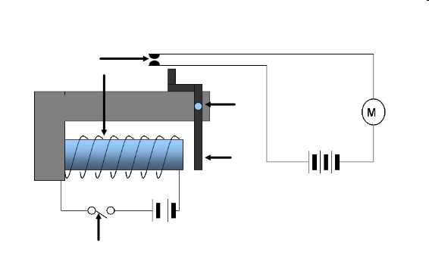
Review question
Name the parts of the relay.
1
2
5
4
3

Slide 32
Review Answers
Contacts
Electromagnet
Switch
Armature
Pivot

Slide 33
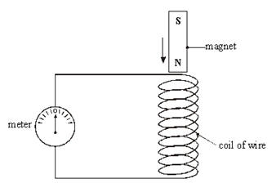
Electromagnetism
When a conductor cuts across the lines of a magnetic field, a voltage will be induced across the conductor.
This can be done by moving the conductor or moving the magnetic field.

Slide 34
Electromagnetism
From practical work (or research) it can be shown that the size of the induced voltage will depend on the:
magnetic field strength
number of coils
speed of the motion
angle at which the field lines are cut
Induced voltages are very important for the operation of devices called transformers…

Slide 37
Electromagnetism
Q. Why are transformers important devices?
A. They are essential for the transmission of voltages from power stations to our homes.
There are two main types of transformer.
A step-up transformer increases the voltage from a power station. This means that overhead cables carry extremely high voltages (400000 V).
A step-down transformer decreases the voltage. These transformers ensure a relatively small voltage (230 V) is supplied to our homes.

Slide 38
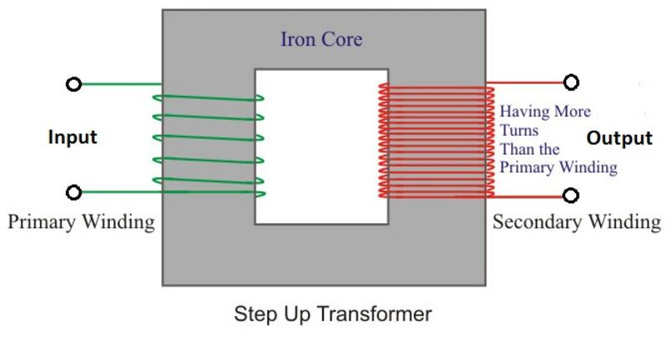
Electromagnetism
Step-up Transformers

Slide 39
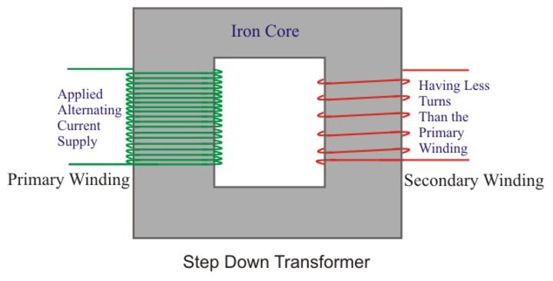
Electromagnetism
Step-down Transformers

Slide 40
Electromagnetism
Transformers operate by having a changing magnetic field created on their primary side.
This changing magnetic field induces a voltage in the windings (coils) on their secondary side.
In a step-up transformer the secondary voltage is greater than the primary voltage. (The voltage has transformed up to a higher number.)
In a step-down transformer the secondary voltage is less than the primary voltage. (The voltage has transformed down to a lower number.)

Slide 41
Electromagnetism
From practical work (or personal research) it can be shown that the following equation applies to both types of transformer:
where,
N_{s} is the number of secondary turns (coils)
N_{p} is the number of primary turns (coils)
V_{s} is the secondary voltage
V_{p} is the primary voltage

Slide 42
Electromagnetism
Example One - Model power transmission lines are set up to show how electricity is distributed from a power station to consumers.
State the purpose of transformer Y.
Calculate the secondary voltage from transformer X.

Slide 43
Electromagnetism
Example One – Solution
a) Transformer Y steps down the voltage.
b)
N_{s} / N_{p} = V_{s} / V_{p}
960 / 120 = V_{s} / 2.5
8 = V_{s} / 2.5
V_{s} = 8 x 2.5
V_{s} = 16 V

Slide 44
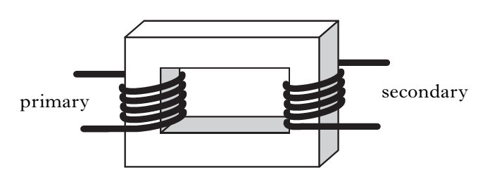
Electromagnetism
Example Two - At a power station a transformer is used step up the voltage 20 kV to 400 kV before it is transmitted by overhead cables.
There are 3000 turns on the primary coil. Calculate the number of turns on the secondary coil.

Slide 45
Electromagnetism
Example Two – Solution
(Remember “k” or “kilo” means “x10³” or multiply by 1000)
N_{s} / N_{p} = V_{s} / V_{p}
N_{s} / 3000 = 400000 / 20000
N_{s} / 3000 = 20
N_{s} = 20 x 3000
N_{s} = 60000 turns

Slide 46
Electromagnetism
Copy and complete the following table.
N_{s} | N_{p} | V_{s} | V_{p} | Step up or Step down?
 | 450 turns | 690 V | 230 V
800 turns |  | 120 V | 6 V
125 turns | 750 turns |  | 24 V
50 turns | 500 turns | 23 V

Slide 47
Electromagnetism
Copy and complete the following table.
N_{s} | N_{p} | V_{s} | V_{p} | Step up or Step down?
1350 turns | 450 turns | 690 V | 230 V | Up
800 turns | 40 turns | 120 V | 6 V | Up
125 turns | 750 turns | 4 V | 24 V | Down
50 turns | 500 turns | 23 V | 230 V | Down

