Slide 1
S3/S4 Physics
Energy

Slide 2
Energy
Can you name the seven types of energy that were used in your S1/S2 Science course?

Slide 3
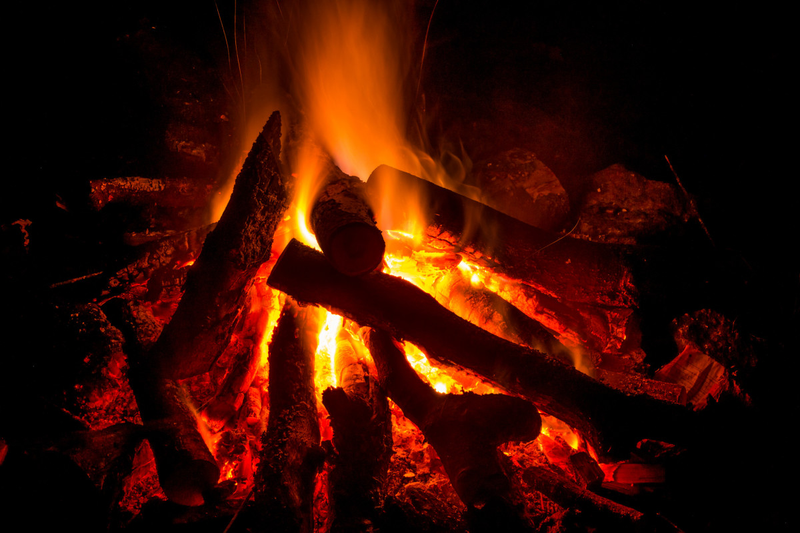

Slide 4
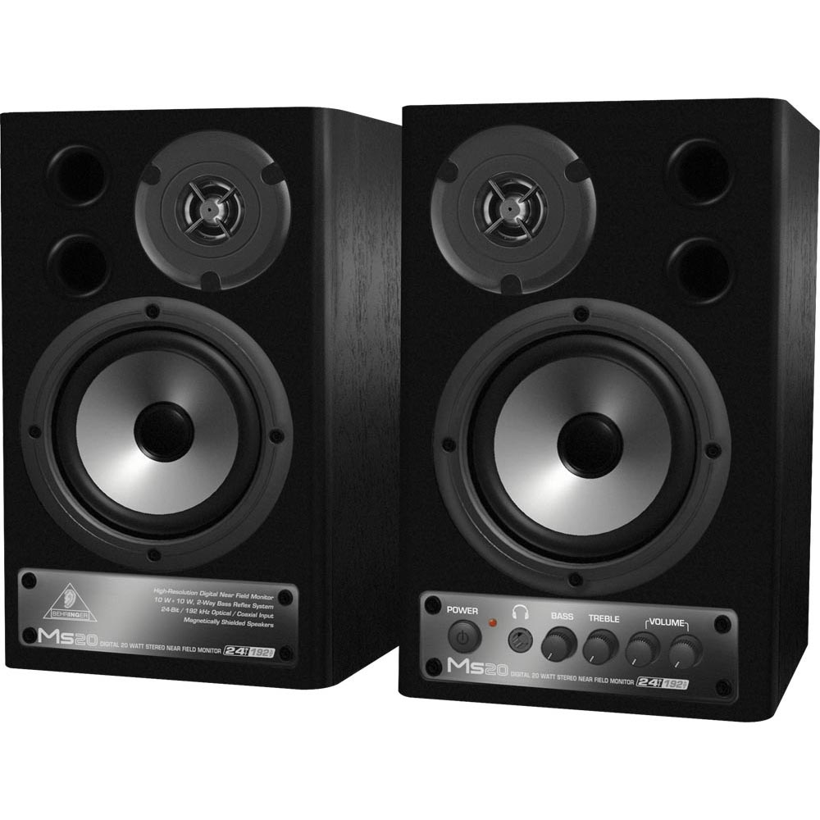

Slide 5
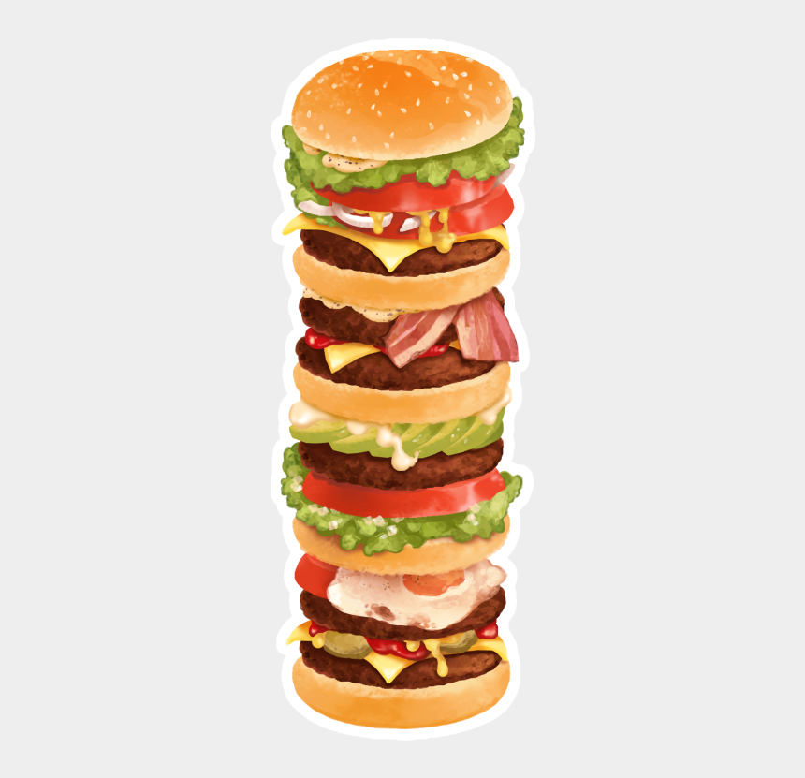

Slide 10
Energy
Can you remember the energy rule from your S1/S2 Science course?
Energy cannot be created or destroyed.
Energy can be changed from one type into another type.
These statements combine to form the Law of Conservation of Energy.
All types of energy are measured in the same unit – Joules (J).
Machines are often used to change one type of energy into another type of energy.

Slide 11
Energy
Change of energy | Device
Electrical to Heat
Chemical to Electrical
Electrical to Light
Sound to Electrical

Slide 12
Energy - Work Done or Energy Transferred
The work done on an object is a measure of the energy transferred to the object.
The work done on (or energy transferred to) an object can be calculated using the following equation:
Work done = force x distance
In symbol form this equation is written as:
E_{w} = Fd
Work done is measured in Joules (J)
Force is measured in Newtons (N)
Distance (or displacement) is measured in metres (m)

Slide 13
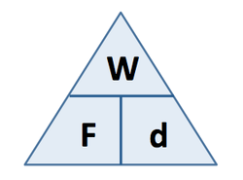
Energy - Work Done or Energy Transferred
The work done or energy transferred equation can be represented by the following triangle:

Slide 14
Energy - Work Done or Energy Transferred
Example One
A jotter is pushed 0.75 m across a desk, by a force of 60 N. Calculate the energy transferred to the jotter.
Solution
E_{w} = F x d
E_{w} = 60 x 0.75
E_{w} = 45 J

Slide 15
Energy - Work Done or Energy Transferred
Example Two
A filing cabinet is pulled 25 cm. The work done in moving the filing cabinet is 90 J. Calculate the force applied to the filing cabinet.
Solution (Remember distance is measured in metres)
E_{w} = F x d
90 = F x 0.25
F = 90 / 0.25
F = 360 N

Slide 16
Energy - Work Done or Energy Transferred
Example Three
During braking a bus loses 30 kJ of energy. The brakes supply a force 1200 N. Calculate the distance the bus moves during braking.
Solution (Remember “k” means “x10³” or multiply by 1000)
E_{w} = F x d
30 x 103 =1200 x d
d = 30 x 10³ / 1200
d = 25 m

Slide 17
Energy – Work Done or Energy Transferred
Copy and complete the following table:
Work Done (J) | Force (N) | Distance (m)
 | 5 | 2
 | 300 | 0.5
50 | 2
5 | 15
3000 |  | 60
100 |  | 0.4

Slide 18
Energy – Work Done or Energy Transferred
Copy and complete the following table:
Work Done (J) | Force (N) | Distance (m)
10 | 5 | 2
150 | 300 | 0.5
50 | 2 | 25
4.5 | 15 | 0.3
3000 | 50 | 60
100 | 250 | 0.4

Slide 19
Energy - Gravitational Potential Energy
When work is done to raise an object to a higher position, the energy transferred to the object is said to be stored as gravitational potential energy (E_{p}).
An object “loses” gravitational potential energy when it moves to a lower height.
The equation to calculate gravitational potential energy is a special version of the work done equation.

Slide 20
Energy – Gravitational Potential Energy
When objects move up and down we usually talk about “height” rather than “distance”. The work done equation can change to…
E_{w} = F x h
The minimum force needed to move objects to a higher height is weight. W = m x g. The work done equation can change to…
E_{w} = m x g x h
The symbol for gravitational potential energy is E_{p}. So the work done equation can be written as…

Slide 21
Energy – Gravitational Potential Energy
E_{p} = mgh
where,
E_{p} is gravitational potential energy measured in Joules (J)
m is mass measured in kilograms (kg)
g is gfs measured in Newtons per kilogram (Nkg⁻¹)
h is height (vertical distance) measured in metres (m)

Slide 22
Energy – Gravitational Potential Energy
Example One
Calculate the gravitational potential energy gained by a 4 kg package when it is raised through a height of 1.2 m.
Solution (Remember gfs for planet Earth is 9.8 Nkg⁻¹)
E_{p} = m x g x h
E_{p} = 4 x 9.8 x 1.2
E_{p} = 47 J

Slide 23
Energy – Gravitational Potential Energy
Example Two
A 5.5 kg school bag gains 49 J when it is lifted on to a desk. Calculate the height of the desk.
Solution (Remember gfs for planet Earth is 9.8 Nkg⁻¹)
E_{p} = m x g x h
49 = 5.5 x 9.8 x h
h = 49 / 5.5 x 9.8
h = 0.91 m

Slide 24
Energy – Gravitational Potential Energy
Example Three
A brick drops 6.3 m on to the ground, losing 140 J of gravitational potential energy. Calculate the mass of the brick.
Solution (Remember gfs for planet Earth is 9.8 Nkg⁻¹)
E_{p} = m x g x h
140 = m x 9.8 x 6.3
m = 140 / 9.8 x 6.3
m = 2.3 kg

Slide 25
Energy – Gravitational Potential Energy
Copy and complete the following table:
Ep (J) | mass | gfs (Nkg⁻¹) | height
 | 5 kg | 9.8 | 2 km
 | 200 g | 9.8 | 2 m
180 | 20 kg | 9.8
6 | 100 g | 9.8
100 |  | 9.8 | 4.1 m
10 |  | 9.8 | 50 cm

Slide 26
Energy – Gravitational Potential Energy
Copy and complete the following table:
Ep (J) | mass | gfs (Nkg⁻¹) | height
98000 | 5 kg | 9.8 | 2 km
3.92 | 200 g | 9.8 | 2 m
180 | 20 kg | 9.8 | 0.92 m
6 | 100 g | 9.8 | 6.1 m
100 | 2.5 kg | 9.8 | 4.1 m
10 | 2 kg | 9.8 | 50 cm

Slide 27
Energy – Kinetic Energy
All moving objects have kinetic energy (E_{k}).
The kinetic energy of a moving object will depend on the object’s mass and speed.
The greater the mass the greater the kinetic energy.
The greater the speed the greater the kinetic energy.
So a large, fast moving object will have a lot of kinetic energy.

Slide 29
Energy – Kinetic Energy
Kinetic energy can be calculated from the following equation:
E_{k} = ½mv²
where,
E_{k} is the kinetic energy measured in Joules (J)
m is the mass measured in kilograms (kg)
v is the speed measured in metres per second (ms⁻¹)

Slide 30
Energy – Kinetic Energy
Example One
A pupil, mass 60 kg, is running at 3.0 ms⁻¹. Calculate the pupil’s kinetic energy.
Solution
E_{k} = ½mv²
E_{k} = ½ x 60 x (3)²
E_{k} = ½ x 60 x 9
E_{k} = 270 J

Slide 31
Energy – Kinetic Energy
Example Two
A rugby ball travelling at 4.0 ms⁻¹ has 28 J of kinetic energy. Calculate the mass of the rugby ball.
Solution
E_{k} = ½mv²
28 = ½ x m x (4)²
28 = ½ x m x 16
m = 28 / (½ x 16)
m = 3.5 kg

Slide 32
Energy – Kinetic Energy
Example Three
A trolley of mass 0.24 kg has 0.58 J of kinetic energy. Calculate the speed of the trolley.
Solution
E_{k} = ½mv²
0.58 = ½ x 0.24 x (v)²
0.58 = 0.12 x (v)²
(v)² = 0.58 / (0.12)
v = √4.8 = 2.2 ms⁻¹

Slide 33
Energy – Kinetic Energy
Copy and complete the following table:
E_{k} (J) | Mass (kg) | Speed (ms⁻¹)
 | 2 | 2
 | 10 | 8
40 |  | 4
1000 |  | 5
62.5 | 5
0.9 | 20

Slide 34
Energy – Kinetic Energy
Copy and complete the following table:
E_{k} (J) | Mass (kg) | Speed (ms⁻¹)
4 | 2 | 2
320 | 10 | 8
40 | 5 | 4
1000 | 40 | 5
62.5 | 5 | 5
0.9 | 20 | 0.3

Slide 35
Energy
Remember…
Energy cannot be created or destroyed.
Energy can be changed from one type into another type.
These statements combine to form the Law of Conservation of Energy.
Energy calculations also use the Law of Conservation of Energy.

Slide 36
Energy – Law of Conservation
Example One
A 3.0kg ball is dropped from a window 10m on to the ground below.
a) Calculate the loss in gravitational potential energy of the ball.
b) By applying the law of conservation of energy, state the kinetic energy of the ball just before it hits the ground.
c) Calculate the speed of the ball just before it hits the ground.
d) The actual speed of the ball was 13 ms⁻¹. Explain why this is different from your answer in part c).

Slide 37
Energy – Law of Conservation
Solution
a)
E_{p} = m x g x h
E_{p} = 3 x 9.8 x 10
E_{p} = 294 J
b)
E_{k} = 294 J

Slide 38
Energy – Law of Conservation
Solution (continued)
c)
E_{k} = ½mv²
294 = ½ x 3 x (v)²
294 = 1.5 x (v)²
(v)² = 294 / 1.5
v = √196 = 14 ms⁻¹
d) Not all of the E_{p} becomes E_{k}. Some energy will be changed to heat due to the air resistance as the ball travels towards the ground.

Slide 39
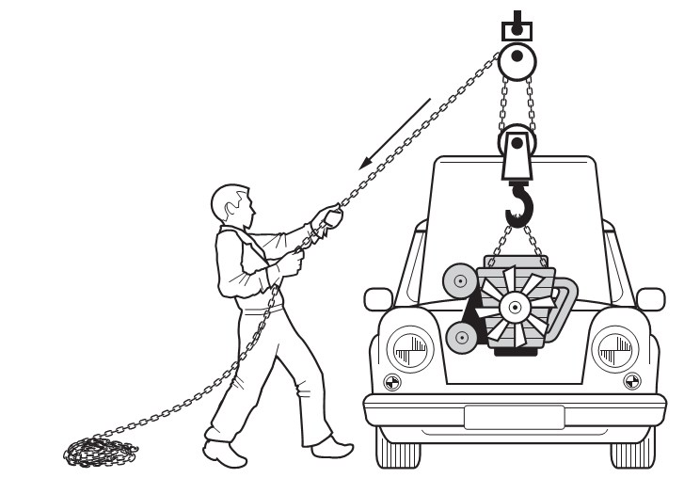
Energy – Law of Conservation
Example Two
A mechanic lifts an engine from a car using a pulley system.

Slide 40
Energy – Law of Conservation
Example Two (continued)
a) The mechanic pulls 4.5 m of chain with a constant force of 250 N. Calculate the work done by the mechanic.
b) By applying the law of conservation of energy, state the gravitational potential energy gained by the engine.
c) Explain why the actual gravitational potential energy will be less than the value in part b).

Slide 41
Energy – Law of Conservation
Solution
a)
E_{w} = F x d
E_{w} = 250 x 4.5
E_{w} = 1125 J
b) 1125 J
c) Not all of the work done will become Ep. Some of the work done will change to heat energy. (Due to the friction of the chain being pulled over the pulley.)

Slide 42
Energy – Review Questions
Q.1. The engine of a train exerts a force of 8 kN and does 2 x 10⁶ J of work. Calculate the distance travelled by the train.
Q.2. A 4 kg bag is lifted onto a shelf and gains 72 J of gravitational potential energy. Calculate the height the bag was lifted.
Q.3. A football travelling at 5 ms⁻¹ has 27 J of kinetic energy. Calculate the mass of the football.
Q.4. A 25 kg sack is pulled 4 m along a level floor with a horizontal force of 100 N. The sack is then lifted 0.8 m onto a work bench. Calculate the total work done on the sack.

Slide 43
Energy – Review Questions
Q.5.
A ball of mass 3 kg falls through a height of 5 m onto the ground.
a) Calculate the change in gravitational potential energy of the ball.
b) Just before reaching the ground the speed of the ball is 9.3 ms⁻¹. Calculate the kinetic energy of the ball.
c) Use the law of conservation of energy to comment on your answers to parts a) and b).

Slide 44
Energy – Review Answers
Q.1. 250 m
Q.2. 1.84 m
Q.3. 2.16 kg
Q.4. 596 J
Q.5. a) 147 J
Q.5. b) 130 J
Q.5 c) Not all of the E_{p} becomes E_{k}. Some energy will be changed to heat due to the air resistance as the ball travels towards the ground.

