Slide 1
S3/S4 Physics
Gas Laws and the Kinetic Model

Slide 2
Gas Laws and the Kinetic Model
What is pressure?

Slide 3
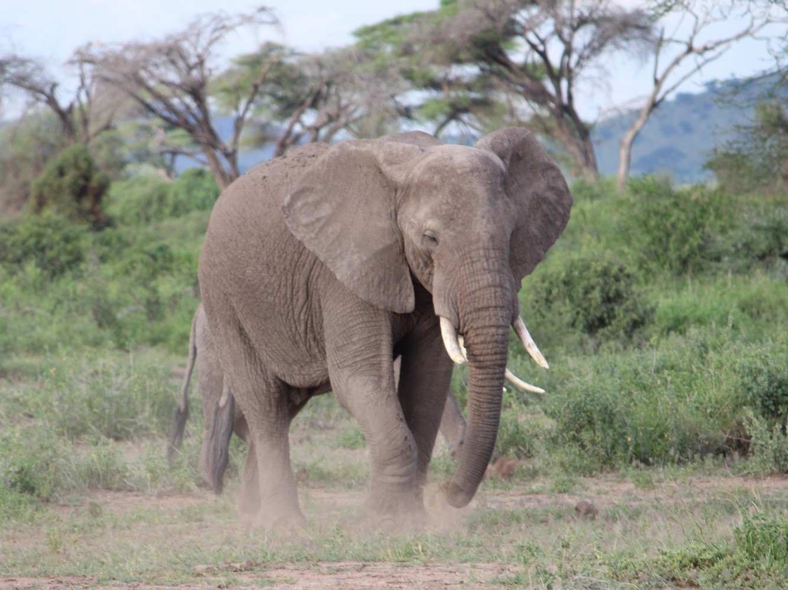
Gas Laws and the Kinetic Model
From practical work, or research, find the relationship between pressure, force and area of contact.

Slide 4
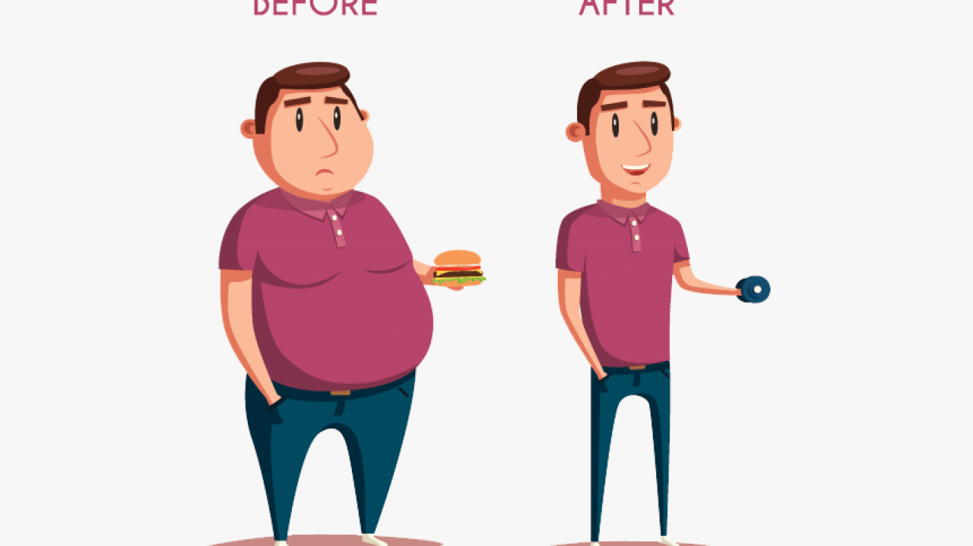
Gas Laws and the Kinetic Model
When an object is placed on a surface it will cause a FORCE on the surface.
When you INCREASE the downwards FORCE, but do not change the area of contact, the PRESSURE on the surface will INCREASE.

Slide 5
Gas Laws and the Kinetic Model
The AREA OF CONTACT between the object and the surface will make a difference to what happens.
When you INCREASE the AREA OF CONTACT, but do not change the downwards force, the PRESSURE on the surface will DECREASE.

Slide 6
Gas Laws and the Kinetic Model
As pressure is the force per unit area, the equation for calculating pressure is:
where,
p is pressure measured in Pascals (Pa)
F is force measured in Newtons (N)
A is the area in square metres (m²)
(1 Pascal is the same as 1 Newton per square metre; i.e. 1 Pa = 1 Nm⁻²)

Slide 7
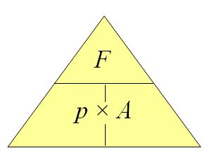
Gas Laws and the Kinetic Model
The pressure equation can be represented as a triangle:

Slide 8
Gas Laws and the Kinetic Model
Example One
A box weighs 120 N and has a base area of 3 m². Calculate the pressure it exerts on the ground.
Solution
p = F / A
p = 120 / 3
p = 40 Pa

Slide 9
Gas Laws and the Kinetic Model
Example Two
A textbook covers an area of 0.06 m² when placed on a desk. The pressure on the desk is 30 Pa. Calculate the force the textbook exerts on the desk.
Solution
p = F / A
30 = F / 0.06
F = 30 x 0.06
F = 1.8 N

Slide 10
Gas Laws and the Kinetic Model
Example Three
A 5 kg bag exerts a pressure of 700 Pa on the ground. Calculate the area of contact between the bag and the ground.
Solution (Remember the downward force, weight = m x g)
p = F / A
700 = (5 x 9.8) / A
A = (5 x 9.8) / 700
A = 0.07 m²

Slide 11
Gas Laws and the Kinetic Model
Example Four
A pupil that swings on their stool is more likely to damage the floor. Why?
Solution
When swinging the area of contact (one leg instead of four legs) with the floor is much less. As the weight of the pupil (downward force) does not change, the pressure on the floor will increase. As there is more pressure, the stool is more likely to damage the floor.

Slide 12
Gas Laws and the Kinetic Model
Copy and complete the following table:
Pressure (Pa) | Force (N) | Area of Contact (m²)
 | 400 | 80
 | 3.6 | 3
1000 |  | 2
750 |  | 0.3
60 | 300
4.5 | 18

Slide 13
Gas Laws and the Kinetic Model
Copy and complete the following table:
Pressure (Pa) | Force (N) | Area of Contact (m²)
5 | 400 | 80
1.2 | 3.6 | 3
1000 | 2000 | 2
750 | 225 | 0.3
60 | 300 | 5
4.5 | 18 | 4

Slide 14
Gas Laws and the Kinetic Model
Extra Question (Do this on your own)
A rectangular steel block (mass 3kg) measures 10 cm × 8 cm × 6 cm.
Calculate the greatest and the least pressure which it can exert on a surface.
Answers
Greatest = 6125 Pa
Least = 3675 Pa

Slide 15
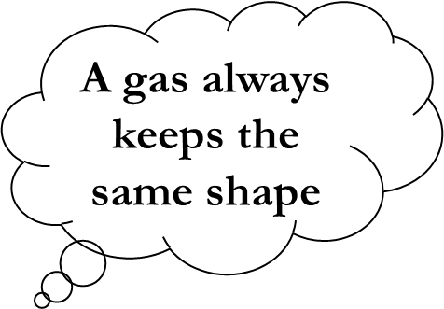
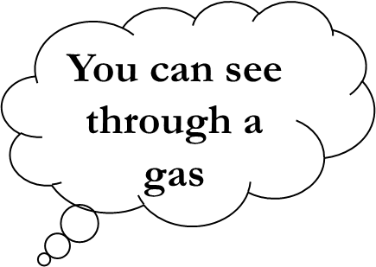
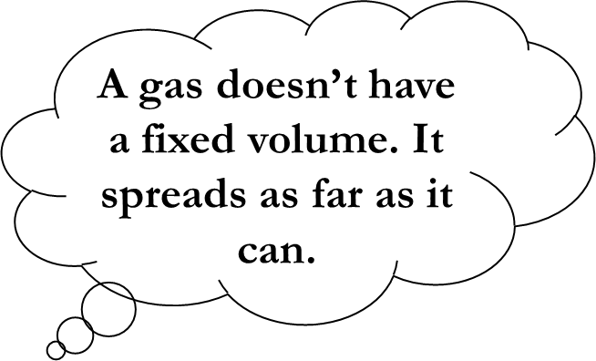
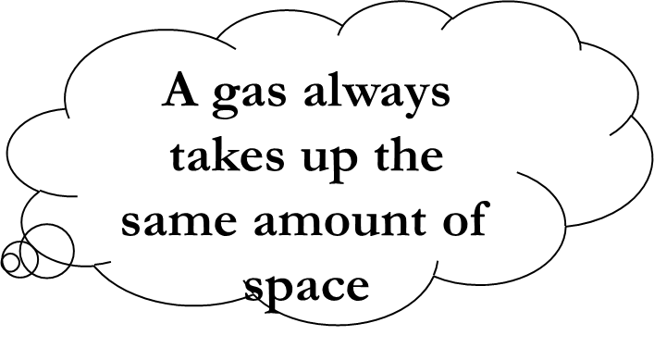
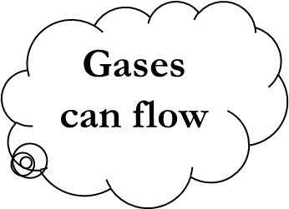
Gas Laws and the Kinetic Model
Which bubbles are true for all gases?
Gases are colourless

Slide 16
Gas Laws and the Kinetic Model
Behaviour of gas particles…what do you know about their movements?

Slide 17
Gas Laws and the Kinetic Model
Complete these statements about the Kinetic Model of an ideal gas.
Gases are made up of lots of very s_ _ _ _ particles.
Gas particles are very f_ _ apart.
Gas particles move in a r_ _ _ _ m fashion.
Gas particles move at very h_ _ _ speeds.

Slide 18
Gas Laws and the Kinetic Model
The final statement for the Kinetic Model of an ideal gas is:
“When gas particles collide with any object they do not lose any kinetic energy.”
(These types of collision are called elastic.)

Slide 19
Gas Laws and the Kinetic Model
The kinetic model can be used to explain the pressure of a gas.
“The pressure of a gas is caused by the particles colliding with the walls of the container.
Each collision will cause a force to be exerted on an area of the container. (p = F / A)
The more frequent (or violent) the collisions the greater will be the pressure of the gas.”

Slide 20
Gas Laws and the Kinetic Model

Slide 21
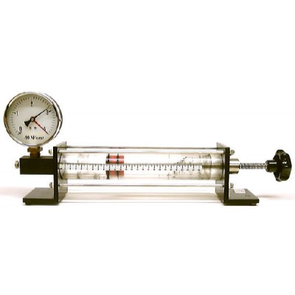
Gas Laws and the Kinetic Model
From practical work, or research, find the relationship between the pressure of a gas and the volume of a gas.
Pressure gauge Trapped air
Volume scale

Slide 22
Gas Laws and the Kinetic Model
Pressure | Volume | Pressure x Volume
15 | 2.2
13 | 2.5
11.5 | 2.8
10.5 | 3.1
9 | 3.4
8 | 3.7

Slide 23
Gas Laws and the Kinetic Model
A simple analysis of this data shows that:
When a gas is put into a smaller volume it will exert more pressure on its container.
When a gas is put into a bigger volume it will exert less pressure on its container.
Complete the last column of the table and carry out a further analysis of the data.

Slide 24
Gas Laws and the Kinetic Model
Pressure | Volume | Pressure x Volume
15 | 2.2 | 33
13 | 2.5 | 32.5
11.5 | 2.8 | 32.2
10.5 | 3.1 | 32.55
9 | 3.4 | 30.6
8 | 3.7 | 29.6

Slide 25
Gas Laws and the Kinetic Model
The data shows that the last column, allowing for experimental uncertainties, is approximately the same value each time.
In other words, pressure is inversely proportional to volume.
Assuming there is no change in temperature or mass, this is a statement of Boyle’s Law.

Slide 26
Gas Laws and the Kinetic Model
Boyle’s Law can be written in equation form.
where,
p₁ represents initial pressure p₂ represents final pressure
V₁ represents initial volume V₂ represents final volume

Slide 27
Gas Laws and the Kinetic Model
Boyle’s Law can be represented in graphical form.

Slide 28
Gas Laws and the Kinetic Model
Boyle’s Law can be explained using the kinetic model.
If the volume of a container is decreased, the randomly moving, high speed gas particles will collide with the walls of the container more often.
More collisions will cause more force on the container. (F increases)
As volume decreases there is also less area for collisions. (A decreases)
From the equation p = F / A if “F” increases in value and “A” decreases in value there must be an increase in the value of pressure.

Slide 29
Gas Laws and the Kinetic Model
Boyle’s Law Example One
A sealed syringe has 6 cm³ of air trapped inside it. The plunger of the syringe is adjusted until the volume of trapped air is 18 cm³ at a pressure of 1.0 x 10⁵ Pa. Calculate the initial pressure of the trapped air.
Solution
p₁V₁ = p₂V₂
p₁ x 6 = 1.0 x 10⁵ x 18
p₁ = (1.0 x 10⁵ x 18) / 6
p₁ = 3.0 x 10⁵ Pa

Slide 30
Gas Laws and the Kinetic Model
Boyle’s Law Example Two
A cylinder containing an inert gas has a volume of 0.06 m³. The pressure of the gas in the cylinder is 1.8 x 10⁶ Pa. Calculate the volume occupied by the gas at atmospheric pressure of 1.01 x 10⁵ Pa.
Solution
p₁V₁ = p₂V₂
1.8 x 10⁶ x 0.06 = 1.01 x 10⁵ x V₂
V₂ = (1.8 x 10⁶ x 0.06) / 1.01 x 10⁵
V₂ = 1.07 m³

Slide 31
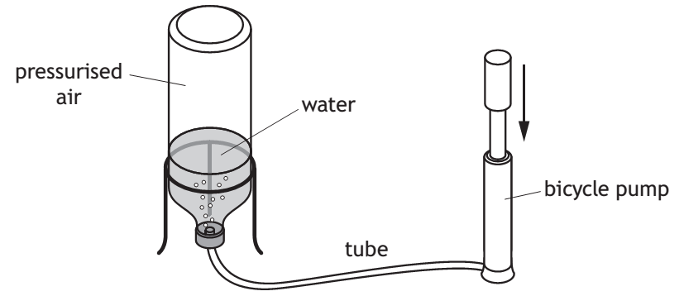
Gas Laws and the Kinetic Model
Boyle’s Law Example Three
A water rocket is shown below.

Slide 32
Gas Laws and the Kinetic Model
Boyle’s Law Example Three
Before being launched the pressure of the air is 1.74 x 10⁵ Pa. During the flight of the rocket the volume of air changes from 7.5 x 10⁻⁴ m³ to 8.7 x 10⁻⁴ m³. Calculate the new pressure inside the water rocket.
Solution
p₁V₁ = p₂V₂
1.74 x 10⁵ x 7.5 x 10⁻⁴ = p₂ x 8.7 x 10⁻⁴
p₂ = (1.74 x 10⁵ x 7.5 x 10⁻⁴) / 8.7 x 10⁻⁴
p₂ = 1.5 x 10⁵ Pa

Slide 33
Gas Laws and the Kinetic Model
Copy and complete the following table:
p₁ (Pa) | V₁ (m³) | p₂ (Pa) | V₂ (m³)
2.5 x 10⁵ |  | 5.0 x 10⁵ | 3
1.4 x 10⁵ |  | 4.2 x 10⁵ | 0.5
 | 2 | 2.1 x 10⁵ | 4
 | 3 | 3.5 x 10⁵ | 0.6
5.0 x 10⁵ | 5 | 1.0 x 10⁶
2.0 x 10⁵ | 8 |  | 16

Slide 34
Gas Laws and the Kinetic Model
Copy and complete the following table:
p₁ (Pa) | V₁ (m³) | p₂ (Pa) | V₂ (m³)
2.5 x 10⁵ | 6 | 5.0 x 10⁵ | 3
1.4 x 10⁵ | 1.5 | 4.2 x10⁵ | 0.5
4.2 x 10⁵ | 2 | 2.1 x 10⁵ | 4
0.7 x 10⁵ | 3 | 3.5 x 10⁵ | 0.6
5.0 x 10⁵ | 5 | 1.0 x 10⁶ | 2.5
2.0 x 10⁵ | 8 | 1.0 x 10⁵ | 16

Slide 35
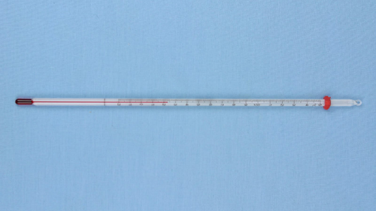
Gas Laws and the Kinetic Model
Q. What is temperature?
A.
A measure of the mean kinetic energy of the particles in a substance.
Temperature is usually measured in degrees Celsius ºC.

Slide 36
Gas Laws and the Kinetic Model
Q. What happens to the particles in a substance when there is less heat energy?
A. They will move around less and their kinetic energy will be lower meaning the temperature of the substance will be less.

Slide 37
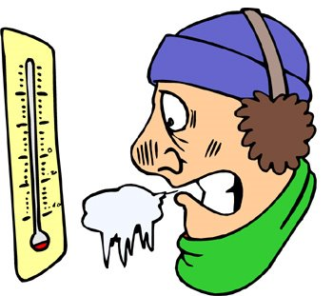
Gas Laws and the Kinetic Model
Q. What happens to the particles in a substance when it is really cold?
A. The particles will stop moving, they will have no kinetic energy meaning the temperature will have reached zero!

Slide 38
Gas Laws and the Kinetic Model
Q. Why do temperatures below 0 ºC exist if no particles can move?
A. Particles can move and have kinetic energy until the temperature drops to -273 ºC. At this temperature absolutely no particles can move.

Slide 39
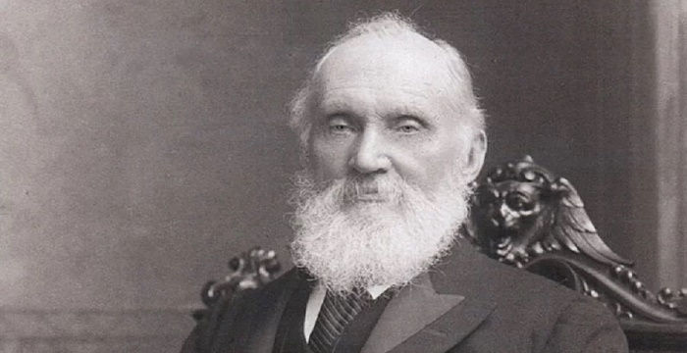
Gas Laws and the Kinetic Model
Lord Kelvin worked out that no particles can move at -273 ºC and called this temperature ABSOLUTE ZERO.
This was such an important discovery that Lord Kelvin had a temperature scale named after him.

Slide 40
Gas Laws and the Kinetic Model
The temperature at which absolutely no particles can move can be written as:
-273 ºC OR Absolute zero OR Zero Kelvins OR 0 K
To convert a ºC temperature into a Kelvin temperature you add 273.
ºC + 273 = Kelvin
To convert a Kelvin temperature into a ºC temperature you take away 273.
Kelvin - 273 = ºC

Slide 41
Gas Laws and the Kinetic Model
Copy and complete the following table:
Temperature (ºC) | 0 |  | 100 |  | 273 |  | -270 |  | 27
Temperature (K) |  | 0 |  | 400 |  | 75 |  | 350

Slide 42
Gas Laws and the Kinetic Model
Copy and complete the following table:
Temperature (ºC) | 0 | -273 | 100 | 127 | 273 | -198 | -270 | 77 | 27
Temperature (K) | 273 | 0 | 373 | 400 | 546 | 75 | 3 | 350 | 300

Slide 43
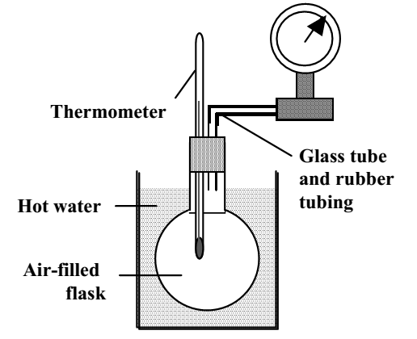
Gas Laws and the Kinetic Model
From practical work, or research, find the relationship between the pressure and the temperature of a gas.

Slide 44
Gas laws and the Kinetic Model
Pressure (x10⁵ Pa) | Temperature (ºC) | Temperature (K)
1.02 | 20 | 293
1.04 | 40 | 313
1.08 | 60 | 333
1.08 | 80 | 353
1.09 | 100 | 373

Slide 45
Gas Laws and the Kinetic Model
A simple analysis of the data shows that:
When the temperature of a gas is increased, it will exert more pressure.
When the temperature of a gas is decreased, it will exert less pressure.
Further analysis of the data can be carried out by plotting a graph of pressure against temperature in Kelvins.

Slide 46
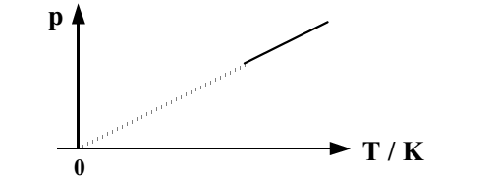
Gas Laws and the Kinetic Model

Slide 47
Gas Laws and the Kinetic Model
The graph shows that it is possible to project a straight line passing through the origin when pressure is plotted against temperature in Kelvins.
In other words, pressure is directly proportional to temperature in K.
Assuming there is no change in volume or mass, this is a statement of Gay-Lussac’s Law.

Slide 48
Gas Laws and the Kinetic Model
Gay-Lussac’s Law can be written in equation form.
where,
p₁ represents initial pressure p₂ represents final pressure
T₁ represents initial temperature in K T₂ represents final temperature in K

Slide 49
Gas Laws and the Kinetic Model
Gay-Lussac’s Law can be explained using the kinetic model.
If the temperature of a gas is increased, the kinetic energy of the randomly moving high speed particles will increase.
If there is no increase in volume (“A” stays the same), there will be more collisions between the gas and its container walls. These collisions will also be more violent (“F” increases) with the walls.
From the equation p = F / A, if “F” increases in value and there is no change in “A” there will be an increase in pressure.

Slide 50
Gas Laws and the Kinetic Model
Gay-Lussac’s Law Example One
In a Gay-Lussac’s experiment the final pressure of the gas was measured as 1.15 x 10⁵ Pa. The temperature was increased from 37 ºC to 77 ºC during the experiment. Calculate the initial pressure.
Solution (Remember ”T” must be in Kelvins – convert by adding 273)
p₁ / T₁ = p₂ / T₂
p₁ / 310 = 1.15 x 10⁵ / 350
p₁ = (1.15 x 10⁵ x 310) / 350
p₁ = 1.02 x 10⁵ Pa

Slide 51
Gas Laws and the Kinetic Model
Gay-Lussac’s Law Example Two
The pressure of a gas is 1.2 x 10⁵ Pa at temperature of 22 ºC. The temperature of the gas is increased to 37 ºC. The volume of the gas remains constant. Calculate the new pressure of the gas.
Solution (Remember ”T” must be in Kelvins – convert by adding 273)
p₁ / T₁ = p₂ / T₂
1.2 x 10⁵ / 295 = p₂ / 310
p₂ = (1.2 x 10⁵ x 310) / 295
p₂ = 1.26 x 10⁵ Pa

Slide 52
Gas Laws and the Kinetic Model
Gay-Lussac’s Law Example Three
The pressure in a helium balloon is 1.0 x 10⁵ Pa when the temperature is 20 ºC. If the pressure drops to 80% of its initial value, calculate the new temperature. (Assume no change in the balloon’s volume.)
Solution (Remember ”T” must be in Kelvins – convert by adding 273)
p₁ / T₁ = p₂ / T₂
1.0 x 10⁵ / 293 = 0.8 x 10⁵ / T₂
T₂ = (293 x 0.8 x 10⁵ ) / 1.0 x 10⁵
T₂ = 234 K
T₂ = -39 ºC

Slide 53
Gas Laws and the Kinetic Model
Copy and complete the following table:
p₁ (Pa) | T₁ (K) | p₂ (Pa) | T₂ (K)
2.2 x 10⁵ |  | 1.1 x 10⁵ | 160
1.2. x 10⁵ |  | 0.24 x 10⁵ | 60
 | 1500 | 1.3 x 10⁵ | 500
 | 80 | 1.5 x 10⁵ | 200
1.4 x 10⁵ | 300 | 2.1 x 10⁵
0.9 x 10⁵ | 540 |  | 120

Slide 54
Gas Laws and the Kinetic Model
Copy and complete the following table:
p₁ (Pa) | T₁ (K) | p₂ (Pa) | T₂ (K)
2.2 x 10⁵ | 320 | 1.1 x 10⁵ | 160
1.2. x 10⁵ | 300 | 0.24 x 10⁵ | 60
3.9 x 10⁵ | 1500 | 1.3 x 10⁵ | 500
0.6 x 10⁵ | 80 | 1.5 x 10⁵ | 200
1.4 x 10⁵ | 300 | 2.1 x 10⁵ | 450
0.9 x 10⁵ | 540 | 0.2 x 10⁵ | 120

Slide 55
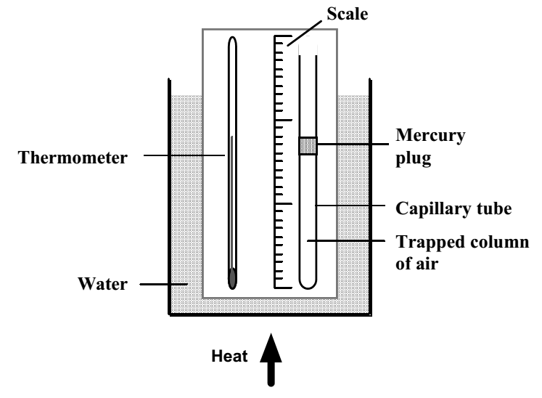
Gas Laws and the Kinetic Model
From practical work, or research, find the relationship between the volume and the temperature of a gas.

Slide 56
Gas Laws and the Kinetic Model
Temperature (ºC) | Temperature (K) | Volume | Volume Temperature
87 | 360 | 8.9
77 | 350 | 8.2
67 | 340 | 7.9
57 | 330 | 7.5
47 | 320 | 7.4
37 | 310 | 6.9

Slide 57
Gas Laws and the Kinetic Model
A simple analysis of this data shows that:
When the temperature of a gas is increased, it will occupy a greater volume.
When the temperature of a gas is decreased, it will occupy a smaller volume.
Complete the last column of the table and carry out a further analysis of the data.

Slide 58
Gas Laws and the Kinetic Model
Temperature (ºC) | Temperature (K) | Volume | Volume Temperature
87 | 360 | 8.9 | 0.025
77 | 350 | 8.2 | 0.023
67 | 340 | 7.9 | 0.023
57 | 330 | 7.5 | 0.023
47 | 320 | 7.4 | 0.023
37 | 310 | 6.9 | 0.022

Slide 59
Gas Laws and the Kinetic Model
The data shows that the last column, allowing for experimental uncertainties, is approximately the same value each time.
In other words, volume is directly proportional to temperature in Kelvins.
Assuming there is no change in pressure or mass, this is a statement of Charles’ Law.

Slide 60
Gas Laws and the Kinetic Model
Charles’ Law can be written in equation form.
where,
V₁ represents initial volume V₂ represents final volume
T₁ represents initial temperature in K T₂ represents final temperature in K

Slide 61
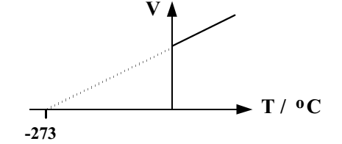
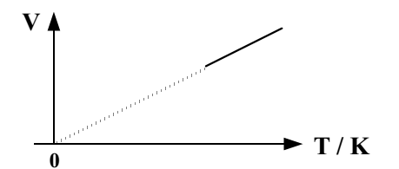
Gas Laws and the Kinetic Model
Charles’ Law can be represented in graphical form.

Slide 62
Gas Laws and the Kinetic Model
Charles’ Law can be explained using the kinetic model.
If the temperature of a container is increased, the randomly moving high speed gas particles, will gain more kinetic energy. This will result in more violent collisions (“F” will increase) on the container walls.
For pressure to remain constant, according to the equation p = F / A, there must be an increase in area.
This can be achieved if the volume of the container is increased, as this will increase the area over which the collisions take place.

Slide 63
Gas Laws and the Kinetic Model
Charles’ Law Example One
In a Charles’ Law experiment the final volume of the gas was 6 cm³. The temperature change during the experiment from 50 ºC to 4 ºC. Calculate the initial volume of the gas.
Solution (Remember ”T” must be in Kelvins – convert by adding 273)
V₁ / T₁ = V₂ / T₂
V₁ / 323 = 6 / 277
V₁ = (6 x 323) / 277
V₁ = 7 cm³

Slide 64
Gas Laws and the Kinetic Model
Charles’ Law Example Two
The temperature of a sample of gas is 20 ºC. The volume of the gas is 0.30 m³. The container is free to expand. The temperature of the gas is increased to 50 ºC. Calculate the new volume occupied by the gas.
Solution (Remember ”T” must be in Kelvins – convert by adding 273)
V₁ / T₁ = V₂ / T₂
0.30 / 293 = V₂ / 323
V₂ = (0.30 x 323) / 293
V₂ = 0.33 m³

Slide 65
Gas Laws and the Kinetic Model
Charles’ Law Example Three
A weather balloon’s volume is 15 m³ when the temperature is 17 ºC. The volume of the weather balloon increases by 10%, calculate the new temperature. (Assume no change in the pressure.)
Solution (Remember ”T” must be in Kelvins – convert by adding 273)
V₁ / T₁ = V₂ / T₂
15 / 290 = 16.5 / T₂
T₂ = (16.5 x 290) / 15
T₂ = 319 K
T₂ = 46 ºC

Slide 66
Gas Laws and the Kinetic Model
Copy and complete the following table:
V₁ (m³) | T₁ (K) | V₂ (m³) | T₂ (K)
 | 300 | 12 | 600
 | 490 | 3 | 70
3 |  | 1.5 | 400
12 |  | 18 | 360
7 | 200 | 14
4 | 250 |  | 2000

Slide 67
Gas Laws and the Kinetic Model
Copy and complete the following table:
V₁ (m³) | T₁ (K) | V₂ (m³) | T₂ (K)
6 | 300 | 12 | 600
21 | 490 | 3 | 70
3 | 800 | 1.5 | 400
12 | 240 | 18 | 360
7 | 200 | 14 | 400
4 | 250 | 32 | 2000

Slide 68
Gas Laws and the Kinetic Model
Boyle’s Law, Gay-Lussac’s Law and Charles’ Law can be combined into the General Gas Equation.

Slide 69
Gas Laws and the Kinetic Model
General Gas Equation – Example
A flexible container has a volume of 0.14 m³ when the temperature is 290 K and the pressure is 1 x 10⁵ Pa. When the temperature doubles and the pressure trebles, calculate the volume of the container.
Solution
p V / T = constant
1 x 10⁵ x 0.14 / 290 = 48.3
3 x 10⁵ x V / 580 = 48.3
V = 0.09 m³

Slide 70
Review Questions
Q.1. Explain why diggers that work on soft, muddy ground need to have such huge tyres.
Q.2. A ballerina, mass 56 kg, is able to balance on an area of 1 x 10⁻⁴m². Calculate the pressure they are able to exert on the surface.
Q.3. A solid at a temperature of -10 ºC is heated until it becomes a liquid at 60 ºC. State this temperature change in kelvins.
Q.4. The volume of trapped air in a Boyle’s law experiment changes from 200 ml to 50 ml. If the starting pressure is 100 kPa, calculate the final pressure.

Slide 71
Review Questions
Q.5. The pressure in a diver’s oxygen tank is 100 kPa when the temperature is 295 K. Calculate the pressure in the tank when the temperature drops to 280 K.
Q.6. A weather balloon is inflated to a volume of 270000 litres when the temperature is 300 K. If the balloon cools to 250 K, calculate its new volume.
Q.7. A balloon contains 1.5 m³ of helium at a pressure of 100,000 Pa and a temperature of 300 K. If the pressure is increased to 250,000 Pa at a temperature of 400 K, calculate the new volume of the balloon.

Slide 72
Review Answers
Q.1. Large tyres increase the area of contact with the ground. As the downwards force (weight) does not change, the pressure on the ground is relatively small. This stops the digger sinking into the ground.
Q.2. 5.5 x 10⁶ Pa
Q.3. 70 K
Q.4. 4.0 x 10⁵ Pa
Q.5. 0.95 x 10⁵ Pa
Q.6. 225000 litres
Q.7. 0.8 m³

