Slide 1
S3/S4 Physics
Generation of Electricity

Slide 2
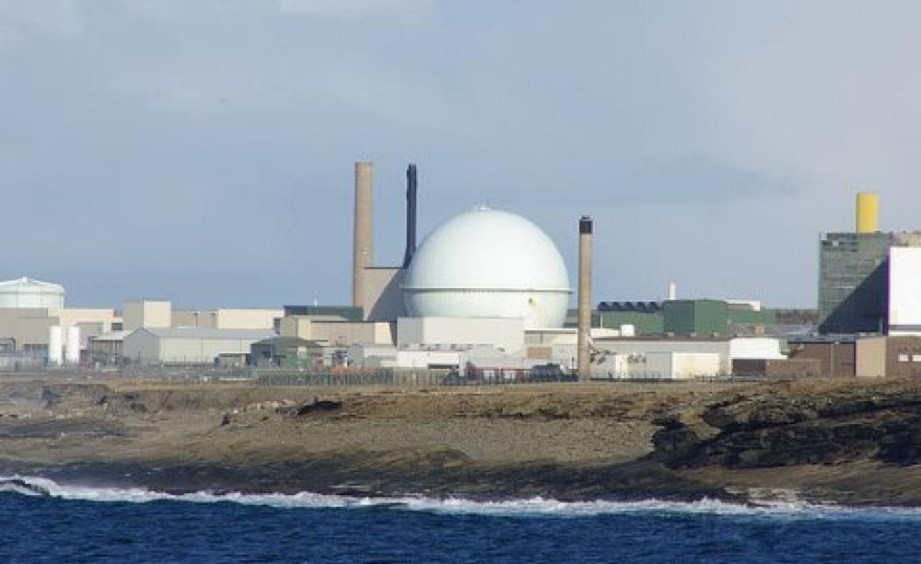
Generation of Electricity

Slide 3
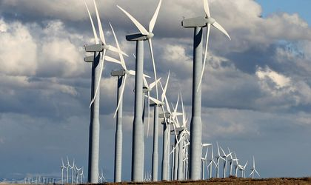
Generation of Electricity

Slide 4
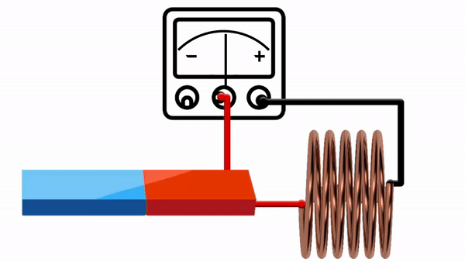
Generation of Electricity
When a moving magnetic field is placed near a wire, the wire can have electrical energy induced in it.

Slide 5
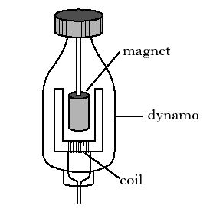
Generation of Electricity
If the magnetic field is able to rotate (spin) a generator (or dynamo) can be built.

Slide 6
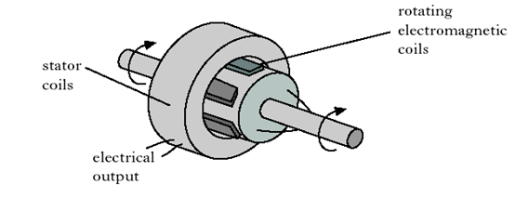
Generation of Electricity
A rotating magnetic field is used in the electrical generators of most power stations.

Slide 7
Generation of Electricity
A simplified diagram of a fossil fuel (coal, oil, gas) power station is shown below:
In this case a turbine is used to turn the drive shaft, to create a rotating magnetic field in the generator.

Slide 8
Generation of Electricity
Two key energy changes are needed for non-renewable power stations to operate.
Chemical to Heat
This happens in the boiler (fossil fuels) or reactor (nuclear).
Kinetic to Electrical
This happens in the generator.

Slide 9
Generation of Electricity
Quick question…
… from S1 what is meant by the terms
Energy source
Non-renewable
Renewable?

Slide 10
Generation of Electricity
Create a table to classify the following energy sources into two groups
renewable or non-renewable.
coal gas hydro nuclear solar tidal oil wind
Renewable | Non-renewable

Slide 11
Generation of Electricity
By carrying out research can you find at least one advantage and one disadvantage for the sources in the previous table.
Present your research to the rest of the class…you can decide on which format the presentation should take.
PowerPoint
Poster
A solo talk
Sing it to the class!

Slide 12
Generation of Electricity
All non-renewable power stations can generate a lot of electrical energy.
The non-renewable power stations that use fossil fuels (coal, oil and gas) also produce a lot of atmospheric pollution.
The non-renewable power stations that use nuclear fuel generate the most electrical energy per kilogram of fuel but they also produce radioactive waste. This radioactive waste can be harmful to living cells and can be hard to store or destroy.

Slide 13
Generation of Electricity
Renewable power stations do not generate a lot of electrical energy and can be expensive to set up.
However, renewable energy power stations produce very little atmospheric pollution.
The energy sources for renewable power stations are freely available, e.g. wind, but are not always available, e.g. it is not always sunny in Scotland!

Slide 14
Generation of Electricity
Electrical energy is supplied all over the world. Which sources are used most often? (All % values are approximate)
These values vary from country to country – nuclear is 75% in France.
Research and create a similar table for Scotland.
Source | % of World Energy Supplied
coal | 41
gas | 20
hydro | 16
nuclear | 14
wind | 5
solar | 2

Slide 15
Generation of Electricity
Efficiency of energy supply is very difficult to measure. In the table below all % values are approximate.
These values vary from country to country – angle to the sun will effect your solar efficiency.
Source | Efficiency of Supply
hydro | 90
wind | 45
coal | 37
gas | 35
solar | 16

Slide 16
Generation of Electricity
Systems are not 100% efficient.
The energy that gets put into a system does not all become useful output energy.
But it is easier to measure the efficiency of individual parts of the system.

Slide 17
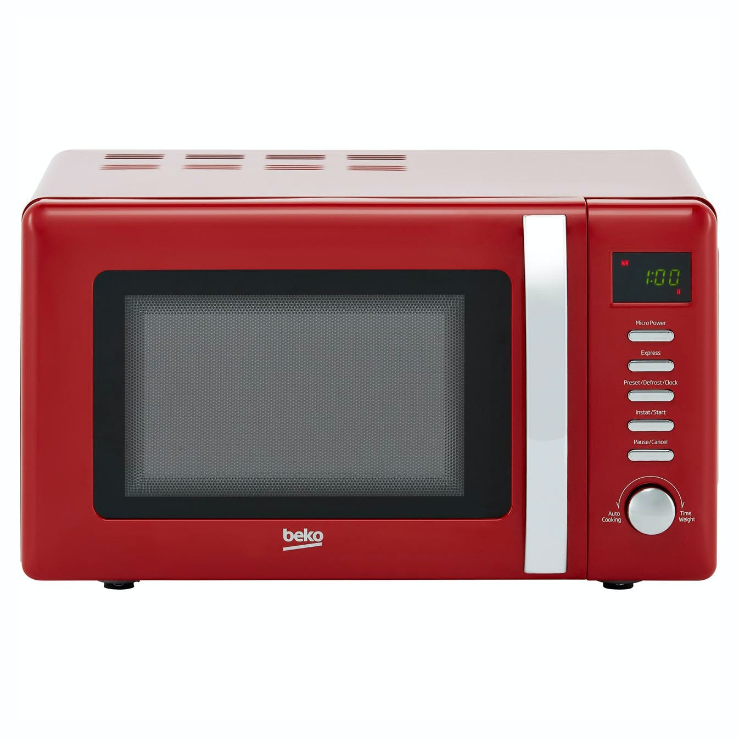
Generation of Electricity
A microwave oven is not 100% efficient because…

Slide 18
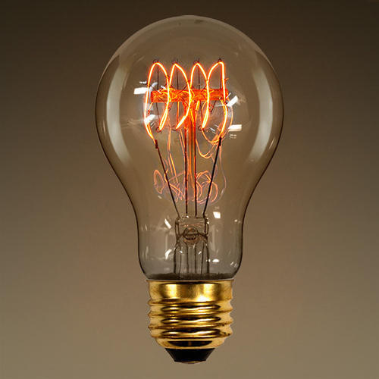
Generation of Electricity
A filament lamp is not 100% efficient because…

Slide 19
Generation of Electricity
Power stations and electricity transmission are not 100% efficient.
But it is easier to find out about the efficiency of individual parts of the whole process.
Explain why each of the following may not be 100% efficient.
Boiler
Turbine
Generator
Overhead cables

Slide 20
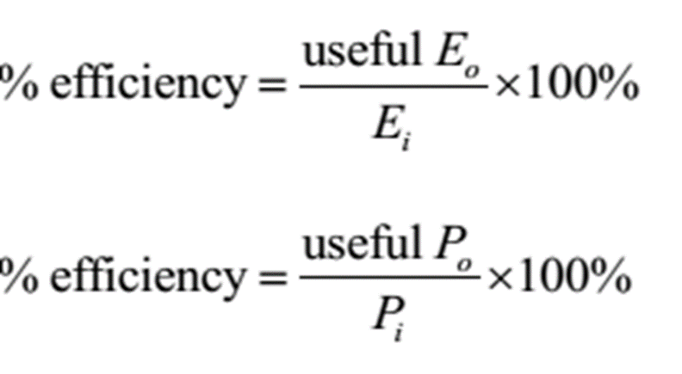
Generation of Electricity
Efficiency is usually quoted as a percentage and can be calculated using the following equations:

Slide 21
Generation of Electricity – Review Questions
Q.1.

Slide 22
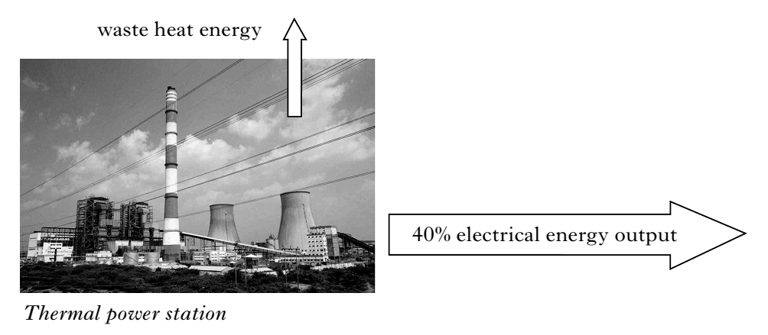
Generation of Electricity – Review Questions
Q.2. A thermal power station has an efficiency of 40%.

Slide 23
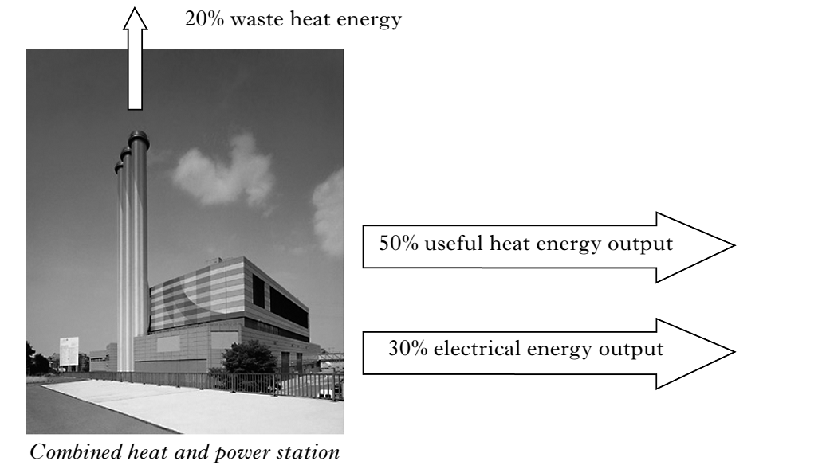
Generation of Electricity – Review Questions
Q.2. A combined heat and power station produces hot water for homes as well as generating electrical energy.

Slide 24
Generation of Electricity – Review Questions
Q.2.
State the percentage of waste heat energy from the thermal power station.
State the useful energy output from the combined heat and power station.

Slide 25
Generation of Electricity – Review Questions
Q.3. A nuclear power station has an energy output of 1500 megajoules. A hydro power station has an energy output of 25 megajoules.
State an advantage of using a nuclear power station.
State an advantage of using a hydro power station.
Calculate the number of hydro power stations needed to generate the same value of energy as one nuclear power station.

Slide 26
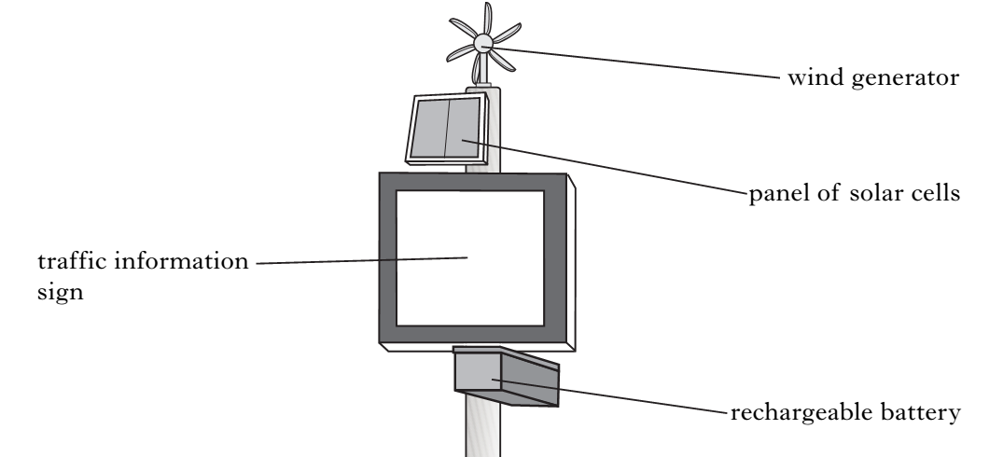
Generation of Electricity – Review Questions
Q.4. Part of a traffic information sign is shown below.

Slide 27
Generation of Electricity – Review Questions
Q.4. One square metre of solar cells can generate up to 80 watts of power. The panel of solar cells has an area of 0.4 square metres.
a) State the energy change that takes place in a solar cell.
b) Calculate the maximum power output from the panel of solar cells.

Slide 28
Generation of Electricity – Review Questions
Q.4. The table below shows the power output of the wind generator at different speeds.
c) State the power output when the wind speed is 6 ms⁻¹.
d) The maximum power output from the wind generator is 64 W. State the wind speed that will achieve maximum power output.
Wind Speed (ms⁻¹) | 2 | 4 | 6 | 8 | 10
Power Output (W) | 8 | 16 |  | 32 | 40

Slide 29
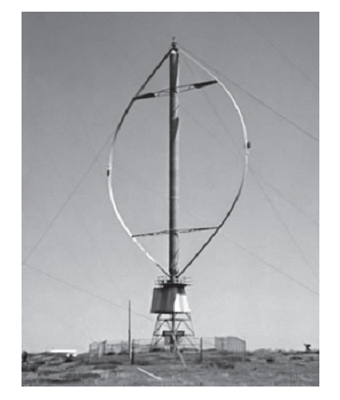
Generation of Electricity – Review Questions
Q.5. A scientific research station near the South Pole uses a vertical axis windmill to generate electricity.

Slide 30
Generation of Electricity – Review Questions
Q.5. During a 24 hour period the average power output of the wind powered generator is 25 kilowatts.
Show that the electricity generated is 600 kilowatt-hours.
The station uses 200 kilowatt-hours of the energy it generates in a 24 hour period. The remaining energy is sold at 9 pence per kilowatt-hour. Calculate the income in a 24 hour period.

Slide 31
Generation of Electricity – Review Answers
Q.1. D
Q.2. a) 60% b) 80%
Q.3. a) Nuclear generates a lot of electrical energy
Q.3. b) Hydro does causes any air pollution.
Q.3. c) 60
Q.4. a) Light to Electrical b) 32 W c) 24 W d) 16 ms⁻¹
Q.5. a) 24 x 25 b) £36.00

