Slide 1
S3/S4 Physics
Input Devices

Slide 2
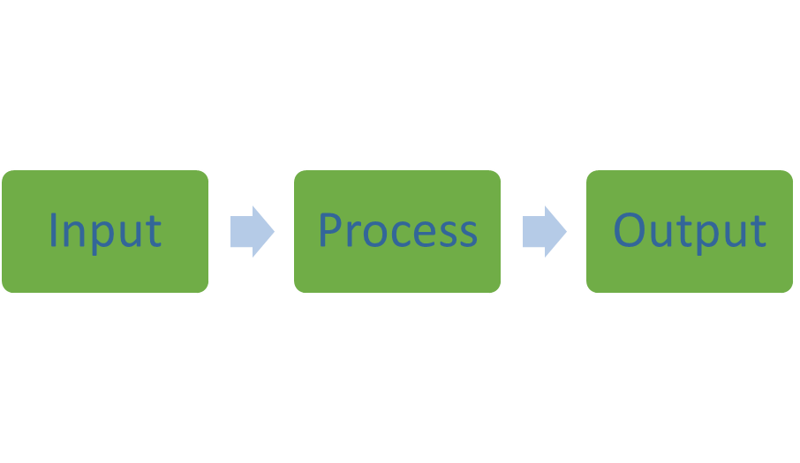
Input Devices
Electrical and electronic systems can be split into three parts:

Slide 3
Input Devices
The input part, detects or senses or takes in a type of energy.
The process part, processes electrical energy.
The output part, gives out a useful type of energy.

Slide 4
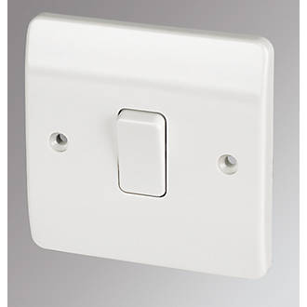
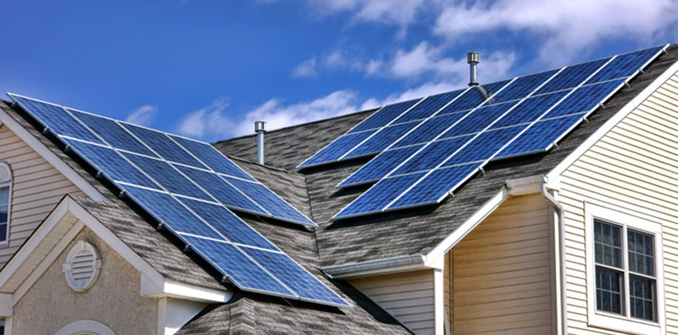
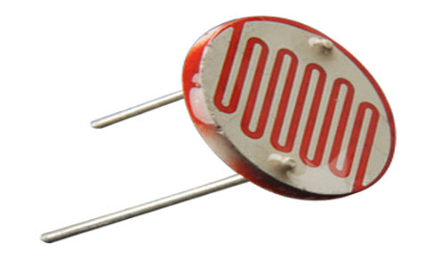

Slide 5
Input Devices
Input devices sense or take in a useful energy and convert it to electrical energy.
Examples
Switch
Microphone
Photovoltaic (Solar) Cell
LDR
Thermistor

Slide 6
Input Devices
From practical work and/or research complete the following table:
Device | Symbol | Energy Input | Possible Use
LDR
Microphone
Solar Cell
Switch
Thermistor

Slide 7
Input Devices - Thermistors
A thermistor is an example of an input sensor.
The resistance of a thermistor depends on temperature (heat energy).
The greater the temperature the lower the resistance.
(Temperature Up Resistance Down – T.U.R.D)
The symbol for a thermistor is shown below:

Slide 8
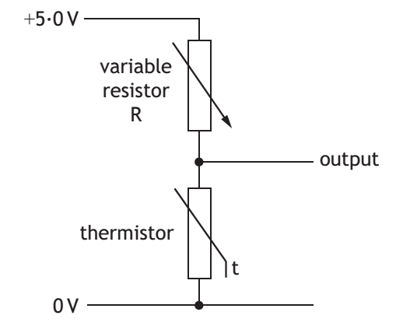
Input Devices - Thermistors
Thermistors are often used as input sensors in more complex circuits.

Slide 9
Input Devices - Thermistors
In this circuit when the temperature increases, the resistance of the thermistor will __crease.
(T.U.R.D)
This will make the output reading __crease.
In this circuit when the temperature decreases, the resistance of the thermistor will __crease.
This will make the output reading __crease.

Slide 10
Input Devices - LDRs
An LDR is an example of an input sensor.
The resistance of an LDR depends on light level.
The greater the light level the lower the resistance.
(Light level Up Resistance Down – L.U.R.D)
The symbol for an LDR is shown below:

Slide 11
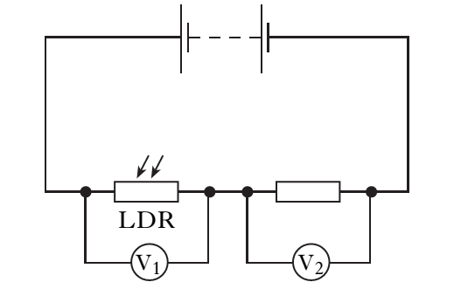
Input Devices - LDRs
LDRs are often used as input sensors in more complex circuits.

Slide 12
Input Devices - LDRs
In this circuit when the light level increases the resistance of the LDR will __crease.
(L.U.R.D)
This will make the reading on voltmeter V₁ __crease.
Assuming there is no change in the potential difference (voltage) of the supply, the reading on voltmeter V₂ must __crease.
A decrease in light level would have the opposite effect.

Slide 13
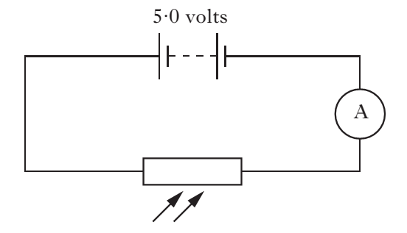
Input Devices – Thermistors and LDRs
Example One
An LDR is used as a light sensor in an automatic soap dispenser. The circuit is shown below.

Slide 14
Input Devices – Thermistors and LDRs
Example One (continued)
When the LDR is uncovered the reading on the ammeter is 2 mA. Calculate the resistance of the LDR.
Solution
(Remember “m or milli” means x 10⁻³)
V = I x R
5 = 2 x 10⁻³ x R
R = 5 / 2 x10⁻³
R = 2500 Ω

Slide 15
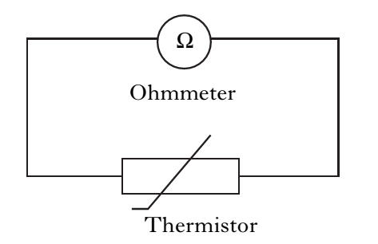
Input Devices – Thermistors and LDRs
Example Two
The circuit below is used to monitor changes in the temperature of a liquid. The thermistor is fully immersed in the liquid.
State what happens to the resistance of the ohmmeter when the liquid cools.
Solution – (Temperature down; resistance up) Ohmmeter reading increases.

Slide 16
Input Devices – Thermistors and LDRs
Example Three
A thermistor is connected to a 6 V supply as shown below.
Calculate the ammeter reading when the thermistor is placed in a beaker of water at 40 ºC.

Slide 17
Input Devices – Thermistors and LDRs
Solution
Read the resistance value from the table then apply Ohm’s Law.
V = I x R
6 = I x 400
I = 6 / 400
I = 0.015 A

Slide 18
Input Devices - Capacitors
Capacitors
Capacitors are devices that store up electrical charge.
When this happens the potential difference (voltage) across the capacitor increases.
A typical capacitor circuit is shown on the next slide.

Slide 19
Input Devices - Capacitors

Slide 20
Input Devices - Capacitors
Capacitors
The maximum potential difference (voltage) that can be reached is equal to the supply voltage (V_{S}). For the circuit shown the maximum potential difference would be 4.5V.
The capacitance (storage space) in a capacitor is measured in Farads(F).
Capacitors are often used in timing circuits.

