Slide 1
S3/S4 Physics
Newton’s Laws

Slide 3
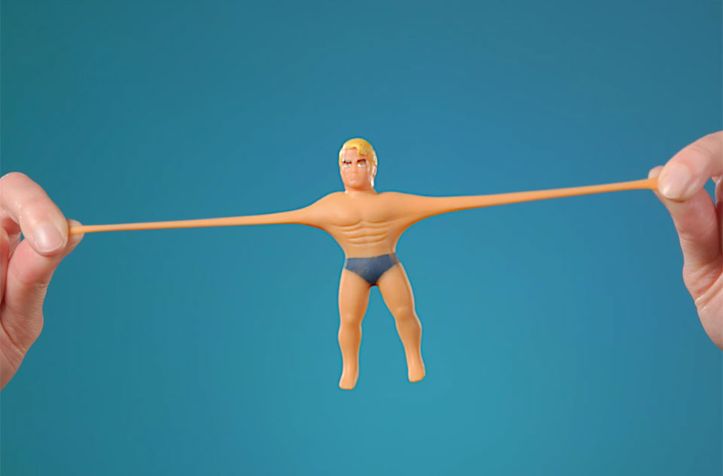
Newton’s Laws
Forces
Forces can be detected when they change the shape of an object.

Slide 4
Newton’s Laws
Forces
Forces can be detected when they change the speed of an object.

Slide 5
Newton’s Laws
Forces
Forces can be detected when they change the direction of an object.

Slide 6
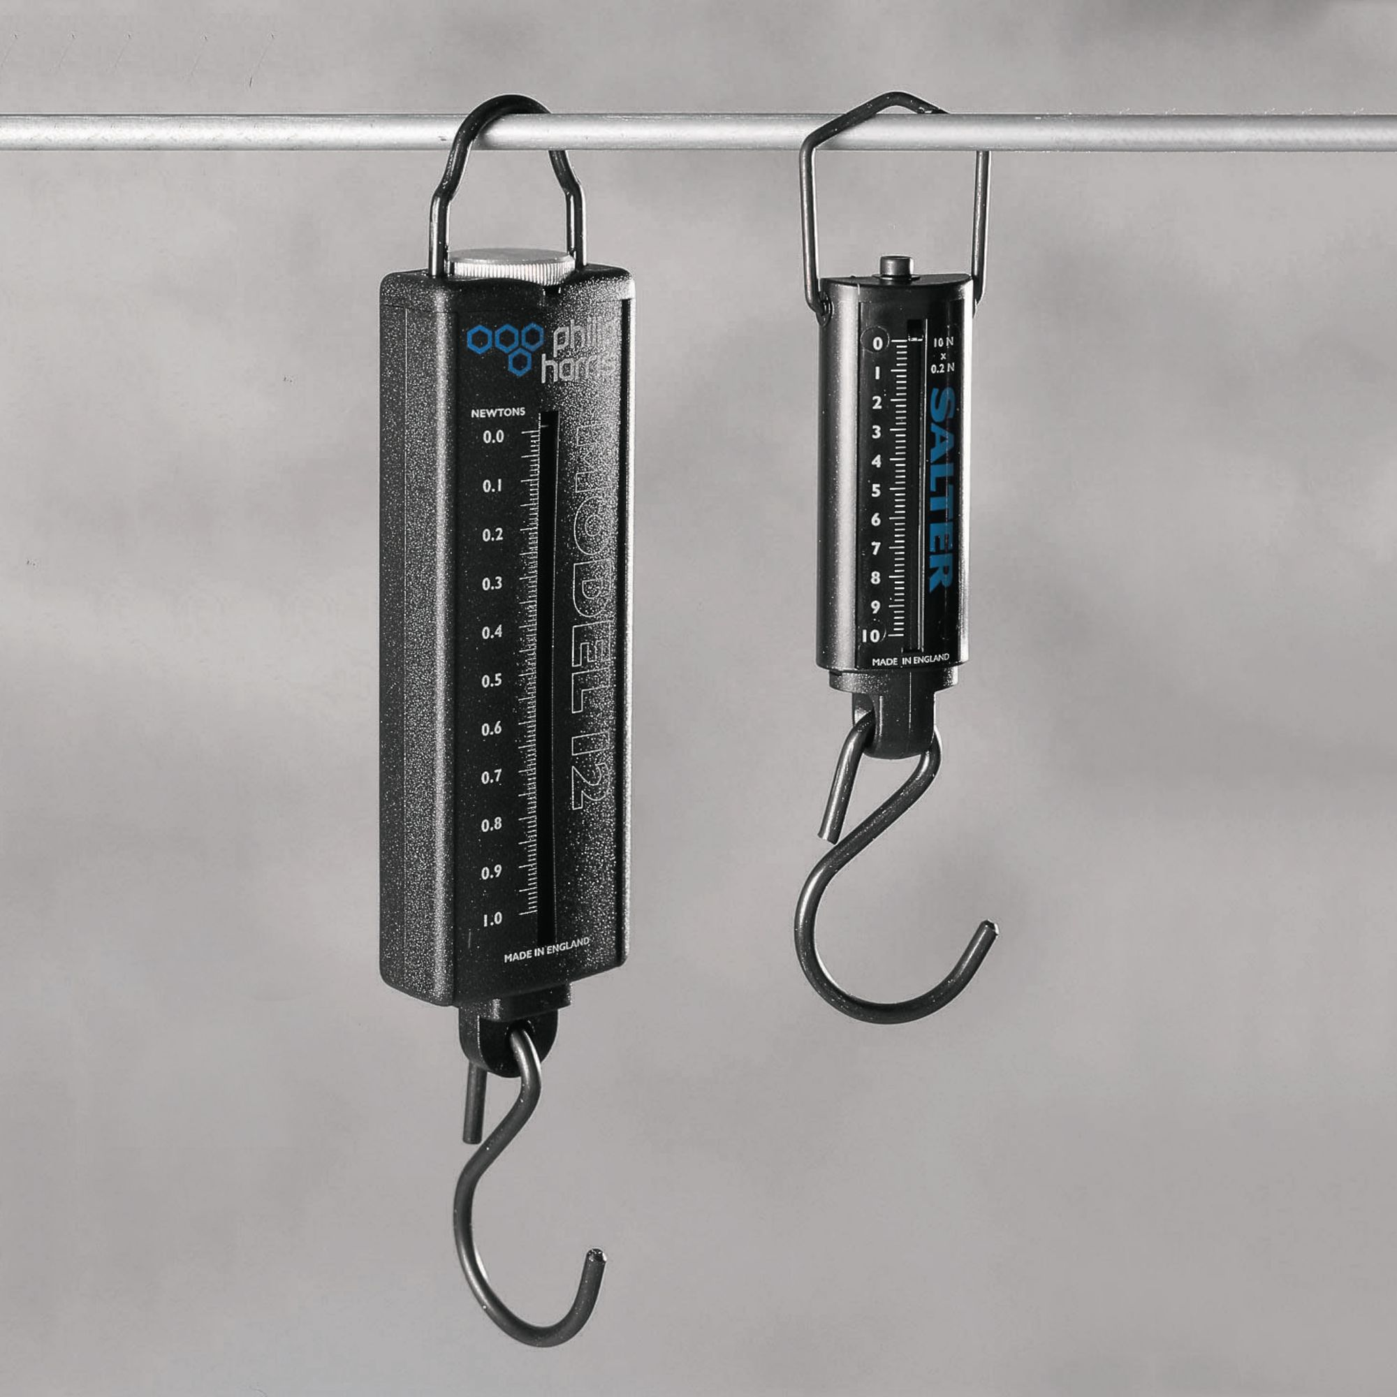
Newton’s Laws
The magnitude (size) of a force can be measured using a Newton Balance.

Slide 7
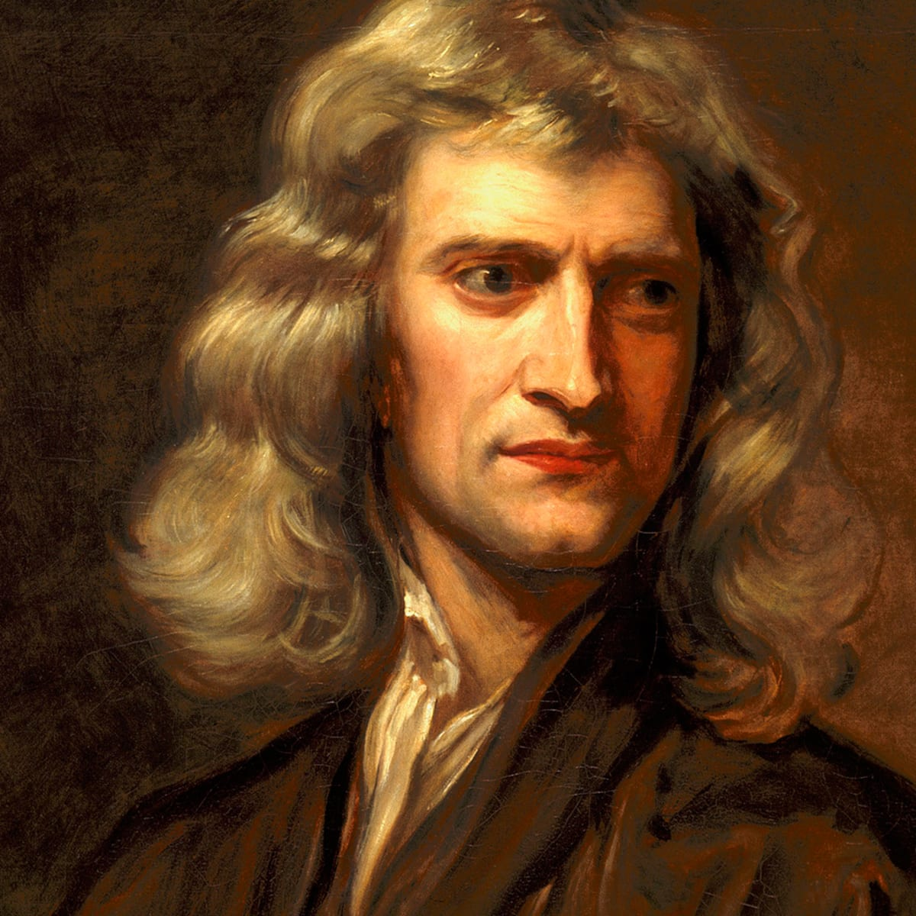
Newton’s Laws
The unit used to measure force is the Newton (N).

Slide 8
Newton’s Laws
Friction
Friction causes a force that opposes the motion of an object.
Friction is caused by the contact between two surfaces.

Slide 9
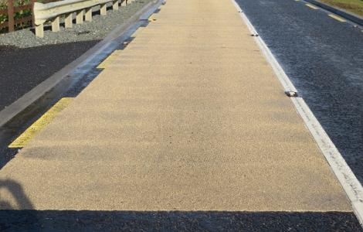
Newton’s Laws
High Friction
The force of friction can be increased by making the surfaces rougher.

Slide 10
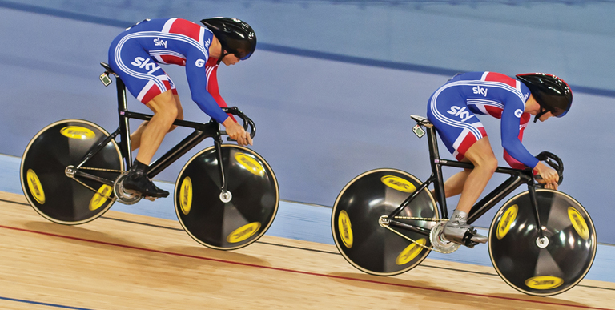
Newton’s Laws
Low Friction
The force of friction can be reduced by making surface (or shapes) smoother or more streamlined.

Slide 11
Newton’s Laws
Balanced forces can happen when two forces that are the same size as each other act on the same object but in opposite directions.

Slide 12
Newton’s Laws
From practical work or research find out what happens to an object when the forces acting on an object are balanced.
When objects are at rest or travel with a constant speed the forces applied to the object are said to be balanced.
2000 N 2000 N
Frictional Force Engine Force
Newton worked this out and called it his First Law of Motion.

Slide 13
Newton’s Laws
Newton’s First Law can be written as follows:-
“ A stationary object will remain at rest or a moving object will remain with a constant speed when balanced forces act on the object.”

Slide 14
Newton’s Laws
From practical work or research find the relationship between the variables force (F), mass (m) and acceleration (a).
It can be shown that...
… the acceleration of an object will increase when the force acting on it increases. (Assume no change in mass.)
…the acceleration of an object will decrease when the mass of the object increases. (Assume no change in force.)

Slide 15
Newton’s Laws
Newton carried out practical work and research on this relationship.
This work helped to form his Second Law of Motion, which is normally written as the following equation:
F = ma
where,
F is the unbalanced force measured in Newtons (N)
m is the mass in kilograms (kg)
a is the acceleration in metres per second per second (ms⁻²)

Slide 16
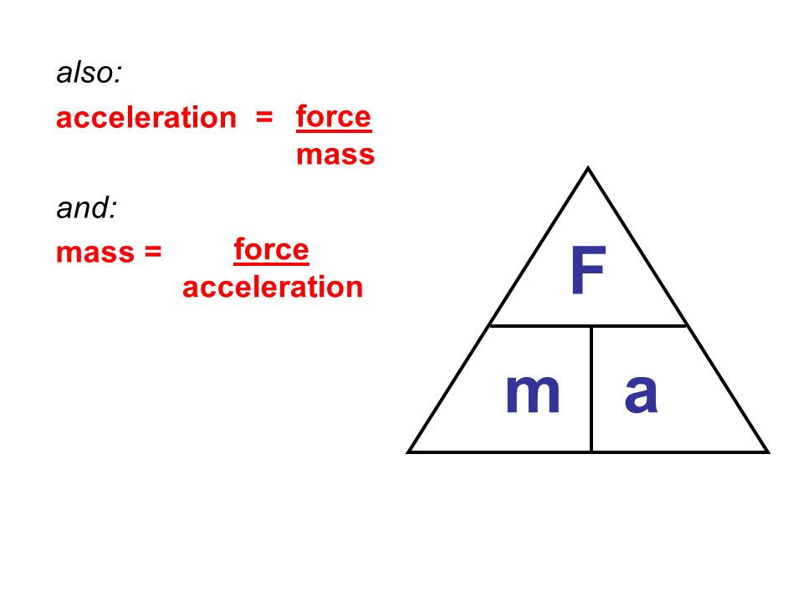
Newton’s Laws
This equation can also be written as a triangle:

Slide 17
Newton’s Laws – Calculations Part One
Example One
An unbalanced force acts on a mass of 15 kg, which makes it accelerate at 5 ms⁻². Calculate the unbalanced force acting on the mass.
Solution
F = m x a
F = 15 x 5
F = 75 N

Slide 18
Newton’s Laws – Calculations Part One
Example Two
A sledge is being pulled by an unbalanced force of 90 N. The sledge accelerates at 4.5 ms⁻². Calculate the mass of the sledge.
Solution
F = m x a
90 = m x 4.5
m = 90 / 4.5
m = 20 kg

Slide 19
Newton’s Laws – Calculations Part One
Example Three
The unbalanced force acting on a car is 1900 N. The car has a mass of 1000 kg. Calculate the acceleration of the car.
Solution
F = m x a
1900 = 1000 x a
a = 1900 / 1000
a = 1.9 ms⁻²

Slide 20
Newton’s Laws – Calculations Part One
Copy and complete the following table:
Force | Mass | Acceleration
 | 10 kg | 5 ms⁻²
 | 0.5 kg | 3 ms⁻²
 | 700 g | 6 ms⁻²
 | 2500 g | 2 ms⁻²
100 N | 0.5 kg
3000 N | 250 kg
2000 N |  | 40 ms⁻²
70 N |  | 3.5 ms⁻²

Slide 21
Newton’s Laws – Calculations Part One
Copy and complete the following table:
Force | Mass | Acceleration
50 N | 10 kg | 5 ms⁻²
1.5 N | 0.5 kg | 3 ms⁻²
4.2 N | 700 g | 6 ms⁻²
5 N | 2500 g | 2 ms⁻²
100 N | 0.5 kg | 200 ms⁻²
3000 N | 250 kg | 12 ms⁻²
2000 N | 50 kg | 40 ms⁻²
70 N | 20 kg | 3.5 ms⁻²

Slide 22
Newton’s Laws – Calculations Part Two
Example One
Box X accelerates at 2.5 ms⁻². Calculate the mass of box X.
10 N 25 N
Solution
First, find the unbalanced force. F_{un} = F_{for} – F_{back}; F_{un} = 25 – 10; F_{un} = 15 N
F = m x a
15 = m x 2.5
m = 15 / 2.5
m = 6 kg

Slide 23
Newton’s Laws – Calculations Part Two
Example Two
Box Y has a mass of 5 kg. Calculate the acceleration of box Y.
6 N 28 N
6 N
Solution
First, find the unbalanced force. F_{un} = F_{for} – F_{back}; F_{un} = 28 – 12; F_{un} = 16 N
F = m x a
16 = 5 x a
a = 16 / 5
a = 3.2 ms⁻²

Slide 24
Newton’s Laws - Calculations Part Two
Example Three
A 500 g toy car accelerates at 3 ms⁻² when the engine force is 2 N.
Frictional force Engine force
Calculate the unbalanced force acting on the toy car.
Calculate the frictional force acting on the toy car.

Slide 25
Newton’s Laws – Calculations Part Two
Solution (Remember mass is measured in “kg”)
a)
F = m x a
F = 0.5 x 3
F = 1.5 N
b)
F_{un} = F_{for} – F_{back}
1.5 = 2 – F_{back}
F_{back} = 0.5 N

Slide 26
Newton’s Laws – Calculations Part Two
Example Four
A Physics trolley, mass 0.4 kg, accelerates at 2.5 ms⁻². The force of friction acting on the trolley is 5 N.
Calculate the unbalanced force acting on the trolley.
Calculate the force pushing the trolley forward.

Slide 27
Newton’s Laws – Calculations Part Two
Solution
a)
F = m x a
F = 0.4 x 2.5
F = 1 N
b)
F_{un} = F_{for} – F_{back}
1 = F_{for} – 5
F_{for} = 6 N

Slide 28
Newton’s Laws – Calculations Part Two
Copy and complete the following table:
Force forward (N) | Force back (N) | Mass (kg) | Acceleration (ms⁻²)
10 | 2 | 4
4 | 1 |  | 2
6 |  | 9 | 0.5
12 |  | 2.5 | 4
 | 3 | 4 | 2
 | 24 | 8 | 7

Slide 29
Newton’s Laws – Calculations Part Two
Copy and complete the following table:
Force forward (N) | Force back (N) | Mass (kg) | Acceleration (ms⁻²)
10 | 2 | 4 | 2
4 | 1 | 1.5 | 2
6 | 1.5 | 9 | 0.5
12 | 2 | 2.5 | 4
11 | 3 | 4 | 2
80 | 24 | 8 | 7

Slide 30
Newton’s Laws – Calculations Part Three
Vectors quantities, like force, can be represented by a straight line which ends with an arrowhead.
Two (or more) vectors can be combined to give a single vector known as the resultant vector.
The resultant vector must be stated with a magnitude and a direction.
When solving vector problems, the individual vectors must be combined by using the “tip to tail” method.
(This method can be used for any vector quantity e.g. velocity.)

Slide 31
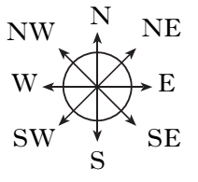
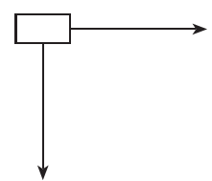
Newton’s Laws – Calculations Part Three
Example One
Two forces act on an object as shown.
120 N
50 N
a) Calculate the magnitude of the resultant force.
b) Calculate the direction in which the resultant force will act.

Slide 32
Newton’s Laws – Calculations Part Three
Solution
Draw a “tip to tail” vector triangle.
50 N
120 N Resultant force
Θ

Slide 33
Newton’s Laws – Calculations Part Three
Solution (Continued)
a) Magnitude of force uses Pythagoras
(Resultant)² = (50)² + (120)²
Resultant = 130 N
b) Direction of force uses SOHCAHTOA
Tan Θ = 50 / 120
Θ = 23º (approx.)
Resultant force = 130 N at 023

Slide 34
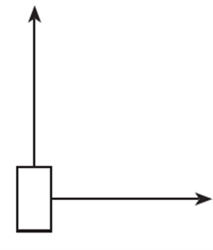
Newton’s Laws – Calculations Part Three
Example Two
An aircraft’s engines are producing a force of 2.2 x 10⁴ N due west when it encounters a side wind is blowing due south at 1.6 x 10⁴ N.
2.2 x 10⁴ N
1.6 x 10⁴ N
Calculate the resultant force on the aircraft.

Slide 35
Newton’s Laws – Calculations Part Three
Solution
Draw a “tip to tail” vector triangle.
Θ
Resultant force
2.2 x 10⁴ N 1.6 x 10⁴ N

Slide 36
Newton’s Laws – Calculations Part Three
Solution (Continued)
Magnitude of force uses Pythagoras
(Resultant)² = (2.2 x 10⁴)² + (1.6 x10⁴)²
Resultant = 2.7 x 10⁴ N
Direction of force uses SOHCAHTOA
Tan Θ = 2.2 x 10⁴ / 1.6 x 10⁴
Θ = 54º (approx.)
Resultant force = 2.7 x 10⁴ N at 234 (always give direction from North)

Slide 37
Newton’s Laws
Can you work out what each of the following images have in common?
Try to think where forces are being applied in each image.

Slide 38
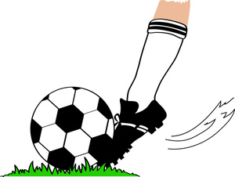
Newton’s Laws

Slide 39
Newton’s Laws
Newton’s Third Law of motion is about pairs of forces.
In each of the following images can you name the action force and its corresponding reaction force.

Slide 40
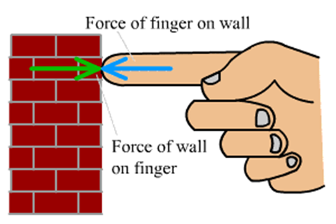
Newton’s Laws
When the action force is finger on wall, the reaction force is wall on finger.

Slide 41
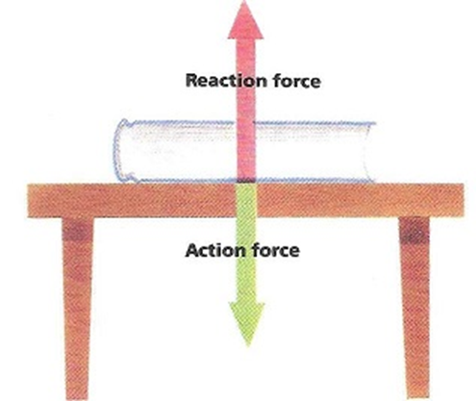
Newton’s Laws
When the action force is book on desk, the reaction force is desk on book.

Slide 42
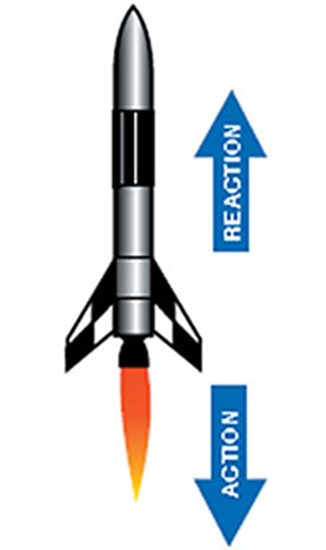
Newton’s Laws
When the action force is rocket on gases, the reaction force is gases on rocket.

Slide 43
Newton’s Laws
When the action force is racquet on ball, the reaction force is ball on racquet.

Slide 44
Newton’s Laws
When the action force is racquet on ball, the reaction force is ball on racquet.
When the action force is finger on wall, the reaction force is wall on finger.
When the action force is book on desk, the reaction force is desk on book.
When the action force is rocket on gases, the reaction force is gases on rocket.

Slide 45
Newton’s Laws
Newton’s Third Law can be summarised as:
“For every action force there is an equal and opposite reaction force.”
OR
“If object A exerts a force on an object B, then B exerts a force on object A which is equal in size but in the opposite direction.”

Slide 46
Newton’s Laws – Weight and Mass
Weight is a force.
The weight of an object always acts downwards.
Weight is measured in Newtons.
The weight of an object can change.

Slide 47
Newton’s Laws – Weight and Mass
Mass measures how much matter there is in an object.
Mass is measured in kilograms.
The mass of an object stays the same at all places.

Slide 48
Newton’s Laws – Weight and Mass
Weight to mass ratio is usually called gravity.
Gravity is the short way to write gravitational field strength (gfs).
Gravity (gfs) is measured in Newtons per kilogram (Nkg⁻¹).
From practical work (or research) find the gfs value for planet Earth.
For each object find its…
…weight from a Newton balance
…mass from a set of scales

Slide 49
Newton’s Laws – Weight and Mass
A possible set of data from the practical work is shown below:
Object | Weight (N) | Mass (kg) | Weight Mass
Mass carrier | 9.2 | 1.045 | 8.8
Tripod stand | 4 | 0.368 | 10.9
Newton balance | 1.3 | 0.145 | 9.0
Goggles | 0.6 | 0.06 | 10
Trolley | 8.3 | 0.870 | 9.5
Craig | 630 | 63 | 10.3

Slide 50
Newton’s Laws – Weight and Mass
Weight to mass ratio is known as gravitational field strength (gfs).
gfs is defined as the weight per unit mass.
For planet Earth the gfs is quoted as 9.8 Nkg⁻¹.
This means that there is a downwards force of 9.8 N acting per one kilogram of mass.

Slide 51
Newton’s Laws – Weight and Mass
gfs can vary depending on where you are on the surface of Earth.
Altitude and latitude make a big difference.
Try to find out where the gfs is greatest and least on the surface of Earth.

Slide 52
Newton’s Laws – Weight and Mass
Weight can be calculated by using the equation:
W = mg
where,
W is weight measured in Newtons (N)
m is mass measured in kilograms (kg)
g is gravitational field strength measured in Newtons per kilogram(Nkg⁻¹)

Slide 53
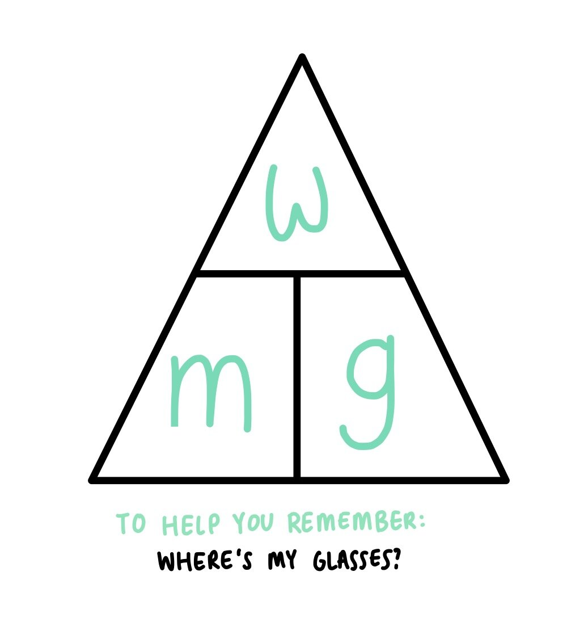
Newton’s Laws
This equation can also be written as a triangle:

Slide 54
Newton’s Laws – Weight and Mass
Example One
Craig, mass 50 kg, visits Mars which has a gfs of 4 Nkg⁻¹.
a) State his mass on Mars. b) Calculate his weight on Mars.
Solution
50 kg
b)
W = m x g
W = 50 x 4
W = 200 N

Slide 55
Newton’s Laws – Weight and Mass
Example Two
Ross wins a trip to the Moon which has a gfs of 1.6 Nkg⁻¹. His weight on the moon is 72 N.
a) Calculate his mass on the moon. b) State his mass on Earth.
Solution
a)
W = m x g
72 = m x 1.6
m = 72 / 1.6
m = 45 kg
b) 45kg

Slide 56
Newton’s Laws – Weight and Mass
Example Three
Mr Downie takes a trip to space but crash lands his spaceship. Mr Downie’s mass on Earth is 65 kg and his weight when he crashes is 715 N. Determine on which planet he crashes.
Solution
W = m x g
715 = 65 x g
g = 715 / 65
g = 11 Nkg⁻¹
By looking up a Physics data sheet the planet must be Neptune.

Slide 57
Newton’s Laws – Weight and Mass
Copy and complete the following table:
Weight (N) | Mass (kg) | gfs (Nkg⁻¹)
 | 50 | 9
 | 35 | 6
92.5 |  | 3.7
356 |  | 8.9
115 | 5
360 | 40

Slide 58
Newton’s Laws – Weight and Mass
Copy and complete the following table:
Weight (N) | Mass (kg) | gfs (Nkg⁻¹)
450 | 50 | 9
210 | 35 | 6
92.5 | 25 | 3.7
356 | 40 | 8.9
115 | 5 | 23
348 | 40 | 8.7

Slide 59
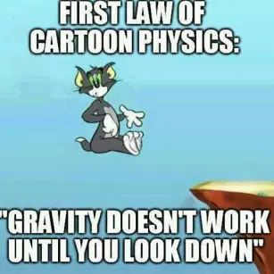
Newton’s Laws – Free Fall
When an object is falling freely due to the force of gravity.

Slide 60
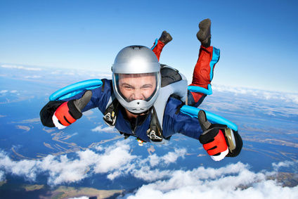
Newton’s Laws – Terminal Velocity
A constant velocity created when the driving force is balanced by the frictional force.

Slide 61
Newton’s Laws
The graph on the next slide shows how the velocity of a parachutist varies with time from the start of the jump until they reach the ground. Explain each section of the graph using Newton’s Laws of Motion.
Your explanation should include the terms:
Balanced
Unbalanced
Free Fall
Terminal Velocity

Slide 62
Newton’s Laws

Slide 64
Newton’s Laws
Section O to A
When the parachutist leaves the aircraft they will be in free fall.
The frictional force (called air resistance) will be less than weight.
There will be an unbalanced force acting on the parachutist.
According to Newton’s Second Law the parachutist will accelerate.

Slide 66
Newton’s Laws
Section A to B
At point A the air resistance has increased to become equal to the weight of the parachutist.
The forces are balanced. The acceleration is now zero.
According to Newton’s First Law the parachutist Is travelling with a constant velocity called terminal velocity.
At point B the parachute is opened.

Slide 68
Newton’s Laws
Section C to D
There is a rapid increase in air resistance when the parachute is opened. The upwards force is now greater than weight for a short time.
At point C the air resistance and weight have become balanced again.
The acceleration is now zero.
The constant velocity is much lower.
At point D the parachutist reaches the ground.

Slide 69
Newton’s Laws – Review Questions
Q.1. An unbalanced force of 96 kN acts on train, which accelerates at 1.2 ms⁻². Calculate the mass of the train.
Q.2. A satellite, mass 50 kg, is being moved to a new location in space. The forces acting on the satellite are shown below.
Calculate the acceleration of the satellite.

Slide 70
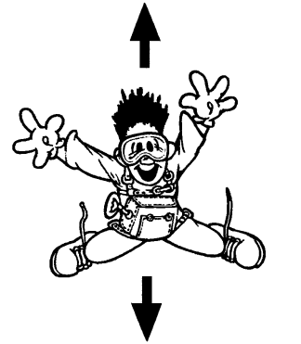
Newton’s Laws – Review Questions
Q.3. A skydiver, mass 75 kg, is shown below.

Slide 71
Newton’s Laws – Review Questions
Q.3. (continued)
a) Copy the diagram and add the labels for the forces acting on the skydiver.
b) Calculate the weight of the skydiver.
c) The unbalanced force on the skydiver is 185 N. Calculate the acceleration of the skydiver.
d) State the value of air resistance acting on the skydiver.

Slide 72
Newton’s Laws – Review Questions
Q.4.
a) Use Newton’s First Law to explain why a space vehicle does not need to have it’s engines switched on in outer space.
b) Use Newton’s Second Law to explain how a space probe is able to land on an object in space.
c) Use Newton’s Third Law to explain how a rocket is launched.

Slide 73
Newton’s Laws – Review Answers
Q.1. 80000 kg
Q.2. 0.2 ms⁻²
Q.3. a) Air resistance
Weight

Slide 74
Newton’s Laws – Review Answers
Q.3. b) 735 N
Q.3. c) 2.5 ms⁻²
Q.3. d) 550 N
Q.4. a) No frictional forces, means space vehicle will continue with a constant speed. (No unbalanced force to cause an acceleration.)
Q.4. b) Thrusters can create an unbalanced force which will allow the space probe to decelerate and/or change direction allowing it to land.
Q.4. c) When the action force is rocket on gases, the reaction force is gases on rocket.

