Slide 1
S3/S4 Physics
Ohm’s Law

Slide 2
Ohm’s Law
Ohm’s law refers to the relationship between potential difference (voltage), current and resistance.
Ohm’s law can be checked in the lab using a power supply, a voltmeter, an ammeter and a resistive component.
The circuit that could be set up is shown on the next slide.

Slide 3
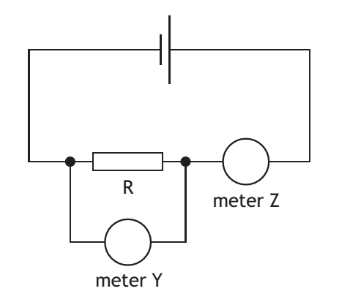
Ohm’s Law

Slide 4
Ohm’s Law
The potential difference from the supply is varied. At each new setting the following readings are taken:
Current from the ammeter (meter Z)
Potential difference (voltage) from the voltmeter (meter Y)

Slide 5
Ohm’s Law
A possible set of results is shown below.
Current (A) | Potential Difference (V)
1.30 | 10
1.90 | 15
2.55 | 20
3.25 | 25
3.75 | 30

Slide 6
Ohm’s Law
The analysis of the data can be carried out numerically or graphically.
Numerically – divide each potential difference value by the matching current value
Graphically – plot a line graph of potential difference (y-axis) against current (x-axis) and draw a line of best fit

Slide 7
Ohm’s Law
Numerical Analysis
10 /1.30 = 7.7 15 / 1.90 = 7.9 20 / 2.55 = 7.8
25 / 3.25 = 7.7 30 / 3.75 = 8.0
The trend in the answers is to give a value that is approximately the same (or constant) every time.
This statement is normally written as:
Voltage / Current = a constant
Where the name of the constant is called resistance.

Slide 8
Ohm’s Law
Graphical Analysis
The line of best fit should be a straight line which passes directly through the origin. This means that potential difference (voltage) is directly proportional to current.
This statement can also be written as:
Voltage / Current = a constant
Where the name of the constant is called resistance.
(To calculate the value of the resistance you need to find the gradient of the line of best fit – N5 content)

Slide 9
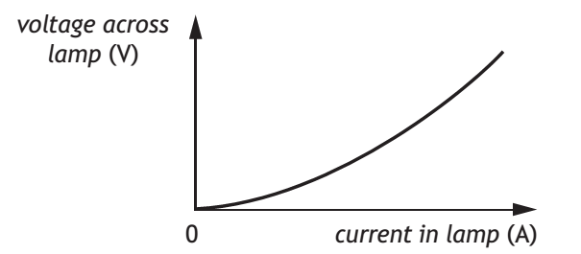
Ohm’s Law
Not all conductors will give a straight line graph passing through the origin. The graph below is for the conducting wire in a filament lamp.

Slide 10
Ohm’s Law
Graphical Analysis
This time when the data is analysed it can be shown that the resistance of the conducting wire in the filament will increase as the potential difference (voltage) across it is increased.
V / I gives a greater number (resistance) when the calculation is carried out further from the origin.
Note: A similar analysis could be carried out to show that the resistance of a conductor is likely to increase with temperature.

