Slide 1
N5 Physics
Ohm’s Law Calculations

Slide 2
Ohm’s Law Calculations
Ohm’s law refers to the relationship between potential difference (voltage), current and resistance.
In equation form this is written as:
V – potential difference (voltage) measured in Volts (V)
I – current measured in Amperes (A)
R – resistance measured in Ohms (Ω)

Slide 3
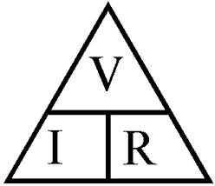
Ohm’s Law Calculations

Slide 4
Ohm’s Law Calculations
Example One
A current of 1.5 A passes through an 8 Ω resistor. Calculate the potential difference (voltage) across the resistor.
Solution
V = I x R
V = 1.5 x 8
V = 8 V

Slide 5
Ohm’s Law Calculations
Example Two
A 400 kV supply is connected to a 2.5 MΩ resistor. Calculate the current passing through the resistor.
Solution
(remember k (for kilo) means x 10³ and M (for Mega) means x10⁶)
V = I x R
400 x 10³ = I x 2.5 x 10⁶
I = 400 x 10³ / 2.5 x 10⁶
I = 0.16 A

Slide 6
Ohm’s Law Calculations
Example Three
A 3 V battery is connected to a lamp. Calculate the resistance of the lamp when it draws 15 mA of current.
Solution
(remember m (for milli) means x 10⁻³)
V = I x R
3 = 15 x 10⁻³ x R
R = 3 / 15 x 10⁻³
R = 200 Ω

Slide 7
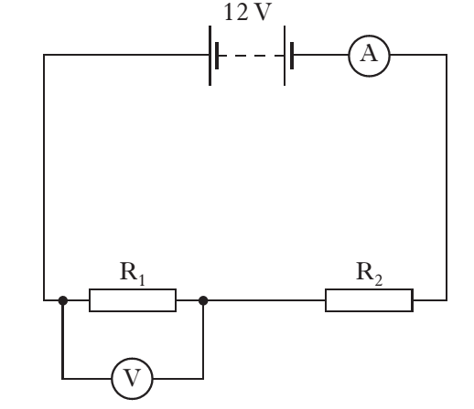
Ohm’s Law Calculations
Example Four
If the ammeter reading is 3.0 A, calculate the total resistance of the circuit.

Slide 8
Ohm’s Law Calculations
Solution
You are looking for the total resistance of a series circuit.
To use Ohm’s Law you will need to use the supply voltage and the current in the circuit.
Supply voltage is on the diagram and the current is in the question.
V = I x R
12 = 3.0 x R
R = 4 Ω

Slide 9
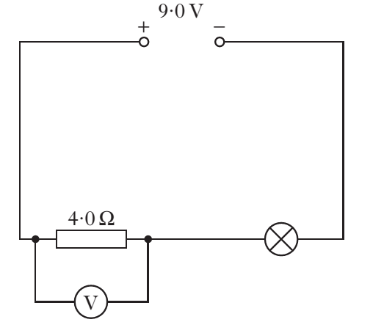
Ohm’s Law Calculations
Example Five
If the current in the lamp is 1.5 A, calculate the reading on the voltmeter.

Slide 10
Ohm’s Law Calculations
Solution
This is a series circuit. The current is the same at all points.
In other words, the current in the lamp is the same as the current in the resistor.
Resistor value is on the diagram.
V = I x R
V = 1.5 x 4
V = 6 V

Slide 11
Review Questions
1. A current of 0.6 A passes through an 12 Ω resistor. Calculate the potential difference (voltage) across the resistor.
2. A 12 V supply is connected to a 2.4 kΩ resistor. Calculate the current passing through the resistor.
3. A conductor is connected to a 1.5 V battery. When a current of
25 mA is in the conductor, calculate its resistance.

Slide 12
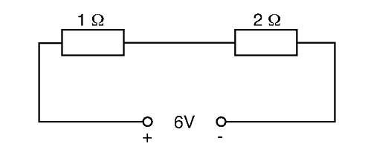
Review Questions
4. Two resistors are connected to a 6 V supply as shown.
The current in the 1 Ω resistor is 0.2 A. Calculate the potential difference (voltage) across the 2 Ω resistor.

Slide 13
Review Answers
1. V = I x R; V = 0.6 x 12; V = 7.2 V
2. V = I x R; 12 = I x 2.4 x10³; I = 5.0 x 10⁻³ A
3. V = I x R; 1.5 = 25 x 10⁻³ x R; R = 60 Ω
4. As this is a series circuit the current is the same at all points.
V = I x R; V = 0.2 x 2; V = 0.4 V

