Slide 1
S3/S4 Physics
Output Devices

Slide 2
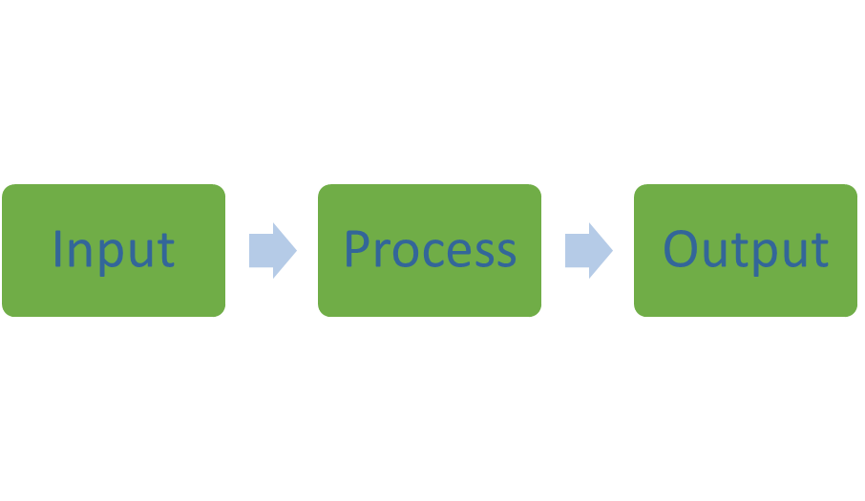
Output Devices
Electrical and electronic systems can be split into three parts:

Slide 3
Output Devices
The input part, detects or senses or takes in a type of energy.
The process part, processes electrical energy.
The output part, gives out a useful type of energy.

Slide 4
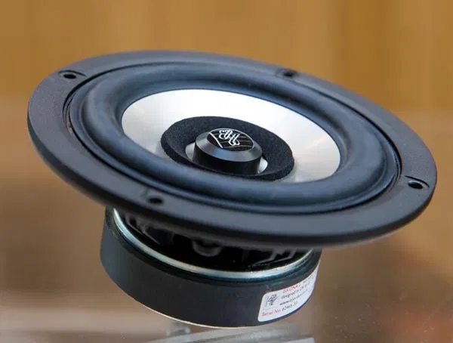
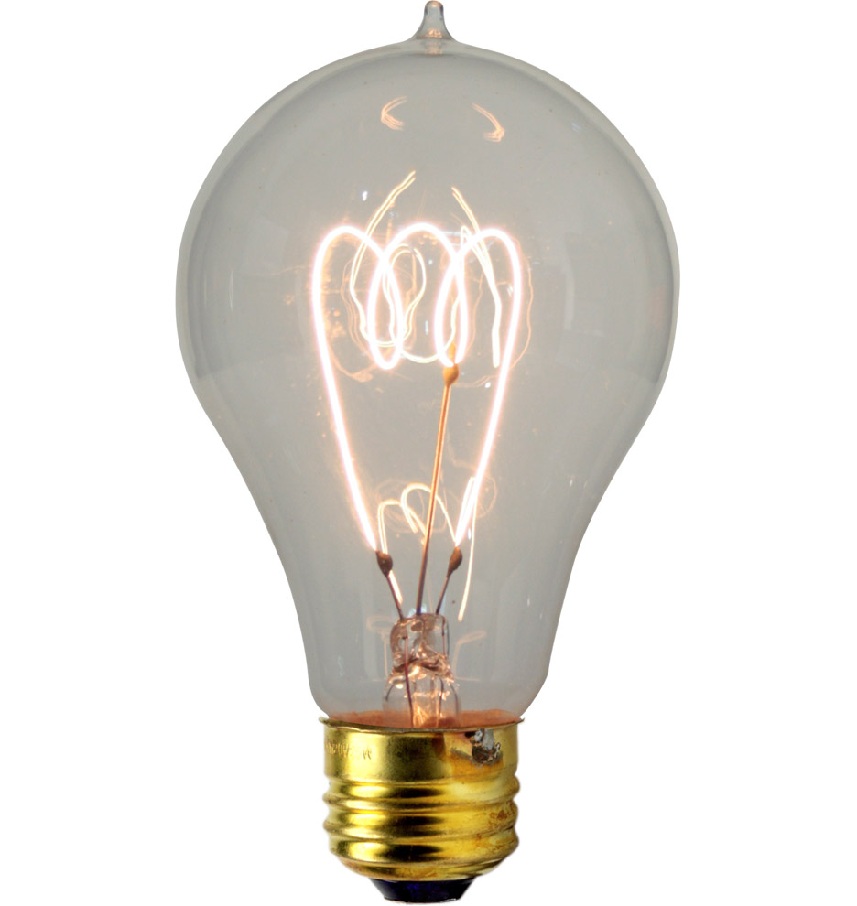
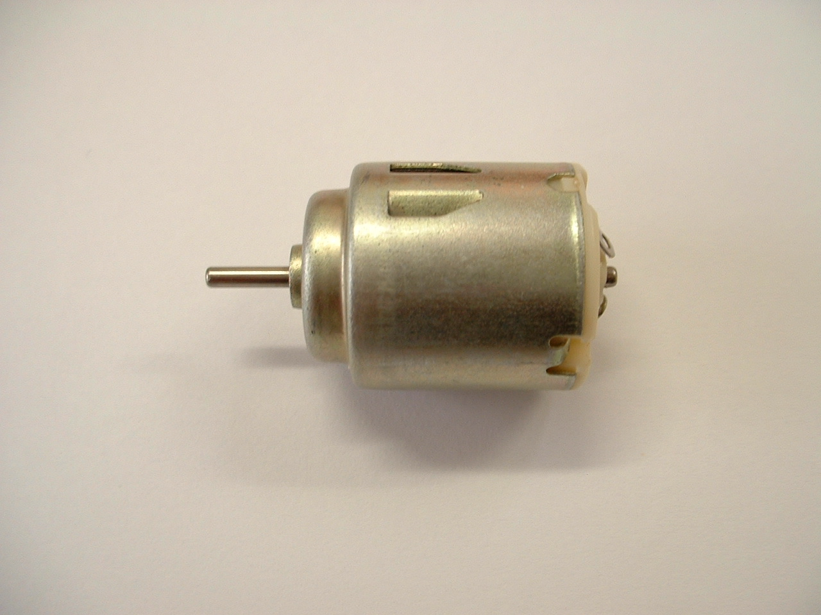
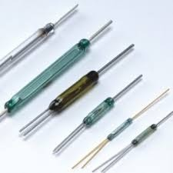

Slide 5
Output Devices
Output devices convert electrical energy into another useful energy.
Examples
LED
Motor
Loudspeaker (Buzzer)
Relay
Lamp
Solenoid

Slide 6
Output Devices
From practical work and/or research complete the following table:
Device | Symbol | Energy Output | Possible Use
LED
Motor
Loudspeaker
Relay
Lamp

Slide 7
Output Devices
Output devices can also be classified as digital or analogue.
Digital
A digital output switches directly from one value to the next value e.g. from on to off
Analogue
An analogue output has a continuous range of conditions that it can display

Slide 8
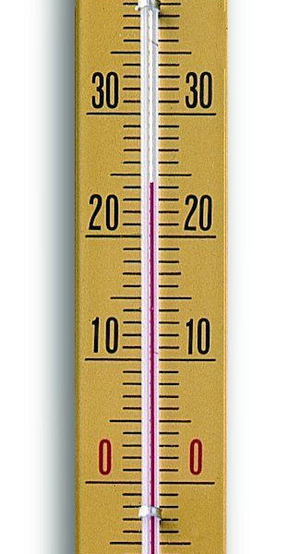

Slide 9
Output Devices
The clock is digital. It switches directly from 10.33 to 10.34.
The thermometer is analogue. It has a continuous range. The mercury can stop anywhere on the scale. It could stop in-between numbers on the scale.

Slide 10
Output Devices
Can you classify each of the following output devices as analogue or digital?
Output Device | Analogue or Digital
LED
Lamp
Loudspeaker
Buzzer
Motor
Relay

Slide 11
Output Devices - LEDS
LEDs
LEDs are low voltage output devices which operate on small currents of about 60mA.
An LED must be placed correctly in a circuit or it will not light up.
When correctly positioned the current in the circuit will flow into the tip of the triangle in the LED symbol.
This is shown on the next slide.

Slide 12
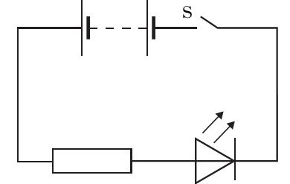
Output Devices - LEDs
R

Slide 13
Output Devices - LEDs
LEDs
The resistor, R, protects the LED by limiting the current.
This stops the LED from overheating.
LEDs are often used as indicator lights.
Example
In the following circuit the LED is rated at 2V, 100mA. Calculate the resistance of resistor R.

Slide 14
Output Devices - LEDs

Slide 15
Output Devices - LEDs
Solution
As this is a series circuit the current in the LED will be the same as the current in resistor R – 100 mA (remember “m or milli” means x 10⁻³)
There are 6 V available from the supply. The LED operates at 2 V. This means there are 4 V (6 – 2 = 4) for the resistor. Apply Ohm’s Law.
V = I x R
4 = 100 x 10⁻³ x R
R = 4 / 100 x10⁻³
R = 40 Ω

