Slide 1
S3/S4 Physics
Process Devices

Slide 2
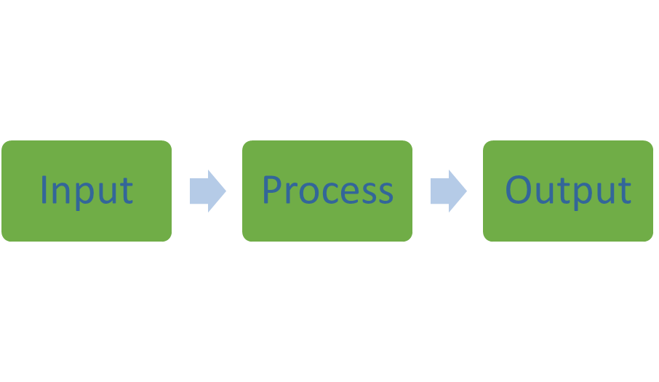
Process Devices
Electrical and electronic systems can be split into three parts:

Slide 3
Process Devices
The input part, detects or senses or takes in a type of energy.
The process part, processes electrical energy.
The output part, gives out a useful type of energy.

Slide 4
Process Devices
There are only 10 types of people in the world.
One type can understand binary and the other type do not.

Slide 5
Process Devices
Logic gates are an example of digital process devices.
All logic gates operate from inputs that can be described as…
… ON or OFF or HIGH or LOW or 1 or 0
Three common types of logic gates are
NOT-gate
AND-gate
OR-gate

Slide 7
Process Devices
By carrying out practical work or research find out the following for each of the logic gates.
Symbol
Statement of how they operate
Truth table

Slide 8
Process Devices
NOT-gate
Symbol
The output from a NOT-gate is the opposite of the input.
Put another way the output is NOT what goes in to it.
This statement can be shown in a Truth Table.

Slide 9
Process Devices

Slide 10
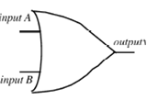
Process Devices
OR-gate
Symbol has a curved back like an “O”.
The OR-gate will give an output when input A OR input B OR both inputs are switched on.
This statement can be shown in a Truth Table.

Slide 11
Process Devices

Slide 12
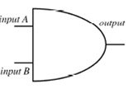
Process Devices
AND-gate
Symbol has a straight back like a “D”.
The AND-gate will only give a symbol when input A AND input B are switched on.
This statement can be shown in a Truth Table.

Slide 13
Process Devices

Slide 14
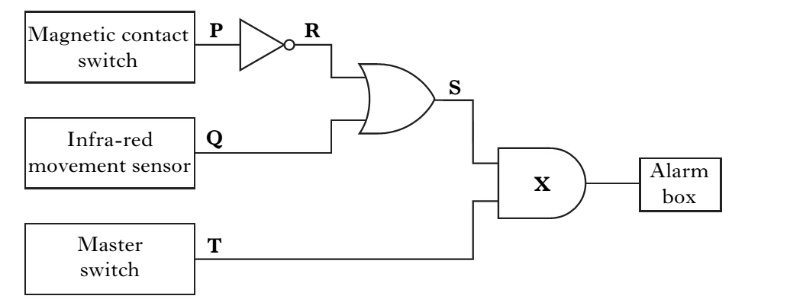
Process Devices - Logic Problems
Logic circuits are used in many electronic systems.
To design these circuits you need to think LOGICALLY.

Slide 16
Process Devices – Logic Problems
Examples of logical thinking
When you see the word DARK think NOT LIGHT.
When you see the word COLD think NOT HOT.

Slide 17
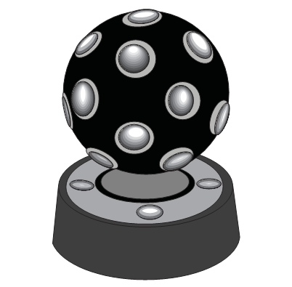
Process Devices – Logic Problems
Example One
An electronic device used for a party produces a changing light pattern when it detects music, but only when it is dark.
Draw the logic circuit for this electronic device.

Slide 18
Process Devices – Logic Problems
Solution
Remember to think logically!
The device needs to detect music AND dark.
Thinking logically - dark is NOT light.
The logic circuit must use an AND-gate and a NOT-gate could look like this.

Slide 19
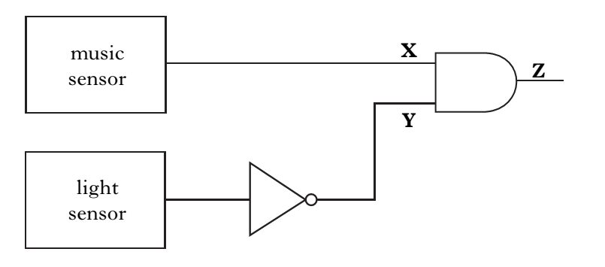

Slide 20
Process Devices – Logic Problems
Example Two
Draw a logic diagram for a seat-belt warning display. When the seat-belt is not in place (switch is in off position) and the ignition switch is in the on position a warning must be displayed.
Solution
Remember to think logically!
For the warning to be given one switch must be NOT on, AND the other switch is on. The logic circuit must use an AND-gate and a NOT-gate and could look like this.

Slide 22
Process Devices – Logic Problems
The next five slides have other logic problems to solve. But there is an extra challenge!
Can you work out which input devices and output devices should be used with each logic diagram?
Good luck : )

Slide 23
Solving Logic Problems
Example One
Design a logic circuit for a set of straighteners.
An indicator light comes on when the straighteners have been switched on and they have reached the correct temperature.

Slide 24
Solving Logic Problems
Example Two
Design a logic circuit for a door bell.
The door bell has only to work when it is switched on at night time.

Slide 25
Solving Logic Problems
Example Three
Design a logic circuit for a baby alarm.
The alarm has to give an output when it is switched on and the baby makes any kind of sound.

Slide 26
Solving Logic Problems
Example Four
Design a logic circuit for an interior light in a car.
The light should come on when the passenger door or the driver door or both are opened.

Slide 27
Solving Logic Problems
Example Five
Design a logic circuit for turning on a heating fan at night when the temperature is too cold.

Slide 28
Process Devices - Transistors
There are many types of transistor.
In this course we will study two types of transistor.

Slide 29
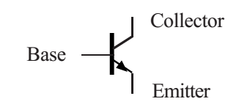
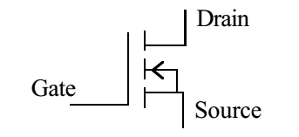
Process Devices - Transistors
NPN Bipolar Transistor
MOSFET

Slide 30
Process Devices - Transistors
Transistors act like an electronic switch.
They switch on when they receive a high enough voltage.
A typical npn bipolar transistor will switch on at around 0.7V.
A typical MOSFET will switch on at around 2V.
Transistors are often used along with potential dividers in electronic control devices.

Slide 31
Process Devices - Transistors
Transistor questions usually need you to…
Identify the components in the circuit
Explain how the circuit operates
You must remember…
L.U.R.D
T.U.R.D
Potential (Voltage) divider theory
And that low resistance needs a low voltage and that a high resistance needs a high voltage.

Slide 32
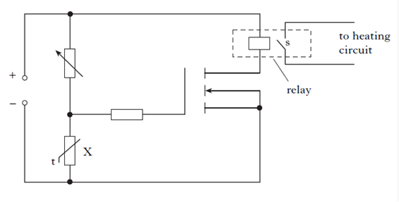
Process Devices - Transistors
Example One
Explain how the following transistor circuit operates.

Slide 33
Process Devices - Transistors
Identify all the components – this will let you work out what quantity changes to let the circuit operate. This particular circuit will react to changes in heat/temperature as component X is a thermistor.
You now need to understand the terms LURD and TURD. For this circuit TURD is used – temperature up resistance down.
Now ask yourself what will happen to the voltage when the resistance changes? (Remember - voltage will always go down when resistance goes down and vice versa.)

Slide 34
Process Devices - Transistors
Next, you have to work out how to turn on the transistor. This will always happen when the voltage across the transistor is increased to the switching voltage. So for the above circuit we need the resistance across the thermistor to increase. This will create a big enough voltage across the transistor.
For the resistance to increase the temperature must go down.
Always finish with a statement about what happens when the transistor is switched on. In this case, “current flows to the relay and the heating circuit is switched on”.

Slide 35
Process Devices - Transistors
Example Two
An electronic circuit that is used to control an automatic blind is shown below.
Name the type of transistor used in the circuit.
Explain how the circuit operates to close the blind.

Slide 36
Process Devices - Transistors

Slide 37
Process Devices - Transistors
Solution
a) MOSFET
b) (Remember L.U.R.D)When the light level increases, the resistance of the LDR will decrease. Less of the supply voltage will be across the LDR.
More of the supply voltage will be across the variable resistor.
This means there will also be more voltage across the MOSFET.
When the voltage across the MOSFET increases to the switching voltage (approx. 2V) it will switch on.
Current will flow to the motor. The motor will be turned on.

