Slide 1
S3/S4 Physics
Projectile Motion

Slide 2
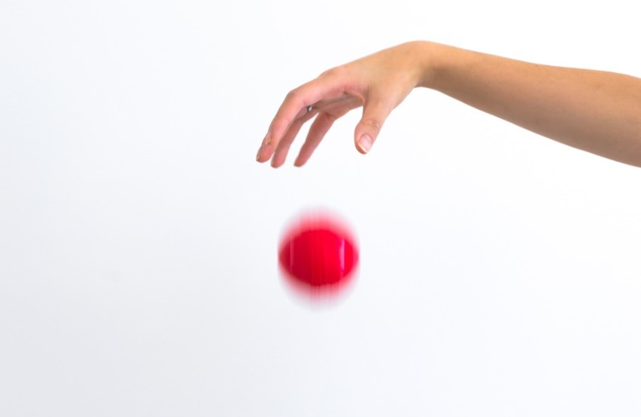
Projectile Motion
A 3 kg ball is allowed to fall freely.
Ignoring air resistance the unbalanced force acting on the ball will be the downward force, weight.
If the weight of the ball is 29.4 N, calculate:
The gravitational field strength.
The acceleration of the ball.

Slide 3
Projectile Motion
Weight Calculation
Acceleration Calculation
W = m x g
29.4 = 3 x g
g = 29.4 / 3
g = 9.8 Nkg⁻¹
F = m x a
29.4 = 3 x a
a = 29.4 / 3
a = 9.8 ms⁻²

Slide 4
Projectile Motion
On any planet the following is true:
“Acceleration due to gravity is the same value as gravitational field strength.”
For planet Earth a = 9.8 ms⁻² and g = 9.8 Nkg⁻¹
This means that any object falling freely will accelerate at 9.8 ms⁻².
Mass does not change the acceleration due to gravity.

Slide 5
Projectile Motion

Slide 6
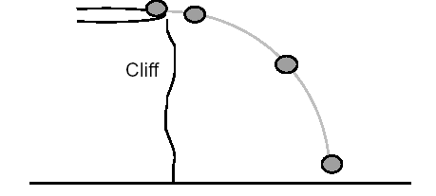
Projectile Motion
Falling objects often follow a curved path.
When studying the motion of falling objects it is useful to treat horizontal motion and vertical motion independently.

Slide 7
Projectile Motion

Slide 8
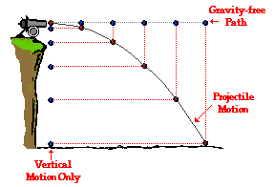

Slide 9
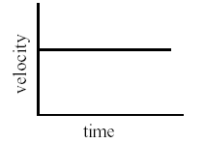
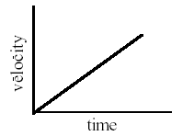
Projectile Motion
Horizontal Motion
Vertical Motion
Velocity (speed) is constant
Always use d = v x t OR s = v x t
Acceleration is constant (9.8ms⁻²)
Always use v = u + at (u = 0 ms⁻¹)

Slide 10
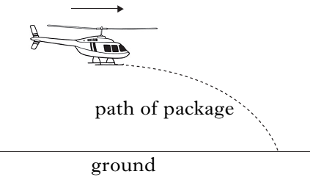
Projectile Motion
Example One
A helicopter is flying horizontally at 55 ms⁻¹ when it drops supplies as part of a relief operation. The package takes 8 s to reach the ground.

Slide 11
Projectile Motion
Example One
A helicopter is flying horizontally at 55 ms⁻¹ when it drops supplies as part of a relief operation. The package takes 8 s to reach the ground.
a) Calculate the horizontal range (how far the package travels horizontally) in 8 s.
Solution
d = v x t
d = 55 x 8
d = 440 m

Slide 12
Projectile Motion
Example One
A helicopter is flying horizontally at 55 ms⁻¹ when it drops supplies as part of a relief operation. The package takes 8 s to reach the ground.
b) The parachute on the package fails to open. Calculate the vertical velocity of the package when it hits the ground.
Solution (Remember: highest point all objects have 0 ms⁻¹ for “u”)
v = u + at
v = 0 + (9.8 x 8)
v = 78.4 ms⁻¹

Slide 13
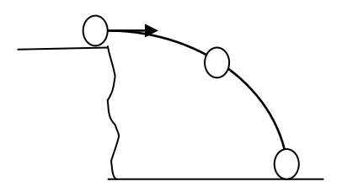
Projectile Motion
Example Two
A ball is kicked horizontally from the top of a cliff at 4 ms⁻¹. The ball takes 4 s to reach the sea.

Slide 14
Projectile Motion
Example Two
A ball is kicked horizontally from the top of a cliff at 4 ms⁻¹. The ball takes 4 s to reach the sea.
Calculate the horizontal range of the ball in 4 s.
Solution
d = v x t
d = 4 x 4
d = 16 m

Slide 15
Projectile Motion
Example Two
A ball is kicked horizontally from the top of a cliff at 4 ms⁻¹. The ball takes 4 s to reach the sea.
b) Calculate the vertical velocity of the ball after 4 s.
Solution (Remember: highest point all objects have 0 ms⁻¹ for “u”)
v = u + at
v = 0 + (9.8 x 4)
v = 39.2 ms⁻¹

Slide 16
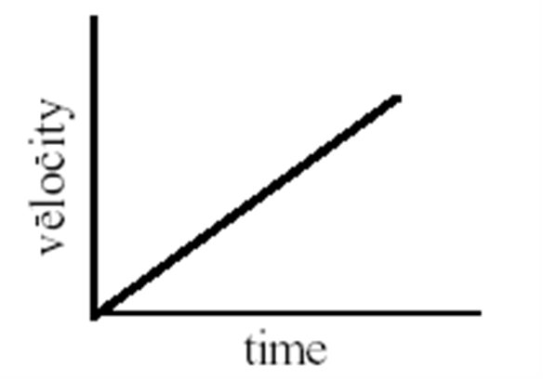
Projectile Motion
Example Two
A ball is kicked horizontally from the top of a cliff at 4 ms⁻¹. The ball takes 4 s to reach the sea.
c) Draw the graph of the ball’s vertical motion.
Solution
4 ms⁻¹
4 s

Slide 17
Projectile Motion
Example Two
A ball is kicked horizontally from the top of a cliff at 4 ms⁻¹. The ball takes 4 s to reach the sea.
d) Use the information from the graph to calculate the vertical height of the cliff.
Solution
Distance (vertical height) = area under graph
Distance (vertical height) = ½ x 4 x 4
Distance (vertical height) = 8 m

Slide 18
Projectile Motion
Newton imagined a cannon so big that it could sit on top of the Earth.
Any object fired from this cannon would behave like a projectile.
It would have a constant horizontal velocity and a constant vertical acceleration.

Slide 19
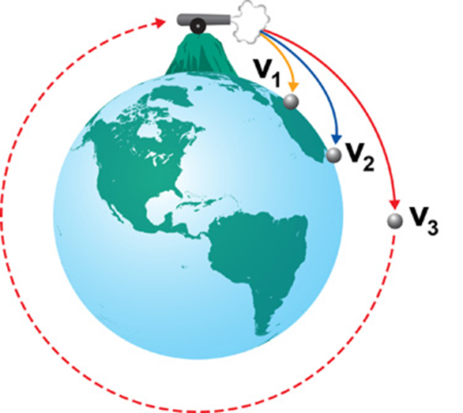
Projectile Motion
If the horizontal velocity was great enough the projectile would follow the path shown by V₁ in the following diagram.

Slide 20
Projectile Motion
Increasing the horizontal velocity to V₂ would make the object follow the curvature of the Earth a bit further.

Slide 21
Projectile Motion
If the horizontal velocity become so fast, V₃, it would be possible for the object to follow the curvature of the Earth without hitting it.

Slide 22
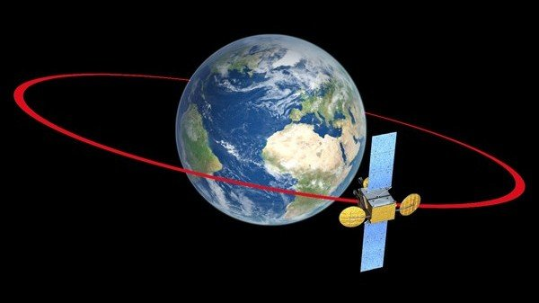
Projectile Motion
An object at the correct height above the Earth and with a fast enough horizontal velocity will be pulled towards Earth by gravity without hitting it. This is why satellites are able to stay in orbit.

Slide 23
Projectile Motion – Review Questions
Q.1.
If the gfs on Jupiter is 23 Nkg⁻¹, state the value of acceleration due to gravity on Jupiter.
Q.2.
Copy and complete the following:
“Projectiles have a constant (horizontal / vertical) velocity and constant (horizontal / vertical) acceleration.”

Slide 24
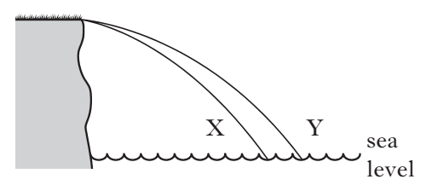
Projectile Motion – Review Questions
Q.3. Two identical balls X and Y are projected horizontally from the edge of a cliff.
a) True or False. They take the same time to reach the sea.
b) True or False. Y has a greater horizontal velocity than X.

Slide 25
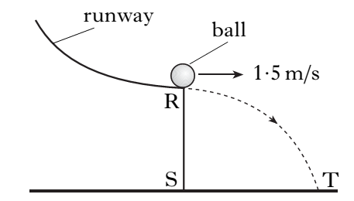
Projectile Motion – Review Questions
Q.4. A ball rolls down a runway and leaves it at point R.
a) The ball takes 0.6 s to travel from R to T. Calculate the horizontal range of the ball.
b) Calculate the vertical velocity of the ball when it reaches T.

Slide 26
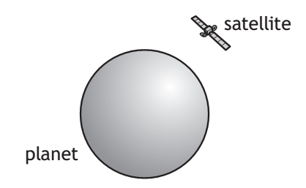
Projectile Motion – Review Questions
Q.5. A satellite is in a circular orbit around a planet.
a) True or False. As the satellite orbits the planet, its horizontal velocity increases.
b) True or False. The satellite has a constant vertical acceleration.

Slide 27
Projectile Motion – Review Answers
Q.1. 23 ms⁻²
Q.2. Projectiles have a constant horizontal velocity and constant vertical acceleration.
Q.3. a) True b) True
Q.4. a) 0.9 m
Q.4. b) 5.9 ms⁻¹
Q.5. a) False b) True

