Slide 1
S3/S4 Physics
Resistance Circuits

Slide 3
Resistance Circuits
In S1 you learned the definition of resistance as…
…the opposition to the flow of current.
This means…
…the greater the resistance the lower the current and
…the lower the resistance the greater the current.

Slide 4
Resistance Circuits - Series
When resistors are connected in series the total resistance always increases when you add extra resistors.
The total resistance is always greater than the largest resistance value.
So if R₁ = 4 Ω, R₂ = 5 Ω and R₃ = 9 Ω, the total resistance will be greater than 9 Ω.

Slide 5
Resistance Circuits - Series
From practical work (or research) it can be shown that for resistors in series, the total resistance, R_{T}, can be calculated from:
R_{T} = R₁ + R₂ +…

Slide 6
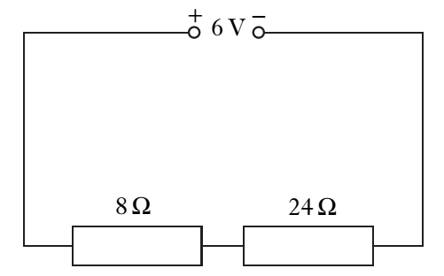
Resistance Circuits -Series
Example
Calculate the total resistance in the following circuit.

Slide 7
Resistance Circuits - Series
Solution
(Before doing the calculation you should be expecting an answer that is greater than the largest resistance - 24 Ω)
R_{T} = R₁ + R₂
R_{T} = 8 + 24
R_{T} = 32 Ω

Slide 8
Resistance Circuits - Series
Special Case
When all the resistors connected in series have the same value the total resistance, is the resistance value multiplied by the number of resistors.
If the resistors in the above circuit all have a value of 7 Ω, the total resistance would be (7 x 3) = 21 Ω

Slide 9
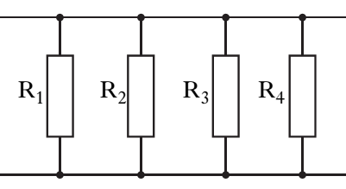
Resistance Circuits - Parallel
When resistors are connected in parallel the total resistance always decreases when you add extra resistors.
The total resistance is always less than the smallest resistance value.
So if R₁ = 4 Ω, R₂ = 5 Ω, R₃ = 9 Ω and R₄ = 12 Ω the total resistance will be less than 4 Ω.

Slide 10
Resistance Circuits - Parallel
From practical work (or research) it can be shown that for resistors in parallel, the total resistance, R_{T}, can be calculated from:

Slide 11
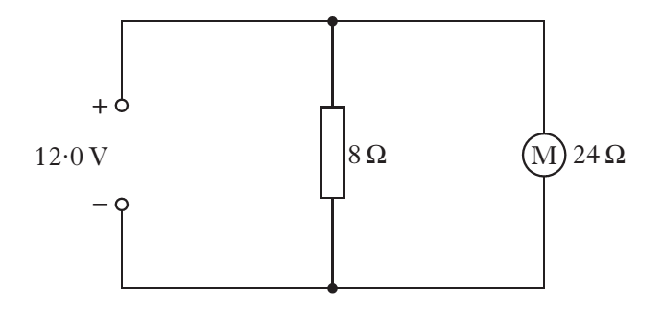
Resistance Circuits - Parallel
Example
Calculate the total resistance of the following circuit.

Slide 12
Resistance Circuits - Parallel
Solution
(Before doing the calculation you should be expecting an answer that is less than the largest resistance - 8 Ω)
1 = 1 + 1
R_{T} = R₁ + R₂
1 = 1 + 1
R_{T} = 8 + 24
There are a number of ways to complete this calculation.

Slide 13
Resistance Circuits - Parallel
Method One – Using Your Calculator!
You can add the fractions on the right hand side of the equation on your calculator. Your calculator is likely to display one of the following:
4 1 0.1666666
24 6
But these all represent 1 . Need to turn these numbers upside down.
R_{T}
So R_{T} = 6 Ω

Slide 14
Resistance Circuits - Parallel
Method Two – Decimals
Change the numbers on the right hand side to decimals and add them together. Be careful with rounding.
1 = 0.125 + 0.0416666
R_{T}
1 = 0.1666666 Need to turn each side upside down to get R_{T}.
R_{T}
So R_{T} = 1 = 6 Ω
0.1666666

Slide 15
Resistance Circuits - Parallel
Method Three – Fractions
Find a common denominator on right hand side and solve.
1 = 3 + 1
R_{T} 24 + 24
1 = 4
R_{T} 24
R_{T} = 24
4
R_{T} = 6 Ω

Slide 16
Resistance Circuits - Parallel
Special Case
When all the resistors connected in parallel have the same value, the total resistance, is the resistance value divided by the number of resistors.
If the resistors in the above circuit all have a value of 60 Ω, the total resistance would be (60 ÷ 4) = 15 Ω

Slide 17
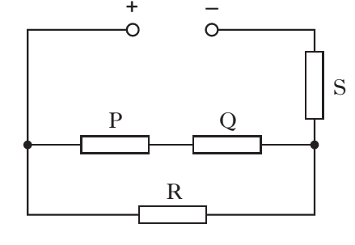
Resistance Circuits - Mixed
When resistors are used in practical circuits they are usually arranged as a mixture of series and parallel.
For mixed circuits always find the parallel resistance value then add on the value of the series resistor.

Slide 18
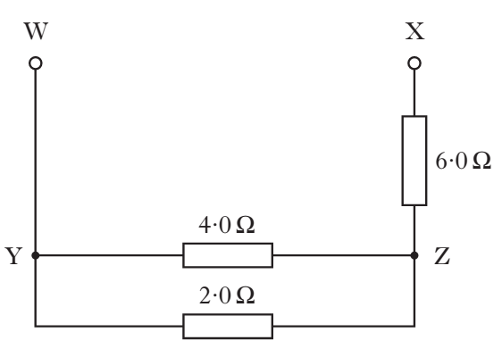
Resistance Circuits - Mixed
Example
In the following circuit find the total resistance between W and X.

Slide 19
Resistance Circuits - Mixed
Solution
1 = 1 + 1
R_{T} R₁ R₂
1 = 1 + 1 (To solve, pick your preferred method)
R_{T} 2 4
R_{T} = 1.3 Ω
Total resistance between W and X = 1.3 + 6.0
Total resistance between W and X = 7.3 Ω

Slide 20
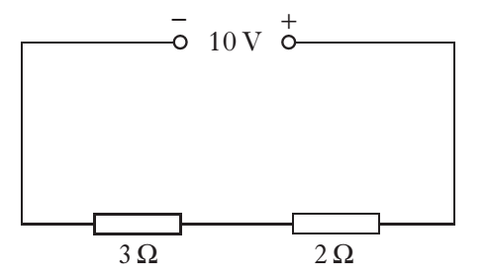
Resistance Circuits – Review Questions
Q.1. Calculate the total resistance in the following circuit.

Slide 21
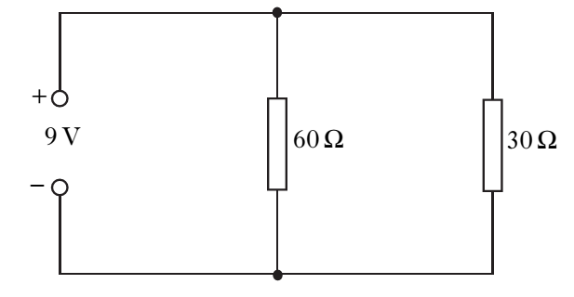
Resistance Circuits – Review Questions
Q.2. Calculate the total resistance in the following circuit.

Slide 22
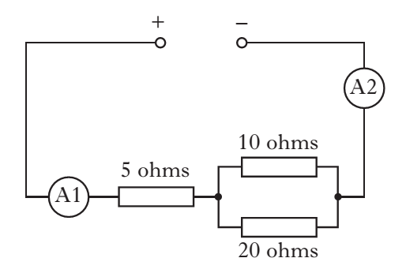
Resistance Circuits – Review Questions
Q.3. Calculate the total resistance in the following circuit.

Slide 23
Resistance Circuits – Review Questions
Q.4. Calculate the total resistance in the following circuit.

Slide 24
Resistance Circuits – Review Questions
Q.5. Calculate the total resistance in the following circuit, if the lamps have resistance values of 15 Ω and 35 Ω.

Slide 25
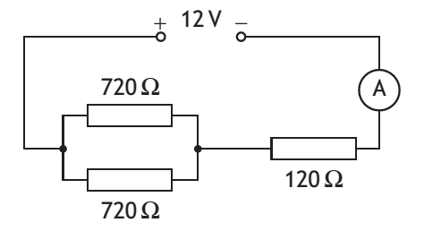
Resistance Circuits – Review Questions
Q.6. Calculate the total resistance in the following circuit.

Slide 26
Resistance Circuits - Answers
Q.1. 5 Ω
Q.2. 20 Ω
Q.3. 11.7 Ω
Q.4. 6 Ω
Q.5. 10.5 Ω
Q.6. 480 Ω

