Slide 1
S3/S4 Physics
Space Exploration

Slide 2
Space Exploration
To develop and understanding of space there are a number of terms that you should be familiar with.
Try to learn the following ten terms and their definitions.
You can pick the learning approach that is best suited to your learning style, e.g. talking partners, mind map etc..

Slide 3
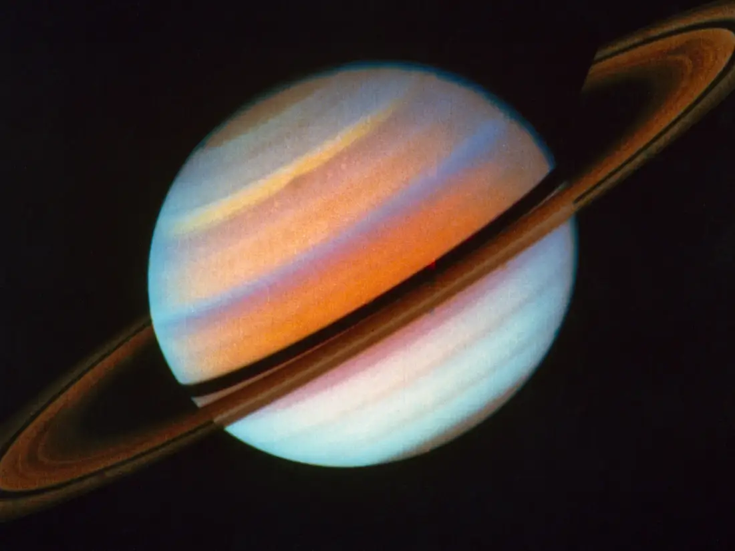
Space Exploration
Planet
An object that orbits a star.

Slide 4
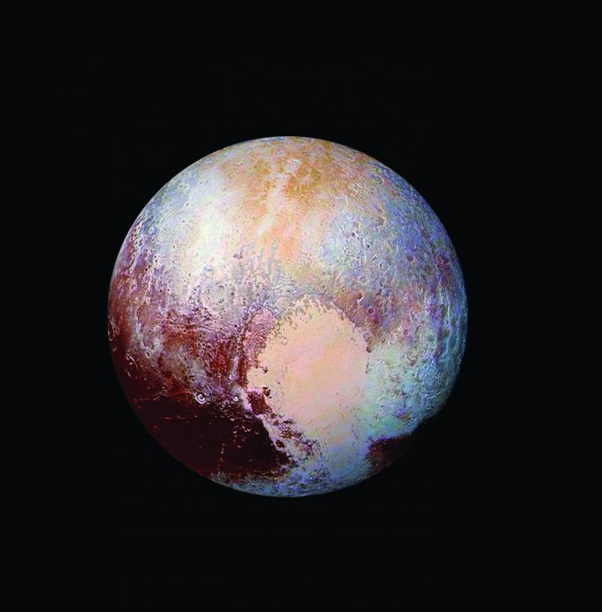
Space Exploration
Dwarf planet
A small object orbiting a star that has enough gravity to form an almost round shape.

Slide 5
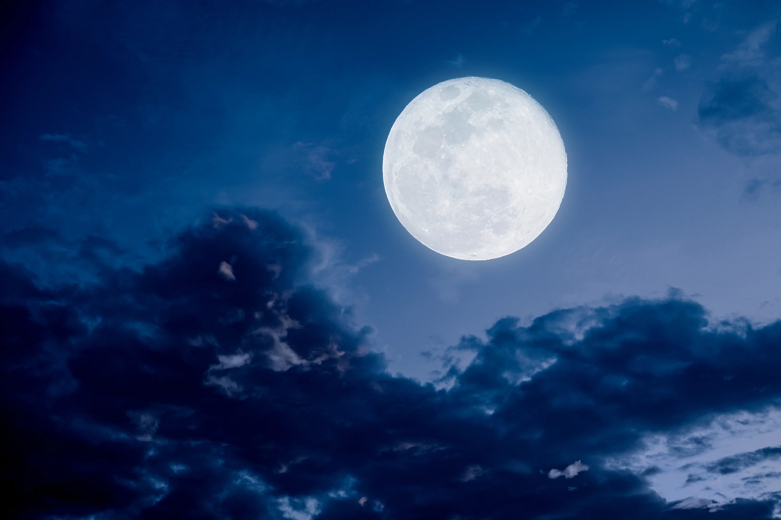
Space Exploration
Moon
A natural satellite of a planet.

Slide 6
Space Exploration
Sun
The star around which the Earth orbits.

Slide 7
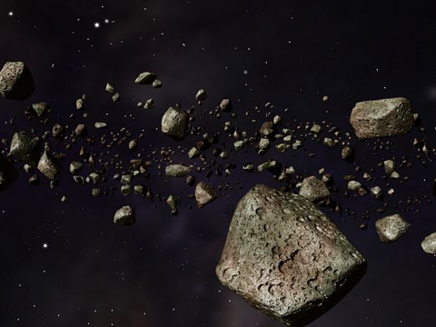
Space Exploration
Asteroid
A small rocky object that orbits the Sun.

Slide 8
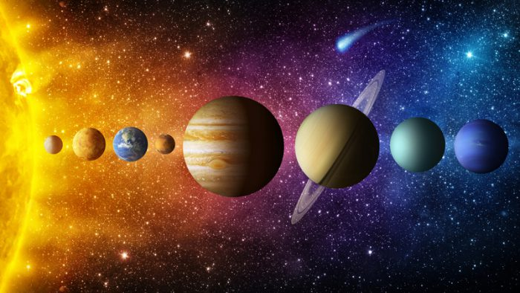
Space Exploration
Solar System
A star and all the planets that orbit it, e.g. the Sun and MVEMJSUN.

Slide 9
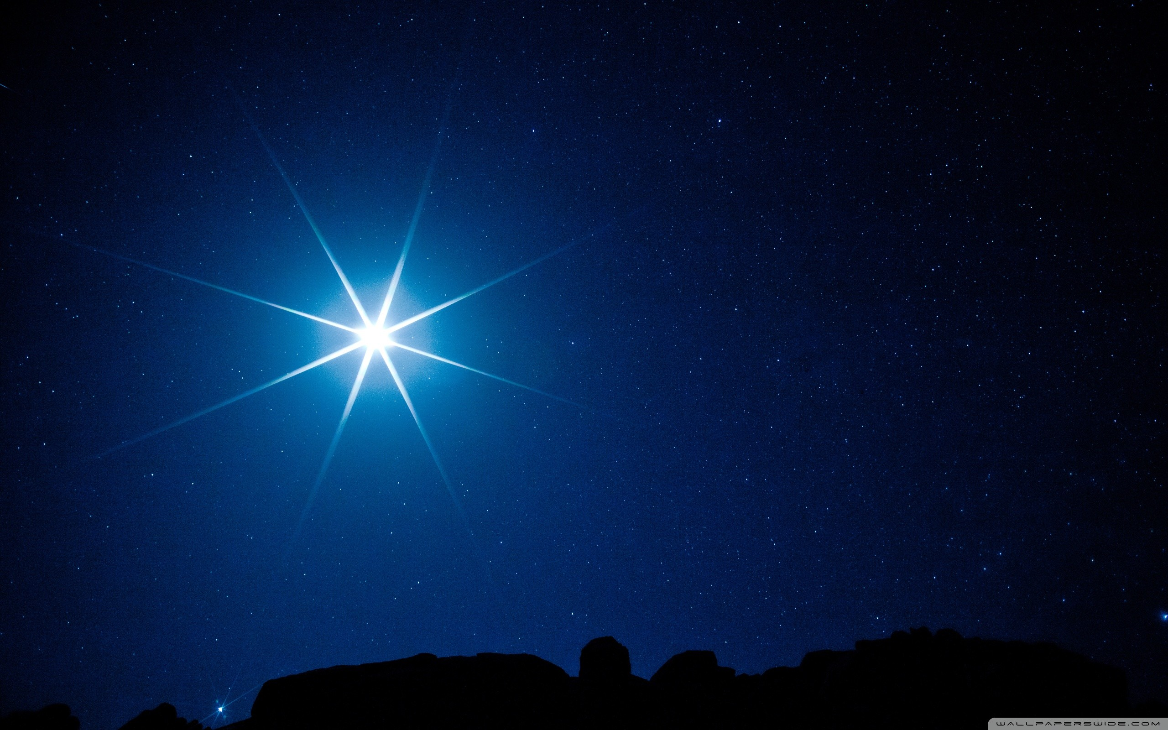
Space Exploration
Star
A luminous sphere of gaseous matter that produces its energy from nuclear fusion.

Slide 10
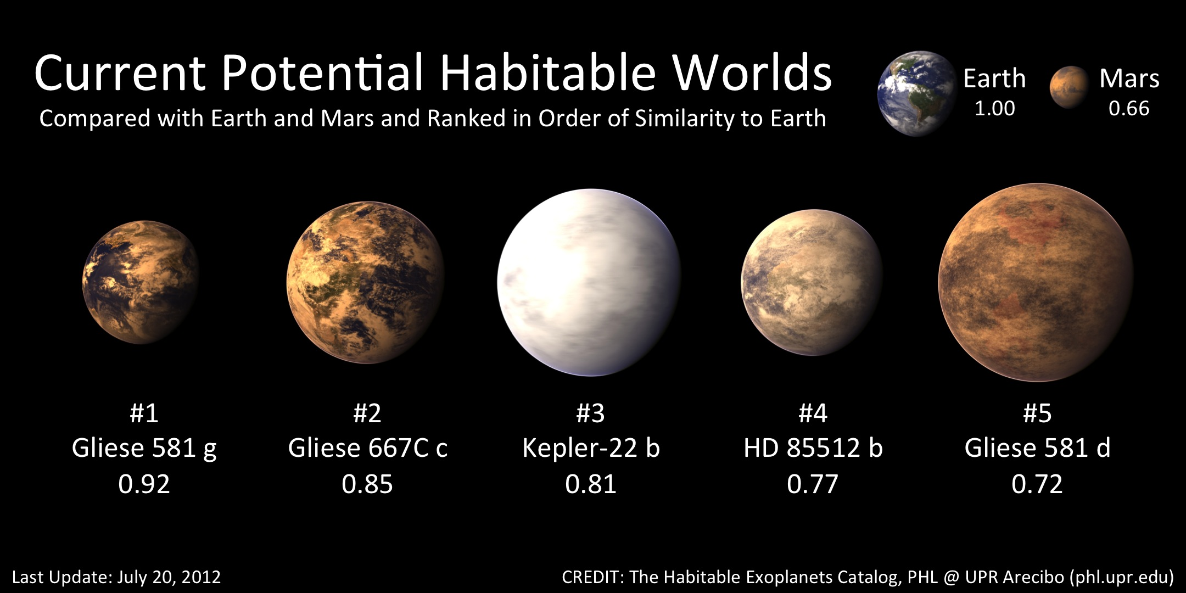
Space Exploration
Exoplanet
A planet outside our Solar System.

Slide 11
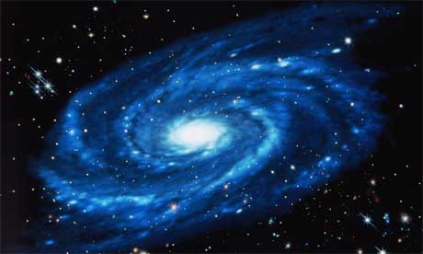
Space Exploration
Galaxy
A collection of stars.

Slide 12
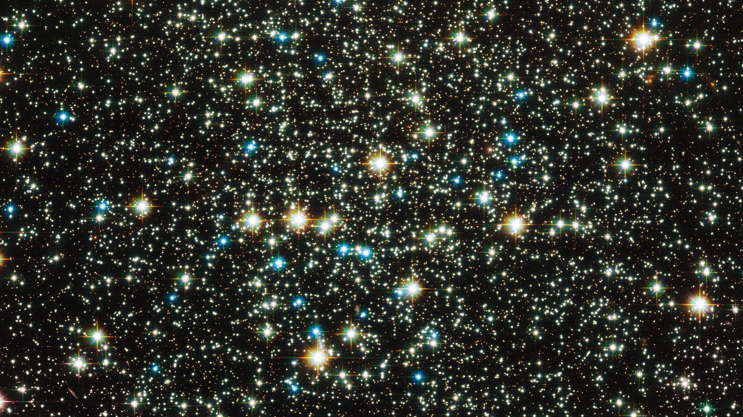
Space Exploration
Universe
The whole of space.

Slide 13
Space Exploration
Time to check your knowledge of the space terms.

Slide 14
Space Exploration
Planet
An object that _____ a star.

Slide 15
Space Exploration
Sun
The _____ around which the Earth orbits.

Slide 16
Space Exploration
Star
A luminous sphere of gaseous matter that produces its energy from nuclear _____.

Slide 17
Space Exploration
Universe
The whole of _____.

Slide 18
Space Exploration
Galaxy
A collection of _____.

Slide 19
Space Exploration
Solar System
A star and all the _____ that orbit it, e.g. the Sun and MVEMJSUN.

Slide 20
Space Exploration
Moon
A _____ satellite of a planet.

Slide 21
Space Exploration
Dwarf planet
A small object orbiting a star that has enough _____ to form an almost round shape.

Slide 22
Space Exploration
Asteroid
A small _____ object that orbits the Sun.

Slide 23
Space Exploration
Exoplanet
A planet outside our _____ _____.

Slide 24
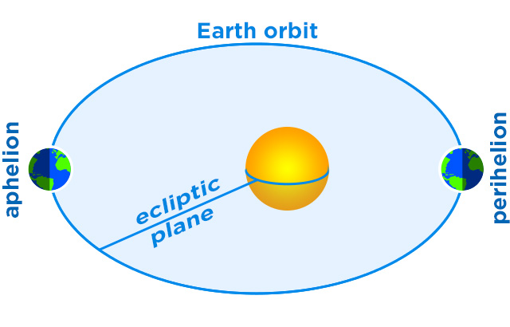
Space Exploration
Q. What is a satellite?
A. In Physics, a satellite is an object which orbits another larger object.
For example, a planet is a satellite of a star.

Slide 25
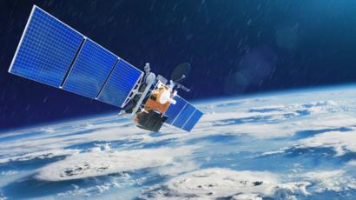
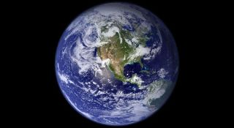
Space Exploration
There are two types of satellite…artificial and natural
But all satellites stay in orbit because they are being pulled by the gravity of the larger object.

Slide 26
Space Exploration
Artificial satellites were first put into orbit around planet Earth in the 1950s. They have many uses including:
Communications (your mobile phones!)
GPS
Data gathering (e.g. weather)
Scientific discovery
Space exploration (e.g. Hubble and ISS)

Slide 27
Space Exploration
The time it takes a satellite to orbit the Earth is known as its period. The further away from the Earth the longer the period.
Artificial satellites with a 24 hour period are called geo-stationary.
Most communication satellites are geo-stationary and orbit at a height of 36000 km.

Slide 28
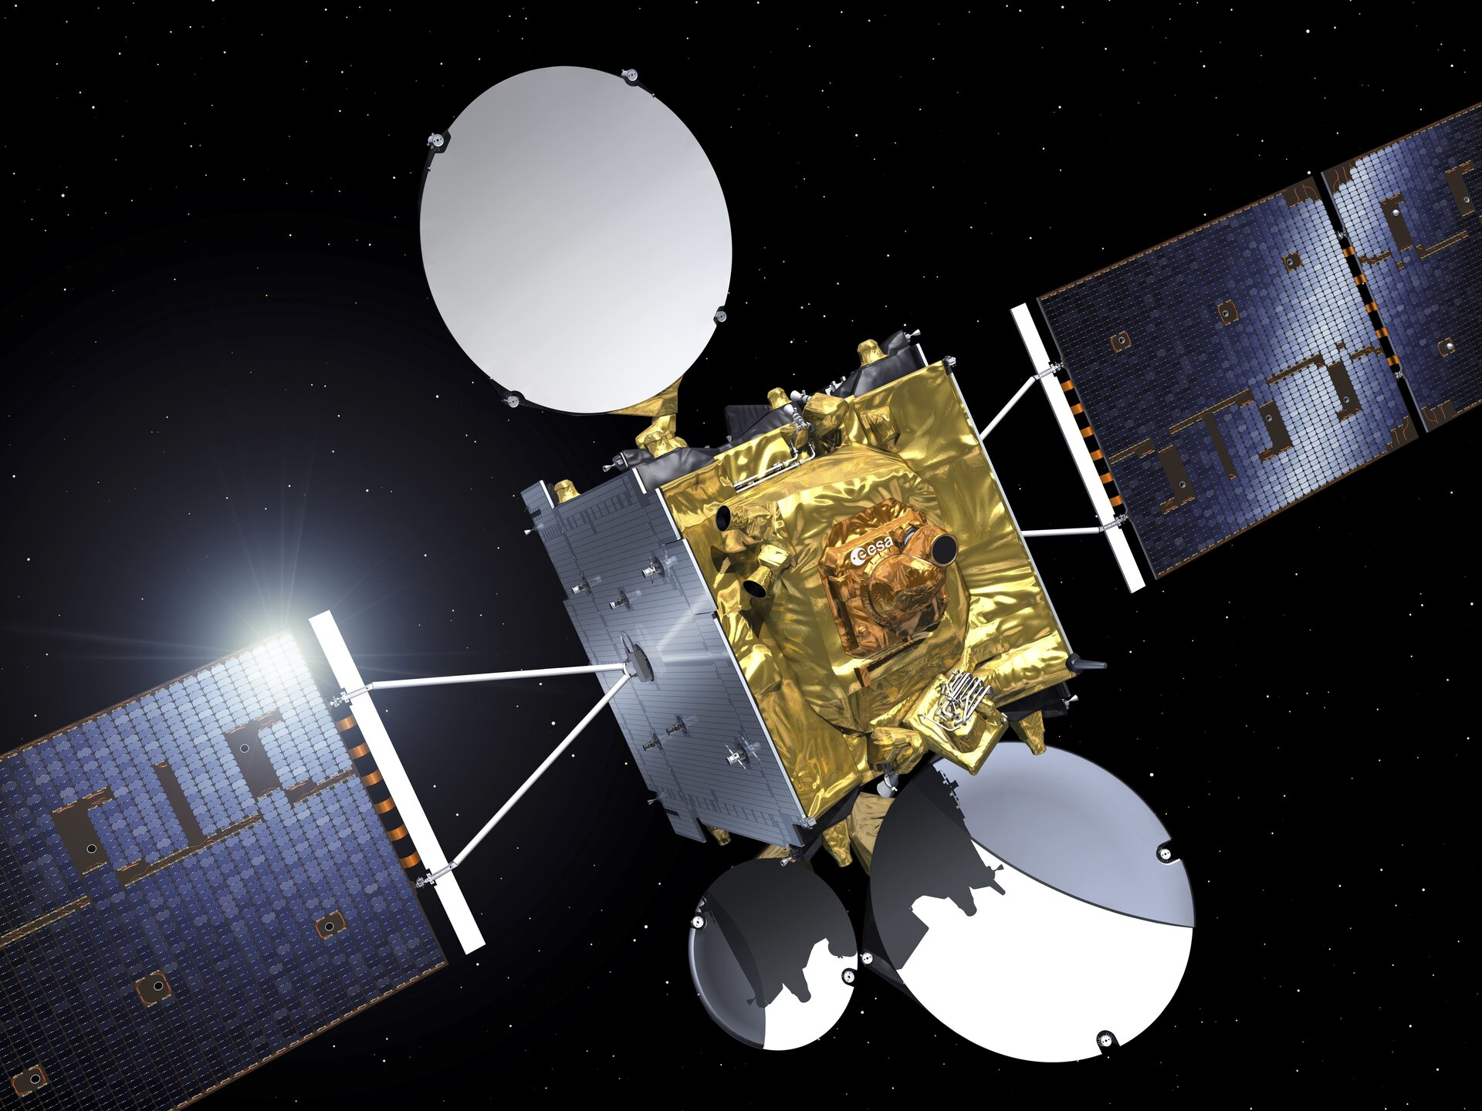
Space Exploration
Communication satellites are not giant mirrors in space.

Slide 29
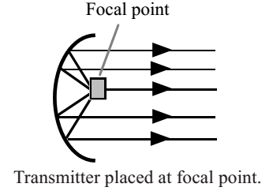
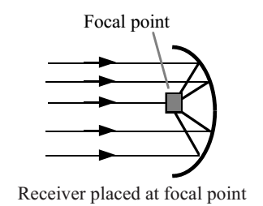
Space Exploration
Communication satellites use curved reflectors to help them transmit and receive signals.
Transmission Reception
Communication satellites usually use radio and microwaves.

Slide 30
Space Exploration
Just over ten times further from the Earth than communication satellites is an example of a natural satellite. The moon.
The moon’s orbit is caused by the gravitational pull of the Earth. But the moon is large enough to have a gravitational pull on the Earth…that’s why our oceans have a low and a high tide!
The distance from the Earth to the moon is about 400,000 km.
The moon’s period is 28 days.

Slide 31
Space Exploration
Example
A communications satellite is used to send radio signals from London to Washington. A ground station in London sends signals to the satellite. The satellite transmits signals to a ground station in Washington.

Slide 32
Space Exploration
Example
A communications satellite is used to send radio signals from London to Washington. A ground station in London sends signals to the satellite. The satellite transmits signals to a ground station in Washington.
a) State the speed of the radio waves used by the satellite.
Answer: 3 x10⁸ ms⁻¹
b) The satellite is geo-stationary. State the period of a geo-stationary satellite.
Answer: 24 hours

Slide 33
Space Exploration
Example
A communications satellite is used to send radio signals from London to Washington. A ground station in London sends signals to the satellite. The satellite transmits signals to a ground station in Washington.
c) The signal takes 0.122 s to travel from the satellite to the ground station in Washington. Calculate the height of the satellite.
Solution
d = v x t
d = 3 x10⁸ x 0.122
d = 3.66 x 10⁷ m (or 36600 km)

Slide 34
Space Exploration
Research Task One
By carrying out research, investigate the challenges, and their potential solutions, associated with space travel.
Areas to investigate include:
Travelling large distances
Moving spacecraft in a zero friction environment
Energy supplies for the spacecraft and crew

Slide 35
Space Exploration
Research Task Two
By carrying out research, investigate the risks, and the potential rewards, associated with manned space exploration.
Areas to investigate include:
Fuel load on take-off
Exposure to radiation
Pressure differences
Re-entering the Earth’s atmosphere

Slide 36
Space Exploration – Review Questions
Q.1. Light from this object takes 8 minutes to reach Earth.
Q.2. This object is approx. 400 000 km from Earth.
Q.3. There is a band of these objects between Mars and Jupiter.
Q.4. Pluto was declassified to this status in 2006.
Q.5. Ours formed approximately 4.6 billion years ago.

Slide 37
Space Exploration – Review Questions
Decide if each statement is true or false.
Q.6. The moon is an artificial satellite of planet Earth.
Q.7. The closer a satellite is to Earth the shorter its orbital period.
Q.8. Communication satellites are likely to be found 36000 m above Earth.
Q.9. Solar panels can be used to provide electrical energy to satellites.
Q.10. Pressurised spacesuits need to be worn when carrying out repairs to satellites in space.

Slide 38
Space Exploration – Review Answers
Q.1. Sun
Q.2. Moon
Q.3. Asteroids
Q.4. Dwarf planet
Q.5. Galaxy
Q.6. False
Q.7. True
Q.8. False
Q.9. True
Q.10. True

