Slide 1
S3/S4 Physics
Specific Latent Heat

Slide 2
Specific Latent Heat
What do you know about the states of matter?

Slide 3
Specific Latent Heat

Slide 4
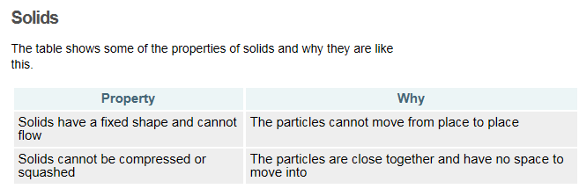
Specific Latent Heat

Slide 5
Specific Latent Heat

Slide 6
Specific Latent Heat

Slide 7
Specific Latent Heat
How can we change the states of matter from one to another?

Slide 8
Specific Latent Heat
If you give substances more energy by heating them, they can change their state from a solid to a liquid and from a liquid to a gas.

Slide 9
Specific Latent Heat
If you remove energy from substances by cooling them, they can change their state from a gas to a liquid and from a liquid to a solid.

Slide 10
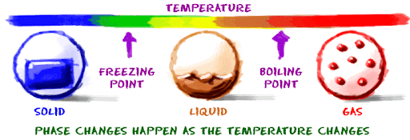
Specific Latent Heat
When a change of state takes place there is no change in temperature.
This is often shown in a graph.

Slide 11
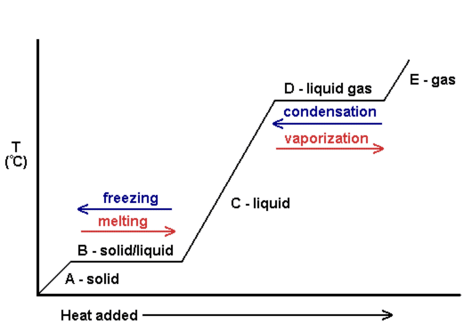
Specific Latent Heat

Slide 12
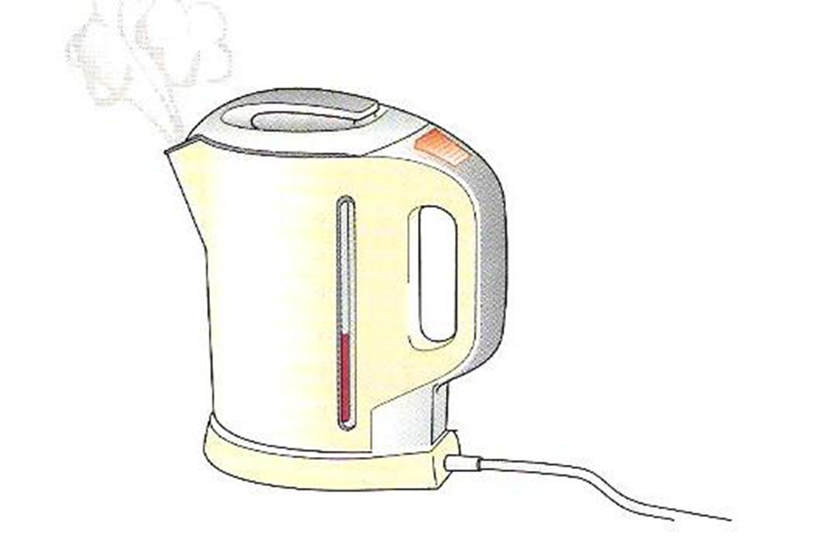
Specific Latent Heat
When a change of state takes place there is no change in temperature.
Vaporisation changes involve liquids and gases.

Slide 13
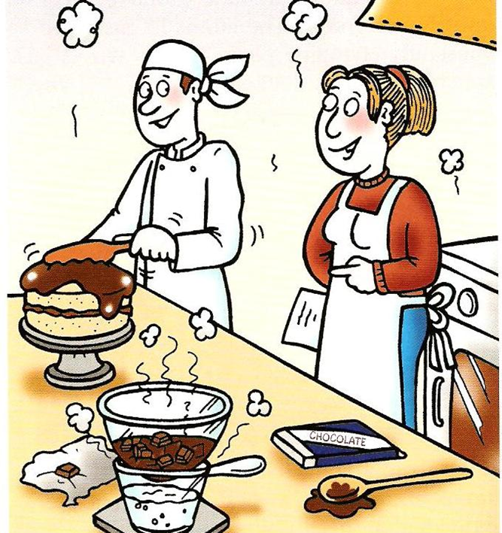
Specific Latent Heat
When a change of state takes place there is no change in temperature.
Fusion changes involve solids and liquids.

Slide 14
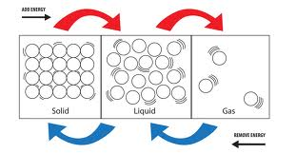
Specific Latent Heat
Fusion Vaporisation
Fusion Vaporisation

Slide 15
Specific Latent Heat
The heat require to change the state of a substance is known as latent heat.
Latent heat can be calculated using the equation:
E_{h} = ml
E_{h} – heat energy in Joules (J)
m – mass in kilograms (kg)
l – latent heat in Joules per kilogram (Jkg⁻¹)

Slide 16
Specific Latent Heat

Slide 17
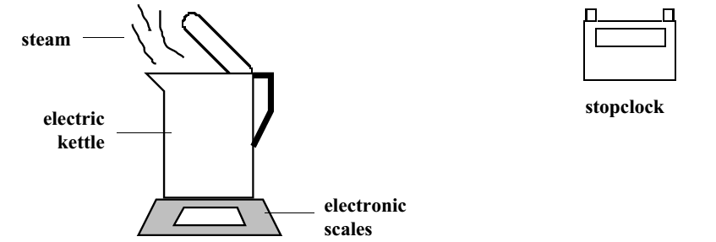
Specific Latent Heat
From practical work, or research, find the latent heat of vaporisation of water.

Slide 18
Specific Latent Heat

Slide 19
Specific Latent Heat

Slide 20
Specific Latent Heat
Example One
Calculate the energy required to melt 5 kg of ice.
Solution
(Remember this is a fusion change when looking up the data sheet.)
E_{h} = m x l
E_{h} = 5 x 3.34 x10⁵
E_{h} = 1.67 x 10⁶ J

Slide 21
Specific Latent Heat
Example Two
45200 J of energy is used to change water into steam. Calculate the mass of water that has been changed into steam.
Solution
(Remember this is a vaporisation change when looking up the data sheet.)
E_{h} = m x l
45200 = m x 22.6 x 10⁵
m = 45200 / 22.6 x 10⁵
m = 0.02 kg

Slide 22
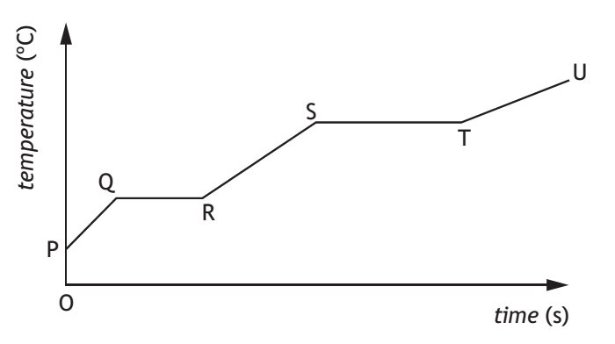
Specific Latent Heat
Example Three
A heater is immersed in a solid substance. Identify which sections of the following graph represent a change of state from:
a) solid to liquid
b) liquid to gas
Solution
a) QR
b) ST

Slide 23
Specific Latent Heat
Example Four
A 75 W heater is used to boil alcohol. The heater is left on for 8 minutes after the liquid begins to boil.
Calculate the energy supplied during the boiling process.
Solution (Remember time is measured in minutes)
E = P x t
E = 75 x (8 x 60)
E = 36000 J

Slide 24
Specific Latent Heat
Example Four (continued)
A 75 W heater is used to boil alcohol. The heater is left on for 8 minutes after the liquid begins to boil.
b) Calculate the mass of alcohol that changes state from liquid to gas.
Solution
(Remember this is a vaporisation change when looking up the data sheet.)
E_{h} = m x l
36000 = m x 11.2 x 10⁵
m = 0.032 kg

Slide 25
Specific Latent Heat
Copy and complete the following table:
Energy (J) | Mass (kg) | Latent Heat (Jkg⁻¹)
 | 1.5 | 2.9 x 10⁵
 | 0.04 | 1.8 x 10⁵
50000 |  | 2.0 x 10⁵
415000 |  | 8.3 x 10⁵
6680 | 0.02
75000 | 3

Slide 26
Specific Latent Heat
Copy and complete the following table:
Energy (J) | Mass (kg) | Latent Heat (Jkg⁻¹)
435000 | 1.5 | 2.9 x 10⁵
7200 | 0.04 | 1.8 x 10⁵
50000 | 0.25 | 2.0 x 10⁵
415000 | 0.5 | 8.3 x 10⁵
6680 | 0.02 | 3.34 x10⁵
75000 | 3 | 0.25 x 10⁵

Slide 27
Specific Latent Heat – Review Questions
Q.1. True or False. There is no change in temperature when a change of state takes place.
Q.2. Calculate the energy required to melt 2 kg of iron.
Q.3. Calculate the energy required to boil 1.2 kg of water at 100 ºC.
Q.4. A solid block of lead Is placed in an insulated flask and heated continuously with a 9000 W immersion heater.
The graph shows how the temperature of the lead changes with time.

Slide 28
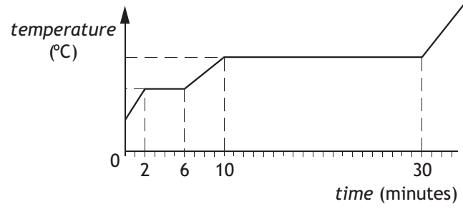
Specific Latent Heat – Review Questions
Q.4. (continued)
Calculate the mass of lead that changes state from solid to liquid.

Slide 29
Specific Latent Heat – Review Answers
Q.1. True
Q.2. 534000 J
Q.3. 2.7 x 10⁶ J
Q.4. 1.44 kg

