Slide 1
S3/S4 Physics
Vectors and Scalars

Slide 2
Vectors and Scalars
A scalar quantity is fully defined by magnitude(size) only.
A vector quantity is fully defined by using both a magnitude(size) and a direction.

Slide 3
Vectors and Scalars
Create a table to classify the following quantities as vector or scalar.
Acceleration Displacement Distance Energy
Force Mass Speed Temperature
Time Velocity Volume Weight

Slide 4
Vectors and Scalars
Vector | Scalar
Acceleration | Distance
Displacement | Energy
Force | Mass
Velocity | Speed
Weight | Temperature
 | Time
 | Volume

Slide 5
Vectors and Scalars
Some of the common scalar quantities can be remembered using:
S.T.D.M.E.
where,
S = Speed
T = Time (or Temperature)
D = Distance
M = Mass
E = Energy

Slide 6
Vectors and Scalars - Distance
Distance is a scalar quantity.
The symbol for distance is “d”.
A distance is defined by magnitude only.
Distances are found by carrying out simple additions.

Slide 7
Vectors and Scalars - Displacement
Displacement is the direct distance travelled in a stated direction from a starting point.
Displacement is a vector quantity.
The symbol for displacement is “s”.
A displacement needs to be defined by a magnitude and a direction.
Displacements are usually found using SOHCAHTOA and Pythagoras.

Slide 8
Vectors and Scalars - Distance and Displacement
Example One
A car travels 40 km due North, then 10 km due South. Calculate the car’s distance travelled and displacement.
Solution
Distance = 40 + 10 = 50 km
Displacement is direct distance travelled in a stated direction from a starting point.
Displacement = 30 km due North (of starting point)

Slide 9
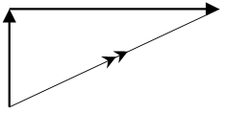
Vectors and Scalars - Distance and Displacement
Example Two
A boat is rowed 5 km due North, then 12 km due East. Calculate the boat’s distance travelled and displacement.
Solution – Draw a “vector triangle” before doing calculations
12 km
5 km
Θ

Slide 10
Vectors and Scalars - Distance and Displacement
Example Two – Solution
Distance = 5 + 12 = 17 km
Displacement uses Pythagoras(magnitude) and SOHCAHTOA(direction)
(Resultant)² = (5)² + (12)²
Resultant = 13 km
Tan Θ = 12 / 5
Θ = 67º (approx.)
Displacement = 13 km at 067

Slide 11
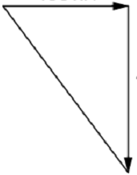
Vectors and Scalars - Distance and Displacement
Example Three
A student runs 30 m due West, then 40 m due South. Calculate the student’s distance travelled and their displacement.
Solution – Draw a “vector triangle” before doing calculations
30 m
Θ
40 m

Slide 12
Vectors and Scalars - Distance and Displacement
Example Three – Solution
Distance = 30 + 40 = 70 m
Displacement uses Pythagoras(magnitude) and SOHCAHTOA(direction)
(Resultant)² = (30)² + (40)²
Resultant = 50 m
Tan Θ = 40 / 30
Θ = 53º (approx.)
Displacement = 13 km at 143 (Always quote bearing from due North)

Slide 13
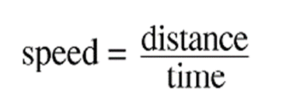
Vectors and Scalars - Speed
Speed is defined as the distance travelled per unit time.
Speed is an example of a scalar quantity.
For all speed calculations we use the equation…
where,
speed is measured in “ms⁻¹”
distance is measured in “m”
time is measured in “s”

Slide 14
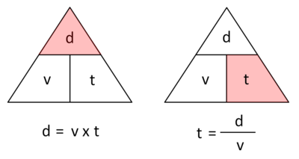
Vectors and Scalars - Speed
Triangles can also help with this equation.

Slide 15
Vectors and Scalars - Speed
The term average speed is often useful for calculations involving long journeys.
For average speed calculations the equation is written as…
where,
_
v is average speed in “ms⁻¹”
d is distance in “m”
t is time in “s”

Slide 16
Vectors and Scalars - Speed
Example One
A car travels a distance of 35 m in a time of 5 s. Calculate the average speed of the car.
Solution
_
v = d / t
= 35 / 5
= 7 ms⁻¹

Slide 17
Vectors and Scalars - Speed
Example Two
A cyclist has an average speed of 8.5 ms⁻¹ and travels for 8 s. Calculate the distance travelled by the cyclist during this time.
Solution
_
v = d / t
8.5 = d / 8
d = 8.5 x 8
d = 68 m

Slide 18
Vectors and Scalars - Speed
Example Three
A vehicle has an average speed of 23 ms⁻¹ when it travels for 345 m. Calculate the time taken by the vehicle for the 345 m journey.
Solution
_
v = d / t
23 = 345 / t
t = 345 / 23
t = 15 s

Slide 19
Vectors and Scalars - Speed
Copy and complete the following table:
Average Speed (ms⁻¹) | Distance (m) | Time (s)
 | 24 | 6.0
 | 33 | 5.5
17 |  | 7.0
11 |  | 8.5
8 | 160
14 | 420

Slide 20
Vectors and Scalars - Speed
Copy and complete the following table:
Average Speed (ms⁻¹) | Distance (m) | Time (s)
4 | 24 | 6.0
6 | 33 | 5.5
17 | 119 | 7.0
11 | 93.5 | 8.5
8 | 160 | 20
14 | 420 | 30

Slide 21
Vectors and Scalars - Speed
The term instantaneous speed is defined as the speed at a particular instant in an object’s journey.
This means that very short time intervals are used in instantaneous speed calculations.
To measure these very short time intervals a device called a light gate can be used to along with a timing app.
Carry out practical work (or research) to find how a light gate and a timing app can help calculate instantaneous speed.

Slide 22
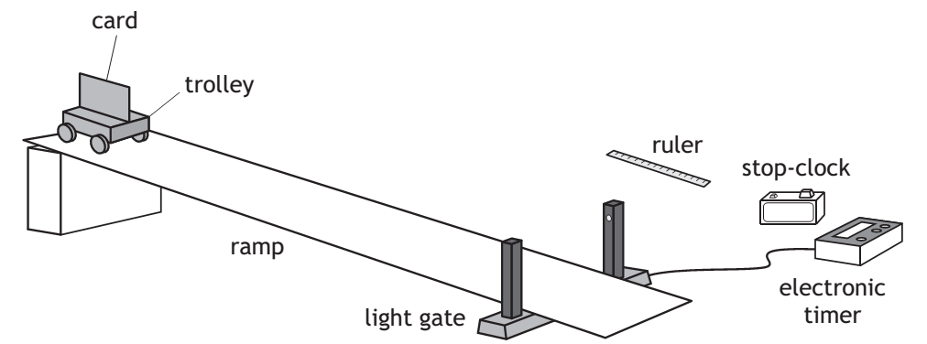
Vectors and Scalars - Speed
Investigate instantaneous speed using the following apparatus:

Slide 23
Vectors and Scalars - Speed
A possible set of data is shown below:
length of card = 10 cm
time on electronic timer = 0.185 s
The equation for instantaneous speed is…
instantaneous speed = length of card / time on electronic timer
instantaneous speed = 0.1 / 0.185
instantaneous speed = 0.54 ms⁻¹

Slide 24
Vectors and Scalars - Velocity
Velocity is a vector quantity.
Velocity has the symbol “v”.
Velocity can be calculated using the equation…
An answer to a velocity calculation must state the direction of the motion.

Slide 25
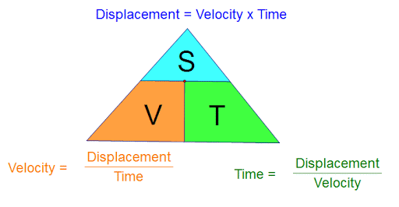
Vectors and Scalars - Velocity
Triangles can also help with this equation.

Slide 26
Vectors and Scalars - Velocity
The term average velocity is often useful for calculations involving long journeys.
For average velocity calculations the equation is written as…
where,
_
v is average velocity in “ms⁻¹”
s is displacement in “m”
t is time in “s”

Slide 27
Vectors and Scalars - Velocity
Example One
A car travels 30 km due North in 30 minutes. Calculate the car’s velocity.
Solution
(Remember to use “m” for distance and “s” for time)
v = s / t
v = 30000 / (30 x 60)
v = 16.7 ms⁻¹ due North

Slide 28
Vectors and Scalars - Velocity
Example Two
A cyclist has an average velocity of 6.5 ms⁻¹ at 225 and travels for 8 s. Calculate the cyclist’s displacement during this time.
Solution
_
v = s / t
6.5 = s / 8
s = 6.5 x 8
s = 52 m at 225

Slide 29
Vectors and Scalars - Velocity
Example Three
The magnitude of a vehicle’s average velocity is 13 ms⁻¹ when it travels for 3.9 km due West. Calculate the time taken by the vehicle for this journey.
Solution (Remember “k” or “kilo” means “x10³ or multiply by 1000)
_
v = s / t
13 = 3.9 x 10³ / t
t = 3.9 x 10³ / 13
t = 300 s

Slide 30
Vectors and Scalars - Velocity
Copy and complete the following table:
Average Velocity | Displacement | Time
 | 50m due North | 5 s
 | 1 km at 045 | 200s
6 ms⁻¹ due South |  | 15 s
100 ms⁻¹ at 270 |  | 2 minutes
4 ms⁻¹ due East | 80 m due East
20 ms⁻¹ at 315 | 0.5 km at 315

Slide 31
Vectors and Scalars - Velocity
Copy and complete the following table:
Average Velocity | Displacement | Time
10 ms⁻¹ due North | 50m due North | 5 s
5 ms⁻¹ at 045 | 1 km at 045 | 200s
6 ms⁻¹ due South | 90 m due South | 15 s
100 ms⁻¹ at 270 | 12 km at 270 | 2 minutes
4 ms⁻¹ due East | 80 m due East | 20 s
20 ms⁻¹ at 315 | 0.5 km at 315 | 25 s

Slide 32
Vectors and Scalars – Review Questions
Q.1.
A car travels 50 km due North, then 30 km due South. The whole journey lasted for 2 hours.
Calculate:
a) Distance travelled
b) Average speed in kmh⁻¹
c) Displacement
d) Average velocity

Slide 33
Vectors and Scalars – Review Questions
Q.2.
A student travels home by walking 200 m due North, then 150 m due West. The whole journey lasted for 10 minutes.
Calculate:
a) Distance travelled
b) Average speed
c) Displacement
d) Average velocity

Slide 34
Vectors and Scalars – Review Solutions
Q.1.
Distance = 50 + 30 = 80 km
b)
_
v = d / t
= 80 / 2
= 40 ms⁻¹

Slide 35
Vectors and Scalars – Review Solutions
Q.1. (continued)
c) Displacement = 20 km due North
d)
_
v = s / t
= 20 / 2
= 10 kmh⁻¹ due North

Slide 36
Vectors and Scalars – Review Solutions
Q.2.
a) Distance = 200 + 150 = 350 m
b)
_
v = d / t
= 350 / (10 x 60)
= 0.58 ms⁻¹

Slide 37
Vectors and Scalars – Review Solutions
Q.2. (continued)
c)
Displacement uses Pythagoras(magnitude) and SOHCAHTOA(direction)
(Resultant)² = (200)² + (150)²
Resultant = 250 m
Tan Θ = 150 / 200
Θ = 37º (approx.)
Displacement = 250 m at 323 (Always quote bearing from due North)

Slide 38
Vectors and Scalars – Review Solutions
Q.2. (continued)
d)
_
v = s / t
= 250 / (10 x 60)
= 0.42 at 323

