Slide 1
S3/S4 Physics
Velocity-time Graphs

Slide 2
Velocity-time Graphs
A velocity-time graph (or speed-time graph) is a useful way to describe the motion of an object.
The shape of the graph can show you if the object…
is speeding up (acceleration)
is slowing down (deceleration)
has a constant velocity (speed)

Slide 3
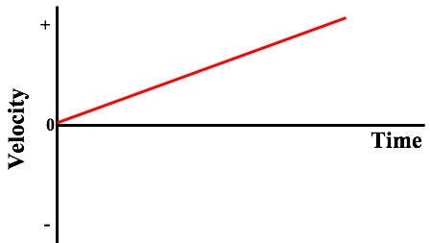
Velocity-time Graphs – Speeding Up

Slide 4
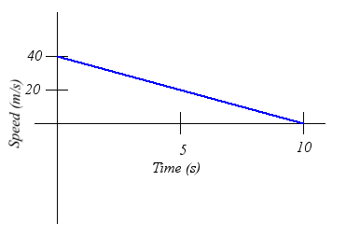
Velocity-time Graphs – Slowing Down

Slide 5
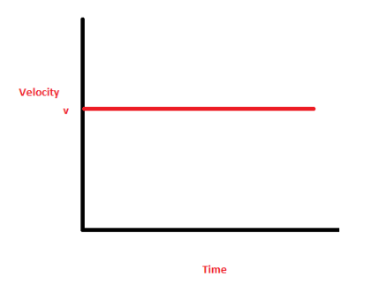
Velocity-time Graphs – Constant Velocity

Slide 6
Velocity-time Graphs
These are the only 3 shapes you need to remember…
Upwards slope means acceleration
Downward slope means deceleration
Horizontal line means constant velocity (speed)

Slide 7
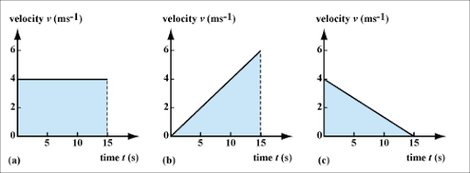
Velocity-time Graphs - Calculations
Velocity (speed) – time graphs are also useful as they allow you to calculate the displacement (distance) for a journey.
To do this you need to find the area under the graph.

Slide 8
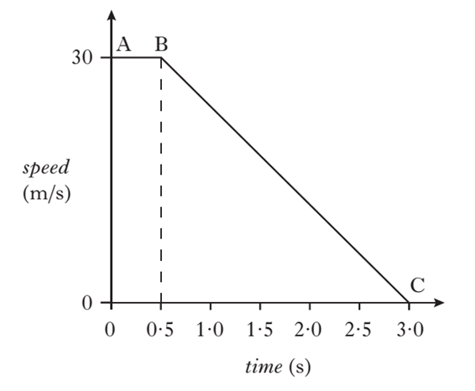
Velocity-time Graphs - Calculations
Example One
The speed-time graph for an object is shown below.
Calculate the distance travelled by the object in 3.0 s

Slide 9
Velocity-time Graphs - Calculations
Solution
Distance = area under graph
d = (area of rectangle) + (area of triangle)
d = (0.5 x 30) + (½ x 2.5 x 30)
d = (15) + (37.5)
d = 52.5 m

Slide 10
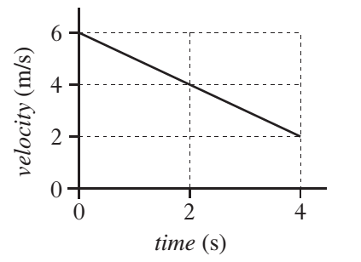
Velocity-time Graphs - Calculations
Example Two
The velocity-time graph for an object is shown below. Calculate the displacement after 4 seconds

Slide 11
Velocity-time Graphs - Calculations
Solution
Displacement = area under graph
s = (area of rectangle) + (area of triangle)
s = (4 x 2) + (½ x 4 x 4)
s = (8) + (8)
s = 16 m

Slide 12
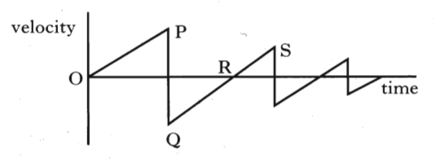
Velocity-time Graphs
Example Three
The velocity-time graph for a dropped ball, which bounces several times is shown below. Explain the motion of the ball between:
O and P b) Q and R c) R and S

Slide 13
Velocity-time Graphs
Solution
O and P – ball accelerates towards ground
Q and R – Q ball leaves ground; R ball at highest point
R and S – ball accelerates towards ground again

Slide 14
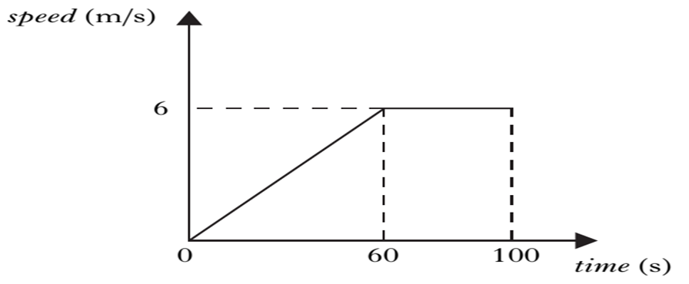
Velocity-time Graphs – Review Questions
Q.1.
A balloon’s speed-time graph is shown below. Calculate the height of the balloon after 100 s.

Slide 15
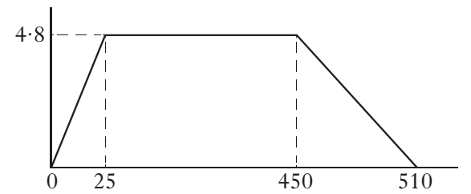
Velocity-time Graphs – Review Questions
Q.2. The velocity-time graph for a boat’s motion during a rowing event is shown below. Calculate the boat’s displacement during the event.
velocity
(ms⁻¹)
time (s)

Slide 16
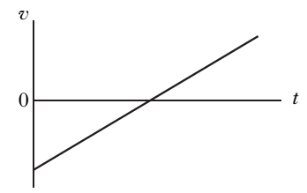
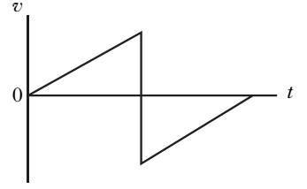
Velocity-time Graphs – Review Questions
Q.3.
Explain which of the following graphs represents a ball being thrown into the air and returning to the thrower’s hand.
Graph A Graph B

Slide 17
Velocity-time Graphs – Review Answers
Q.1. Distance = area under graph
d = (½ x 60 x 6) + (40 x 6)
d = 420 m
Q.2. Displacement = area under graph
s = (½ x 25 x 4.8) + (425 x 4.8) + (½ x 60 x 4.8)
s = (60) + (2040) + (144)
s = 2244 m
Q.3. Graph A.
Graph B cannot be for a thrown object as it starts from zero on the velocity axis.

