Slide 1
Newton’s Laws – Weight and Mass
Weight is a force.
The weight of an object always acts downwards.
Weight is measured in Newtons.
The weight of an object can change.

Slide 2
Newton’s Laws – Weight and Mass
Mass measures how much matter there is in an object.
Mass is measured in kilograms.
The mass of an object stays the same at all places.

Slide 3
Newton’s Laws – Weight and Mass
Weight to mass ratio is usually called gravity.
Gravity is the short way to write gravitational field strength (gfs).
Gravity (gfs) is measured in Newtons per kilogram (Nkg⁻¹).
From practical work (or research) find the gfs value for planet Earth.
For each object find its…
…weight from a Newton balance
…mass from a set of scales

Slide 4
Newton’s Laws – Weight and Mass
A possible set of data from the practical work is shown below:
Object | Weight (N) | Mass (kg) | Weight Mass
Mass carrier | 9.2 | 1.045 | 8.8
Tripod stand | 4 | 0.368 | 10.9
Newton balance | 1.3 | 0.145 | 9.0
Goggles | 0.6 | 0.06 | 10
Trolley | 8.3 | 0.870 | 9.5
Craig | 630 | 63 | 10.3

Slide 5
Newton’s Laws – Weight and Mass
Weight to mass ratio is known as gravitational field strength (gfs).
gfs is defined as the weight per unit mass.
For planet Earth the gfs is quoted as 9.8 Nkg⁻¹.
This means that there is a downwards force of 9.8 N acting per one kilogram of mass.

Slide 6
Newton’s Laws – Weight and Mass
Gravitational Field Strength can vary depending on where you are on the surface of Earth.
Altitude and latitude make a big difference.
Try to find out where the gfs is greatest and least on the surface of Earth.

Slide 7
Newton’s Laws – Weight and Mass
Weight can be calculated by using the equation:
W = mg
where,
W is weight measured in Newtons (N)
m is mass measured in kilograms (kg)
g is gravitational field strength measured in Newtons per kilogram(Nkg⁻¹)

Slide 8
Newton’s Laws
This equation can also be written as a triangle:

Slide 9
Newton’s Laws – Weight and Mass
Example One
Craig, mass 50 kg, visits Mars which has a gfs of 4 Nkg⁻¹.
a) State his mass on Mars. b) Calculate his weight on Mars.

Slide 10
Newton’s Laws – Weight and Mass
Example Two
Ross wins a trip to the Moon which has a gfs of 1.6 Nkg⁻¹. His weight on the moon is 72 N.
a) Calculate his mass on the moon. b) State his mass on Earth.

Slide 11
Newton’s Laws – Weight and Mass
Example Three
Mr Downie takes a trip to space but crash lands his spaceship. Mr Downie’s mass on Earth is 65 kg and his weight when he crashes is 715 N. Determine on which planet he crashes.
Solution

Slide 12
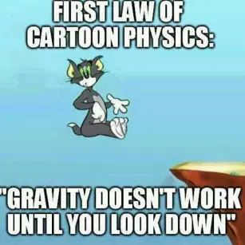
Newton’s Laws – Free Fall
When an object is falling freely due to the force of gravity.

Slide 13
Newton’s Laws – Terminal Velocity
A constant velocity created when the driving force is balanced by the frictional force.

Slide 14
Newton’s Laws
The graph on the next slide shows how the velocity of a parachutist varies with time from the start of the jump until they reach the ground. Explain each section of the graph using Newton’s Laws of Motion.
Your explanation should include the terms:
Balanced
Unbalanced
Free Fall
Terminal Velocity

Slide 15
Newton’s Laws

Slide 17
Newton’s Laws
Section O to A
When the parachutist leaves the aircraft they will be in free fall.
The frictional force (called air resistance) will be less than weight.
There will be an unbalanced force acting on the parachutist.
According to Newton’s Second Law the parachutist will accelerate.

Slide 19
Newton’s Laws
Section A to B
At point A the air resistance has increased to become equal to the weight of the parachutist.
The forces are balanced. The acceleration is now zero.
According to Newton’s First Law the parachutist Is travelling with a constant velocity called terminal velocity.
At point B the parachute is opened.

Slide 21
Newton’s Laws
Section C to D
There is a rapid increase in air resistance when the parachute is opened. The upwards force is now greater than weight for a short time.
At point C the air resistance and weight have become balanced again.
The acceleration is now zero.
The constant velocity is much lower.
At point D the parachutist reaches the ground.

Slide 22
Newton’s Laws – Review Questions
Q.1. An unbalanced force of 96 kN acts on train, which accelerates at 1.2 ms⁻². Calculate the mass of the train.
Q.2. A satellite, mass 50 kg, is being moved to a new location in space. The forces acting on the satellite are shown below.
Calculate the acceleration of the satellite.

Slide 23
Newton’s Laws – Review Questions
Q.2. A satellite, mass 50 kg, is being moved to a new location in space. The forces acting on the satellite are shown below.
Calculate the acceleration of the satellite.

Slide 24
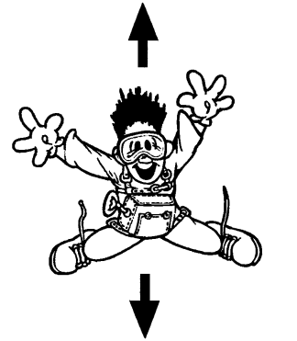
Newton’s Laws – Review Questions
Q.3. A skydiver, mass 75 kg, is shown below.

Slide 25
Newton’s Laws – Review Questions
a) Copy the diagram and add the labels for the forces acting on the skydiver.
b) Calculate the weight of the skydiver.
c) The unbalanced force on the skydiver is 185 N. Calculate the acceleration of the skydiver.
d) State the value of air resistance acting on the skydiver.

Slide 26
Newton’s Laws – Review Questions
a) Copy the diagram and add the labels for the forces acting on the skydiver.
b) Calculate the weight of the skydiver.
c) The unbalanced force on the skydiver is 185 N. Calculate the acceleration of the skydiver.
d) State the value of air resistance acting on the skydiver.

