Slide 1
National 4/5 Waves
Wave Equations

Slide 2
Wave Equations
Wave Equations
f = N/t
T = 1/f
f = 1/T
v = d/t
d = vt
v = f x λ
Typical Questions

Slide 3
Frequency – f = N/t
We use the following equation in order to determine the frequency of wave:
$f= \frac{N}{t}$
Where
f is the wave frequency measured in hertz (Hz)
N is the number of waves passing a point (no unit)
t is the time taken for the waves to pass the point in seconds (s)
REMEMBER:
Frequency is the number of waves passing a point per second

Slide 4
Frequency – f = N/t - EXAMPLE
The diagram shows the waves produced by a source in 4 seconds.
What is the frequency of the waves?

Slide 5
Period – T = 1/f
We use the following equation in order to determine the period of wave:
$T= \frac{1}{f}$
Where
T is the period of the wave measured in seconds (s)
f is the wave frequency measured in hertz (Hz)
REMEMBER:
The period of a wave is the time taken for one complete wave to pass a point

Slide 6
Period – T = 1/f - EXAMPLE
The diagram shows the waves produced by a source in 4 seconds.
What is the period of the waves?

Slide 7
Frequency f = 1/T - EXAMPLE
The diagram shows the waves produced by a source in 4 seconds.
What is the frequency of the waves?

Slide 8
Speed – v = d/t
We use the following equation in order to determine the speed of wave:
$v= \frac{d}{t}$
Where
v is the speed of the wave measured in metres per second (ms⁻¹)
d is the distance the wave has travelled measured in metres (m)
t is the time taken for the waves to travel the distance, measured in seconds (s)
REMEMBER:
Speed is the distance travelled per second

Slide 9
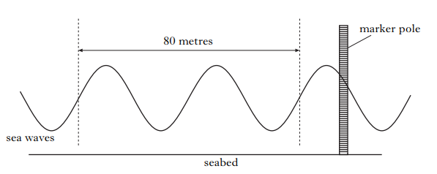
Speed – v = d/t - EXAMPLE
The diagram shows some sea waves a distance from a marker
If the waves travel 80m in a time of 4s, calculate the speed of the wave

Slide 10
Distance – d = vt
Sometimes it will be distance we need to calculate instead of speed. In this case we will need to rearrange the v=d/t equation as shown:
$$d=vt$$
This equation is not shown on the relationships sheet, but is very useful to remember.
Often when we are using this equation we will be asked to use information from the data sheet at the front of the paper

Slide 11
The Data Sheet
In all Physics assessments (including an SQA exam) you will be provided with a data sheet on the inside cover of the paper.
This sheet provides data on physical constants including information on the speed of light and sound in different materials.
You should already know some of this from previous study, but it is a useful reference for data we don’t know or are unsure of

Slide 12
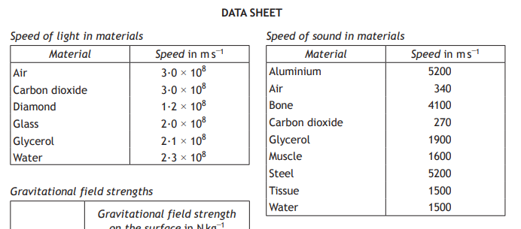
The Data Sheet
Selected information from the data sheet:

Slide 13
Distance – d = vt – EMAMPLE (using information from data sheet)
A student connects a mobile phone to a speaker using a wireless microwave signal
The time taken for the microwave signal to travel from the phone to the speaker is 2.1 x 10⁻⁸s
Calculate the distance between the mobile phone and the speaker

Slide 14
Distance – d = vt – EMAMPLE (using information from data sheet)
Information from the data sheet:
All parts of the electromagnetic spectrum travel as the same speed so the speed of microwaves in air is the same as the speed of light in air

Slide 15
Speed – v = fλ
We use the following equation in order to determine the speed of wave:
$v=f λ$
Where
v is the speed of the wave measured in metres per second (ms⁻¹)
f is the frequency of the wave measured in Hertz (Hz)
λ is the wavelength of the wave measured in metres (m)
v
$$f= \frac{v}{λ}$$
f
λ
$$λ= \frac{v}{f}$$

Slide 16
Speed – v = fλ - EXAMPLE
An electromagnetic wave has a frequency 1.2GHz. Show that the wavelength of this wave is 0.25m
Information from the data sheet:

Slide 17
Typical questions
Questions will / may often:
Contain more than one equation
Require information from the data sheet
Include a diagram

Slide 18
Example
A student observes waves generated by a wave machine as they travel from one end of a pool to the other (as shown in the diagram)
90m
The pool is measured to be 90m long

Slide 19
90m
Calculate the wavelength of the waves

Slide 20
90m
The waves take 6s to travel from one end of the pool to another.
Calculate the frequency of the waves
We know:
N = 4.5
λ = 20m

Slide 21
90m
Calculate the speed of the waves
We know:
N = 4.5 t = 6s
λ = 20 m
f = 0.75 Hz

Slide 22
Summary
Wave Equations
f = N/t
T = 1/f
f = 1/T
v = d/t
d = vt
v = f x λ
Where:
f - frequency measured in hertz (Hz)
N - number of waves (no unit)
t – time taken measured in seconds (s)
T – period of a wave measured in seconds (s)
v – speed of a wave measured in metres per second (ms⁻¹)
d – distance travelled by a wave measured in metres (m)
λ – the wavelength of a wave measured in metres (m)

