Slide 1
National 4/5 Waves
Units, Prefixes and Scientific Notation

Slide 2
Units, Prefixes and Scientific Notation
SI units
Prefixes and Scientific Notation
Scientific Notation Practice
Converting Units Practice

Slide 3
SI Units
There are many ways of describing a quantity, for example distance: metres, miles, feet or yards etc
To avoid confusion, physicist have decided on using consistent or standard units internationally.
This means that when we are doing calculation involving, for example, a distance, we always use metres. Metres are the standard (SI) unit for distance.
It is important that we always write down the standard units that we are using and convert to the appropriate units where necessary

Slide 4
Prefixes and Scientific Notation
Often in physics, we are dealing with very small or very large numbers. In order to save ourselves from writing such numbers as 0.0000000001 or 230 000 000, we use prefixes and scientific notation.
It is important to be able to use scientific notation to be able to convert numbers to SI units for calculations .
On the next page you find a list of common prefixes and their scientific notations. You should take a note of these and learn them – as you do more calculation involving scientific notation you will get better at them.

Slide 5
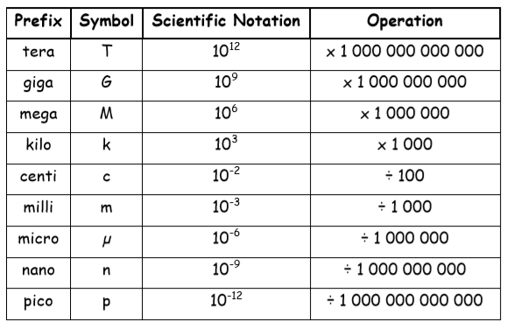
Common prefixes

Slide 6
Scientific notation in practice
Example 1 – large numbers
Write the distance 120000m in scientific notation and express it with an appropriate prefix.
Lets look at the number more closely: 1 2 0 0 0 0
The number can now be
expressed as:
1.2 x 10⁵ m
This is how many times the first digit has been multiplied by 10
.
= 5
Place a decimal point here
Count how many digits are after the decimal point

Slide 7
Scientific notation in practice
We now need to express the distance 1.2 x 10⁵ m with an appropriate prefix.
Most of the prefixes come in multiples of 3 (or thousands) e.g. 1km = 1x10³m
If a value is expressed in terms of x10^{x} we can change the value of x by moving the decimal point forward or backward.
Moving forward – 1.2 x 10⁵ becomes 0.12 x 10⁶
Moving backward – 1.2 x 10⁵ becomes 12 x 10⁴
NOTE: if the decimal point is moved forward, x increases, if moved backward, x decreases

Slide 8
Scientific notation in practice
We can now express number 1.2 x 10⁵ m as:
0.12 x 10⁶ m (0.12 Mm – 0.12 megameters)
or
120 x 10³ m (120km – 12o kilometers)

Slide 9
Scientific notation in practice
Example 2 – small numbers
Write the current 0.00024A in scientific notation and express it with an appropriate prefix.
Lets look at the number more closely: 0 . 0 0 0 2 4
The number can now be
expressed as:
24 x 10⁻⁵ A
This is how many times the final number has been divided by 10
.
= 5
Count how many zeros are before the last digit

Slide 10
Scientific notation in practice
We now need to express the current 24 x 10⁻⁵ A with an appropriate prefix.
REMEMBER: Most of the prefixes come in multiples of 3 (or thousands) e.g. 1mA = 1x10-³A
If a value is expressed in terms of x10^{-x} we can change the value of x by moving the decimal point forward or backward.
Moving forward – 24 x 10⁻⁵ becomes 2.4 x 10⁻⁴
Moving backward – 24 x 10⁻⁵ becomes 240 x 10⁻⁶
NOTE: if the decimal point is moved forward, x increases, if moved backward, x decreases

Slide 11
Scientific notation in practice
We can now express number 24 x 10⁻⁵ A as:
240 x 10⁻⁶ A (0.12 µm – 0.12 microamperes)
or
0.24 x 10⁻³ A (0.24mA – 0.24 milliamperes)

Slide 12
Converting units
It is often useful to use scientific notation when converting a non-standard unit to a standard unit.
For example, the standard unit for mass is kilograms, kg. If a value is given in grams, g then we can use scientific notation to express that the value in kg is the value in g divided by 1000 ( x = 10⁻³)
i.e 400g = 400 x 10⁻³ kg (or 0.4kg)

Slide 13
Converting units in practice
1. Convert into metres and put into scientific notation
a) 4km b) 12.6Mm c)5.7cm
2. Convert into kilograms (trickier)
a) 4000g b) 0.1Mg c) 5mg
3. Convert into seconds
a)2.2ms b) 720ns c)0.1µs

Slide 14
Converting units in practice
1. Convert into metres and put into scientific notation
4 x 10³ m b) 12.6 x 10⁶ m c) 5.7 10⁻² m
2. Convert into kilograms (trickier)
a) 4kg b) 100kg c) 5 x 10⁻³g = 5 x 10⁻⁶ kg
3. Convert into seconds
a)2.2 x 10⁻³ s b) 720 x 10⁻⁹ s c) 0.1 x 10⁻⁶s

