Slide 1
Kinematic Relationships
AH Physics

Slide 2
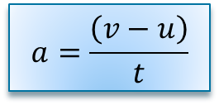
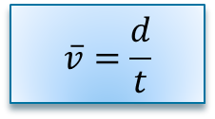
Revision from Higher
In Higher Physics we studied motion and in particular the displacement, velocity and acceleration of an object.
In Advanced Higher Physics we will derive the same equations of motion but using Calculus methods.
Think about this example:
A ball is dropped from a balcony. It hits the ground 1.06 s later. Determine the height of the balcony.
(How would a N5 class solve this?)
$$a=\frac{\left(v−u\right)}{t}$$
$$\overline{v}=\frac{d}{t}$$
Distance gone = area under velocity time graph

Slide 3
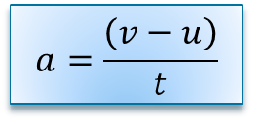
N5 solution
A ball is dropped from a balcony. It hits the ground 1.06 s later. Determine the height of the balcony.
Firstly determine the final speed of the ball as it hits the ground
Then sketch a velocity time graph
Velocity (ms-1)
$$a=\frac{\left(v−u\right)}{t}$$
Then work out the area under the graph = ½ x b x h
10.4
$$\left(v−0\right)=9.8×1.06$$
$$v=10.4 ms^{−1}$$
1.06 time (s)
Surely there is a quicker way of doing this…..there is!
Height of the balcony = 5.5 m

Slide 4
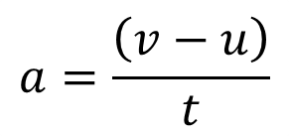
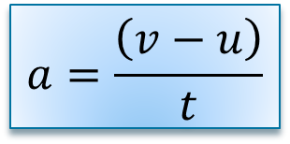
Derivation of equations of motion - Revision
We derived 3 new equations of motion in Higher Physics. They are all based on the fact that….
$$a=\frac{\left(v−u\right)}{t}$$
displacement= area under a velocity time graph
and
Equation 1. Simply rearrange the acceleration equation:
$$a=\frac{\left(v−u\right)}{t}$$
$$at=(v−u)$$
$$at+u=v$$
$$v=u+at$$

Slide 5
Equation of motion…….2 (revision from Higher)
Displacement is found by finding the area under the graph
Velocity (ms-1)
In this case the green rectangle + the blue triangle
s = (area 1) + (area 2)
s = (u x t) + ( ½ (v-u) t)
s = (ut) + ½(at) t
s = ut + ½ at²
$$a=\frac{\left(v−u\right)}{t}$$
$$at=(v−u)$$
s = ut + ½ at²
t
time (s)

Slide 6
Equation of motion …….3 (revision from Higher)
Square the 1st equation of motion.
Example:
A diver drops from a cliff 55.0 metres high.
Calculate his velocity as he hits the water.
(assuming a = g = 9.8 ms⁻²)
$$v=u+at$$
$$v^{2}={\left(u+at\right)}^{2}$$
$$v^{2}=u^{2}+2as$$
$$v^{2}=u^{2}+2uat+a^{2}t^{2}$$
$$v^{2}=0+(2 ×9.8 ×55)$$
$$v^{2}=u^{2}+2a(ut+\frac{1}{2}at^{2})$$
$v=32.8$ms⁻¹
$$v^{2}=u^{2}+2as$$
(This is 73 mph!)

Slide 7
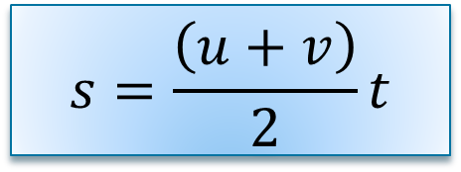
Equation of motion……4 (revision from Higher)
There is a 4th equation of motion that is basically just “displacement = average velocity x time”
$$s=\frac{\left(u+v\right)}{2}t$$
Average velocity = (initial velocity + final velocity) /2
Example:
The new Tesla Roadster goes from 0 – 60mph (26.8 ms⁻¹) in 1.90 s. Calculate the distance gone in this time.
(car is travelling in a straight line therefore distance = displacement)
s = (0 + 27)2 x 1.9
s = 25.5m

Slide 8
Using Calculus
Calculus (or “The Calculus”) is a branch of mathematics invented by Newton (or was it Leibnitz?) in the 17th Century. It deals with quantities that are changing all the time.
In Higher Physics we only studied motion that either had a constant velocity or a constant acceleration.
If we want to study motion where the acceleration is changing, we need to use calculus methods.
The 2 calculus methods you need to be aware of are:
Differentiation – finding the gradient of a graph at a point.
Integration – Finding the area under a graph up to a point.
(You’ve already been doing this we just haven’t called it calculus!)

Slide 9
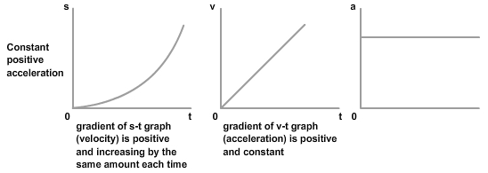
Gradients
Velocity is the rate of change of displacement:
(It is the first derivative of displacement)
$$v=\frac{s}{t}=\frac{∆s}{∆t}=\frac{ds}{dt}$$
The ‘d’ just means a very small change in a quantity.
Acceleration is the rate of change of velocity:
(It is the derivative of velocity)
$$a=\frac{(v−u)}{t}=\frac{∆v}{∆t}=\frac{dv}{dt}$$
So: acceleration is the 2nd derivative of displacement.
(acceleration is the “rate of change of the rate of change” of displacement)
$$a=\frac{d}{dt}\frac{ds}{dt}=\frac{d^{2}s}{{dt}^{2}}$$

Slide 10
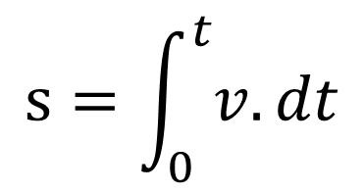
Integrals
This stretched out ‘s’ simply means the sum of all the individual areas under the graph from 0 → t.
In some situations the acceleration will not be constant and the velocity time graph will be curved.
For example this graph shows the velocity time graph for a car in the first 10 seconds after it moves off.
$$s=\int_{0}^{t}{v.dt}$$
To find the distance gone we need to find the area under the graph.
It is possible to estimate this by dividing it into thin vertical slices and finding the sum of all these individual areas.
However if we know the equation of the line we can find the area precisely by using integration.

Slide 11
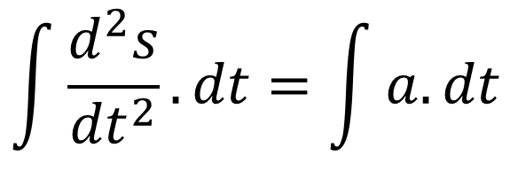
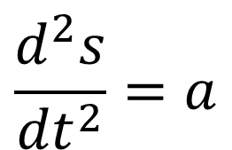
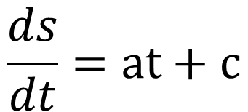
Deriving equations of motion using calculus methods
$$\frac{d^{2}s}{{dt}^{2}}=a$$
Remember acceleration is the 2nd differential of displacement:
$$\int{\frac{d^{2}s}{{dt}^{2}}.dt=\int{a.dt}}$$
Integrate both sides with respect to time (limits not required):
$$\frac{ds}{dt}=at+c$$
Remember $\frac{ds}{dt}=v$
when t=0 v=u c= u
$$v=u+at$$
Then integrate again to get the equation for displacement……..

Slide 12
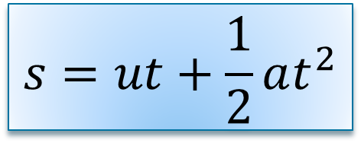
Deriving equations of motion by calculus methods
$$v=u+at$$
$$\int{v.dt}=\int{\left(u+at\right).dt}$$
$$\int{\frac{ds}{dt}.dt=}\int{u.dt+\int{at.dt}}$$
when t=0, s=0 , c =0
$$s=ut+\frac{1}{2}at^{2}+c$$
$$s=ut+\frac{1}{2}at^{2}$$

Slide 13
Calculations using calculus methods
The rules for differentiation and integration can be used to solve problems if the equation for the velocity of an object is known..
i.e. An Edinburgh tram starts from rest. The velocity of the tram at time t is given by the relationship:
$$v=0.71t+0.005t^{2}$$
For acceleration you would differentiate then sub in for the time.
a) Determine the acceleration of the tram when t = 20s.
b) Determine the displacement of the tram at t = 20s.
For displacement, you would integrate then sub in for the time.
$$a=\frac{dv}{dt}=0.71+0.01t$$
$$s=\int{v.dt}=\int{\left(0.71t+0.005t^{2}\right).dt}$$
$a=0.71+(0.01×20$)
$$s=\frac{{0.71t}^{2}}{2}+\frac{{0.005t}^{3}}{3}$$
$$a=0.91 ms^{−2}$$
$$s=\frac{{0.71×(20)}^{2}}{2}+\frac{{0.005×(20)}^{3}}{3}$$
$$s=155 m$$

