Slide 1
Space station
Stanford torus

Slide 2
The Torus Spaceship
A torus spaceship is shaped like a bicycle wheel. The spaceship spins and the centripetal force at the rim produces a “gravity-like” effect on object at the rim of the spinning ship. The rate of spin affects the magnitude of the central force and hence the size of the “gravity” force experienced.
The central hub can be used for docking and would have a “weightless” environment.
This design has been used in many science fiction movies for example, Interstallar, Mission to Mars, and 2001 - A Space Odyssey Watch

Slide 6
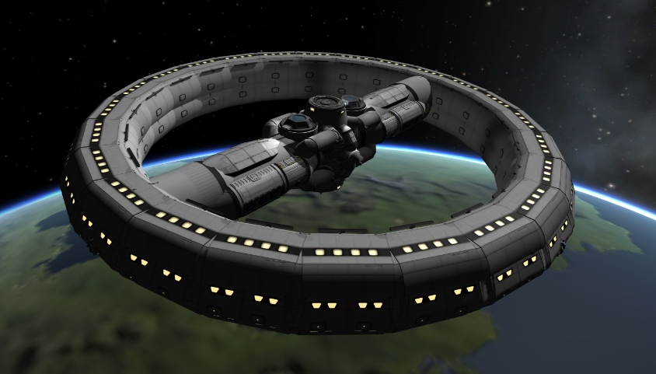
Rotating spaceship
A torus shaped spaceship has a radius of 500m.
Determine the angular velocity of the spaceship required to produce a sensation of gravity equal to Earths gravity at the rim.
(This is about 1.3 rpm)

