Slide 1
National 4/5 Waves
Diffraction

Slide 2
Diffraction
Defining Diffraction
Diffraction around objects
Diffraction through gaps
Practical contexts

Slide 3
Diffraction

Slide 4
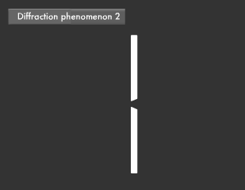
Defining Diffraction
All waves will bend around obstacles placed in their way. This bending effect is called DIFFRACTION.

Slide 5
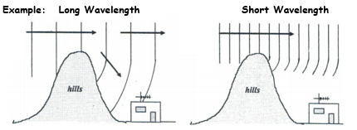
Diffraction around objects
Longer wavelength waves e.g. radio waves will diffract more than shorter wavelength waves e.g. microwaves

Slide 6
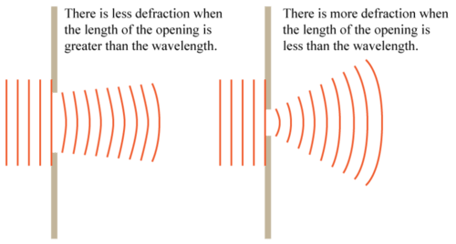
Diffraction through gaps
When a wave diffracts through a gap, the amount of diffraction that takes place depends on the wavelength of the wave, the size of the gap AND how these two measurements relate to each other.

Slide 7
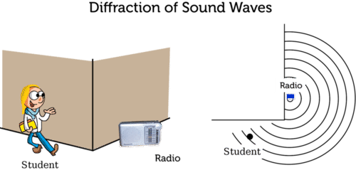
Practical contexts
Diffraction is why we can hear the sound from objects around a corner but cannot see them.
Sound waves have a much longer wavelength than light waves (or any other part of the electromagnetic spectrum) and so experience more diffraction

