Slide 1
S3/S4 Physics
Potential Dividers

Slide 2
Potential Dividers
A potential (voltage) divider circuit is a very useful circuit.
A potential (voltage) divider circuit usually consists of a supply voltage and resistive components (usually two) connected in series.
The supply potential (voltage) is divided up across the resistors in the circuit.

Slide 3
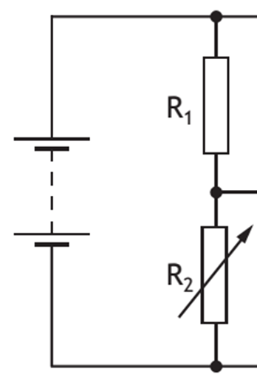
Potential Dividers
V₁
V_{s}
V₂

Slide 4
Potential Dividers
For all potential (voltage) dividers the following is true:
The larger resistance will always have the greater potential difference (voltage ) across it
The sum of the individual potential differences (voltages) will be equal to the supply voltage
V₁ + V₂ = V_{s}

Slide 5
Potential Dividers
The ratio of the potential differences (voltages) will depend on the ratio of resistance values.
This can also be written as:
V₁ / V₂ = R₁ / R₂

Slide 6
Potential Dividers
V₁ = ?
V_{s}
V₂ = 16 V

Slide 7
Potential Dividers
Example One
In the previous circuit R₁ = 20 Ω and R₂ = 80 Ω. Calculate the value of V₁.
V₁ / V₂ = R₁ / R₂
V₁ / 16 = 20 / 80
V₁ / 16 = 0.25
V₁ = 0.25 x 16
V₁ = 4 V

Slide 8
Potential Dividers
V₁ = 25 V
V_{s}
V₂ = 10 V

Slide 9
Potential Dividers
Example Two
In the previous circuit R₂ = 80 Ω. Calculate the value of R₁.
V₁ = R₁
V₂ R₂
25 = R₁
10 80
R₁ = 25 x 80
10
R₁ = 200 Ω

Slide 10
Potential Dividers
V₁
V_{s}
V₂

Slide 11
Potential Dividers
For the previous circuit calculate the missing value in each row.
V₁ (Volts) | V₂ (Volts) | R₁ (Ohms) | R₂ (Ohms)
5 | 15 |  | 30
 | 30 | 40 | 60
5 | 2 |  | 8
 | 12 | 60 | 36
4 | 1 | 24
35 |  | 14 | 6

Slide 12
Potential Dividers
Answers
V₁ (Volts) | V₂ (Volts) | R₁ (Ohms) | R₂ (Ohms)
5 | 15 | 10 | 30
20 | 30 | 40 | 60
5 | 2 | 20 | 8
20 | 12 | 60 | 36
4 | 1 | 24 | 6
35 | 15 | 14 | 6

Slide 13
Potential Dividers
Not all potential (voltage) divider circuits can be solved using ratios.
An alternative equation is shown below.

Slide 14
Potential Dividers
V₁
V_{s}
V₂ = ?

Slide 15
Potential Dividers
Example
The value of R₁ in the previous circuit is 150 Ω, and R₂ = 300 Ω. Calculate the value of V₂.
Solution
It can be useful to find the value in the bracket first.
R₂ / (R₁ + R₂) = 300 / (150 + 300) = 300 / 450 = 0.67
V₂ = 0.67 x V_{s}
V₂ = 0.67 x 12
V₂ = 8 V

Slide 16
Potential Dividers
V₁
V_{s}
V₂ = ?

Slide 17
Potential Dividers
For the previous circuit calculate V₂ for each row.
V_{S} (Volts) | R₁ (Ohms) | R₂ (Ohms) | V₂ (Volts)
5 | 10 | 10
6 | 12 | 24
21 | 40 | 200
12 | 5 | 3
8 | 28 | 4
15 | 20 | 30

Slide 18
Potential Dividers
Answers
V_{S} (Volts) | R₁ (Ohms) | R₂ (Ohms) | V₂ (Volts)
5 | 10 | 10 | 2.5
6 | 12 | 24 | 4
21 | 40 | 200 | 17.5
12 | 5 | 3 | 4.5
8 | 28 | 4 | 1
15 | 20 | 30 | 9

