Slide 1
S3/S4 Physics
Power Calculations

Slide 2
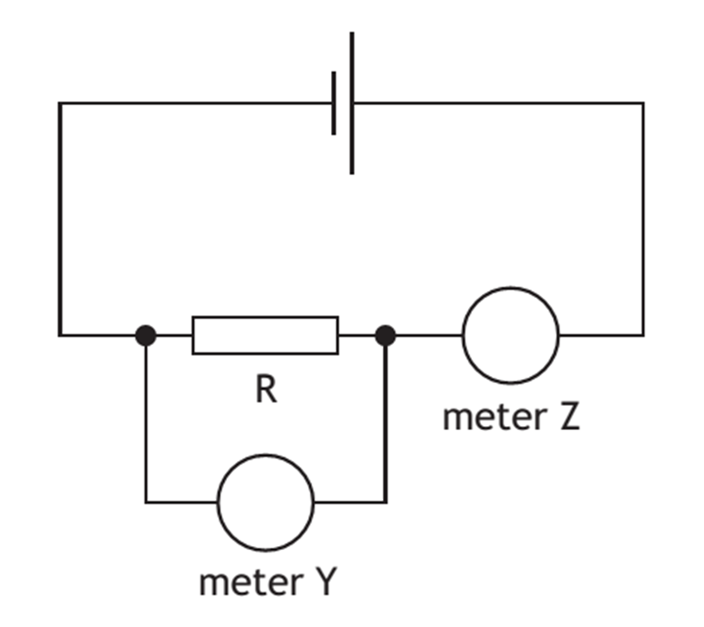
Power Calculations
The power rating of lamps and resistors can be checked using the following circuit:

Slide 3
Power Calculations
The potential difference from the supply is varied. At each new setting the following readings are taken:
Current from the ammeter (meter Z)
Potential difference (voltage) from the voltmeter (meter Y)

Slide 4
Power Calculations
A possible set of results for four different lamps is shown below.
Lamp | Power rating (W) | Current (A) | Potential Difference (V) | I x V
A | 0.6 | 0.2 | 2.8 | 0.56
B | 12 | 0.95 | 11.4 | 10.83
C | 36 | 3.0 | 11.6 | 34.8
D | 48 | 3.9 | 11.6 | 45.24

Slide 5
Power Calculations
Data Analysis
Comparing the data in the “Power Rating” column with the data in the “I x V” column it can be shown that:
Power rating = I x V

Slide 6
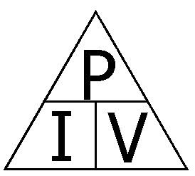
Power Calculations
This equation can also be represented as a triangle:

Slide 7
Power Calculations
Example One
A car headlamp is operated from a 12 V car battery. A current of 4 A passes through the headlamp when it is switched on. Calculate the power rating of the headlamp.
Solution
P = I x V
P = 4 x 12
P = 48 W

Slide 8
Power Calculations
Example Two
An appliance is operated from a 25 V supply. Calculate the current in the appliance if it has a power rating of 225 W.
Solution
P = I x V
225 = I x 25
I = 225 / 25
I = 9 A

Slide 9
Power Calculations
Example Three
A current of 0.16 A goes through a lamp of power rating 0.72 W. Calculate the potential difference across the lamp.
Solution
P = I x V
0.72 = 0.16 x V
V = 0.72 / 0.16
V = 4.5 V

Slide 10
Power Calculations
Copy and complete the following table:
Power | Current | Potential Difference
 | 2 A | 12 V
 | 5 mA | 500 V
120 W |  | 60 V
2.3 kW |  | 230 V
0.9 | 0.1 A
6.9 kW | 30 A

Slide 11
Power Calculations
Copy and complete the following table:
Power | Current | Potential Difference
24 W | 2 A | 12 V
2.5 W | 5 mA | 500 V
120 W | 3 A | 40 V
2.3 kW | 10 A | 230 V
0.9 | 0.1 A | 9 V
6.9 kW | 30 A | 230 V

Slide 12
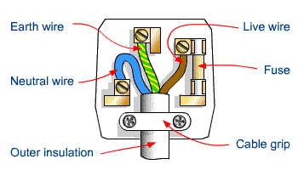
A Plug for Safety
Can you correctly wire a plug?

Slide 13
Power Calculations
For household appliances the current that flows to them is controlled by a fuse in the plug.
In the UK the two most common values of fuse are
3 amperes (3A) and
13 amperes (13A)
The symbol for a fuse is:

Slide 14
Power Calculations
Example One
Calculate the fuse value needed for a 1200W hair dryer.
Example Two
Calculate the fuse value needed for a 350W electric saw.
It appears that we do not have enough data to complete the above calculations…to use P = I x V a value for “V” is needed.

Slide 15
Power Calculations
For all domestic sockets in the UK “V” is quoted as 230 V.
Example One – Solution
P = I x V
1200 = I x 230
I = 1200 / 230
I = 5.2 A
As 5.2 A is greater than 3 A, a 13 A fuse will be needed.

Slide 16
Power Calculations
Example Two – Solution
P = I x V
350 = I x 230
I = 350 / 230
I = 1.5 A
As 1.5 A is less than 3 A, a 3 A fuse will be needed.

Slide 17
Power Calculations
As a general rule if an appliance has a power rating greater than 720 W a 13 A fuse must be used.
If an appliance has a power rating less than 720 W a 3 A fuse must be used.
Mains sockets – series or parallel?
The mains supply to a house is always connected in parallel – you can turn one socket off and all other sockets will continue to operate.

Slide 18
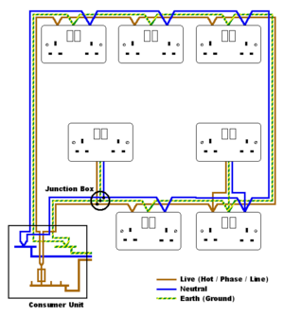

Slide 19
Power Calculations
Another equation that can be used for power calculations is:
where,
P is power measured in Watts (W) or Joules per second (Js⁻¹)
I is current measured in Amperes (A)
R is resistance measured in Ohms (Ω)

Slide 20
Power Calculations
Example One
The flex of an appliance has a resistance of 0.2 Ω. The maximum safe current that can pass through the flex is 5.0 A. Calculate the maximum power rating of the flex.
Solution
P = I² x R
P = (5)² x 0.2
P = 25 x 0.2
P = 5 W

Slide 21
Power Calculations
Example Two
The power rating of a kettle is 2300 W. When the current in the element is 10 A, calculate the resistance of the element.
Solution
P = I² x R
2300 = (10)² x R
2300 = 100 x R
R = 2300 /100
R = 23 Ω

Slide 22
Power Calculations
Example Three
The element of a toaster has a resistance of 57.5 Ω. If the power rating of the toaster is 920 W, calculate the current in the element.
Solution
P = I² x R
920 = I² x 57.5
I² = 920 / 57.5
I² = 16
I = √16 = 4 A

Slide 23
Power Calculations
Copy and complete the following table:
Power | Current | Resistance
 | 2 A | 15 Ω
 | 3 A | 100 Ω
1150 W | 5 A
120 kW | 20 A
36 W |  | 4 Ω
60 W |  | 2.4 Ω

Slide 24
Power Calculations
Copy and complete the following table:
Power | Current | Resistance
60 W | 2 A | 15 Ω
900 W | 3 A | 100 Ω
1150 W | 5 A | 46 Ω
120 kW | 20 A | 300 Ω
36 W | 3 A | 4 Ω
60 W | 5 A | 2.4 Ω

Slide 25
Power Calculations
Another equation that can be used for power calculations is:
where,
P is power measured in Watts (W) or Joules per second (Js⁻¹)
V is potential difference (voltage) measured in Volts (V)
R is resistance measured in Ohms (Ω)

Slide 26
Power Calculations
Example One
A microphone has a resistance of 75 kΩ when it is operated from a 3 V supply. Calculate the power rating of the microphone.
Solution
(Remember “k” or “kilo” means “x10³” or multiply by 1000)
P = V² / R
P = (3)² / 75 x 10³
P = 9 / 75 x 10³
P = 1.2 x10⁻⁴ W

Slide 27
Power Calculations
Example Two
A 9.6W speaker has a resistance of 15Ω. Calculate the maximum operating voltage of the speaker.
Solution
P = V² / R
9.6 = V² / 15
V² = 9.6 x 15
V² = 144
V = √144 = 12 V

Slide 28
Power Calculations
Example Three
A 0.16mW amplifier, has a voltage of 20 mV across it. Calculate the resistance of the amplifier.
Solution
(Remember “m” or “milli” means “x10⁻³” or divide by 1000)
P = V² / R
0.16 x 10⁻³ = (20 x 10⁻³)² / R
R = (20 x 10⁻³)² / 0.16 x 10⁻³
R = 2.5 Ω

Slide 29
Power Calculations
Copy and complete the following table:
Power (W) | Potential Difference (V) | Resistance (Ω)
 | 5 | 100
 | 12 | 20
50 | 2
1000 | 230
36 |  | 0.25
40 |  | 2.5

Slide 30
Power Calculations
Copy and complete the following table:
Power (W) | Potential Difference (V) | Resistance (Ω)
0.25 | 5 | 100
7.2 | 12 | 20
50 | 2 | 0.08
1000 | 230 | 52.9
36 | 3 | 0.25
40 | 10 | 2.5

Slide 31
Power Calculations – Review Questions
For these review questions the following triangles could be used:

Slide 32
Power Calculations – Review Questions
Q.1. A 920 W microwave is operated from a 230 V mains socket. Calculate the current flowing through the microwave.
Q.2. The current flowing through the heater in a shower is 6 A. If the resistance of the heater is 2 kΩ, calculate the power rating of the shower.
Q.3. A spotlight has a resistance of 3 Ω and is operated at 12 V. Calculate the power rating of the spotlight when it is operating at 12 V.
Q.4. The power developed in a resistor is 7.5 W when the current through it is 1.25 A. Calculate the resistance of the resistor.

Slide 33
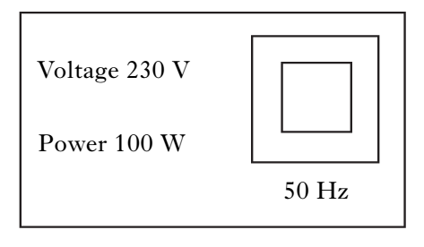
Power Calculations – Review Questions
Q.5. The information shown below is for an electric food mixer.
Calculate the resistance of the electric food mixer.

Slide 34
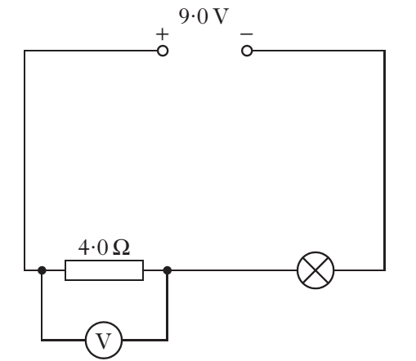
Power Calculations – Review Questions
Q.6. A circuit is set up as shown.
The current in the lamp is 1.5 A. The reading on the voltmeter is 6 V. Calculate the power developed in the lamp.

Slide 35
Power Calculations - Answers
Q.1. 4 A
Q.2. 72000 W
Q.3. 48 W
Q.4. 4.8 Ω
Q.5. 529 Ω
Q.6. 4.5 W

